Slide 1
Notes:
This is the blank slide from the previous speaker. The MC will advance to the next slide, then call you up. Please be sitting at the back of the room, so you have a few seconds for the music to play as you walk up

Slide 2
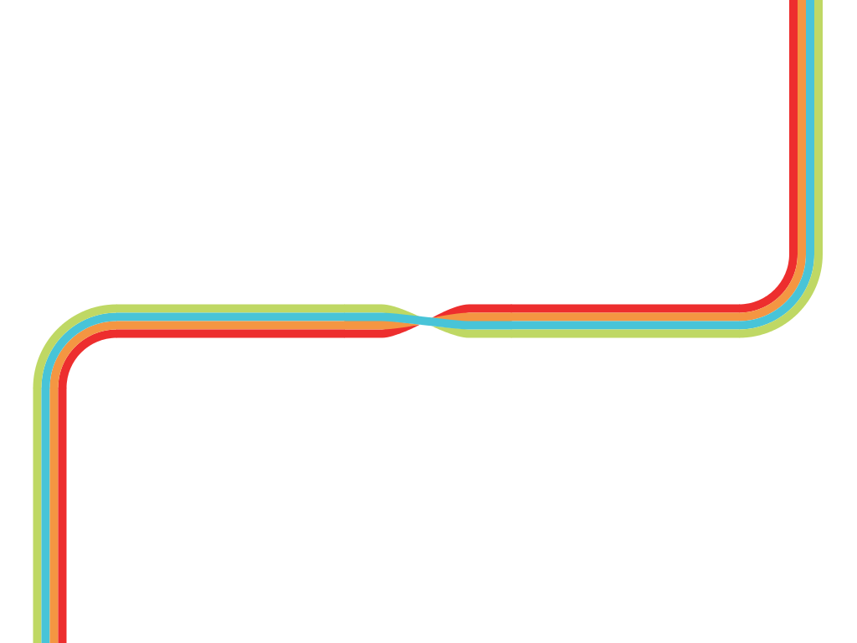

Generating functions
Patrick Stevens
Notes:
The MC will advance to this slide before the start of your talk. You must not click backwards to it. If you add notes to this slide, you probably won’t see them.

Slide 3
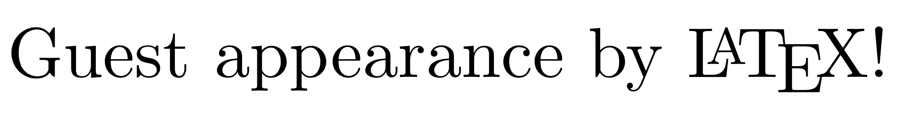
Generating functions
Patrick Stevens
Notes:
When you click for the first time, or hit the space bar, you’ll advance to this second slide, which will simply stop the music. That lets you talk over the title slide if you want to before moving on.

Slide 4
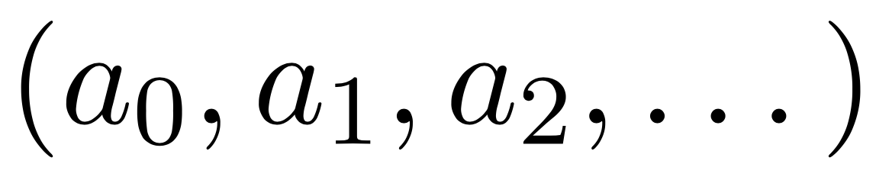
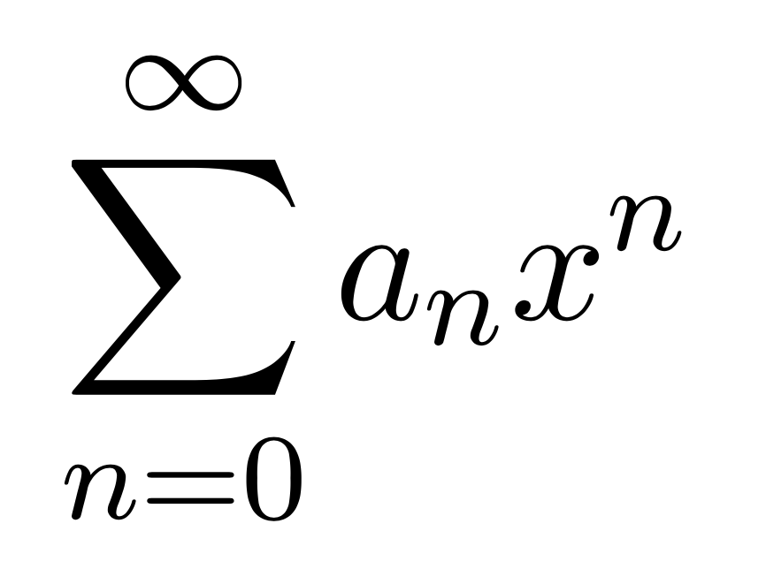
What is a generating function?
Given a sequence
Function packages up sequence

Slide 5
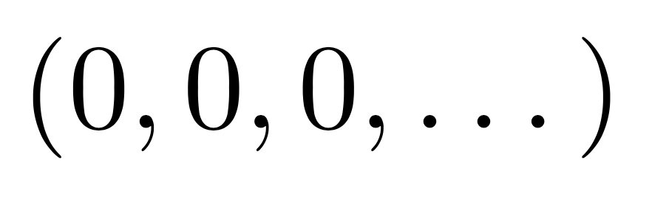
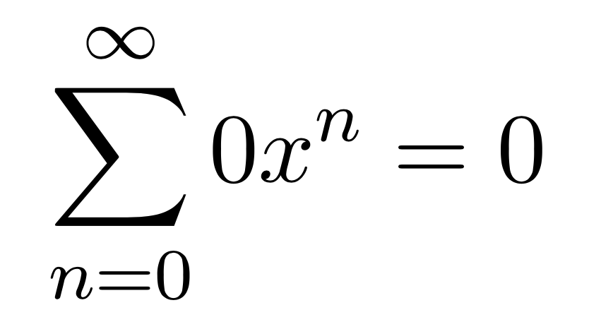
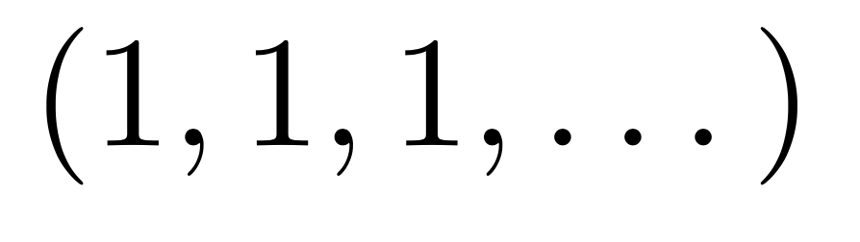
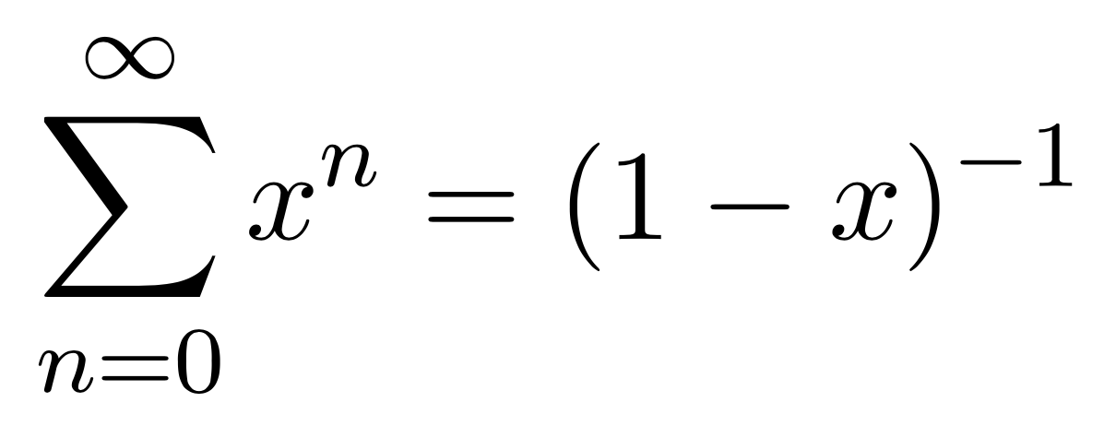
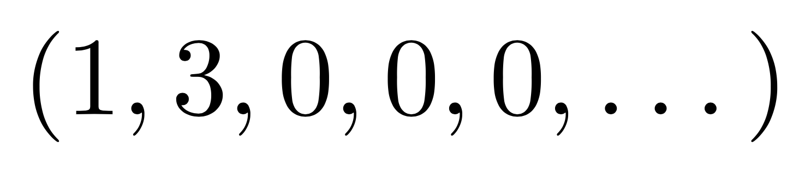
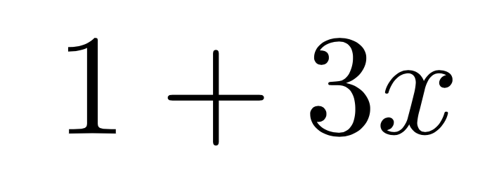
Examples
Sequence
Function is simple:
Sequence
Function (due to Newton):
Sequence
Function:

Slide 6
Why?
Easier to reason about entire sequence
Great for recurrences

Slide 7
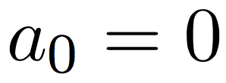
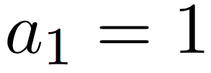
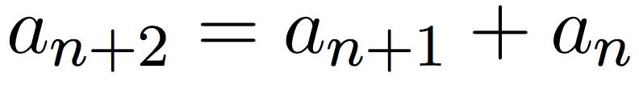
Fibonacci
Sequence defined by
0, 1, 1, 2, 3, 5, 8, 13, 21, …

Slide 8
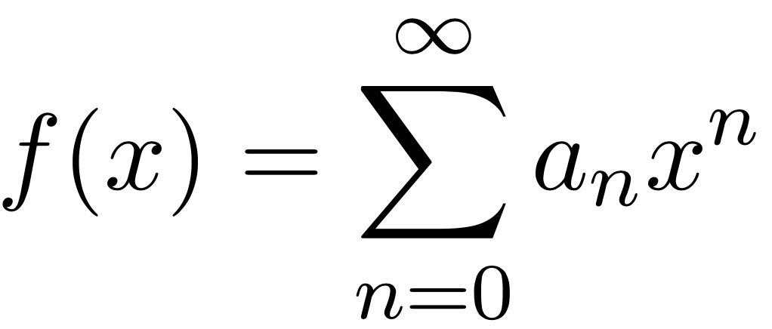
Generating function?
Pretty ugly
Can we get a nicer form?

Slide 9
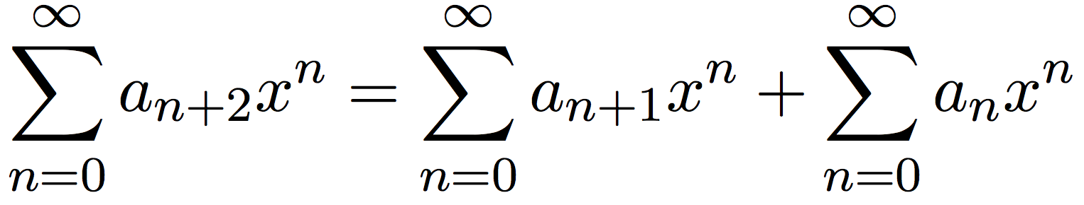
Recurrence
Sum both sides
What is the left-hand side?

Slide 10
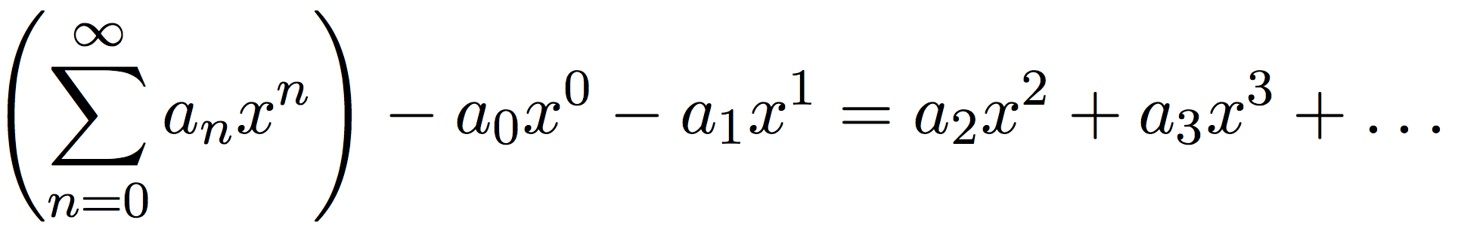
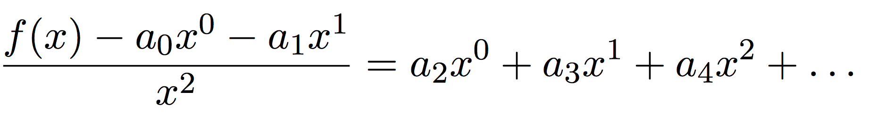
Left-hand side
Related to the Fibonacci generating function
That’s the left-hand side!

Slide 11
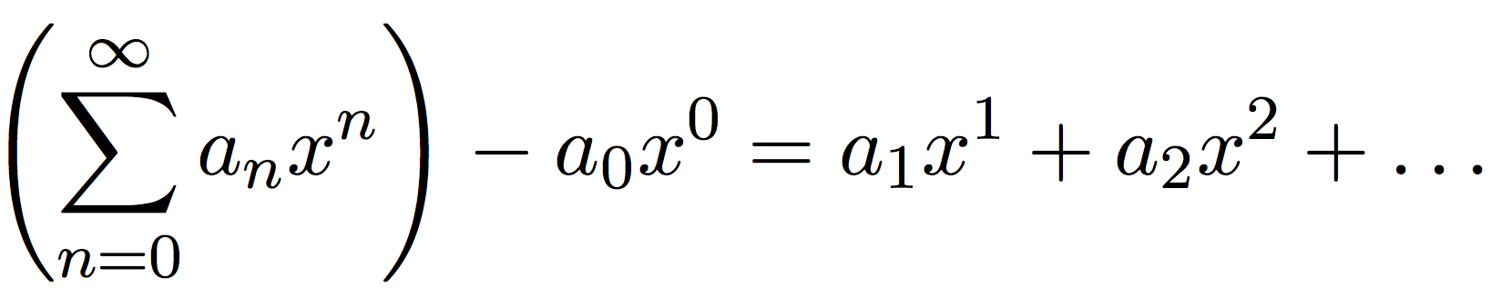
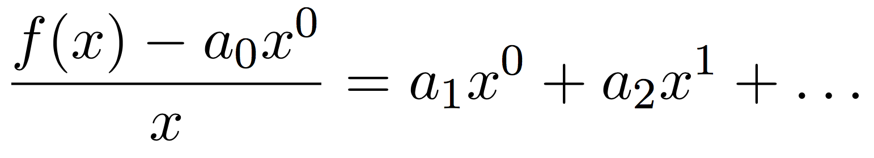
Right-hand side
Rightmost bit is just
Leftmost bit: same trick

Slide 12
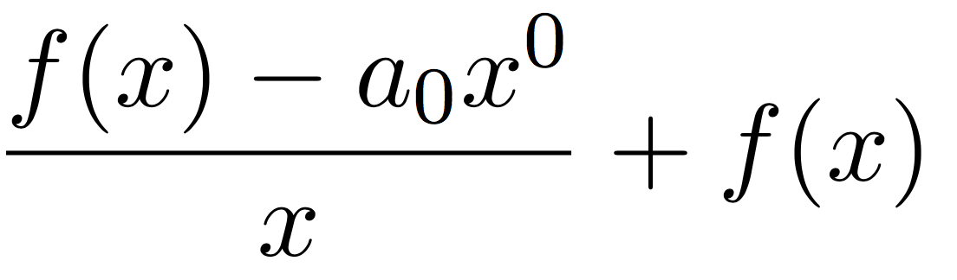
Right-hand side: simplified

Slide 13
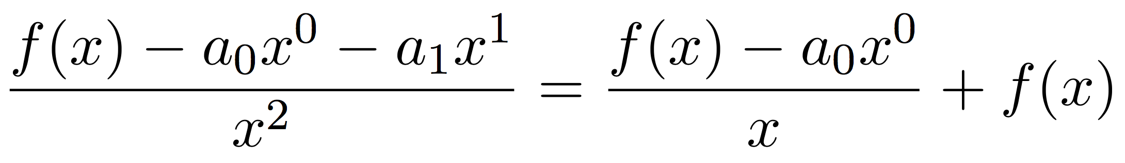
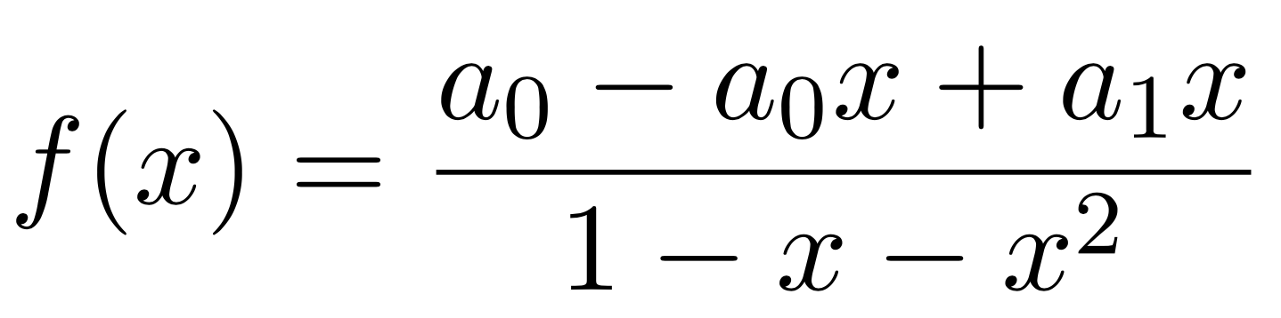
The two together
Left-hand side equals right-hand side
Solve:

Slide 14
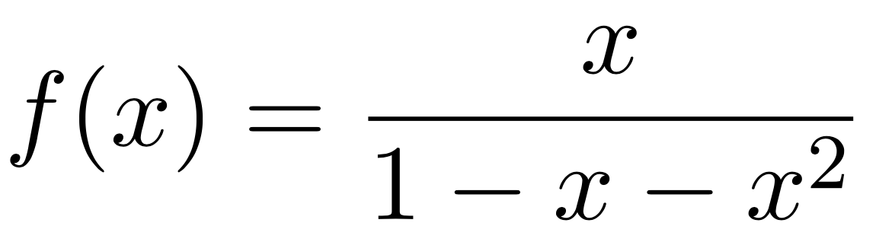
Simplified
Captures the entire Fibonacci sequence

Slide 15
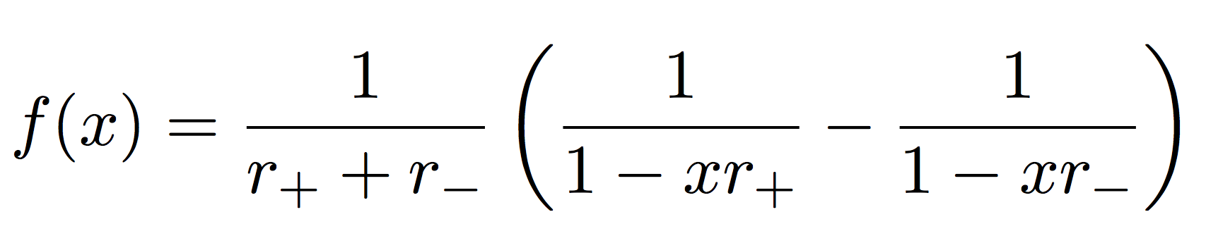
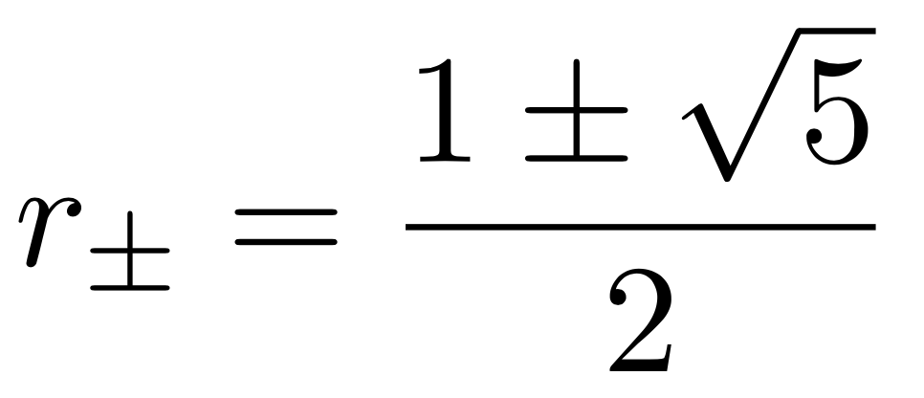
General formula for Fibonacci number
What are the coefficients in the expansion?
Can express this in partial fractions (A-level!)

Slide 16
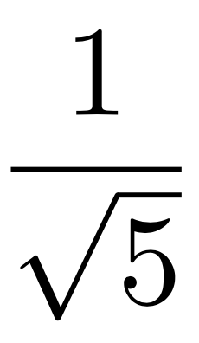
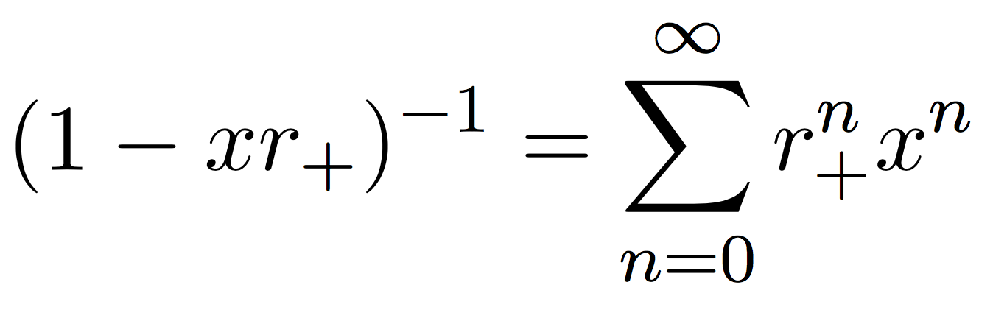
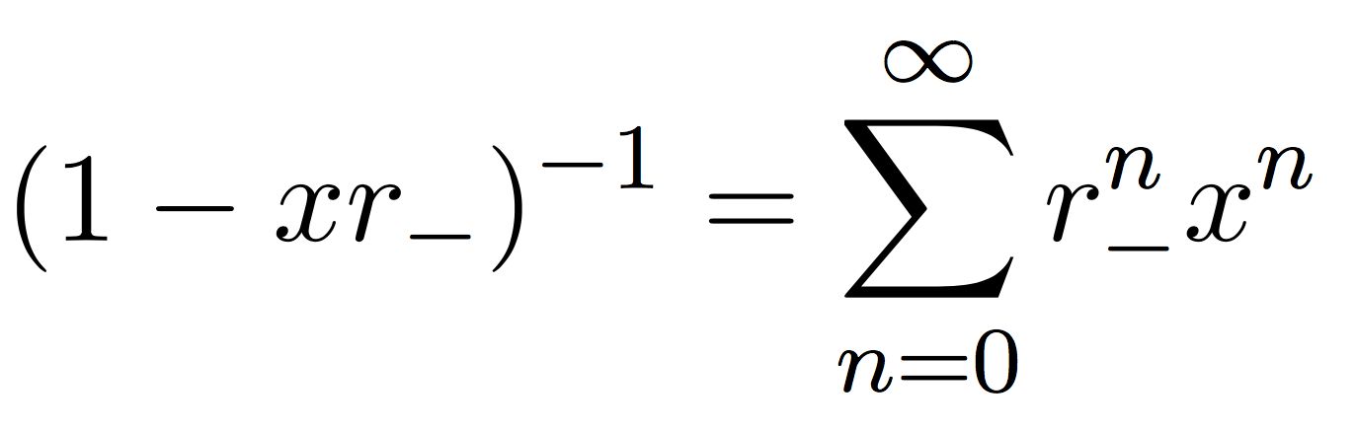
General formula for Fibonacci number
First bit is
Recall from earlier (Newton):
So
Also

Slide 17
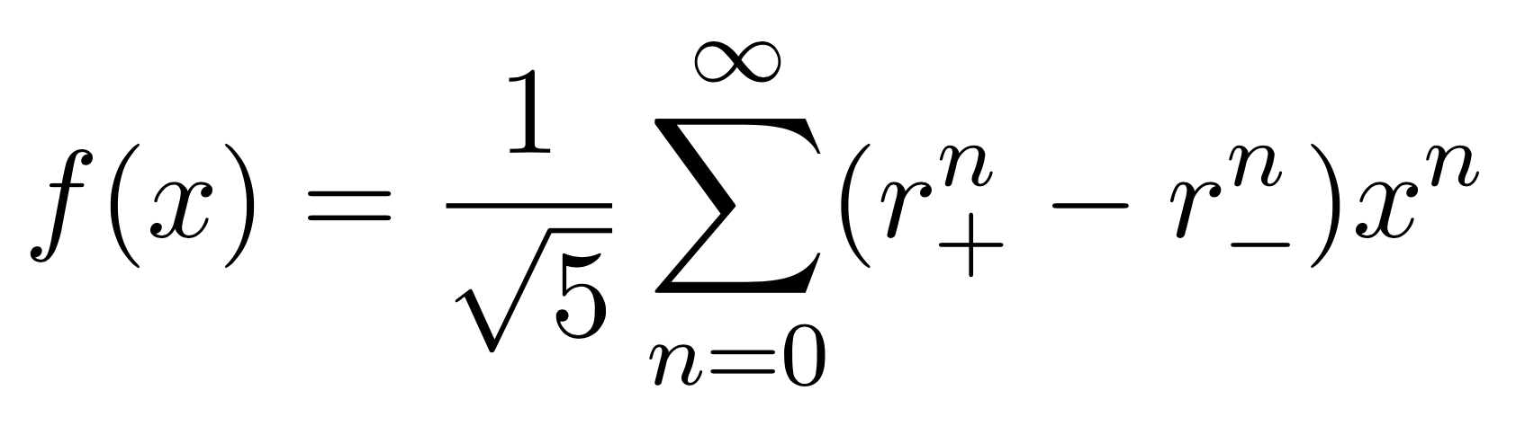
General formula for Fibonacci number
So

Slide 18
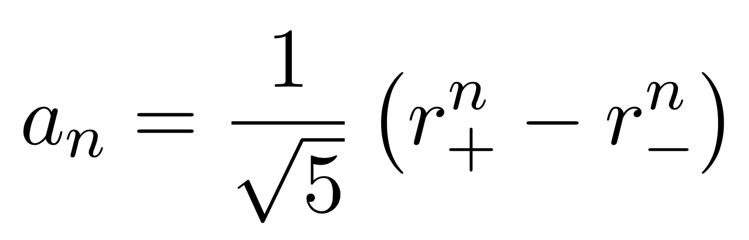
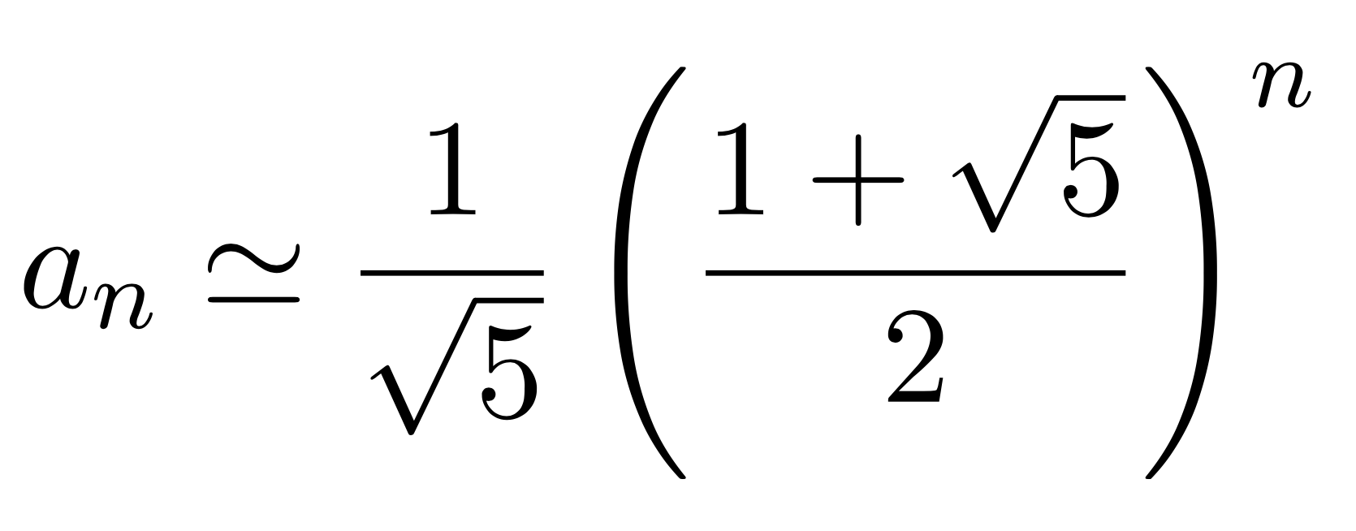
General formula for Fibonacci number
So
The smaller root is less than 1 so powers go to 0 fast
So

Slide 19
Summary/Questions?
Generating functions treat entire sequences in one go
Capture asymptotics
Simplify recurrences
Prove combinatorial identities [not done here!]
Fibonacci numbers are ideal test case

Slide 20
Notes:
You must not click beyond this slide. If you don’t have any content slides, this is what will be projected for the entire duration of your talk.

