Slide 1
Notes:
This is the blank slide from the previous speaker. The MC will advance to the next slide, then call you up. Please be sitting at the back of the room, so you have a few seconds for the music to play as you walk up

Slide 2
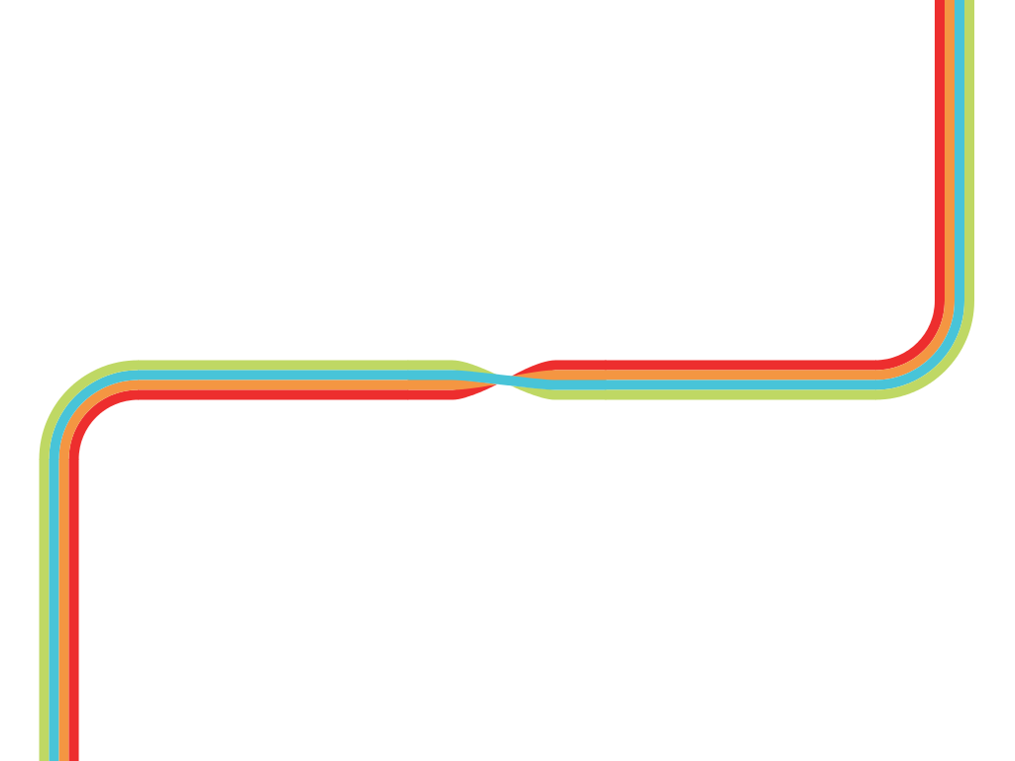

The Game of Life
Patrick Stevens
Notes:
The MC will advance to this slide before the start of your talk. You must not click backwards to it. If you add notes to this slide, you probably won’t see them.

Slide 3
The Game of Life
Patrick Stevens
Notes:
When you click for the first time, or hit the space bar, you’ll advance to this second slide, which will simply stop the music. That lets you talk over the title slide if you want to before moving on.

Slide 4
What is it?
“Cellular automaton”
Grid with cells, each on/off
Evolves one step at a time
Cell turns on depending on its neighbours

Slide 5
Example
From Wikipedia page

Slide 6
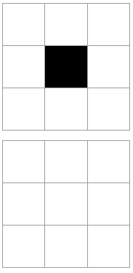
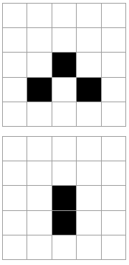
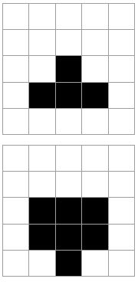
Exact rules
Live cell with fewer than two live neighbours: dies
Live cell with two or three live neighbours: lives
Live cell with more than three live neighbours: dies
Dead cell with exactly three live neighbours: lives
Examples

Slide 7

Patterns
Glider
Pattern has translated itself across space!

Slide 8
Patterns
Glider gun
By Kieff - Own work, CC BY-SA 3.0, https://commons.wikimedia.org/w/index.php?curid=101736

Slide 9

NOT gate
Glider is an electron
Incoming gliders interact and die
So set up a constant glider stream, and send incoming signal in perpendicularly
Output is “constant stream” if no input, “nothing” if there is input
Notes:
Don’t try and comprehend how this works, it’s like asking how a transistor works. Just trust the demo

Slide 10
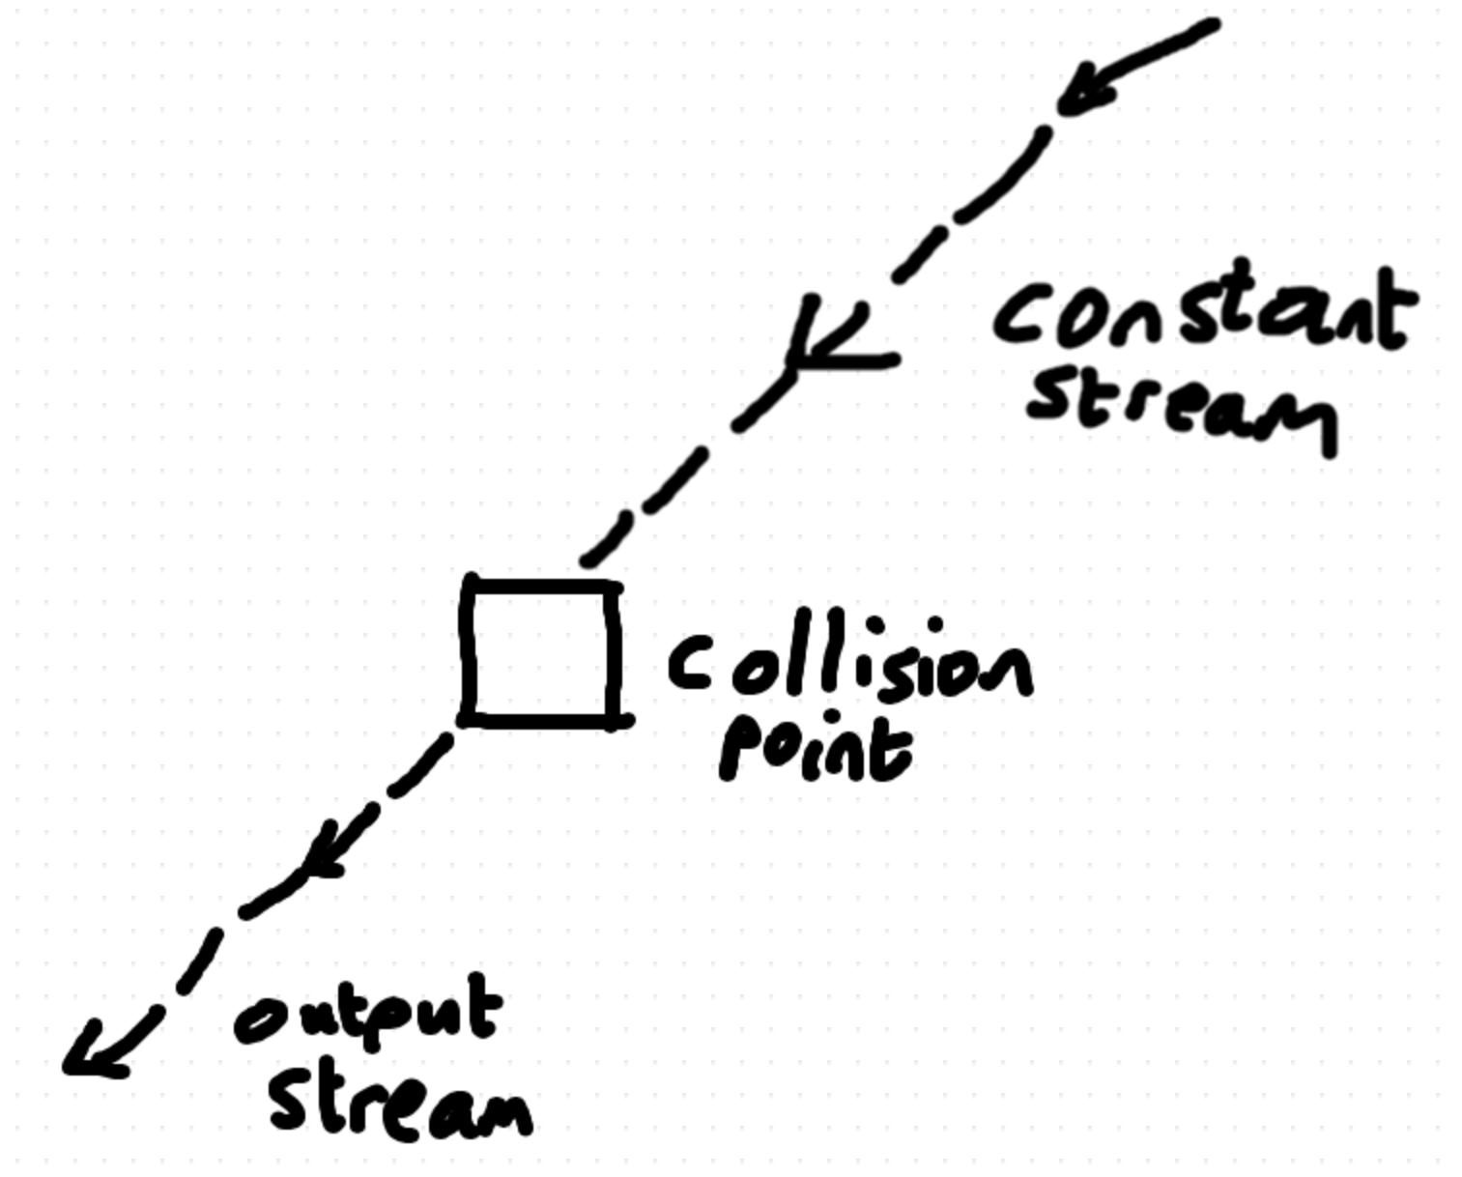
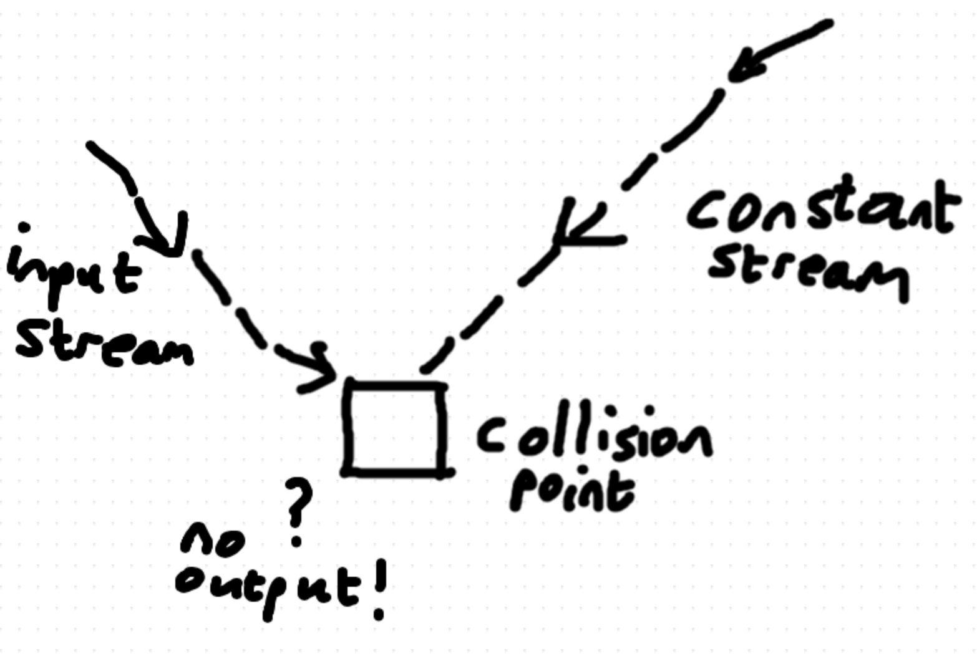
NOT gate
Notes:
Don’t try and comprehend how this works, it’s like asking how a transistor works. Just trust the demo

Slide 11

Absorb glider
Can get rid of a glider using a stopper
Incoming glider hits stopper and dies…
leaving stopper unchanged
Stopper is itself constant over time
Notes:
Don’t try and comprehend how this works, it’s like asking how a transistor works. Just trust the demo

Slide 12
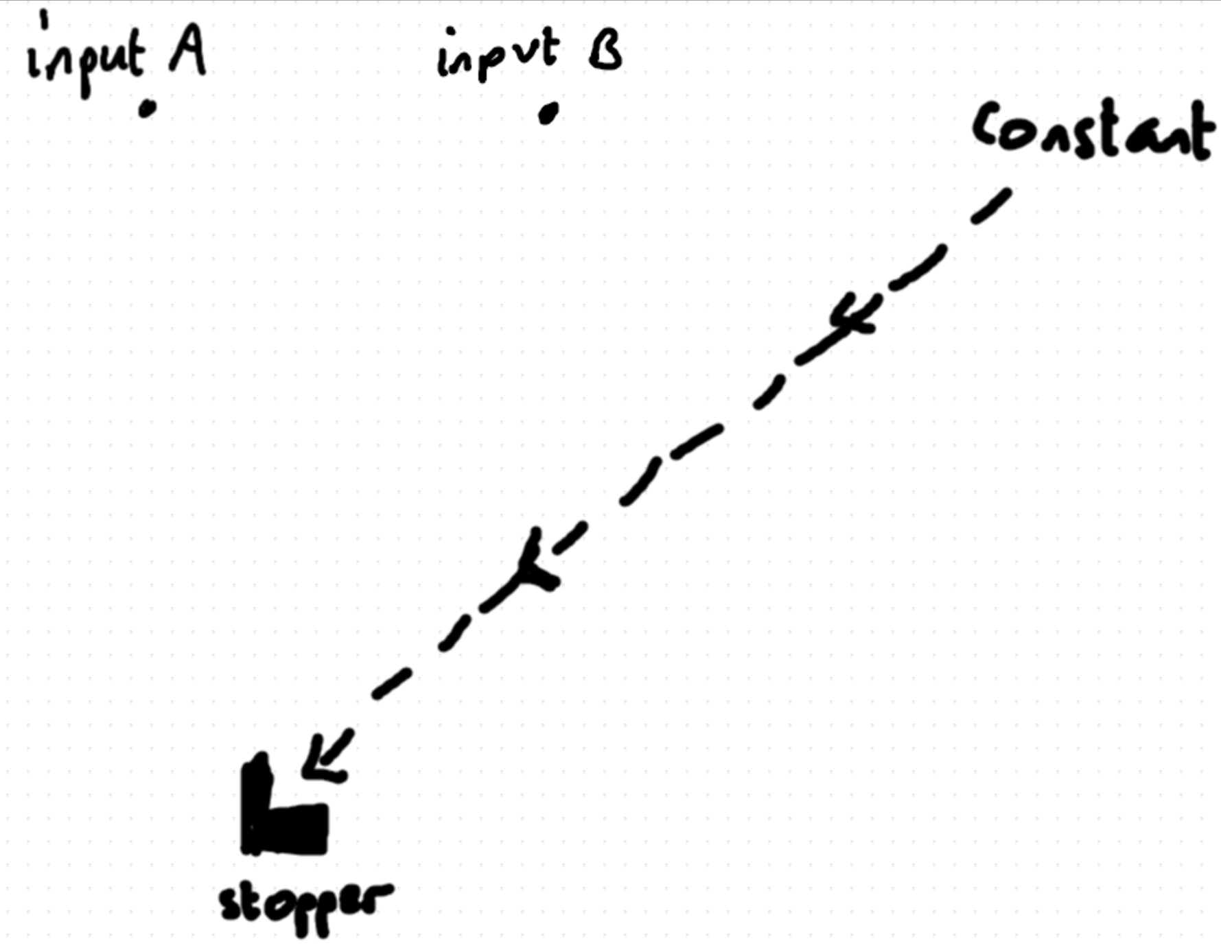
AND gate
Previous idea: can make streams of gliders cancel
Setup:
Notes:
Don’t try and comprehend how this works, it’s like asking how a transistor works. Just trust the demo

Slide 13
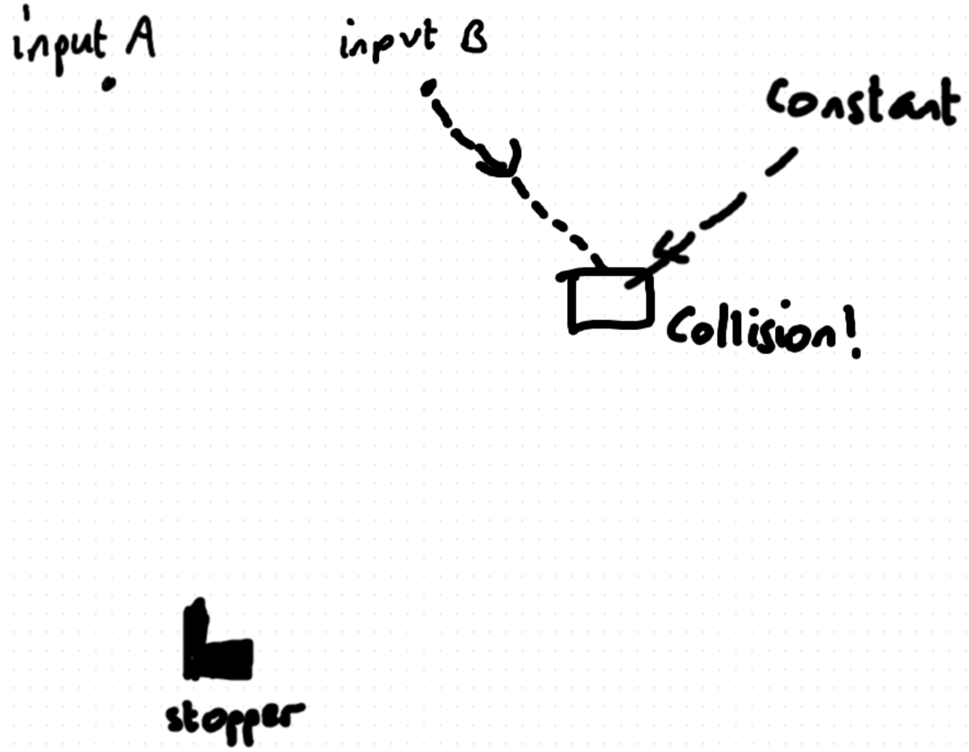
AND gate
Notes:
Don’t try and comprehend how this works, it’s like asking how a transistor works. Just trust the demo

Slide 14
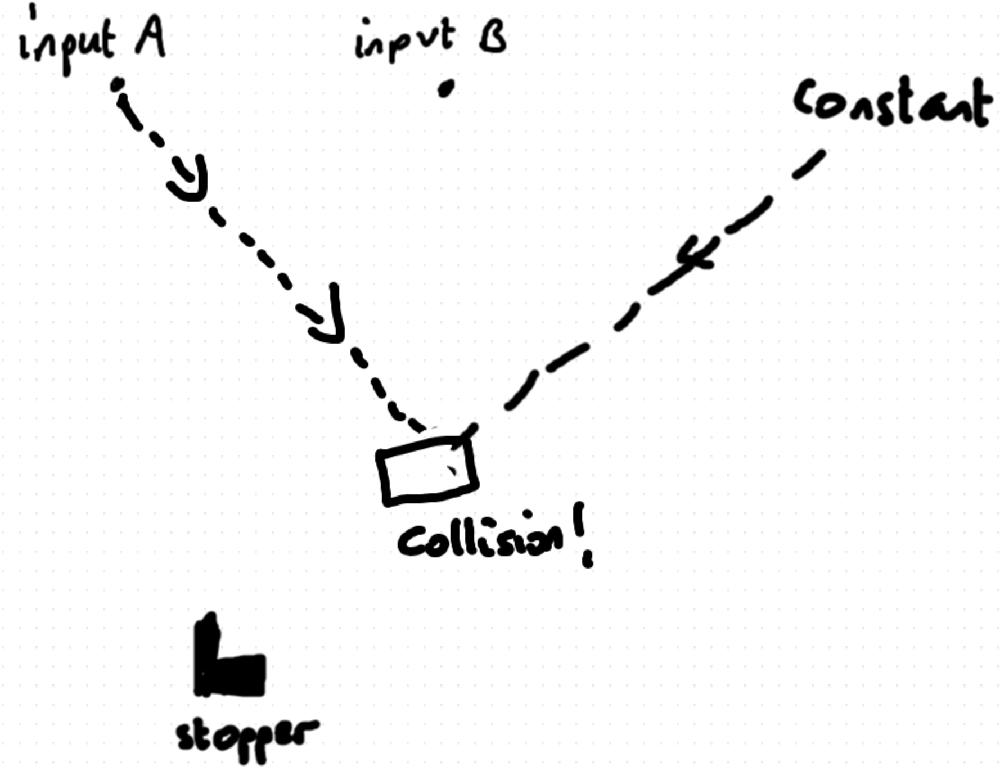
AND gate
Notes:
Don’t try and comprehend how this works, it’s like asking how a transistor works. Just trust the demo

Slide 15
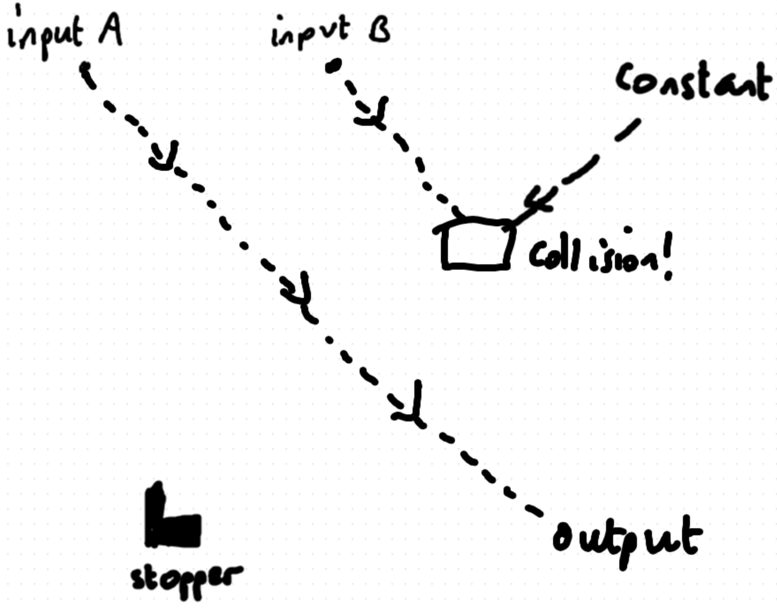
AND gate
Notes:
Don’t try and comprehend how this works, it’s like asking how a transistor works. Just trust the demo

Slide 16
NAND is enough
With NOT and AND, we can make NAND
String together lots of NANDs and you can make any circuit
Gliders are analogous to electrons
So can simulate any computer inside Game of Life
Turing complete! (and hence Rice’s Theorem)

Slide 17
Appendix: Terrifying video
Emulator of Game of Life, in Game of Life
Doesn’t use mechanism outlined above, but a much more efficient one
Will paste link in Ensoft chat for the interested
https://www.youtube.com/watch?v=xP5-iIeKXE8

Slide 18
Notes:
You must not click beyond this slide. If you don’t have any content slides, this is what will be projected for the entire duration of your talk.

