Slide 1
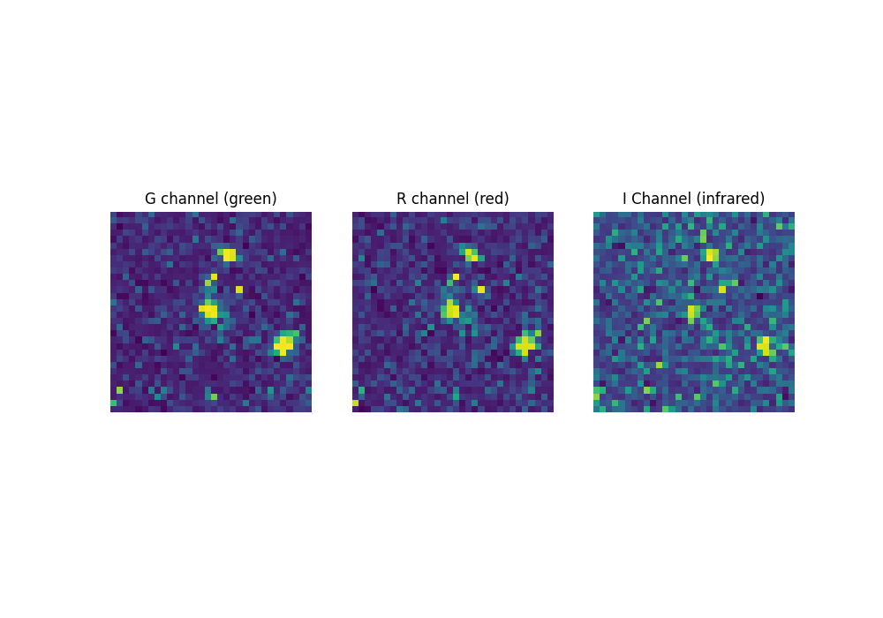
36x36 images cropped to 32x32 to avoid padding and alignment issues
3 channels, GRI, commonly used in astrophotography to capture radiation
Channels are pre-processed so the galaxy is centered, log-scaled and 1% of brightest pixels saturated to bring out the relevant features

Slide 2
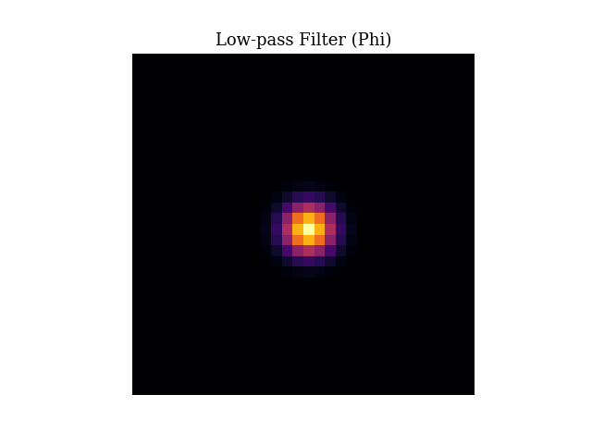
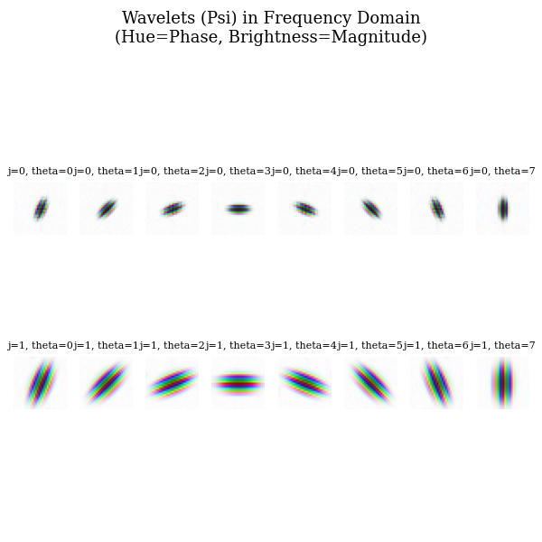
WSN Implementation with Rigid-motion for rotation invariance

Slide 3
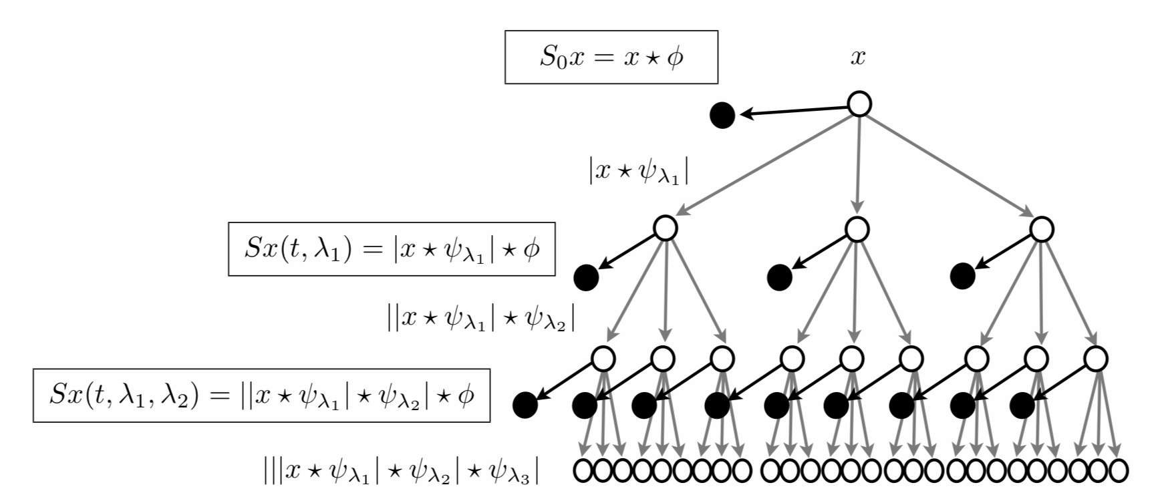
To reduce number of maps, stack all orientation maps of a same scale and sum before applying low pass filter
Order 1 goes from J*L maps to J

Slide 4
Next steps:
Currently around 74% accuracy, add bispectrum/bicoherence features to account for correlation between wavelets to squeeze final 5ish% hopefully
Begin analysis of maps

