Slide 1
The Bitcoin Network and Protocol
By: Sawan Singh Mahara
Under: Prof. Chiranjeevi G.N

Slide 2
Brief Overview

Slide 3
What is the Network?
Distributed
Decentralised
Trust-less
Best-Effort Basis

Slide 4
Prerequisite

Slide 5
The Ledger
A + 1000
B + 1000
C + 1000
A - 300
B - 400
A - 900
A=> 1200
B=> 400
C=> 1000
Set of Transactions
A Owes 200
B is Owed 600
C is Owed 1000

Slide 6
ECoin
Issue 1:
String of binary digits on a hard drive
Ledger System
Issue 2:
Unauthorised Removal of Funds
Digital Signatures
Issue 3:
Repeat Transactions
Serial Numbers
But Serial Numbers need to be Issued by a ‘third party’

Slide 7
Only the Receiver is Verifying Transactions

Slide 8
Double Spending
Alice wants from Bob and Charlie.
Same Serial Number
Send to Both
Independently Verify

Slide 9
Let Everyone in the Network Verify Transactions

Slide 10
Issue: Everyone can Easily Verify
Transactions aren’t being verified by humans.
A consensus is used.
We trust that everyone on the network is with us and against an attacker
An attacker can make multiple instances of themselves

Slide 11
Proof-of-Work
Make it hard for nodes to verify transactions.
No fake consensus can be built up.
Only ‘worthy’ nodes can verify transactions
Why Verify?
To Earn ECoins

Slide 12
Mining
Better to Verify Multiple Transactions
Ledger contains multiple ‘verified’ transactions
Many nodes want to earn ECoins
Race to be the first to verify transactions
This verification process is called Mining

Slide 13
BlockChain
A collection of transactions in called a BLOCK
Chain of Blocks BLOCKCHAIN
History of EVERY transaction
How to make this Secure?

Slide 14
HASHING

Slide 15
Hashing
A Function
Variable Length to Fixed Length
So far, impossible to reverse engineer
Extremely Sensitive to inputs

Slide 16
Multiple Guesses = Best Bet

Slide 17

SHA-256
32 Character Output
Chunks of 64 Characters as Input
$2^{256}$ Total possible Outputs
Guessing The Inputs for a Particular Output= Impossible
WHY?

Slide 18
32 Characters Output
64 Characters Input
A
Group 1
SHA-256
Group 2
B
C
Initialised Using Prime Numbers
Group 16
H

Slide 19
Group 1
Constant
A
x
Group 2
B
A
Group 16
C
B
Group 17
Add UP
Group 18
H
G
Group 64
Add UP

Slide 20
32 Characters Output
64 Characters Input
a
Group 1
b
Group 2
c
Remaining Inputs
Group 16
d

Slide 21
Proof-of-Work
‘Work’ = Node Guessing Input for a Hash
‘Proof’ = Network Verifies
A
B
C
The Final Hash
Jobs of Hash
Condenses Information into 32 Characters
Acts as a good test of ‘computational power’
H

Slide 22
Bitcoin Block

Slide 23
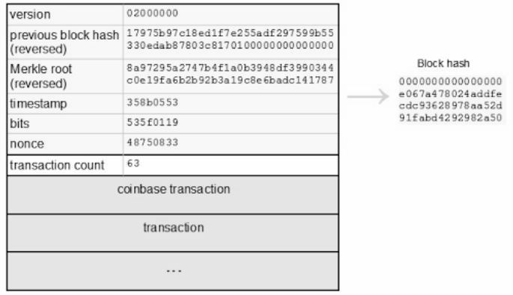
A Block

Slide 24
Merkle Trees
Hierarchical Hashing
Multiple Transactions can always be hashed into one.
MERKLE ROOT

Slide 25
H(a)
H(ab)
H(b)
H(abc)
Transaction Hashes
H(c)
H(c)
Merkle Root

Slide 26
A Block

Slide 27
Transactions
In
Out
In
Out
M- Inputs
N- Outputs
In
Out

Slide 28
Transactions
Alice Gets 20 Bitcoins
Bob Gets 10 BitCoins
In
Out
Out
Bob Gets 5 BitCoins
Bob Gets 15 BitCoins
In
Out
Domnic Gets 25 BTC
Charlie Gets 40 BitCoins
In
Out
Charlie Gets 15 BTC

Slide 29
What is Meant by Owning Bitcoins?
Unreferenced Transactions with your name
Public key is your name.
Adding up all unreferenced transaction outputs which have your public key = How many bitcoins you have
You can refer an output only ONCE.

Slide 30
Applications of BlockChain
Distributed Cloud
Identification Systems
Smart Contracts
Voting

Slide 31
THANK YOU

