Slide 1
Time Series Forecasting:
Population levels in
Austin Animal Shelter
Helen Skinner

Slide 2

Contents
Problem and solution
Data
Model
Results
Uses, shortcomings and further work
Acknowledgements

Slide 3
Problem and solution
Problem: For resourcing and budgeting reasons, animal shelters need to accurately forecast the animal population.
Solution:
  Build a time series model to forecast the population ahead 1 year
    Ensure it can be re-run with updated data as required
  Aim to make the model as accurate as possible

Slide 4


Data – Overview
data.austintexas.gov
Data preprocessing required:
  Convert intake/outtake to population
  Group birds, livestock and other into single category
  Create time series variables where required
October 1, 2013 to present day
5 animal categories: dogs, cats, birds, livestock and other

Slide 5
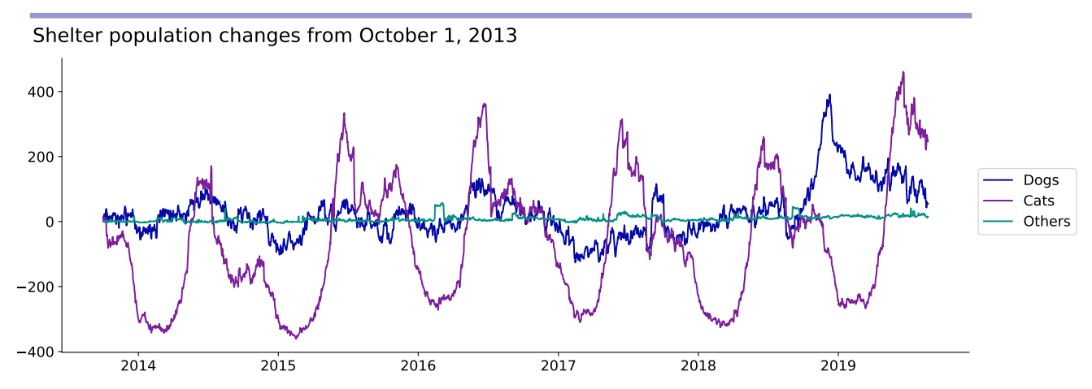
Data – Animal population
  Annual seasonality for cats
    Maybe for dogs too
    Potential weekly seasonality but hard to see
  Divide by zero errors could be an issue

Slide 6
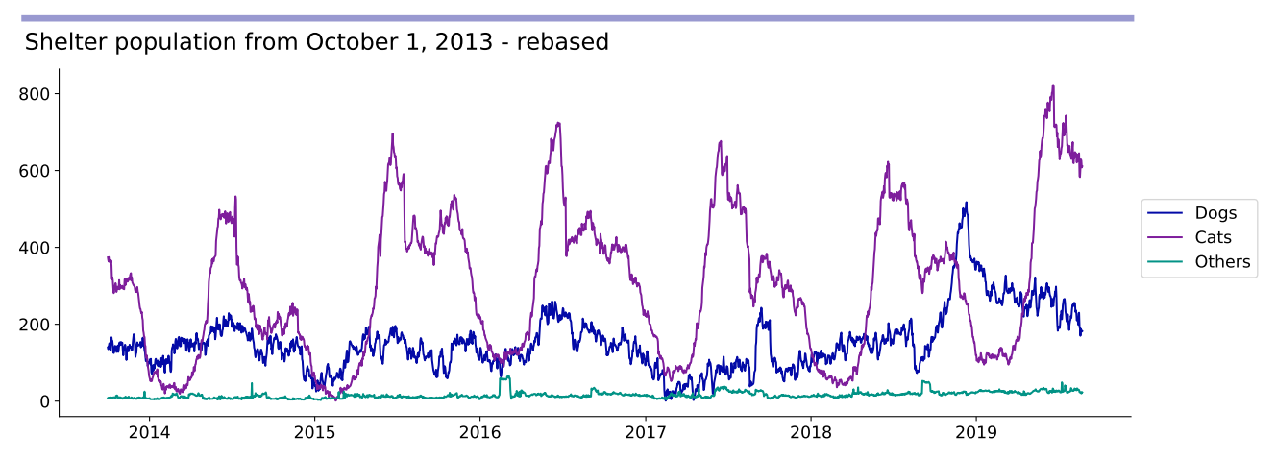
Data – Animal population
  Rebased population data so never goes to zero
  Potential increasing trend visible?

Slide 7
Unsupervised learning - Seasonality
Aim: Use unsupervised clustering techniques to understand what seasonality exists within the data.
How:
  Use a KMeans algorithm
    Flexible (can try different numbers of clusters)
    Fast
  Look to see if months / days group together indicating similarity

Slide 8
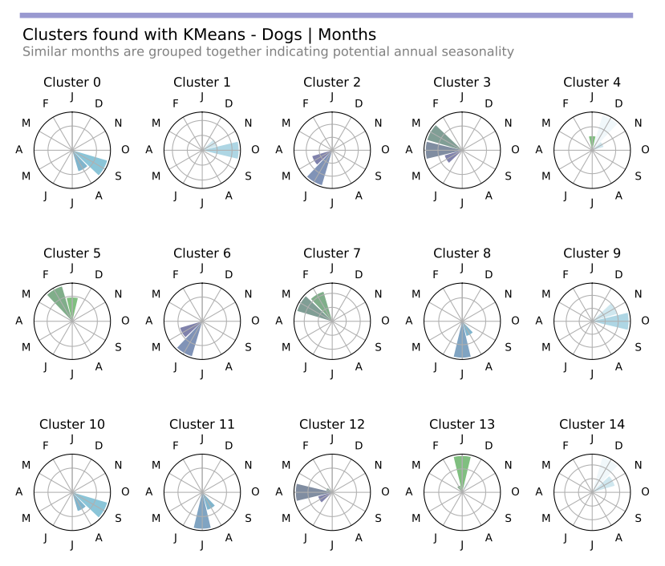
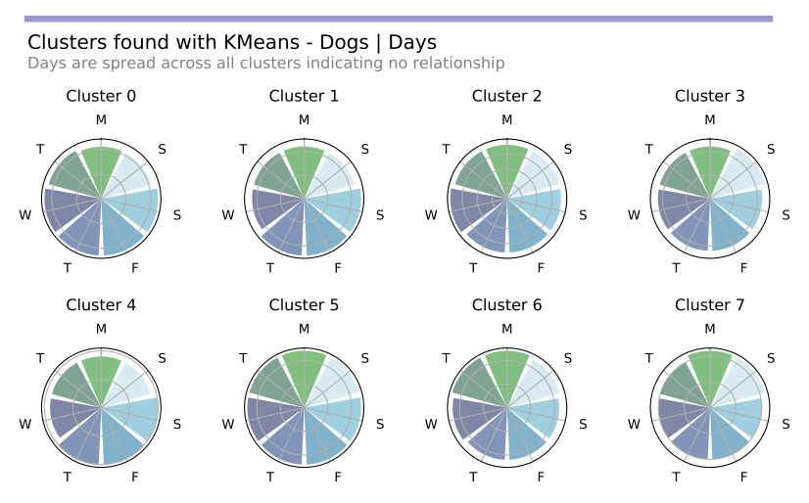
Unsupervised learning - Dogs
  No visible grouping by day
  Clear grouping by month
    Not exact month but same time of year

Slide 9
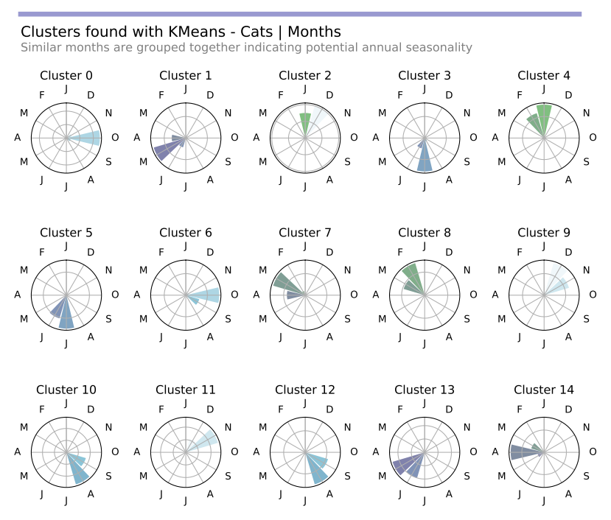
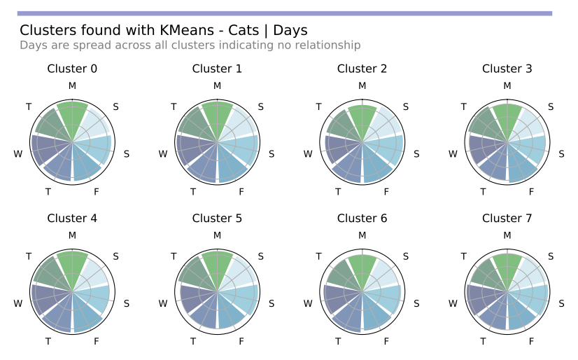
Unsupervised learning - Cats
  No visible grouping by day
  Clear grouping by month
    Not exact month but same time of year

Slide 10
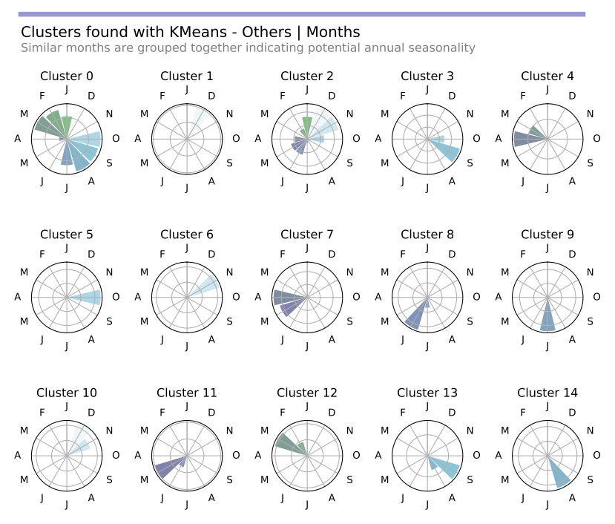
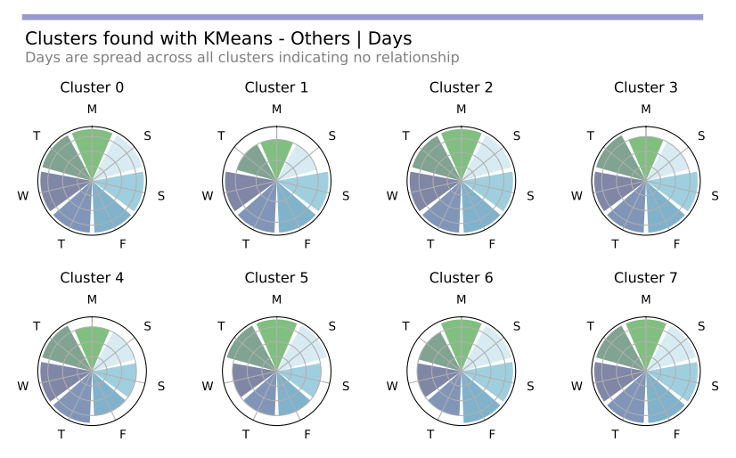
Unsupervised learning - Others
  No visible grouping by day
  Limited grouping by month
    Concentrated in cluster 0 and cluster 2

Slide 11
Modeling – Algorithms tested
Baseline algorithms
Time series algorithms
Neural Network
Naive
ARIMA
Assumes future values will be equal to the most recent known value.
Assumes future values are based on previous terms and previous errors.
Supervised learning technique which uses previous terms as features to learn from.
Seasonal Naive
Prophet
Random Forest
Assumes future values will be equal to the average of the known values at the same date.
Algorithm developed by Facebook which separately models trend and seasonality.
Supervised learning technique which uses previous terms as features to learn from.

Slide 12
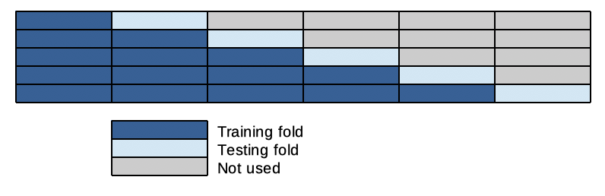
Modeling – Selection pathway
Final Dataset
2014 – 2016
2017
2018
Training
Validation
Testing
Evaluate
and compare performance
Evaluate performance
Maintains chronological order but potential for overfitting
Best
algorithm
Best version of each algorithm
Best version of each algorithm

Slide 13
Modeling – Error evaluation
MAPE
Mean Absolute Percentage Error
Unit free so can compare between different time series
Gives extreme values when y_{t} is close to zero and is undefined if y_{t} is equal to zero
MAE
Mean Absolute Error
Same scale as data
  Cannot use to make comparisons between different time series
Minimizing this leads to forecasts of the median
RMSE
Root Mean Squared Error
Same scale as data
  Cannot use to make comparisons between different time series
Minimizing this leads to forecasts of the mean
MASE
Mean Absolute Scaled Error
Can compare between different time series
Uses a scaled error based on a naive forecast of the training data

Slide 14
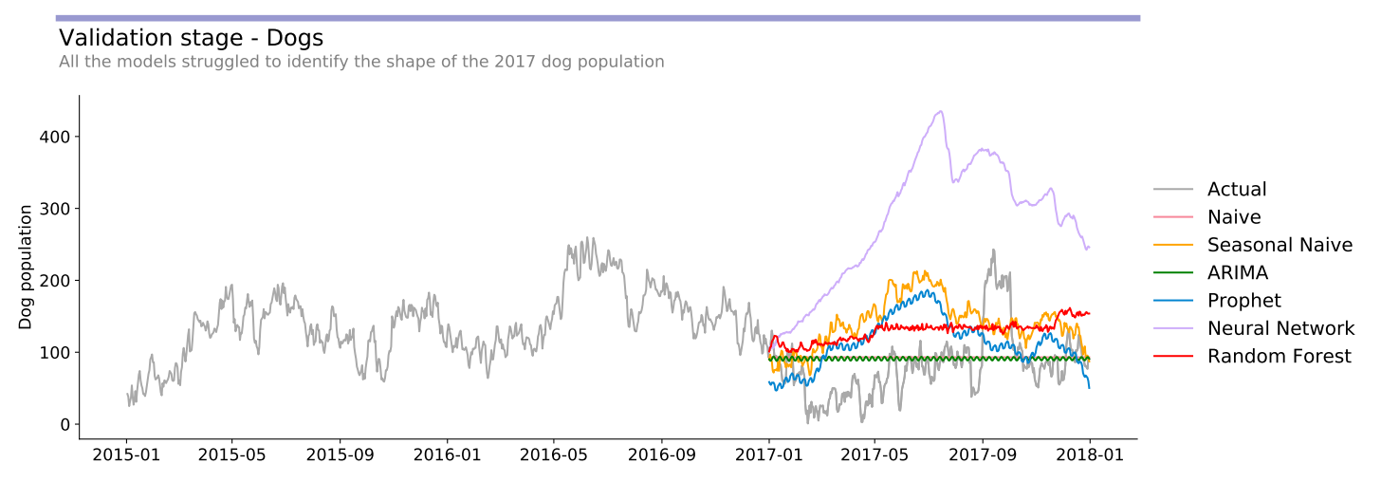
Modeling – Dog validation results
Baselines | MAE | RMSE | MAPE | MASE
Naive | 35.5 | 48.2 | 125.9 | 4.2
Seasonal Naive | 72.8 | 82.1 | 205.1 | 8.6
TS Models | MAE | RMSE | MAPE | MASE
ARIMA | 34.7 | 47.8 | 121.2 | 4.1
Prophet | 56.8 | 66.1 | 149.4 | 6.7
Neural Network | 201.0 | 215.9 | 439.9 | 23.8
Random Forest | 59.6 | 64.6 | 181.9 | 7.1

Slide 15
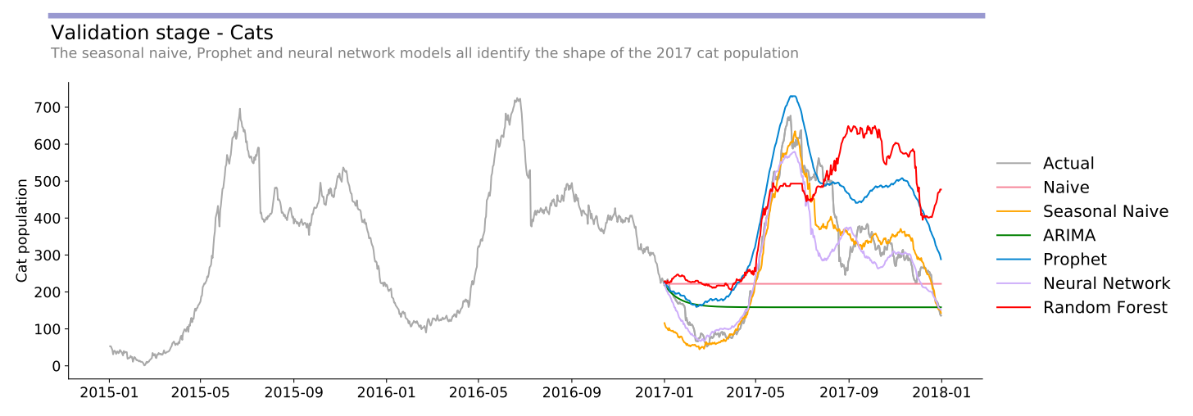
Modeling – Cat validation results
Baselines | MAE | RMSE | MAPE | MASE
Naive | 145.7 | 183.6 | 63.2 | 16.9
Seasonal Naive | 44.3 | 58.9 | 17.9 | 5.1
TS Models | MAE | RMSE | MAPE | MASE
ARIMA | 170.2 | 217.8 | 57.0 | 19.7
Prophet | 108.2 | 123.0 | 55.3 | 12.5
Neural Network | 47.5 | 71.8 | 16.0 | 5.5
Random Forest | 158.4 | 188.8 | 79.6 | 18.3

Slide 16
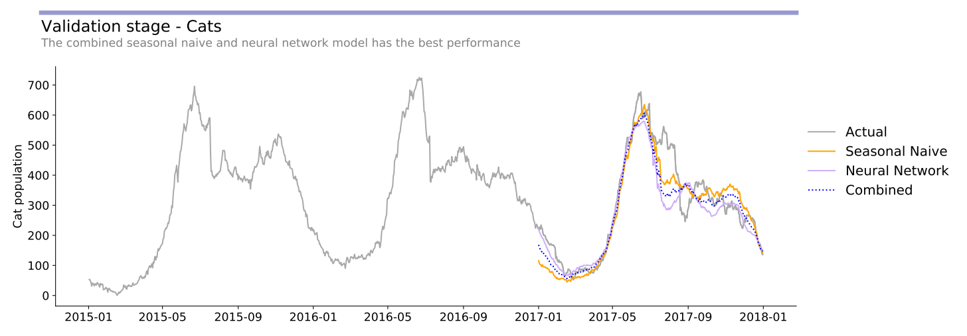
Modeling – Cat validation results 2
Baselines | MAE | RMSE | MAPE | MASE
Naive | 145.7 | 183.6 | 63.2 | 16.9
Seasonal Naive | 44.3 | 58.9 | 17.9 | 5.1
TS Models | MAE | RMSE | MAPE | MASE
ARIMA | 170.2 | 217.8 | 57.0 | 19.7
Prophet | 108.2 | 123.0 | 55.3 | 12.5
Neural Network | 47.5 | 71.8 | 16.0 | 5.5
Random Forest | 158.4 | 188.8 | 79.6 | 18.3
Combined | 42.5 | 61.2 | 15.2 | 4.9

Slide 17
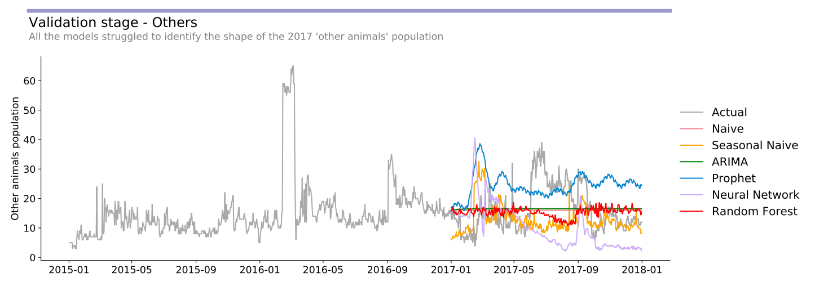
Modeling – Other validation results
Baselines | MAE | RMSE | MAPE | MASE
Naive | 6.3 | 7.7 | 45.2 | 3.3
Seasonal Naive | 7.1 | 9.9 | 42.0 | 3.8
TS Models | MAE | RMSE | MAPE | MASE
ARIMA | 6.4 | 7.7 | 47.5 | 3.4
Prophet | 10.7 | 12.2 | 93.3 | 5.7
Neural Network | 10.7 | 13.2 | 70.6 | 5.7
Random Forest | 6.9 | 8.5 | 47.2 | 3.6

Slide 18
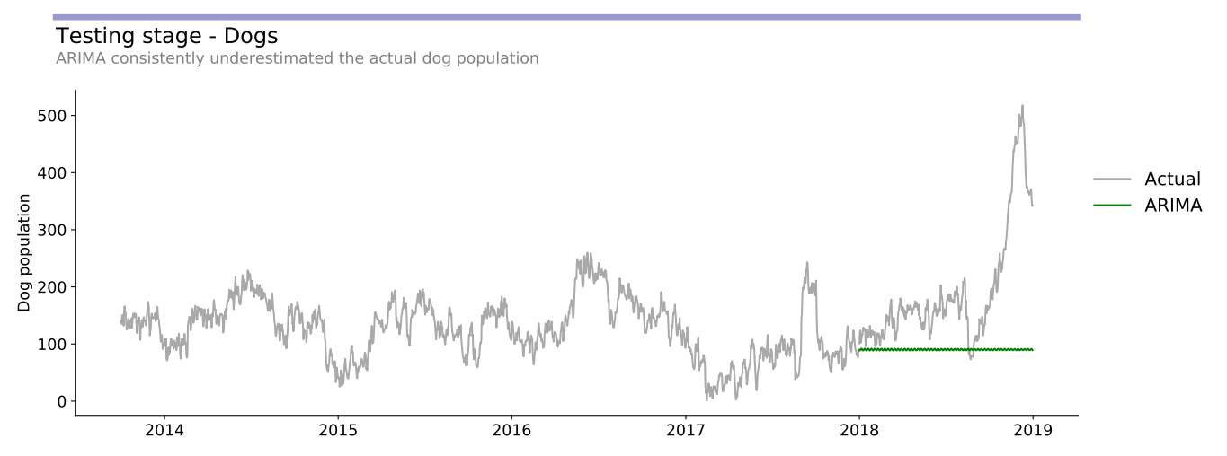
Modeling – Dog test results
  Forecasts almost constant value
    Misses upward trend
  Spike is unusual – perhaps unpredictable
MAE
131.1
34.7
RMSE
159.1
47.8
MAPE
52.3
121.2
MASE
14.9
4.1
Test
Validation

Slide 19
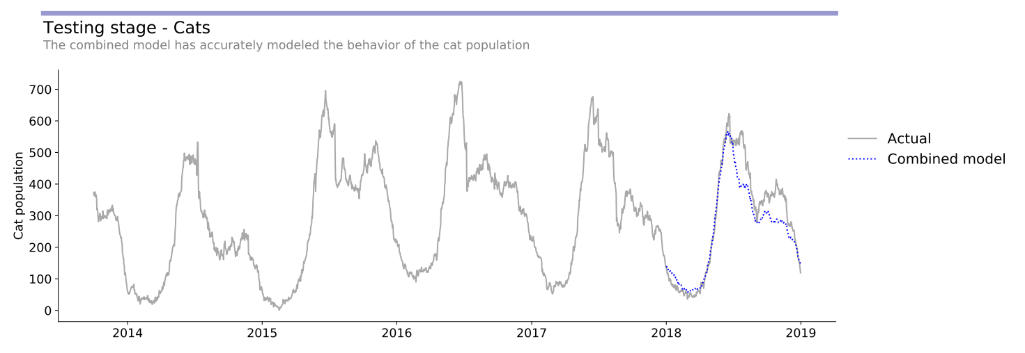
Modeling – Cat test results
  Tracks seasonal pattern very well
    Misses secondary peak
  Overall slightly underestimates
MAE
88.0
42.5
RMSE
125.1
61.2
MAPE
27.6
15.2
MASE
9.8
4.9
Test
Validation

Slide 20
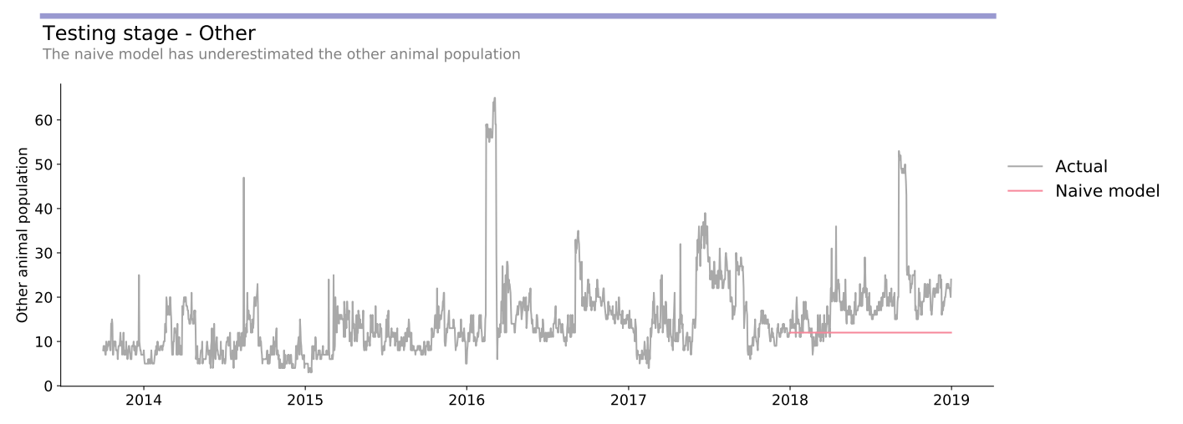
Modeling – Other test results
  Forecasts constant value
    Misses upward trend
  Spikes appear random
MAE
10.1
6.3
RMSE
12.4
7.7
MAPE
41.0
121.2
MASE
5.4
4.1
Test
Validation

Slide 21
Strengths of the models
Cat model
  Accurately identifies the general shape of the population
  Animal shelter is able to estimate when peaks are likely to occur
Dog and other models
  Models are more ‘boring’ but have lower errors, so less likely to be as significantly wrong as more complex models
  Reasonable short term estimates but quickly outdated
    Potentially could improve by re-running models more often

Slide 22
Weak points of the models
Evaluation metrics
  ‘Averaging’ models have lowest errors but forecast straight lines
  Dog and other models not useful for capturing expected up and down periods
  Potentially alternative evaluation metrics are required
Random spikes
  Almost impossible to predict
Overfitting
  Very likely with sliding windows cross validation
  Difficult to combine the need for long training data periods and the decreasing usefulness of older data

Slide 23
Further work
Additional data
Employment / economic data
Animal health – perhaps using NLP techniques
Intervention campaigns e.g. discounted adoption fees
Evaluation metrics
Consider what desired outcome is
Is underestimating worse than overestimating?
Different data
Intake / Outtake
The daily change (rather than absolute daily number)
Different models
RNNs
LSTM
Further hyperparameter tuning
Prophet – holidays, specific changepoints
NN / RF – several more options to consider
Further feature engineering
Understand feature importances (look back periods, months / days)
Use PCA to remove collinearity

Slide 24
Acknowledgements
Technical advice and support gratefully received from
  Jenny Yu
  Tom Nickson
  Technical Coaching and peer group via Slack
References
  Forecasting: Principles and Practice by Rob J Hyndman and George Athanasopoulos
Icons
  Icons made by OCHA and Freepik from www.flaticon.com

