Slide 1
Predicting Divorce from Demographic Traits
Helen Skinner

Slide 2

Contents
Purpose and justification
Data
Model
Results
Uses, shortcomings and further work
Acknowledgements

Slide 3
Purpose and justification
Purpose: Is it possible to predict whether an individual has ever been divorced based on demographic traits?
Justification:
  Commercial uses
  Intervention targeting and potential prevention
  General interest

Slide 4


Data – Overview
General Social Survey 2012
Significant data preprocessing required:
  Respondents did not answer every question
  Inconsistent coding for ‘inapplicable’, ‘don’t know’ and ‘no answer’
  Potential for label leakage
4,820 respondents
1,069 variables

Slide 5
Data – Preprocessing workflow
Create binary outcome and select observations
Create dummies
*Check for non-normality and collinear variables
Initial Dataset
Select and engineer variables
4,820
4,820
3,311
3,311
3,311
1,069
39
39
202
182
Final Dataset
*on training set only

Slide 6



Data – Select and engineer variables
Dropping | Low response rates Label leakage Manual selection required | e.g. Most opinion questions e.g. Dwelling type
Grouping | Reduce noise Reduce overfitting | e.g. Religion e.g. Occupation
Imputing | Potentially important but some missing data Sensible method available | e.g. Income using logical rules

Slide 7

Data – Create binary outcome and select observations
Binarizing | Compare “not divorced / separated” vs “divorced / separated” Remove all single people as not applicable Previously divorced and now remarried counts as “divorced / separated” Widowed counts as “not divorced / separated”
Dropping | Remove single people as not applicable Remove observations with missing data

Slide 8
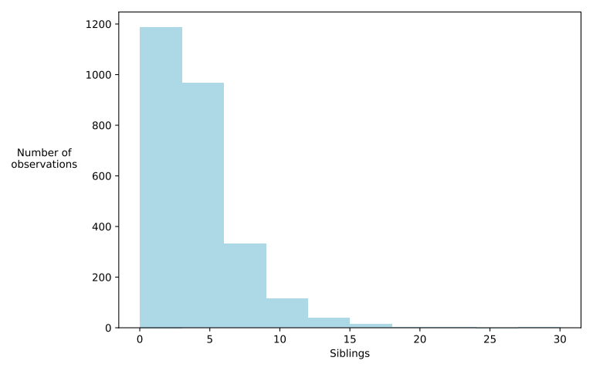
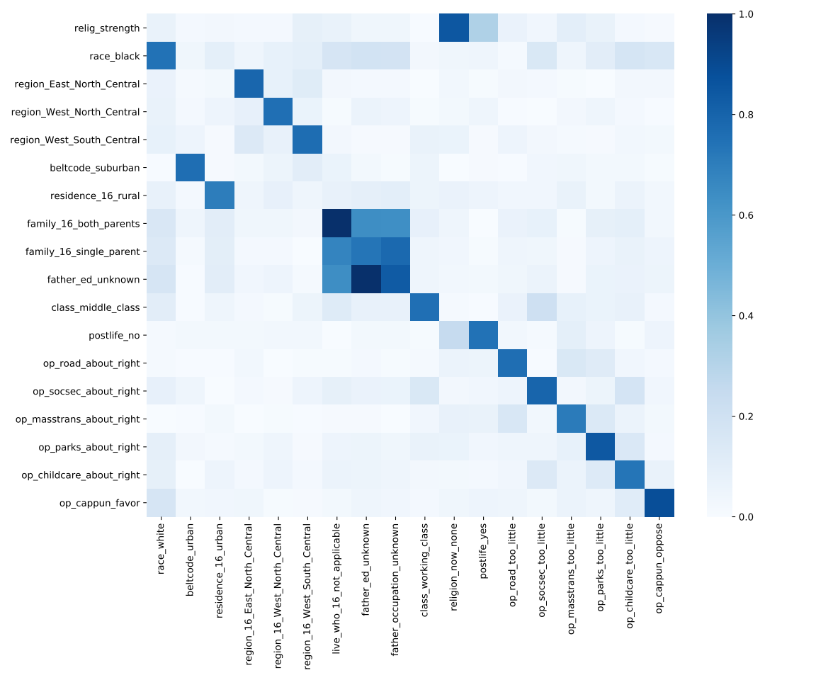
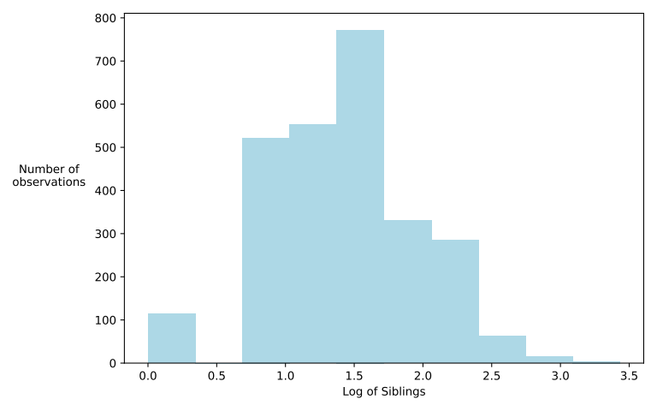
Data – Non-normality and collinearity

Slide 9
Modeling – Selection pathway
Final Dataset
60%
20%
20%
Training
Validation
Testing
Hyperparameter grid search
- KNN - Gaussian Naive Bayes - SVM
- Random Forest - Gradient Boosting
Different data scaling
- Unscaled - StandardScaler
- MinMaxScaler
Evaluate
and compare performance
Evaluate performance
Best
algorithm
Best version of each algorithm
Best version of each algorithm

Slide 10
Modeling – Training strategy
Algorithm | Tuned hyperparameters
KNN | n_neighbors weights
Gaussian Naive Bayes | var_smoothing
Random Forest | n_estimators criterion max_depth max_features
Gradient Boosting | loss learning_rate max_depth max_features
SVM | C gamma
Aim to find best version of each algorithm
Tune each algorithm to find
  Best hyperparameters
  Best data scaling
Use f1 score to assess
All algorithms trained on:
  Unscaled data
  StandardScaler
  MinMaxScaler

Slide 11
Modeling – Training results
Algorithm | Best hyperparameters | Best data scaling
KNN | n_neighbors = 18 weights = distance | Unscaled
Gaussian Naive Bayes | var_smoothing = 1e-09 | StandardScaler
Random Forest | n_estimators = 100 criterion = entropy max_depth = 4 max_features = None | No difference
Gradient Boosting | loss = exponential learning_rate = 0.1 max_depth = 4 max_features = None | No difference
SVM | C = 10 gamma = 0.0005 | Unscaled
To get the best performance from each algorithm:
Use data scaled in this way
Use these hyperparameters

Slide 12
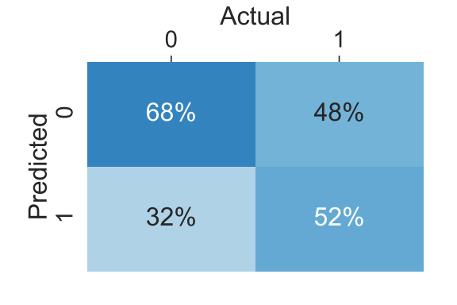
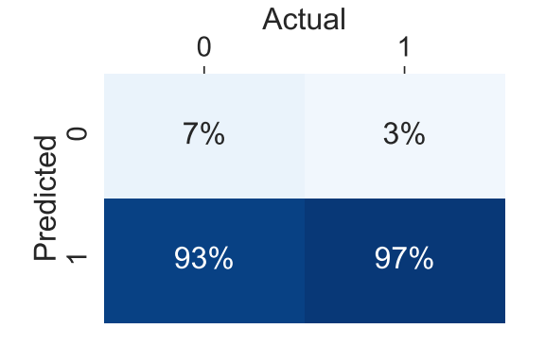
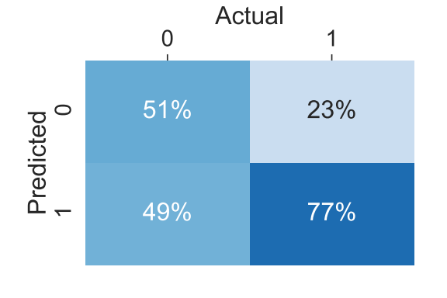
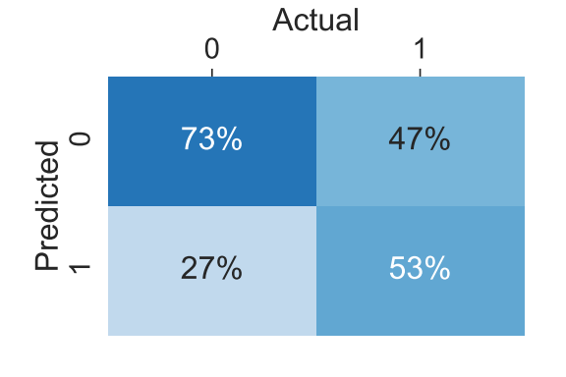
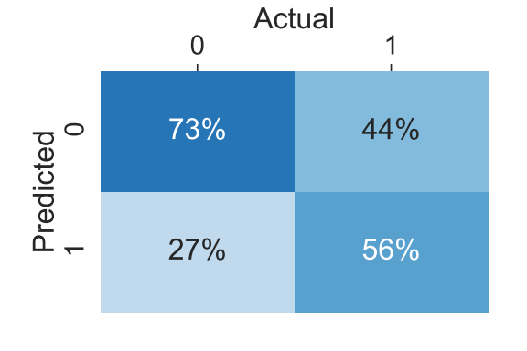
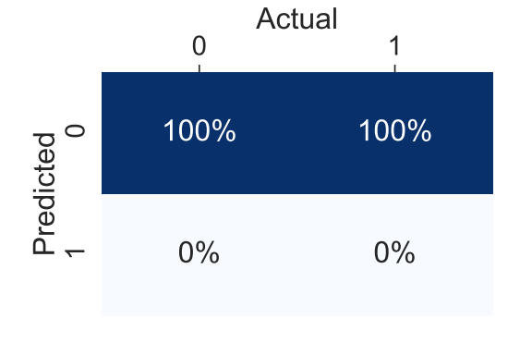
Modeling – Validation results
KNN
G. Naive Bayes
Random
Forest
f1: 0.546 Accuracy: 0.610
f1: 0.621 Accuracy: 0.470
f1: 0.649 Accuracy: 0.627
Gradient
Boosting
SVM
Guessing
f1: 0.570 Accuracy: 0.642
f1: 0.589 Accuracy: 0.653
f1: N/A Accuracy: 0.551

Slide 13
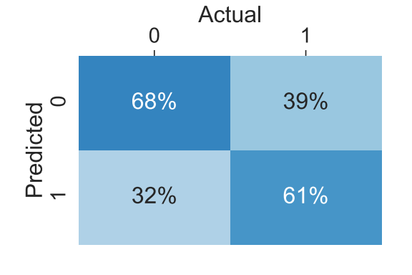
Modeling – Validation results
Random
Forest
Average of Random Forest and SVM
f1: 0.649 Accuracy: 0.627
SVM
f1: 0.610 Accuracy: 0.650
f1: 0.589 Accuracy: 0.653

Slide 14
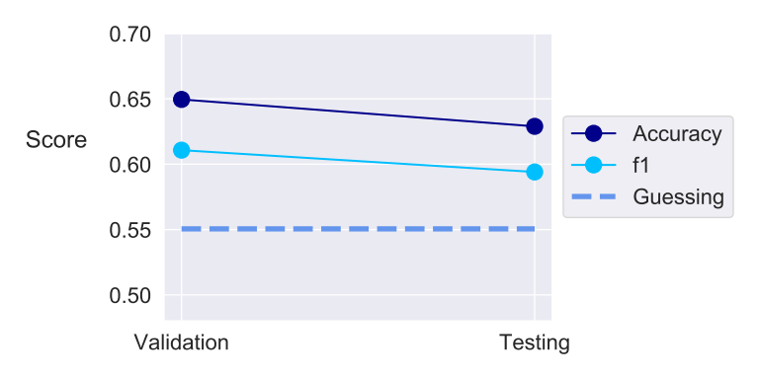
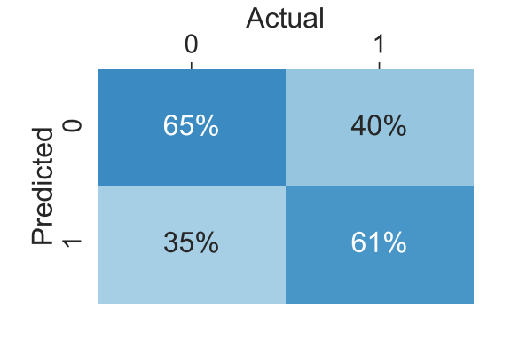
Modeling – Testing results
Average of Random Forest and SVM
Small reduction in accuracy on test set compared to validation
Still more accurate than guessing all not divorced
f1: 0.594 Accuracy: 0.629

Slide 15
Practical uses of the model
Advertising or actuarial
  Counseling or legal services via social media to at risk groups
  Insurance implications
Intervention
  Support or help for at risk groups
  Charity or governmental
General interest
  Individuals may be interested to know personal probability
  Either for decision-making or not

Slide 16
Weak points of the model
Accuracy
  Approximately 8 percentage points better than guessing
Feature importances
  Difficult to extract due to use of SVM
Scaling
  Run time of 11.2 seconds for training set with 2,648 observations and testing set with 663 observations
  Estimated run time of over 24 hours for datasets over ~5 million

Slide 17
Further work
Test on alternative data
Other years of GSS available
Would require significant data preprocessing
Try using PCA
Decrease computing time
Increase difficulty in extracting feature importances
Different data
More observations
Additional variables about marital information e.g. age married
Investigate feature importances
Straightforward for Random Forest
Not so straightforward for SVM
Further feature engineering
Lower collinearity threshold
Categorize occupations differently
Different model
Try non-binary classification
Similar but different predictions e.g. whether someone has children

Slide 18
Acknowledgements
Technical advice and support gratefully received from
  Jenny Yu
  Tom Nickson
  Technical Coaching and peer group via Slack
Icons
  Icons made by OCHA and Freepik from www.flaticon.com

Slide 19
Appendix
Additional slides for information purposes

Slide 20
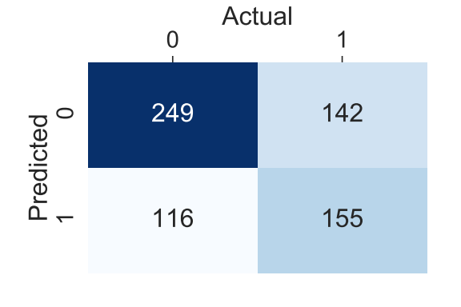
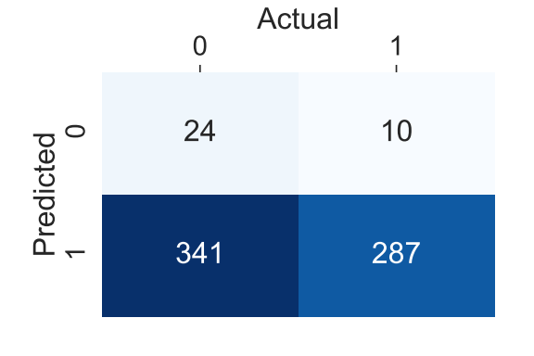
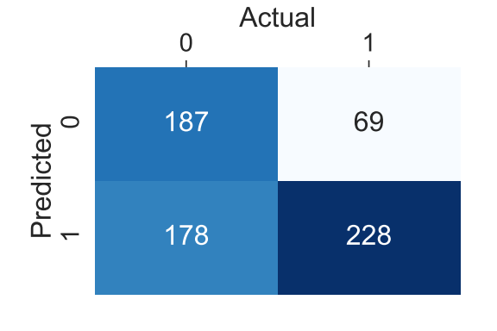

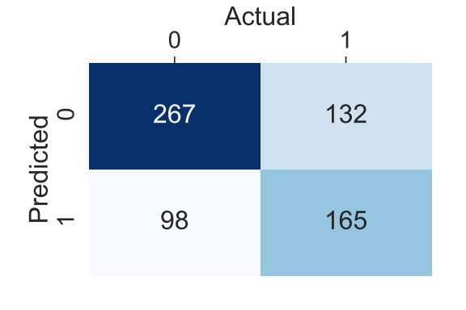
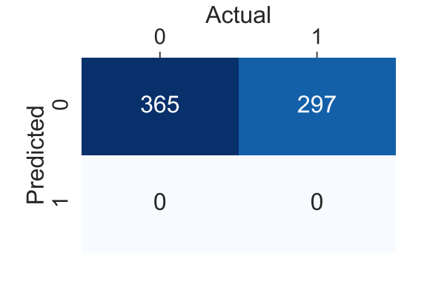
Modeling – Validation results
KNN
G. Naive Bayes
Random
Forest
f1: 0.546 Accuracy: 0.610
f1: 0.621 Accuracy: 0.470
f1: 0.649 Accuracy: 0.627
Gradient
Boosting
SVM
Guessing
f1: 0.570 Accuracy: 0.642
f1: 0.589 Accuracy: 0.653
f1: N/A Accuracy: 0.551

Slide 21
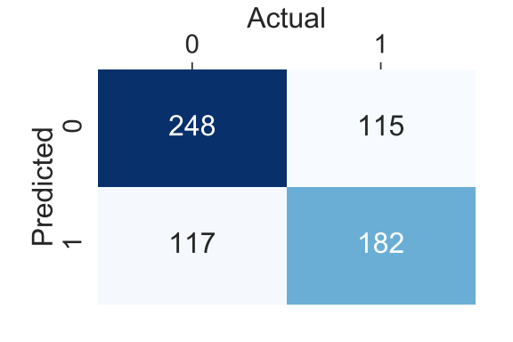
Modeling – Validation results
Random
Forest
Average of Random Forest and SVM
f1: 0.649 Accuracy: 0.627
SVM
f1: 0.610 Accuracy: 0.650
f1: 0.589 Accuracy: 0.653

Slide 22
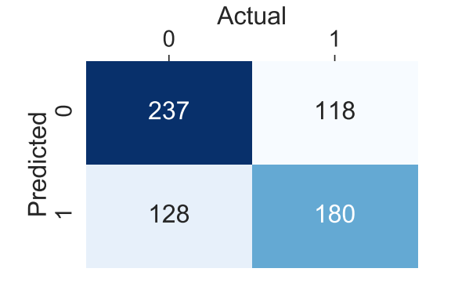
Modeling – Testing results
Average of Random Forest and SVM
Small reduction in accuracy on test set compared to validation
Still more accurate than guessing all not divorced
f1: 0.594 Accuracy: 0.629

