Slide 1
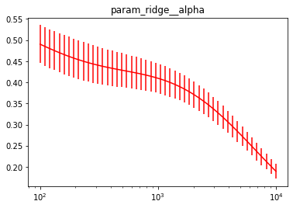
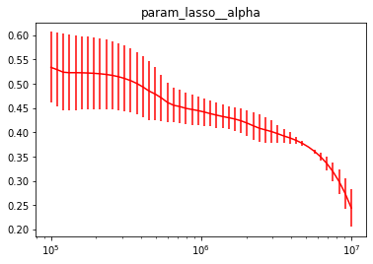
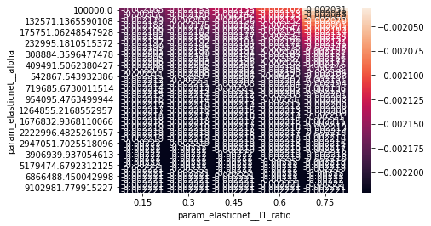
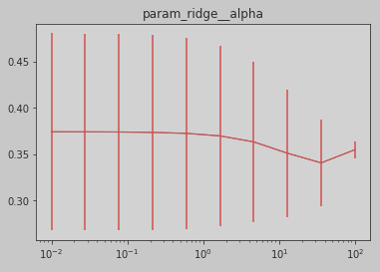
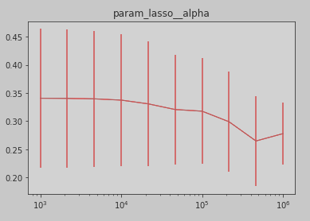
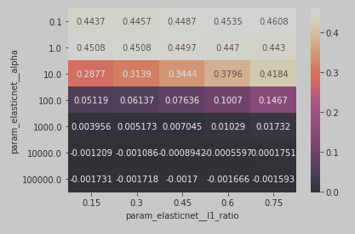
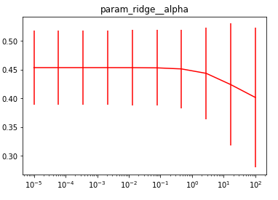
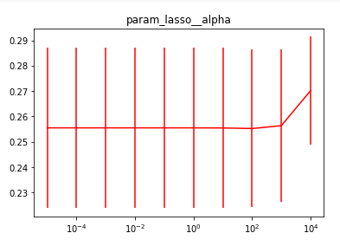
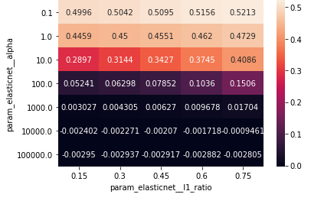
2 folds par erreur

Slide 2
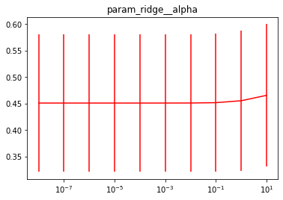
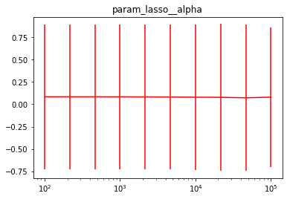
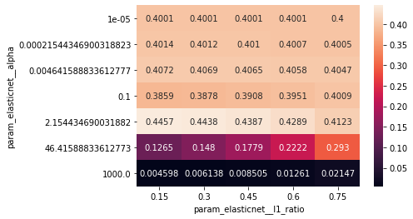
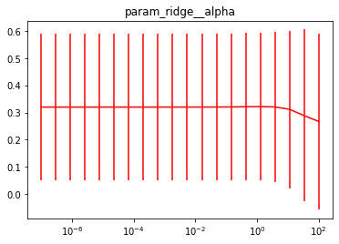
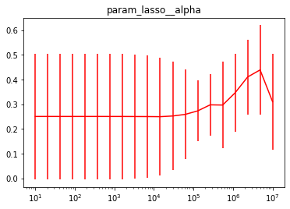
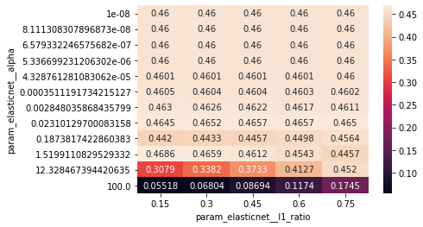
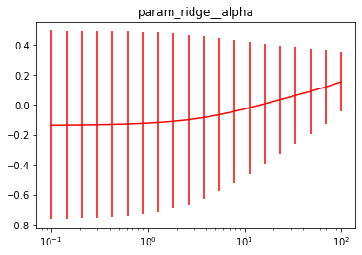
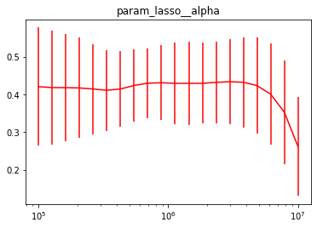
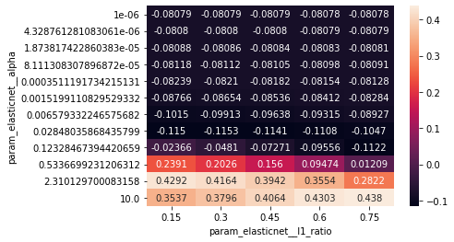
5 folds

Slide 3
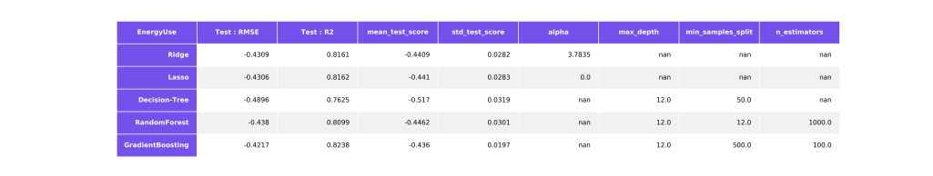
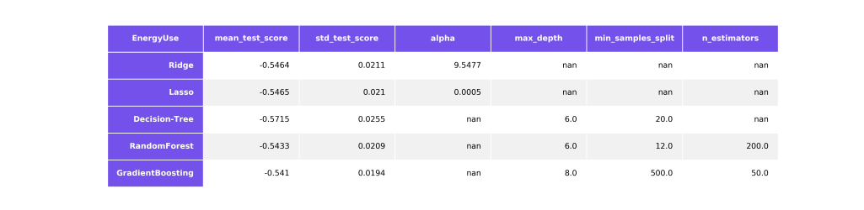

Slide 4
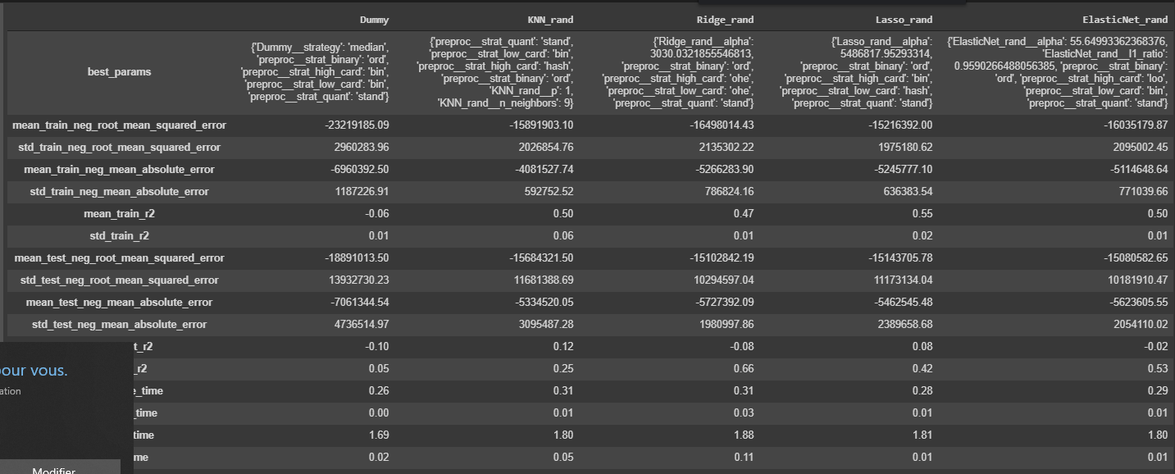
GroupKfolds mais group non renseigné pour le Randomized search CV -> poubelle

Slide 5
Dummy 'Dummy'
param_grid={'preproc__strat_binary': ['ord'],
'preproc__strat_low_card': ['bin'],
'preproc__strat_high_card': ['bin'],
'preproc__strat_quant': ['stand'],
name_reg+'__strategy': ['mean']}
-----Model does not exist in the pickle - computing... Grid Fitting 5 folds for each of 1 candidates, totalling 5 fits
[Parallel(n_jobs=1)]: Using backend SequentialBackend with 1 concurrent workers. [Parallel(n_jobs=1)]: Done 5 out of 5 | elapsed: 10.5s finished
---> Optimization took 12.250s. -----...model dumped
KNN Regressor 'KNN_rand'
param_grid={'preproc__strat_binary': ['ord'],
'preproc__strat_low_card': ['bin', 'ord'],
'preproc__strat_high_card': ['bin', 'ord', 'hash'],
'preproc__strat_quant': ['stand'],
name_reg+'__n_neighbors': [1,2,3,5,7,9,11,15,17],
name_reg+'__p': [1,2]}
-----Model does not exist in the pickle - computing... Randomized Fitting 5 folds for each of 108 candidates, totalling 540 fits
[Parallel(n_jobs=1)]: Using backend SequentialBackend with 1 concurrent workers. [Parallel(n_jobs=1)]: Done 540 out of 540 | elapsed: 20.6min finished
---> Optimization took 1235.305. -----...model dumped
Ridge Regression 'Ridge_rand'
param_grid={'preproc__strat_binary': ['ord'],
'preproc__strat_low_card': ['ohe', 'bin'],
'preproc__strat_high_card': ['ohe', 'bin'],
'preproc__strat_quant': ['stand'],
name_reg+'__alpha': st.loguniform(1e-7, 1e7)}
-----Model does not exist in the pickle - computing... Randomized Fitting 5 folds for each of 200 candidates, totalling 1000 fits
[Parallel(n_jobs=1)]: Using backend SequentialBackend with 1 concurrent workers. [Parallel(n_jobs=1)]: Done 1000 out of 1000 | elapsed: 36.8min finished
---> Optimization took 2208.016s. -----...model dumped
LASSO 'Lasso_rand'
param_grid={'preproc__strat_binary': ['ord'],
'preproc__strat_low_card': ['ohe', 'bin'],
'preproc__strat_high_card': ['bin', 'ord', 'hash'],
'preproc__strat_quant': ['stand'],
name_reg+'__alpha': st.loguniform(1e-7, 1e7)}
-----Model does not exist in the pickle - computing... Randomized Fitting 5 folds for each of 200 candidates, totalling 1000 fits
[Parallel(n_jobs=1)]: Using backend SequentialBackend with 1 concurrent workers. [Parallel(n_jobs=1)]: Done 1000 out of 1000 | elapsed: 37.2min finished
---> Optimization took 2235.110s. -----...model dumped
ElasticNet 'ElasticNet_rand'
param_grid={'preproc__strat_binary': ['ord'],
'preproc__strat_low_card': ['ohe', 'bin', 'hash'],
'preproc__strat_high_card': ['ord', 'hash', 'loo'],
'preproc__strat_quant': ['stand'],
name_reg+'__alpha': st.loguniform(1e-7, 1e7),
name_reg+'__l1_ratio': st.uniform(0,1),
name_reg+'__tol' : st.loguniform(1e-3, 1e0)}
-----Model does not exist in the pickle - computing... Randomized Fitting 5 folds for each of 200 candidates, totalling 1000 fits
[Parallel(n_jobs=1)]: Using backend SequentialBackend with 1 concurrent workers. [Parallel(n_jobs=1)]: Done 1000 out of 1000 | elapsed: 37.2min finished
---> Optimization took 2232.924s. -----...model dumped
Random Forest Regressor 'RandomForest_grid'
param_grid={'preproc__strat_binary': ['ord'],
'preproc__strat_low_card': ['ohe', 'bin', 'hash'],
'preproc__strat_high_card': ['ord', 'hash', 'loo'],
'preproc__strat_quant': ['stand'],
name_reg+'__n_estimators': [100,200,500,1000],
name_reg+'__min_samples_leaf': [1,2,3,5,7,9,13],
name_reg+'__max_features': ['auto', 'sqrt']}
-----Model does not exist in the pickle - computing... Grid Fitting 5 folds for each of 504 candidates, totalling 2520 fits
[Parallel(n_jobs=1)]: Using backend SequentialBackend with 1 concurrent workers. [Parallel(n_jobs=1)]: Done 2520 out of 2520 | elapsed: 213.0min finished
---> Optimization took 12783.680s. -----...model dumped
Support Vector Machine Regression 'SVR_grid‘
param_grid={'preproc__strat_binary': ['ord'],
'preproc__strat_low_card': ['ohe', 'bin', 'hash'],
'preproc__strat_high_card': ['ord', 'hash', 'loo'],
'preproc__strat_quant': ['stand'],
name_reg+'__kernel': ['rbf', 'linear', 'poly'],
name_reg+'__gamma': ['auto'],#np.logspace(-8,0,9),
name_reg+'__epsilon': np.logspace(-3,0,5),
name_reg+'__C': np.logspace(-2,2,5)}
-----Model does not exist in the pickle - computing... Randomized Fitting 5 folds for each of 200 candidates, totalling 1000 fits
[Parallel(n_jobs=1)]: Using backend SequentialBackend with 1 concurrent workers. [Parallel(n_jobs=1)]: Done 1000 out of 1000 | elapsed: 42.8min finished
---> Optimization took 2572.068s. -----...model dumped
XGBoost Regressor 'XGBR_grid'
param_grid={'preproc__strat_binary': ['ord'],
'preproc__strat_low_card': ['ohe', 'bin', 'hash'],
'preproc__strat_high_card': ['ord', 'hash', 'loo'],
'preproc__strat_quant': ['stand'],
# name_reg+'__n_estimators': np.logspace(-8,-1,8),
name_reg+'__n_estimators': [100,500,1000,2000]}
-----Model does not exist in the pickle - computing... Grid Fitting 5 folds for each of 36 candidates, totalling 180 fits
[Parallel(n_jobs=1)]: Using backend SequentialBackend with 1 concurrent workers.
[Parallel(n_jobs=1)]: Done 180 out of 180 | elapsed: 11.8min finished
reg:linear is now deprecated in favor of reg:squarederror
---> Optimization took 708.228s. -----...model dumped

Slide 6
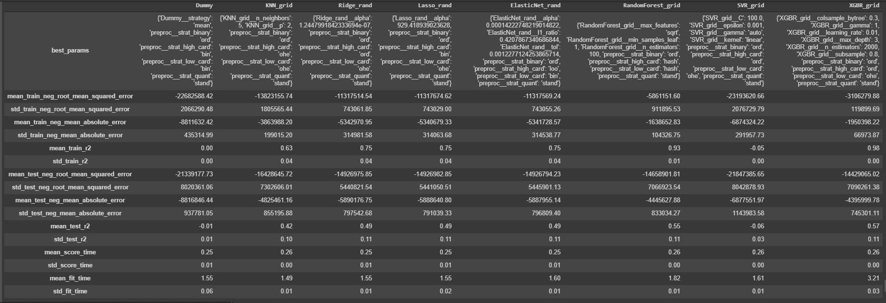
SEU

Slide 7
Dummy 'Dummy'
param_grid={'preproc__strat_binary': ['ord'],
'preproc__strat_low_card': ['bin'], # 'ohe', 'bin', 'ord', 'hash', 'loo'
'preproc__strat_high_card': ['bin'], # 'ohe', 'bin', 'ord', 'hash', 'loo'
'preproc__strat_quant': ['stand'], #'stand', 'minmax', 'maxabs', 'robust', 'norm', 'quant_uni', 'quant_norm', 'pow'
name_reg+'__strategy': ['mean']} # 'mean', 'median'
-----Model not existing - computing... Grid Fitting 5 folds for each of 1 candidates, totalling 5 fits
[Parallel(n_jobs=1)]: Using backend SequentialBackend with 1 concurrent workers. [Parallel(n_jobs=1)]: Done 5 out of 5 | elapsed: 11.3s finished
-----...model dumped
KNN Regressor 'KNN_rand'
param_grid={'preproc__strat_binary': ['ord'],
'preproc__strat_low_card': ['ohe', 'bin', 'ord', 'hash', 'loo'], # 'ohe', 'bin', 'ord', 'hash', 'loo'
'preproc__strat_high_card': ['ohe', 'bin', 'ord', 'hash', 'loo'], # 'ohe', 'bin', 'ord', 'hash', 'loo'
'preproc__strat_quant': ['stand'], # 'stand', 'minmax', 'maxabs', 'robust', 'norm', 'quant_uni', 'quant_norm', 'pow'
name_reg+'__n_neighbors': [1,2,3,5,7,9,11,15,17], # 1,2,3,5,7,9,11,15,17
name_reg+'__p': [1,2]} # 0,1,2
-----Model not existing - computing... Grid Fitting 5 folds for each of 450 candidates, totalling 2250 fits
[Parallel(n_jobs=1)]: Using backend SequentialBackend with 1 concurrent workers. [Parallel(n_jobs=1)]: Done 2250 out of 2250 | elapsed: 87.6min finished
-----...model dumped
Ridge Regression 'Ridge_rand'
param_grid={'preproc__strat_binary': ['ord'],
'preproc__strat_low_card': ['ohe', 'bin'], # 'ohe', 'bin', 'ord', 'hash', 'loo'
'preproc__strat_high_card': ['bin', 'ord', 'hash', 'loo'], # 'ohe', 'bin', 'ord', 'hash', 'loo'
'preproc__strat_quant': ['stand'], # 'stand', 'minmax', 'maxabs', 'robust', 'norm', 'quant_uni', 'quant_norm', 'pow'
name_reg+'__alpha': st.loguniform(1e-7, 1e7)} # np.logspace(-7,7,20) 1,2448e-7
-----Model not existing - computing... Randomized Fitting 5 folds for each of 200 candidates, totalling 1000 fits
[Parallel(n_jobs=1)]: Using backend SequentialBackend with 1 concurrent workers. [Parallel(n_jobs=1)]: Done 1000 out of 1000 | elapsed: 38.5min finished
-----...model dumped
LASSO 'Lasso_rand'
param_grid={'preproc__strat_binary': ['ord'],
'preproc__strat_low_card': ['ohe', 'bin'], # 'ohe', 'bin', 'ord', 'hash', 'loo'
'preproc__strat_high_card': ['bin', 'ord', 'hash', 'loo'], # 'ohe', 'bin', 'ord', 'hash', 'loo'
'preproc__strat_quant': ['stand'], # 'stand', 'minmax', 'maxabs', 'robust', 'norm', 'quant_uni', 'quant_norm', 'pow'
name_reg+'__alpha': st.loguniform(1e-7, 1e7)} 929,42
-----Model not existing - computing... Randomized Fitting 5 folds for each of 200 candidates, totalling 1000 fits
[Parallel(n_jobs=1)]: Using backend SequentialBackend with 1 concurrent workers. [Parallel(n_jobs=1)]: Done 1000 out of 1000 | elapsed: 38.5min finished
-----...model dumped
ElasticNet 'ElasticNet_rand'
param_grid={'preproc__strat_binary': ['ord'],
'preproc__strat_low_card': ['ohe', 'bin'], # 'ohe', 'bin', 'ord', 'hash', 'loo'
'preproc__strat_high_card': ['ord', 'hash', 'loo'], # 'ohe', 'bin', 'ord', 'hash', 'loo'
'preproc__strat_quant': ['stand'], # 'stand', 'minmax', 'maxabs', 'robust', 'norm', 'quant_uni', 'quant_norm', 'pow'
name_reg+'__alpha': st.loguniform(1e-7, 1e7), # np.logspace(-7,7,20) 1,42223e-4
name_reg+'__l1_ratio': st.uniform(0,1), # [0,0.15,0.3,0.45,0.6,0.75,1] 0,421
name_reg+'__tol' : st.loguniform(1e-3, 1e0)} #np.logspace(-4,0,5)} 1,228e-3
-----Model not existing - computing... Randomized Fitting 5 folds for each of 200 candidates, totalling 1000 fits
[Parallel(n_jobs=1)]: Using backend SequentialBackend with 1 concurrent workers. [Parallel(n_jobs=1)]: Done 1000 out of 1000 | elapsed: 38.7min finished
-----...model dumped
Random Forest Regressor 'RandomForest_grid'
param_grid={'preproc__strat_binary': ['ord'],
'preproc__strat_low_card': ['ohe', 'bin', 'hash'], # 'ohe', 'bin', 'ord', 'hash', 'loo'
'preproc__strat_high_card': ['ord', 'hash', 'loo'], # 'ohe', 'bin', 'ord', 'hash', 'loo'
'preproc__strat_quant': ['stand'], # 'stand', 'minmax', 'maxabs', 'robust', 'norm', 'quant_uni', 'quant_norm', 'pow'
name_reg+'__n_estimators': [100,200,500],#,200,500,1000], # nb leaves
name_reg+'__min_samples_leaf': [1,2,5,10], # mean nb leaves in a node
name_reg+'__max_features': ['auto', 'sqrt']}#, 'sqrt']} # 'auto', 'sqrt' (nb features in a tree)
-----Model not existing - computing... Grid Fitting 5 folds for each of 216 candidates, totalling 1080 fits
[Parallel(n_jobs=1)]: Using backend SequentialBackend with 1 concurrent workers. [Parallel(n_jobs=1)]: Done 1080 out of 1080 | elapsed: 69.3min finished
-----...model dumped
Support Vector Machine Regression 'SVR_grid‘
param_grid={'preproc__strat_binary': ['ord'],
'preproc__strat_low_card': ['ohe', 'bin', 'hash'], # 'ohe', 'bin', 'ord', 'hash', 'loo'
'preproc__strat_high_card': ['ord', 'hash', 'loo'], # 'ohe', 'bin', 'ord', 'hash', 'loo'
'preproc__strat_quant': ['stand'], # 'stand', 'minmax', 'maxabs', 'robust', 'norm', 'quant_uni', 'quant_norm', 'pow'
name_reg+'__kernel': ['rbf', 'linear', 'poly'], # kernel coef (radial basis function 'rbf')
name_reg+'__gamma': ['auto'], # np.logspace(-8,0,9), # kernel coef (radial basis function 'rbf')
name_reg+'__epsilon': np.logspace(-3,0,5), 1e-3# accepted error
name_reg+'__C': np.logspace(-2,2,5)} 100 # regularization coef
-----Model not existing - computing... Grid Fitting 5 folds for each of 675 candidates, totalling 3375 fits
[Parallel(n_jobs=1)]: Using backend SequentialBackend with 1 concurrent workers. [Parallel(n_jobs=1)]: Done 3375 out of 3375 | elapsed: 138.3min finished
-----...model dumped
XGBoost Regressor 'XGBR_grid'
param_grid={'preproc__strat_binary': ['ord'],
'preproc__strat_low_card': ['ohe', 'bin', 'hash'], # 'ohe', 'bin', 'ord', 'hash', 'loo'
'preproc__strat_high_card': ['ord', 'hash', 'loo'], # 'ohe', 'bin', 'ord', 'hash', 'loo'
'preproc__strat_quant': ['stand'], # 'stand', 'minmax', 'maxabs', 'robust', 'norm', 'quant_uni', 'quant_norm', 'pow'
name_reg+'__learning_rate': np.logspace(-3,-1,3), 0,01
name_reg+'__n_estimators': [1000,2000], # [100,200,500,1000,2000]
name_reg+'__max_depth': [3,4],
name_reg+'__subsample': [0.8,1],
name_reg+'__colsample_bytree': [0.3,0.8,1], # [0.3,0.5,0.8,0.9,1]
name_reg+'__gamma': [1] }
-----Model not existing - computing... Grid Fitting 5 folds for each of 648 candidates, totalling 3240 fits
[Parallel(n_jobs=1)]: Using backend SequentialBackend with 1 concurrent workers. [Parallel(n_jobs=1)]: Done 3240 out of 3240 | elapsed: 241.0min finished
-----...model dumped

Slide 8
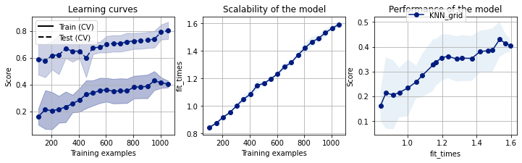
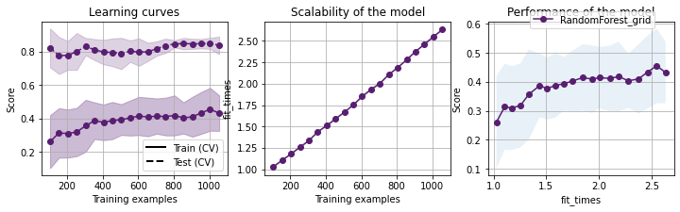
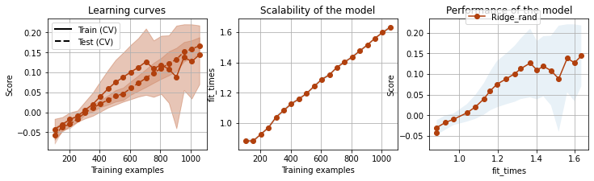
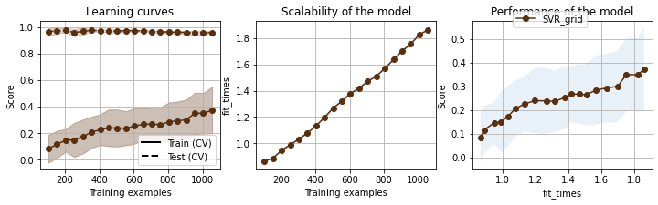
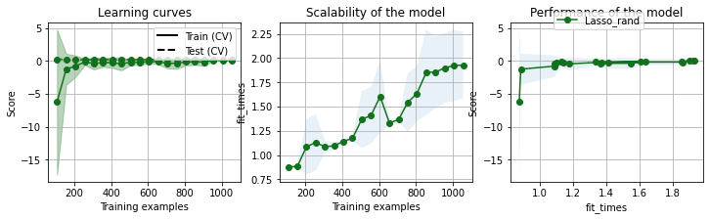
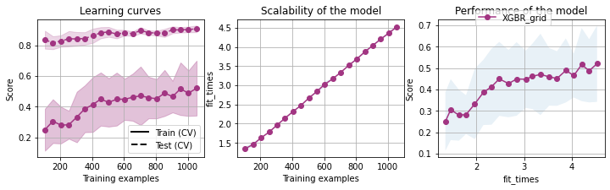
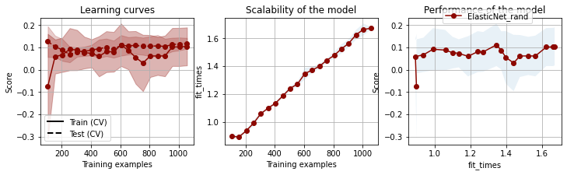
Avec log

Slide 9
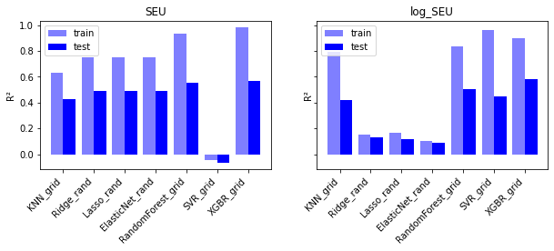

Slide 10
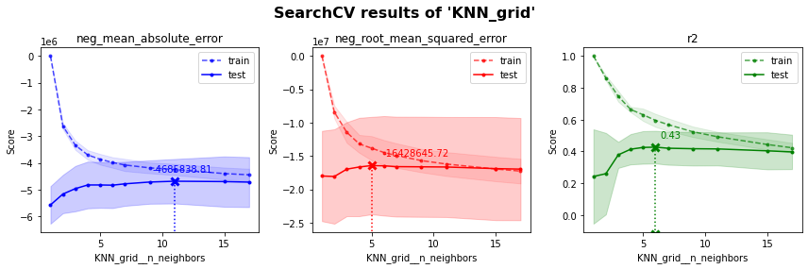
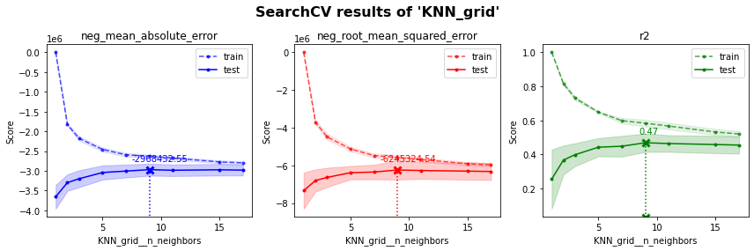
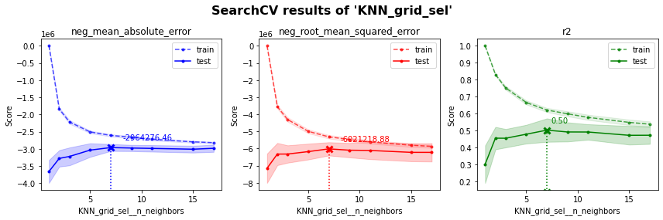
Avec outliers
Sans outliers
Sans outliers et sans mes colonnes

