Slide 1
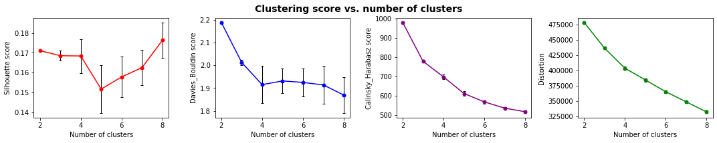
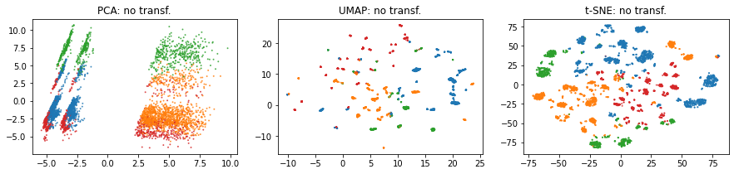
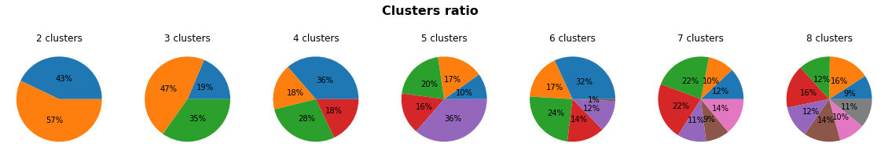
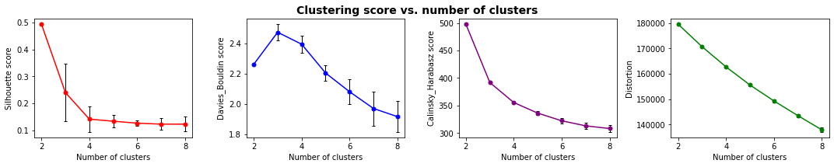
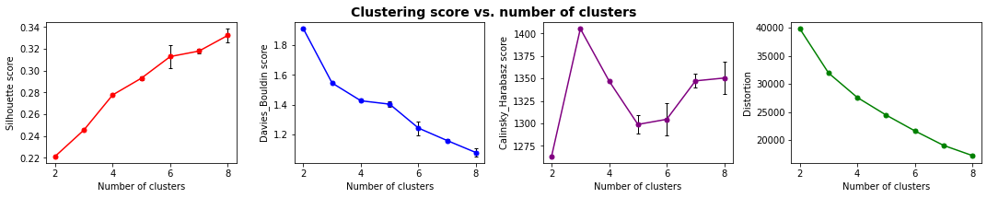
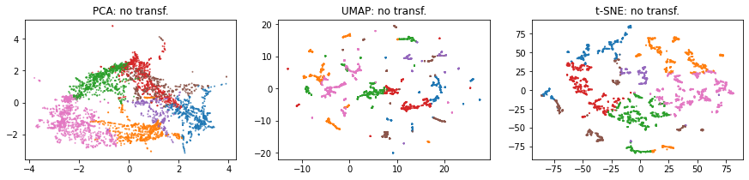
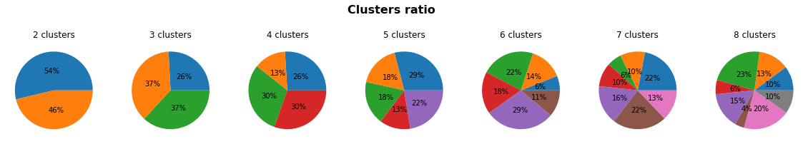
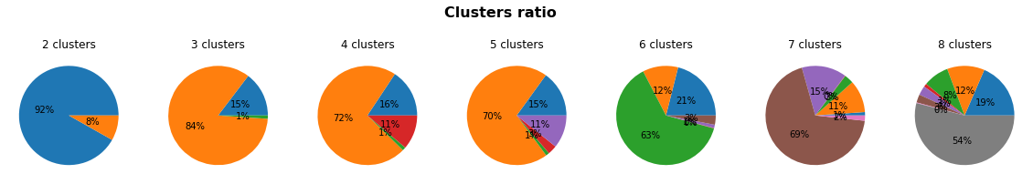
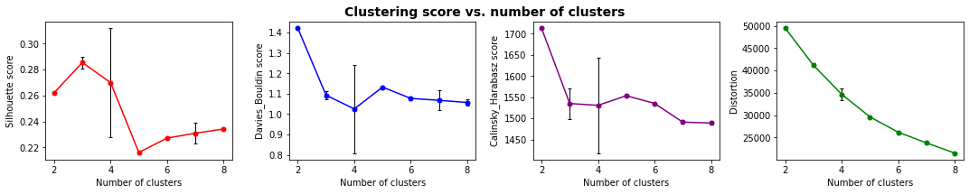
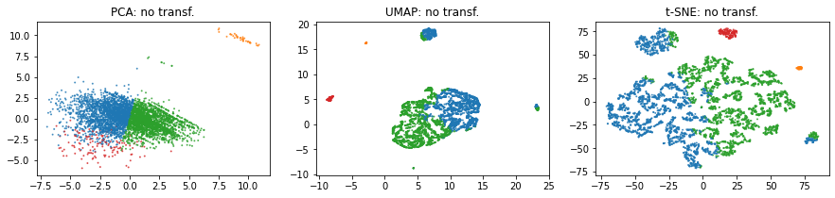
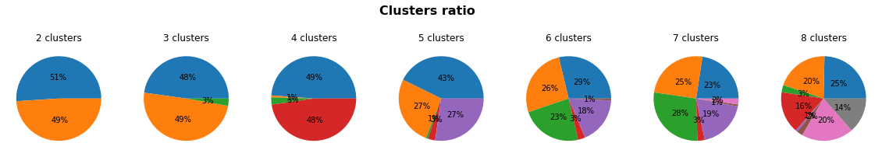
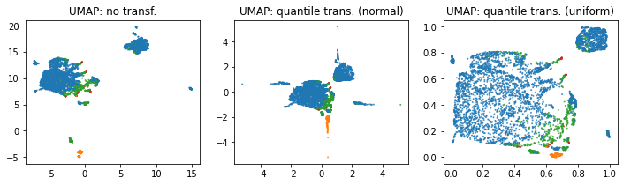
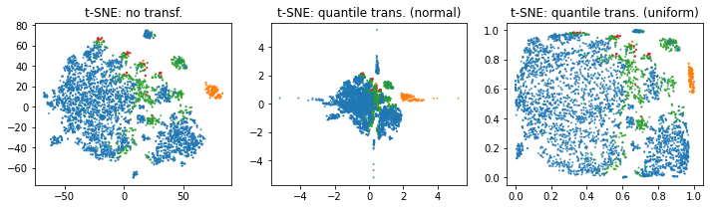
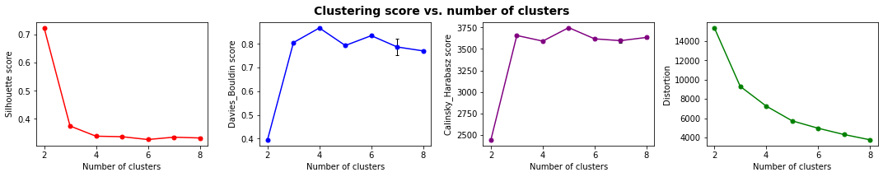
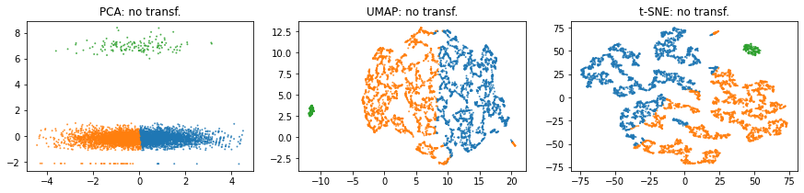
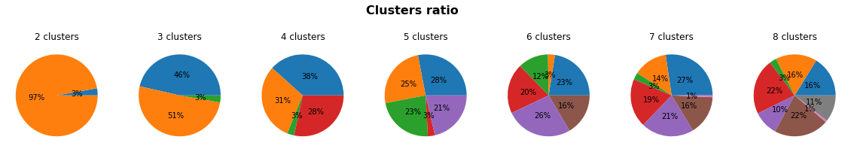
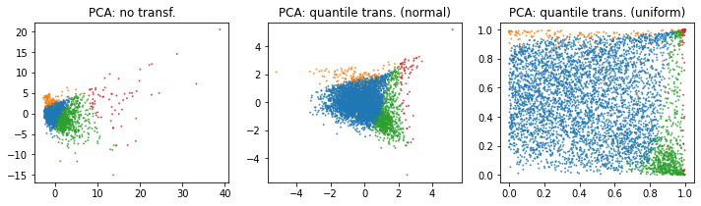
df1 : toutes les colonnes 5000 lignes
1_1, All + quantile transformer - > le moment de la dernière commande et le prix des commandes ne sont pas retenus par le clustering
1_1, All + quantile transformer
2_1, All RFM sauf payments + quantile transformer
2_3, Selection RFM + quantile transformer

Slide 2
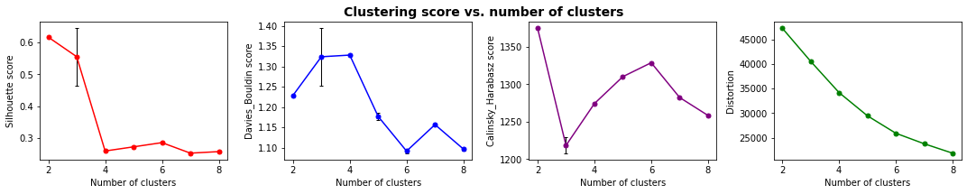
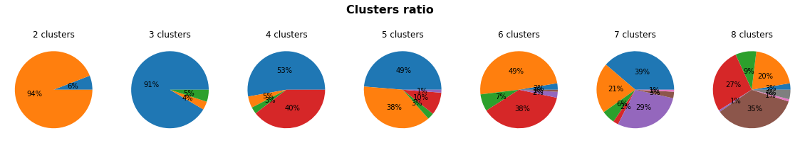
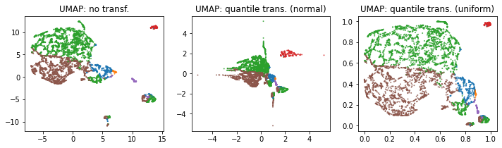
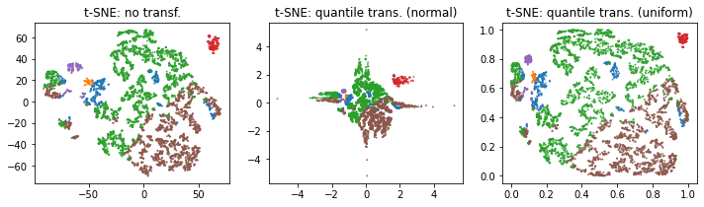
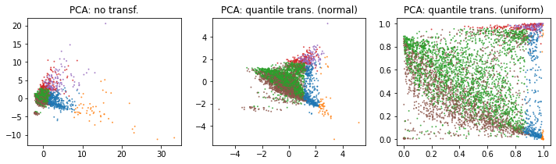
df2 : colonnes RFM 5000 lignes
['time_since_last_purch', 'time_since_first_purch', 'tot_nb_deliv_ord', 'tot_nb_ord', 'single_purch', 'mean_nb_items_per_ord', 'tot_nb_items', 'mean_freight_val_per_order', 'tot_freight_val', 'mean_price_per_order', 'tot_price', 'avg_freight_payval_ratio', 'mean_pay_value_per_order', 'tot_pay_value']

Slide 3
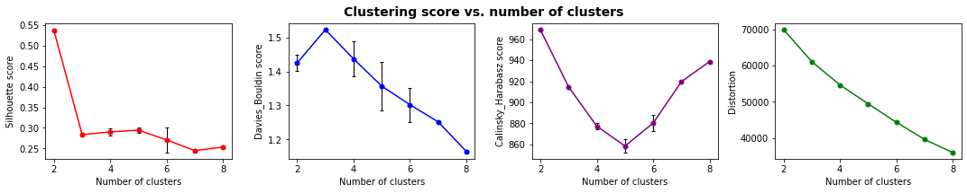
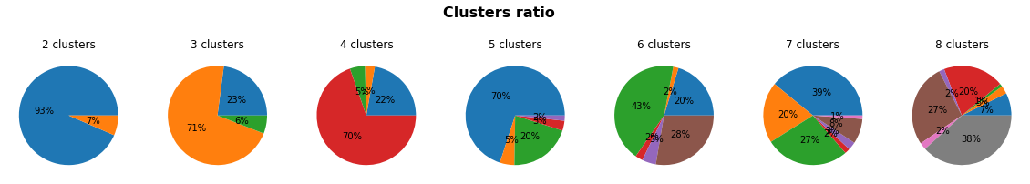
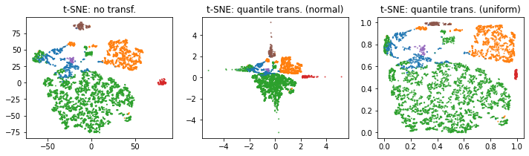
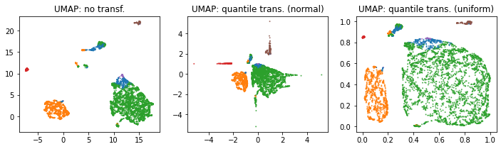
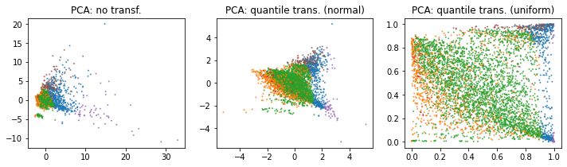
df2bis : colonnes RFM + paytype 5000 lignes
['time_since_last_purch', 'time_since_first_purch', 'tot_nb_deliv_ord', 'tot_nb_ord', 'single_purch', 'mean_nb_items_per_ord', 'tot_nb_items', 'paytype_not_defined_tot_nb', 'paytype_boleto_tot_nb', 'paytype_voucher_tot_nb', 'paytype_debit_card_tot_nb', 'paytype_credit_card_tot_nb', 'mean_pay_install', 'mean_freight_val_per_order', 'tot_freight_val', 'mean_price_per_order', 'tot_price', 'avg_freight_payval_ratio', 'mean_pay_value_per_order', 'tot_pay_value']

Slide 4
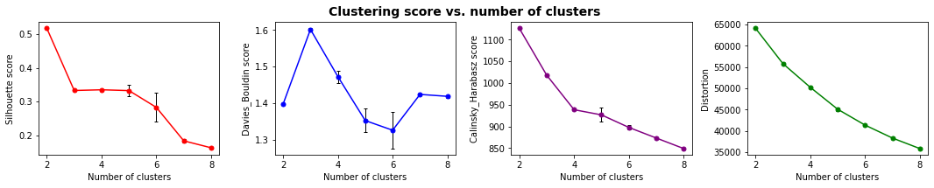
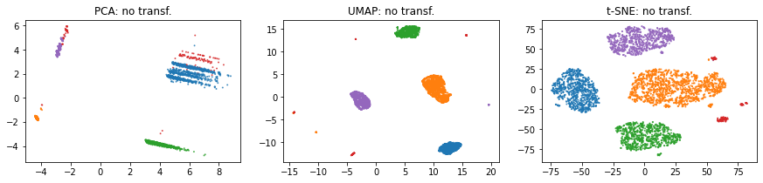
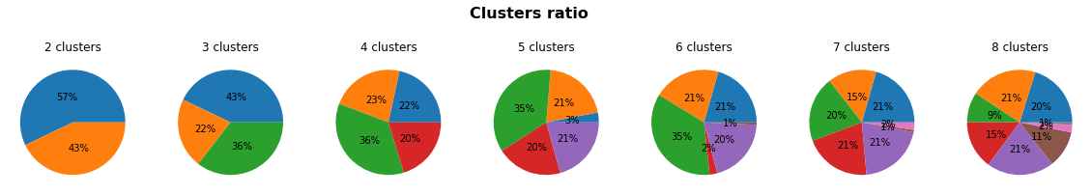
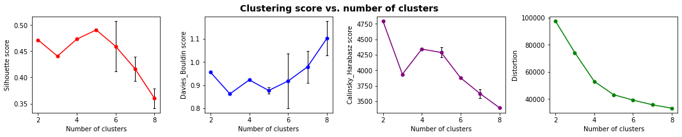
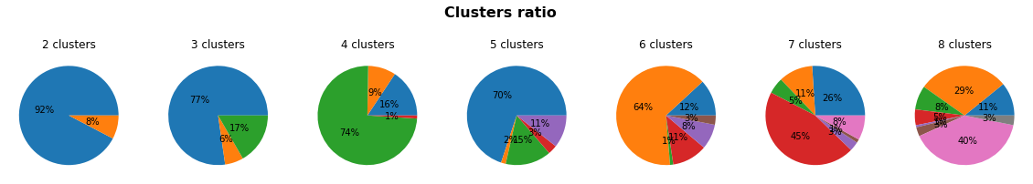
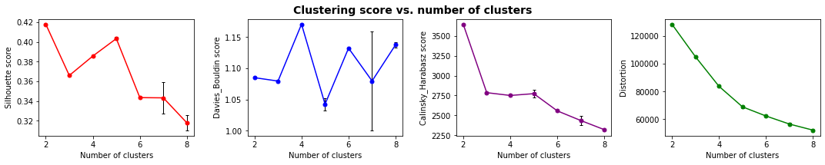
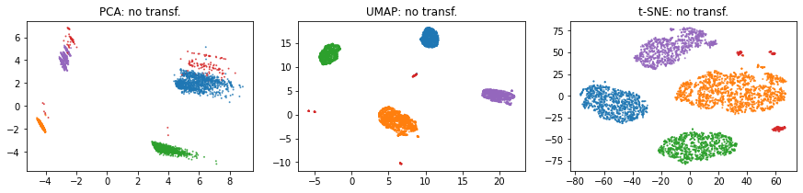
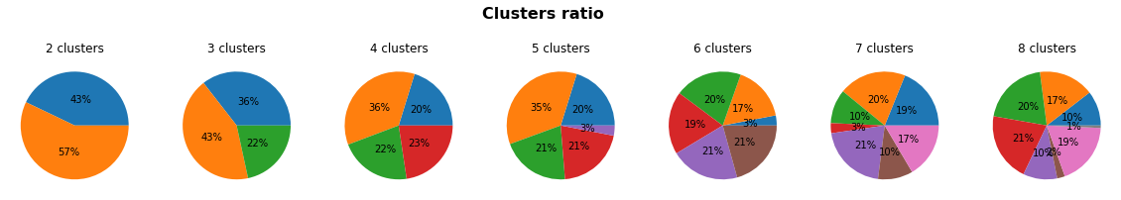
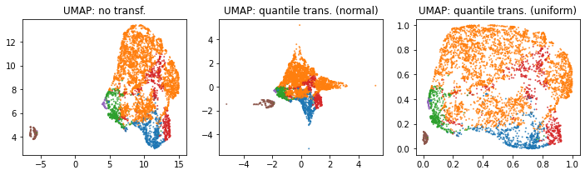
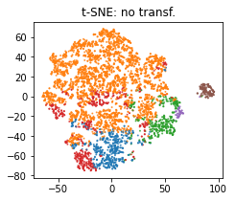
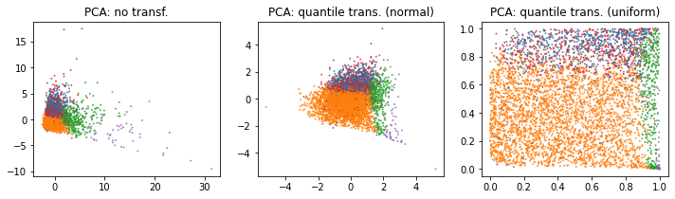
df3 : colonnes prod spec + satisfaction + monetary 5000 lignes
3_3, Selection prod_spec, rev, monet + quantile transformer
3_1, Allprod_spec, rev, monet + quantile transformer
['mean_prod_wei_g', 'nb_not_rec_orders', 'tot_comment_length', 'mean_rev_score', 'mean_freight_val_per_order', 'mean_prod_descr_length', 'mean_comment_length', 'mean_price_per_order', 'mean_ship_delay', 'mean_pay_value_per_order', 'tot_freight_val', 'tot_price', 'tot_pay_value', 'avg_freight_payval_ratio', 'mean_prod_vol_cm3', 'mean_ship_time']]

Slide 5
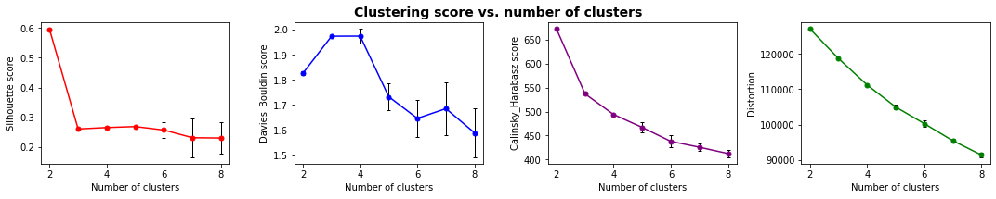
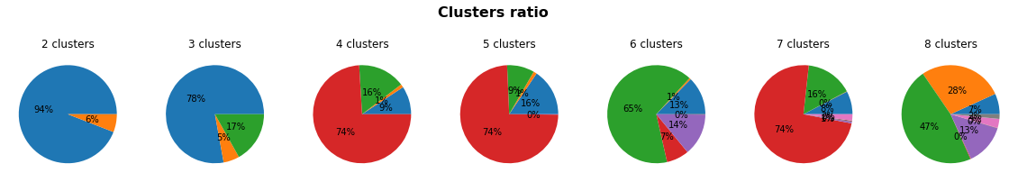
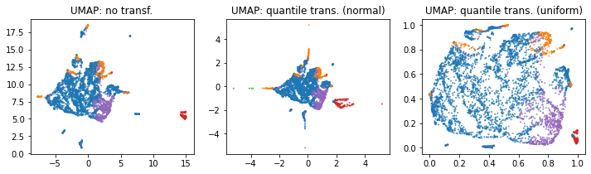
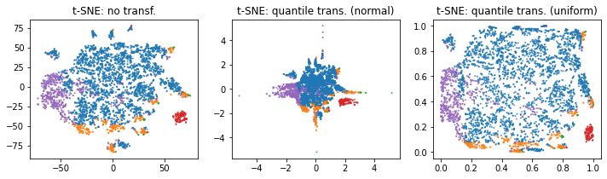
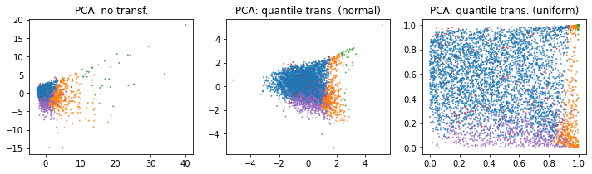
df3bis : colonnes prod spec + cat + satisfaction + monetary 5000 lignes
['tot_pay_value', 'cat_furniture_tot_nb', 'cat_fashion_tot_nb', 'cat_electronics_tot_nb', 'mean_price_per_order', 'mean_ship_delay', 'cat_miscellaneous_tot_nb', 'cat_home_tot_nb', 'mean_pay_value_per_order', 'cat_unknown_tot_nb', 'mean_ship_time', 'cat_books_tot_nb', 'cat_leisure_tot_nb', 'tot_comment_length', 'cat_hygiene_tot_nb', 'mean_prod_vol_cm3', 'cat_multimedia_tot_nb', 'mean_rev_score', 'mean_prod_descr_length', 'mean_comment_length', 'cat_diy_tot_nb', 'mean_prod_wei_g', 'nb_not_rec_orders', 'mean_freight_val_per_order', 'cat_food_tot_nb', 'tot_freight_val', 'tot_price', 'cat_office_tot_nb', 'avg_freight_payval_ratio']

Slide 6
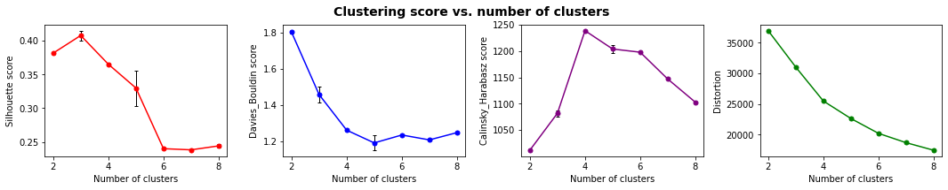
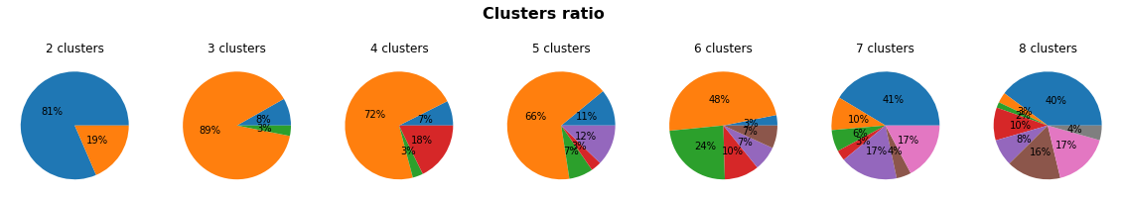
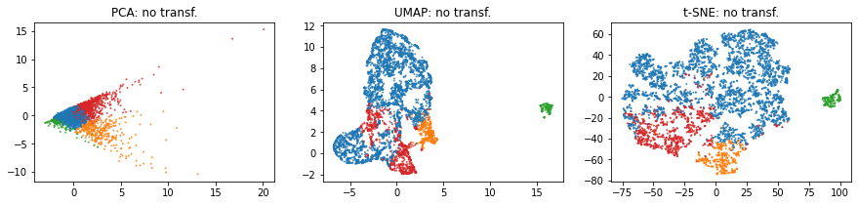
df4 : colonnes 5000 lignes
['avg_freight_payval_ratio', 'tot_freight_val', 'mean_rev_score', 'tot_comment_length', 'mean_ship_delay', 'mean_ship_time',
'nb_not_rec_orders', 'mean_prod_wei_g', 'mean_prod_vol_cm3']

Slide 7
Quantile normalization (norm)
Toutes les variables (produit, paiement, région, satisfaction, rfm)
RFM
Produit satisfaction valeur

Slide 8
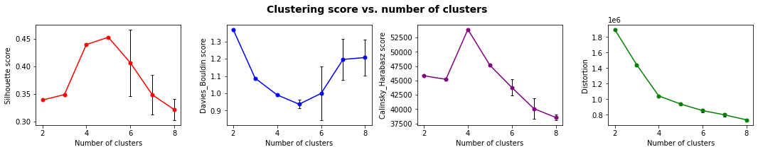
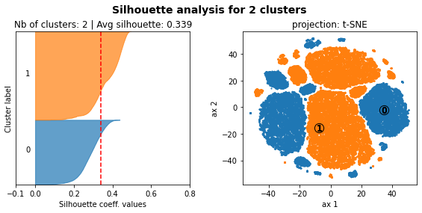
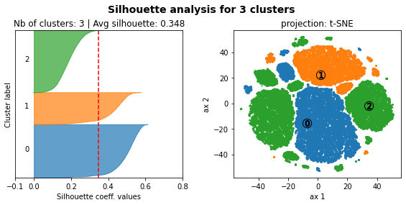
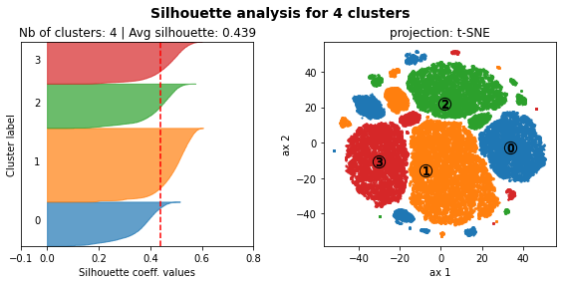



Sélection A, toute la base de données Product related features: 'mean_prod_descr_length', 'mean_prod_wei_g'
Shipping Related features: 'avg_freight_payval_ratio', 'mean_ship_time'
Satisfaction related features: 'tot_comment_length', 'mean_rev_score',
RFM related features (Recency, Frequency, Monetary): 'time_since_last_purch', 'tot_price', 'tot_nb_ord', 'mean_nb_items_per_ord'

Slide 9








Sélection A, toute la base de données Product related features: 'mean_prod_descr_length', 'mean_prod_wei_g'
Shipping Related features: 'avg_freight_payval_ratio', 'mean_ship_time'
Satisfaction related features: 'tot_comment_length', 'mean_rev_score',
RFM related features (Recency, Frequency, Monetary): 'time_since_last_purch', 'tot_price', 'tot_nb_ord', 'mean_nb_items_per_ord'
Retiré ces variables qui ne peuvent pas
être correctement normalisées

