Slide 1
Detours: Binary Interception of Win32 Functions

Slide 2
Problem:
You want to do compelling research!
  You have a great idea for some really
  compelling systems research!
You want it to be relevant!
  You want to prove it on commercial systems
  with commercial applications!
You don’t have source code!
(Or you don’t want to use source code!)

Slide 3
Detours
Is a library for instrumenting and intercepting function calls in Win32 binaries.
Replaces the first instructions of a target function with jmp to a detour function.
Preserves original function semantics through a trampoline function.
Enables interception and instrumentation of Win32 binary programs.

Slide 4
Outline
Motivation & Introduction
Implementation
Demonstration
Related Work
Conclusions

Slide 5
Problem Rephrased:
How do you get your code into an application’s address space?
How do you get your code invoked?

Slide 6
How do you get your code into an application’s address space?
First: Place code into a DLL.
Then do one of the following:
  Link application with your DLL.
    Only works if you have .obj files.
  Modify application .imports to include DLL.
    Detours includes routines for editing .imports.
  Inject DLL into running process.
    Detours calls OpenProcess(), VirtualAllocEx(), WriteProcessMemory(), and CreateRemoteThread()
  Inject DLL into process at creation time.
    Detours calls CreateProcess() w/ CREATE_SUSPENDED.

Slide 7
Rewriting a Binary:
COFF Header
COFF Header
.text
.text
.data
.data
.imports
.imports
.exports
.exports
.detour Header
.imports
Payload
Payloads

Slide 8
How do you get your code invoked?
Replace first instructions of target with a jump to the detour.
Insert replaced instructions into trampoline.
Trampolines can be allocated and initialized either statically or dynamically (see paper for dynamic).

Slide 9
Detouring a Function:
Before:
After:
;; Target Function
Sleep:
push ebp [1 byte]
mov ebp,esp [2 bytes]
push ebx [1 bytes]
push esi [1 byte]
push edi
....
;; Trampoline Function
UntimedSleep:
jmp Sleep
;; Detour Function
TimedSleep:
....
;; Target Function
Sleep:
jmp TimedSleep [5 bytes]
push edi
....
;; Trampoline Function
UntimedSleep:
push ebp
mov ebp,esp
push ebx
push esi
jmp Sleep+5
;; Detour Function
TimedSleep:
....

Slide 10
Invoking Your Code:
Before:
1. Call
Start
Target
2. Return
After:
1. Call
2. Jump
3. Call
4. Jump
Start
Target
Detour
Trampoline
Target
6. Return
5. Return

Slide 11
An Entire Example: SleptTicks
1: #include <windows.h>
2: #include <detours.h>
3: LONG slept = 0;
4: __declspec(dllexport) DETOUR_TRAMPOLINE(VOID WINAPI UntimedSleep (DWORD), Sleep);
5: __declspec(dllexport) VOID WINAPI TimedSleep(DWORD dwMilliseconds)
6: {
7: DWORD begin = GetTickCount ();
8: UntimedSleep ( dwMilliseconds );
9: InterlockedExchangeAdd ( &slept, GetTickCount() – begin );
10: }
11: __declspec(dllexport) DWORD WINAPI GetSleptTicks()
12: {
13: return slept;
14: }
15: BOOL WINAPI DllMain(HINSTANCE hinst, DWORD reason, LPVOID reserved)
16: {
17: if ( reason == DLL_PROCESS_ATTACH )
18: DetourFunctionWithTrampoline ( UntimedSleep, TimedSleep );
19: if ( reason == DLL_PROCESS_DETACH )
20: DetourRemoveTrampoline ( UntimedSleep );
21: }

Slide 12
Micro-Benchmark Performance:
Interception Technique | Intercepted Function
 | Empty Function |  | CoCreateInstance
 | Time | Overhead | Time | Overhead
Direct | 113 ns | n/a | 14.8 μs | n/a
Call Replacement | 143 ns | 30 ns | 15.2 μs | 360 ns
DLL Redirection | 143 ns | 30 ns | 15.2 μs | 360 ns
Detour | 145 ns | 32 ns | 15.2 μs | 360 ns
Breakpoint Trap | 230k ns | 229k ns | 265.9 μs | 265k ns
Overhead: 6 cycles for Empty Function
71 cycles for CoCreateInstance (5 Args.)
1 cache line

Slide 13

Coign: ADPS using Detours
Convert desktop applications into distributed applications from binary files.
1. Find Objects in Application
2. Identify Interfaces and
Measure Communication
3. Partition and Distribute
Notes:
Starting with the application binaries, Coign isolates the COM components in the executable, identifies the interconnecting COM interfaces, and measures inter-component communication through scenario-based profiling.
Coign then cuts the application into client and server components; choosing a distribution that minimizes communication latency.

Slide 14
Coign: COM API Extension
Profiling:
Distributed Execution:
Application
Application
Coign Profiling
Runtime
Coign Distributed
Runtime
COM APIs
Windows NT
COM APIs
Windows NT
COM APIs
Windows NT

Slide 15
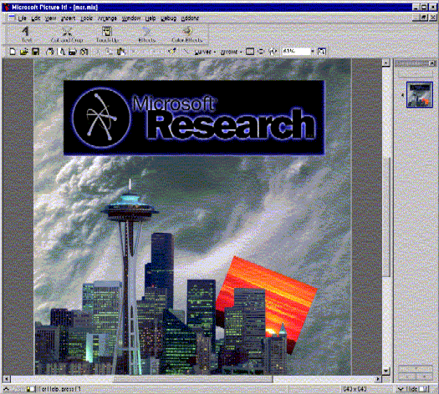
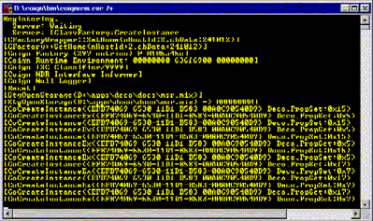
Coign Demo

Slide 16
Other Applications of Detours
Detailed Analysis of DCOM (Millennium Falcon).
  Intercept entry-points between DCOM layers.
Distributed COM-based Win32 API (COP).
  Intercept large subset of Win32 API.
First-Chance Exception Filter
  Intercept KiUserExceptionDispatcher.
Debugger support for non-standard loaders
  Intercept WaitForDebugEvent (DebugString event to LoadDll event).
API Trace Facility.
Test Harnesses.
DLL Versioning
  Attach manifest payload to binaries.

Slide 17
Related Work
Code Patching [Gill ’51]
  Age-old technique for modifying binaries.
  Jump to patch, then either return or jump to target.
Binary Rewriters [Atom ’94, Etch ’97, EEL ’95]
  Static binary rewriters.
  Register allocation
    For Detours the target, detour, and trampoline maintain same call signature to ensure registers are automatically preserved by compiler.
  Fine granularity: instructions & basic blocks.
DyninstAPI [Hollingsworth & Buck ’98]
  Dynamic binary rewriter.
Mediating Connectors [Balzer & Goldman, 1999]
  DLL Redirection.

Slide 18
Conclusions:
Detours provides fast (<100 cycles), light (<18KB .lib), flexible library for instrumenting Win32 binaries.
Trampoline preserve target semantics.
Enables compelling systems research.

