Slide 1
Mastercard Data Quest 2026
Hidden Entrepreneur Detection
10 Behavioral Paradoxes · Cross-border Sourcing · AUC-ROC · Target Product
Genius Level — Complete solution with step-by-step explanations
Team MQD_2026 | May 2026

Slide 2
Table of Contents
Complete breakdown — 31 slides
01
1. Problem Statement — what are we solving and why
2. Data — sources, sizes, structure
3. Loading + concat + merge — simple explanation with example
4. Label — what is it and why?
5. MCC Categories — business, wholesale, logistics, fuel, SaaS/Ads
6. Behavioral Paradoxes — 10 + cross-border:
6a. Clockwork Buyer 6b. Off-Hours Operator
6c. Expense Ratio Inversion 6d. Token Wholesale
6e. Baseline Aggregations 6f. Supplier Fingerprint
6g. Last-Mile Echo 6h. Round-Trip Cash Flow
6i. Inventory Pulse 6j. Multi-Vendor Loyalty
6k. Channel Schizophrenia 6l. Cross-border Sourcing
7. Feature Assembly — 35 features, fillna, dropna
8. CatBoost — why this model, training, parameters
9. 5-Fold Cross-Validation — stability check
10. Results — AUC 1.0, Confusion Matrix, where numbers come from
11. Feature Importance — top-15, what each means
12. SHAP — explaining every prediction
13. Top-100 Hidden Entrepreneurs + Target Product
14. Columns we DON'T use and why (comparison)
15. Technical problems — merge_asof, Round-Trip, pandas 3.0
16. Conclusions — what we achieved, what matters

Slide 3
Problem Statement
What we are solving and why
02
📌 The Problem (simple terms):
We have 80,000 consumer cards (ordinary people).
But SOME owners use them for BUSINESS — buying goods
wholesale, paying for ads, hiring delivery.
The bank can't see this — the card is 'personal'.
Task: find these 'hidden entrepreneurs'.
📌 What we are given:
• 3 million transactions from KNOWN business cards (ground truth)
• 9.8 million transactions from consumer cards (search here)
• Merchant reference directory — who is who
📌 Why AUC-ROC instead of Accuracy?
• If we say 'everyone is consumer', Accuracy = 76%,
but we find nobody. Accuracy is a bad metric.
• AUC-ROC = how well the model DISTINGUISHES
business from consumer. 1.0 = perfect.
📌 What are 'Behavioral Paradoxes'?
They are 10 BEHAVIOR PATTERNS that exist in business cards
but are almost absent in consumer cards. If a consumer card
behaves like a business card — it's a 'hidden entrepreneur'.
🎯 IN SIMPLE TERMS:
Imagine: you see a person in a store.
They buy 1 loaf of bread → consumer.
They buy 100 boxes of cookies → businessperson.
But what if they bought 100 boxes of cookies
with a personal card? The bank only sees:
'Card X spent 50,000 KZT at a supermarket'.
Our model looks NOT at the amount,
but at PATTERNS:
• Do they buy regularly?
• Outside working hours?
• Wholesale or retail?
• Do they switch channels?
• Do they pay abroad?
10 paradoxes = 10 different views
on a card's behavior.

Slide 4
Data — sources, sizes, structure
3 parquet files, 12.8M rows
03
📁 business_cards_MDQ.parquet — 2,997,593 rows, 25,000 cards
Known business cards. label = 1 (ground truth)
📁 consumer_cards_MDQ.parquet — 9,832,487 rows, 80,000 cards
Consumer cards. label = 0 (search here)
📁 merchants_reference.parquet — 2,165 merchant directory
📊 Total: 12,830,080 rows, 105,000 unique cards
📊 Class balance: 76% consumer vs 24% business
# Read only the columns we need
BIZ_COLS = ["transaction_date","transaction_timestamp",
"transaction_amount_kzt","mcc","merchant_id",
"channel","card_number","tokenized",
"is_recurring","country"]
biz = pd.read_parquet("business_cards_MDQ.parquet",
columns=BIZ_COLS)
con = pd.read_parquet("consumer_cards_MDQ.parquet",
columns=CON_COLS)
# Merchant directory (all columns)
bus = pd.read_parquet("merchants_reference.parquet")
💡 IN SIMPLE TERMS:
What is pd.read_parquet? It's like opening an Excel file, but much faster.
Parquet is a columnar storage format — more efficient than CSV.
We read ONLY the columns we need (columns=...) to save memory.
Each row = 1 transaction. One card can have from 1 to 10,000+ transactions.
There are FEWER business cards (25,000), but they are more active — 3M transactions.
There are MORE consumer cards (80,000), but each does fewer transactions — 9.8M.
IMPORTANT: business_cards contains transactions from KNOWN business cards.
consumer_cards contains transactions from ordinary people.
BUT some of them are hidden entrepreneurs (they just got a personal card
and use it for business).

Slide 5
Concatenation — merging 2 tables into 1
pd.concat in simple words + data example
04
# STEP 1: assign labels
biz["label"] = 1 # business
con["label"] = 0 # consumer
# STEP 2: pick only needed columns
cols = BIZ_COLS + ["label"]
biz_subset = biz[cols]
con_subset = con[cols]
# STEP 3: concatenate
df = pd.concat([biz_subset, con_subset],
ignore_index=True)
print(f"Total rows: {len(df):,}")
print(f"label=1 (biz): {(df['label']==1).sum():,}")
print(f"label=0 (con): {(df['label']==0).sum():,}")
# STEP 4: merge merchant info
df = df.merge(
bus[["merchant_id","mcc","merchant_country",
"recurring_capable","merchant_name"]],
on=["merchant_id","mcc"], how="left"
)
🧩 IN SIMPLE TERMS:
pd.concat = glue two tables together, one on top of the other.
We had 2 separate files: business and consumer.
We place one ABOVE the other — we get one big table.
ignore_index=True = reset old indices, create new 0,1,2,...
label = 1 — 'this is a business card'. label = 0 — 'this is a consumer card'.
The model will learn: what features distinguish label=1 from label=0.
Then it will look at consumer cards and say: 'this one looks like business'.
BEFORE:
biz (first 3 rows):
card_number | mcc | amount | label
5200000000000001 | 7311 | 150000 | 1
5200000000000001 | 4214 | 45000 | 1
5200000000000002 | 5021 | 89000 | 1
con (first 3 rows):
card_number | mcc | amount | label
4100000000000001 | 5812 | 3500 | 0
4100000000000001 | 5812 | 1200 | 0
4100000000000002 | 5411 | 8900 | 0
AFTER:
df AFTER concat (first 6 rows):
card_number | mcc | amount | label
5200000000000001 | 7311 | 150000 | 1
5200000000000001 | 4214 | 45000 | 1
5200000000000002 | 5021 | 89000 | 1
4100000000000001 | 5812 | 3500 | 0
4100000000000001 | 5812 | 1200 | 0
4100000000000002 | 5411 | 8900 | 0
Total: 12,830,080 rows!
Now all data is in one place.

Slide 6
MCC Categories
Classifying transactions: business, wholesale, logistics
05
# BUSINESS TRANSACTIONS (everything for business)
BUSINESS_MCCS = {
"7311","7372","5968","4816","4812","4814",
"7379","5734","7392","7399","8931","8111",
"8911","7361","5021","5044","5045","5046",
"5111","5943","5099","5199","5131","5137",
"5139","5169","5172","5193","5039","5065",
"5072","5085","5211","5231","4214","4215",
"4225","4011","4511","7011","4722","4723",
"7394","7512","6381","7321","7333","7338",
"7298","7299","5199","5261","5122","5200",
}
# WHOLESALE PRODUCT PURCHASES
WHOLESALE_PROD_MCCS = {"5021","5039","5044","5045",
"5046","5065","5072","5085","5099","5111",
"5122","5131","5137","5139","5169","5172",
"5193","5199","5200","5211","5231",
}
# LOGISTICS + FUEL
LOGISTICS_MCCS = {"4214","4215","4225","4011"}
FUEL_MCCS = {"5541","5542","5983"}
# SAAS / ADVERTISING (for cross-border)
SAAS_AD_MCCS = {"7311","7372","5968","4816",
"7379","5734"}
🏷️ IN SIMPLE TERMS:
MCC = Merchant Category Code — a code identifying the type of store.
It's like 'departments in a supermarket': 7311 = advertising,
4214 = freight, 5812 = restaurant, 5411 = grocery.
We split all MCCs into 4 groups:
🏢 BUSINESS_MCCS — everything a business needs (ads,
IT, telecom, wholesale, logistics, legal, hotels)
📦 WHOLESALE — wholesale goods (building materials,
electronics, furniture, industrial equipment)
🚚 LOGISTICS — freight, warehouses, railway
⛽ FUEL — vehicle fuel
💻 SAAS_AD — software, ads, cloud (for cross-border)
WHY? To calculate features separately for each group.
For example: 'wholesale spend ratio' = WHOLESALE spend / total spend.
🧮 CALCULATION WALKTHROUGH:
Example: transaction with MCC=5021 (building materials)
Check: is 5021 in WHOLESALE_PROD_MCCS? → YES
So this is a wholesale purchase. Count in wholesale_spend.
If MCC=7311 (ads) AND merchant country ≠ card country:
→ this is a cross-border SaaS/Ads transaction.
Count in cb_saas_ad_count.
If MCC=5812 (restaurant):
→ this is a consumer transaction. Not counted in paradox features.

Slide 7
Clockwork Buyer — Purchase Regularity
Paradox 1: Entrepreneurs buy like clockwork
06
# Sort by (card, MCC, time)
df.sort_values(["card_number","mcc",
"transaction_timestamp"], inplace=True)
# Calculate interval between purchases of same MCC
df["interval_hours"] = df.groupby(
["card_number","mcc"]
)["transaction_timestamp"].diff().dt.total_seconds() / 3600
# CV = std/mean for each (card, MCC) pair
cv_per = df.dropna(subset=["interval_hours"]).groupby(
["card_number","mcc"]
)["interval_hours"].agg(
lambda x: x.std()/x.mean() if x.mean()>1e-9 else np.nan
).rename("cv").reset_index()
# Average CV across all MCCs for each card
clockwork_cv_mean = cv_per.groupby(
"card_number")["cv"].mean()
# How many MCCs have non-zero CV
clockwork_mcc_count = cv_per.dropna(
subset=["cv"]).groupby("card_number")["cv"].count()
💡 IN SIMPLE TERMS:
IDEA: An entrepreneur orders goods every Monday.
A consumer visits stores 'whenever they feel like'.
We measure: HOW REGULAR are the intervals between purchases.
HOW WE CALCULATE (example):
Card X bought office supplies (MCC=5111):
Jan 1 → Jan 8 → Jan 15 → Jan 22 (every week)
Intervals: 7, 7, 7 days. CV = 0/7 = 0 → PERFECT
Card Y bought office supplies:
Jan 1 → Feb 3 → Mar 10 → Apr 5
Intervals: 33, 35, 26 days. CV = 4.7/31 = 0.15 → still regular
Card Z: Jan 1 → Mar 20 → Apr 2 → Dec 15
Intervals: 78, 13, 257 days. CV = large → CHAOTIC
Lower CV → more regular purchasing → entrepreneur
Higher CV → chaotic purchasing → consumer
BEFORE:
AFTER:
RESULTING FEATURES (per card):
card_number | clockwork_cv_mean | clockwork_mcc_count
5200000001 | 0.05 | 8
5200000002 | 0.12 | 5
4100000001 | 0.89 | 2
4100000002 | 1.45 | 1
Business (5200...): low CV (0.05-0.12), many MCCs (5-8)
Consumer (4100...): high CV (0.89-1.45), few MCCs (1-2)

Slide 8
Off-Hours Operator — Purchases outside 9-18
Paradox 2: Business doesn't sleep before 9am and after 7pm
07
# Extract hour from timestamp
df["txn_hour"] = df["transaction_timestamp"].dt.hour
# Define off-hours (before 9 or after 19)
df["is_off_hours"] = (df["txn_hour"] < 9) | \
(df["txn_hour"] >= 19)
# Count business transactions during off-hours
off_hours_biz = df[df["is_business_mcc"] & \
df["is_off_hours"]].groupby("card_number").size()
# All business transactions
biz_mcc_txns = df[df["is_business_mcc"]] \
.groupby("card_number").size()
# Share of off-hours among business transactions
off_hours_ratio = (off_hours_biz / biz_mcc_txns) \
.rename("off_hours_ratio").fillna(0.0)
# Total transactions during off-hours
off_hours_total = df[df["is_off_hours"]] \
.groupby("card_number").size() \
.rename("off_hours_total_count")
💡 IN SIMPLE TERMS:
IDEA: Entrepreneurs order goods outside working hours —
early morning (6-8am), late evening (8-11pm), weekends.
Consumers shop during the day (12-6pm).
HOW WE CALCULATE (example):
From each transaction we extract the HOUR (0-23):
transaction_timestamp = '2026-01-15 07:30:00' → hour = 7
Hour < 9 or >= 19? 7 < 9 → YES → off_hours
Card A (business): 100 business transactions,
70 of them during off-hours. off_hours_ratio = 70/100 = 0.70
Makes sense: store owner orders goods
in the morning before opening.
Card B (consumer): 50 business transactions,
5 during off-hours. off_hours_ratio = 5/50 = 0.10
Consumer occasionally pays for a subscription at night.
BEFORE:
AFTER:
CALCULATION EXAMPLE for card 4100000001:
Transactions (with hour):
txn_1: 2026-01-15 07:30 → hour=7 → off_hours
txn_2: 2026-01-15 14:20 → hour=14 → NOT off_hours
txn_3: 2026-01-16 21:15 → hour=21 → off_hours
txn_4: 2026-01-17 08:45 → hour=8 → off_hours
txn_5: 2026-01-18 12:00 → hour=12 → NOT off_hours
off_hours_ratio = 3/5 = 0.60
total_txns = 5
overall_off_hours_ratio = 3/5 = 0.60

Slide 9
Expense Ratio Inversion — Expense Inversion
Paradox 3: Entrepreneurs spend more on goods than on themselves
08
# Total spend per card
total_spend = df.groupby("card_number") \
["transaction_amount_kzt"].sum() \
.rename("total_spend_kzt")
# Wholesale spend per card
wholesale_spend = df[
df["mcc"].isin(WHOLESALE_PROD_MCCS)
].groupby("card_number")[
"transaction_amount_kzt"
].sum().rename("wholesale_spend_kzt")
# Wholesale share of total spend
wholesale_spend_ratio = (
wholesale_spend / total_spend
).rename("wholesale_spend_ratio").fillna(0.0)
# Log of wholesale spend (smoothing)
wholesale_spend_log = np.log1p(
wholesale_spend
).rename("wholesale_spend_log")
💡 IN SIMPLE TERMS:
IDEA: A consumer spends 90% on food, clothes, entertainment
(MCC: 5411, 5812, 5651, 7841...). Only 10% on 'business'.
An entrepreneur does the opposite: 60-80% of spending is
wholesale purchases of goods (MCC: 5021, 5044, 5111...).
HOW WE CALCULATE (example):
Card A (business): total spent 5,000,000 KZT.
Of that, on wholesale MCCs: 3,500,000 KZT.
wholesale_spend_ratio = 3.5M/5M = 0.70 (70%)
Card B (consumer): total spent 500,000 KZT.
Of that, on wholesale MCCs: 20,000 KZT.
wholesale_spend_ratio = 20K/500K = 0.04 (4%)
Higher ratio → more resembles an entrepreneur
BEFORE:
AFTER:
EXAMPLE: why log1p?
Card A spent 10,000,000 KZT wholesale
Card B spent 50,000 KZT wholesale
That's a 200x difference!
log1p(10M) = 16.1, log1p(50K) = 10.8
Only 1.5x difference → the model won't
be overwhelmed by millionaires

Slide 10
Token Wholesale — Tokenized Wholesale
Paradox 4: Large wholesale via Apple/Google Pay
09
# Filter: wholesale + tokenized
token_wholesale = df[
df["mcc"].isin(WHOLESALE_PROD_MCCS)
& (df["tokenized"] == True)
].copy()
# 90th percentile of business cards
biz_token = token_wholesale[
token_wholesale["label"] == 1
]
p90 = biz_token["transaction_amount_kzt"] \
.quantile(0.90)
# Flag: does the card have any such transaction?
token_wholesale_flag = (
token_wholesale[
token_wholesale["transaction_amount_kzt"] > p90
].groupby("card_number").size().gt(0)
.astype(int).rename("token_wholesale_flag")
)
# Count: how many such transactions?
token_wholesale_count = (
token_wholesale[
token_wholesale["transaction_amount_kzt"] > p90
].groupby("card_number").size()
.rename("token_wholesale_count")
)
💡 IN SIMPLE TERMS:
IDEA: Entrepreneurs pay suppliers via token
(Apple Pay, Google Pay, Samsung Pay) — fast and convenient
for frequent purchases. Consumers mostly tokenize
small everyday transactions.
HOW WE CALCULATE:
1) Take ONLY wholesale MCCs + tokenized = True
2) Among business cards, find the 90th percentile amount:
(90% of business transactions are BELOW this amount)
= 470,088 KZT ≈ $1,150
3) If a consumer card has a wholesale tokenized
transaction ABOVE this threshold → hidden entrepreneur
WHY THE 90TH PERCENTILE?
It represents a 'very large purchase' that an ordinary person
wouldn't make with a token. But an entrepreneur would (restocking).
BEFORE:
AFTER:
Example: consumer card 4100000001:
Wholesale transaction 500,000 KZT, tokenized=True
500K > 470K (business 90th percentile)
→ token_wholesale_flag = 1
→ LIKELY A HIDDEN ENTREPRENEUR
Example: consumer card 4100000002:
No wholesale tokenized transactions at all
→ token_wholesale_flag = 0
→ ordinary consumer

Slide 11
Baseline Aggregations — Basic Statistics
The most important features (tokenized_ratio = 26% importance!)
10
card_agg = df.groupby("card_number").agg(
amount_mean=("transaction_amount_kzt","mean"),
amount_std =("transaction_amount_kzt","std"),
amount_sum =("transaction_amount_kzt","sum"),
amount_max =("transaction_amount_kzt","max"),
n_unique_mcc=("mcc","nunique"),
n_unique_merchants=("merchant_id","nunique"),
n_online=("channel",
lambda x:(x=="online").sum()),
n_pos=("channel",
lambda x:(x=="POS").sum()),
tokenized_txn_count=("tokenized","sum"),
recurring_count=("is_recurring","sum"),
)
# Share of online transactions
card_agg["online_ratio"] = card_agg["n_online"] / (
card_agg["n_online"] + card_agg["n_pos"]
)
# Share of tokenized transactions
card_agg["tokenized_ratio"] = (
card_agg["tokenized_txn_count"] / total_txns
)
# Log of MCC count (smoothing)
card_agg["n_unique_mcc_log"] = np.log1p(
card_agg["n_unique_mcc"]
)
💡 IN SIMPLE TERMS:
IDEA: Beyond smart paradoxes, we need basic data:
• Total number of transactions?
• Average/Max amount?
• How many different stores? MCCs?
• Online vs POS ratio?
• Share of tokenized payments?
THESE FEATURES TURNED OUT TO BE THE MOST IMPORTANT:
tokenized_ratio (26.3%) — business cards pay almost
everything via token. Consumer — cash/card.
online_ratio (20.3%) — business orders online,
consumer goes to the store.
TOGETHER = 46.6% of ALL model importance!
Paradoxes complement, but baseline is the foundation.
BEFORE:
AFTER:
EXAMPLE (typical values):
Feature | Business | Consumer
tokenized_ratio | 0.65-0.85 | 0.05-0.15
online_ratio | 0.70-0.90 | 0.20-0.40
amount_mean | 25,000+ | 3,000-8,000
amount_sum | 2M+ KZT | 200-500K KZT
n_unique_merchants | 50-200 | 10-50
Huge gap! This is why
tokenized_ratio is #1 in importance.

Slide 12
Supplier Fingerprint — Vendor Concentration
Paradox 5 (NEW): Entrepreneur = 3-5 key suppliers
11
# Spend per (card, merchant) pair
merchant_spend = df.groupby(
["card_number","merchant_id"]
)["transaction_amount_kzt"].sum().reset_index()
# Top-3 supplier share of total spend
def _top3_share(g):
total = g["transaction_amount_kzt"].sum()
if total == 0: return 0.0
top3 = g.nlargest(3, "transaction_amount_kzt") \
["transaction_amount_kzt"].sum()
return top3 / total
vendor_concentration = merchant_spend \
.groupby("card_number") \
.apply(_top3_share, include_groups=False)
# Gini coefficient of concentration
def _gini(g):
amounts = g["transaction_amount_kzt"] \
.sort_values().values
if len(amounts)==0 or amounts.sum()==0:
return 0.0
n = len(amounts)
cumsum = np.cumsum(amounts)
return (2*np.sum(cumsum)/cumsum[-1]-n-1)/n
merchant_gini = merchant_spend \
.groupby("card_number") \
.apply(_gini, include_groups=False)
💡 IN SIMPLE TERMS:
IDEA: A consumer visits 100+ different places: grocery stores,
restaurants, clothing shops, Netflix... Money is 'spread thin'.
An entrepreneur buys from 3-5 key suppliers:
wholesale warehouse, logistics company, ad agency.
HOW WE CALCULATE:
vendor_concentration = spend on TOP-3 suppliers
/ total card spend
If 80% of all money went to 3 suppliers → 0.8
→ entrepreneur (narrow circle)
If 20% → 0.2 → consumer (spread out)
Additionally: merchant_gini = Gini coefficient
0 = all spending evenly distributed,
1 = everything to one merchant
BEFORE:
AFTER:
EXAMPLE:
Business card (5200000001):
Supplier 1 (wholesale): 2,000,000 (40%)
Supplier 2 (logistics): 1,500,000 (30%)
Supplier 3 (ads): 500,000 (10%)
Others: 1,000,000 (20%)
vendor_concentration = (2M+1.5M+0.5M)/5M = 0.80
Consumer card (4100000001):
Top-3 = 150K out of 500K = 0.30
→ ordinary consumer

Slide 13
Last-Mile Echo — Wholesale to Logistics Lag
Paradox 6 (NEW): Buy goods → deliver within 0-7 days
12
# Aggregate by day (12.8M → 300K rows)
daily_wholesale = df[df["mcc"].isin(WHOLESALE_PROD_MCCS)] \
.groupby(["card_number","transaction_date"]) \
["transaction_amount_kzt"].sum().reset_index()
daily_logistics = df[
df["mcc"].isin(LOGISTICS_MCCS | FUEL_MCCS)
].groupby(["card_number","transaction_date"]) \
["transaction_amount_kzt"].sum().reset_index()
# Dictionary: card → array of logistics dates
# numpy.searchsorted — binary search
logistics_dates = {
cn: g["date"].values.astype("datetime64[D]")
for cn, g in daily_logistics.groupby("card_number",
sort=False)
}
def _echo_avg(group):
cn = group.name
w_dates = group.loc[group["wholesale_amt"]>0,
"date"].values.astype("datetime64[D]")
l_dates = logistics_dates.get(cn,
np.array([], dtype="datetime64[D]"))
if len(w_dates)==0 or len(l_dates)==0:
return 0.0
# searchsorted = find nearest logistics date
idx = np.searchsorted(l_dates, w_dates, side="left")
idx = np.clip(idx, 0, len(l_dates)-1)
lags = (l_dates[idx] - w_dates).astype(int)
valid = (lags >= 0) & (lags <= 7)
return lags[valid].mean() if valid.sum()>0 else 0.0
avg_echo_lag = daily_merged.groupby("card_number",
sort=False).apply(_echo_avg,
include_groups=False).rename("wholesale_to_logistics_lag")
💡 IN SIMPLE TERMS:
IDEA: Entrepreneur buys goods → pays for delivery to
customer within 0-7 days. A consumer never does this.
HOW WE CALCULATE:
1) Aggregate transactions by DAY (not by hour)
2) For each card, find wholesale purchase days
3) For each wholesale day, find the NEXT logistics/fuel
transaction forward in time
4) Calculate average LAG (days) between wholesale and logistics
5) If lag is 0-7 days → this is Last-Mile Echo
TECHNICAL PROBLEM (important!):
pd.merge_asof with by=['card_number'] HANGS in pandas 3.0.3
Solution: numpy.searchsorted — 100x faster
Why day-level aggregation? 12.8M rows → 300K days.
40x less data = 40x faster processing.
BEFORE:
AFTER:
EXAMPLE:
Card 5200000001 (business):
Day 1: wholesale 500,000 KZT
Day 3: logistics 45,000 KZT → lag=2 days
Day 15: wholesale 300,000 KZT
Day 18: fuel 12,000 KZT → lag=3 days
Average lag = (2+3)/2 = 2.5 days ✓
Card 4100000001 (consumer):
No wholesale purchases → lag = 0
(filled with 168 hours = 1 week)

Slide 14
Round-Trip Cash Flow — Spending Burst Periodicity
Paradox 7 (NEW, REDEFINED): Purchase cycles
13
# Daily spending
daily_spend = df.groupby(
["card_number","transaction_date"]
)["transaction_amount_kzt"].sum().reset_index()
def _burst_periodicity(g):
amounts = g["transaction_amount_kzt"]
if len(amounts) < 5:
return np.nan # not enough data
threshold = amounts.quantile(0.95) # top 5%
burst_days = g[amounts >= threshold] \
["transaction_date"].sort_values()
if len(burst_days) < 2:
return np.nan
intervals = burst_days.diff() \
.dt.days.dropna()
if len(intervals) < 2:
return np.nan
return float(intervals.std())
# Small std = regular purchases
spending_burst_periodicity = daily_spend \
.groupby("card_number") \
.apply(_burst_periodicity, include_groups=False) \
.rename("spending_burst_periodicity")
💡 IN SIMPLE TERMS:
IDEA (original): Detect money round-tripping
(paid → refunded → paid again).
PROBLEM: Our data has ONLY outflows (spending).
No refunds, no deposits, no incoming transactions.
The original paradox is IMPOSSIBLE to implement.
SOLUTION — REDEFINITION:
We look at the PERIODICITY of large spending.
An entrepreneur buys goods every month (spending burst).
A consumer spends large amounts chaotically (NYE, birthday).
HOW WE CALCULATE:
1) Group daily spending per card
2) Find days with spending in the TOP 5% (bursts)
3) Calculate intervals between these days
4) std of intervals — if small, spending is regular
Example: std=2 → bursts every month ±2 days
Example: std=45 → chaotic, once every 6 months-year
BEFORE:
AFTER:
CALCULATION EXAMPLE:
Business card — daily spending:
Jan 1: 500,000 ← top 5%
Jan 5: 3,000
Jan 8: 600,000 ← top 5%
Jan 12: 2,000
Jan 15: 450,000 ← top 5%
...
Intervals: 7d, 7d, 7d...
std = 0.5 days → very regular!
Consumer card:
Bursts every 30-90 days
std = 45 days → chaotic

Slide 15
Inventory Pulse — Mass Purchase + Small Top-ups
Paradox 8 (NEW): Large restock + many small reorders
14
def _inventory_pulse(g):
# Take only wholesale transactions of the card
wholesale = g[g["mcc"].isin(
WHOLESALE_PROD_MCCS)]
if len(wholesale) < 5:
return np.nan # insufficient data
amounts = wholesale["transaction_amount_kzt"]
p30 = amounts.quantile(0.30)
p70 = amounts.quantile(0.70)
small = (amounts <= p30).sum()
large = (amounts >= p70).sum()
return small / large if large > 0 else np.nan
massive_to_small_ratio = df \
.groupby("card_number") \
.apply(_inventory_pulse, include_groups=False) \
.rename("massive_to_small_ratio")
💡 IN SIMPLE TERMS:
IDEA: An entrepreneur buys a million worth of goods once
a month (massive), and between — small reorders of
consumables (small). A consumer does neither.
HOW WE CALCULATE:
1) Take only wholesale transactions of the card
2) Find P30 (30th percentile) and P70 (70th percentile)
3) small = count of transactions ≤ P30
4) large = count of transactions ≥ P70
5) ratio = small / large
If ratio = 3.0: for 1 large purchase there are
3 small top-ups → entrepreneur pattern
If ratio = 0.2: almost all transactions are large →
doesn't look like inventory management
IMPORTANT: need at least 5 wholesale transactions,
otherwise we can't draw conclusions. Return NaN.
BEFORE:
AFTER:
EXAMPLE:
Business card — wholesale transactions:
1,000,000 (large), 50,000 (small), 30,000 (small),
800,000 (large), 40,000 (small), 20,000 (small),
1,200,000 (large), 60,000 (small)
P30 = 35,000, P70 = 900,000
small = 4, large = 3, ratio = 4/3 = 1.33
Consumer card — wholesale transactions:
5,000, 8,000, 12,000, 3,000, 6,000
All ≈ same size, ratio ≈ 1.0
→ not business (no 'bulk+topup' structure)

Slide 16
Multi-Vendor Loyalty Paradox — Volume without Loyalty
Paradox 9 (NEW): High B2B spend, NO recurring subscriptions
15
# Total B2B MCC spend
b2b_spend = df[df["mcc"].isin(BUSINESS_MCCS)] \
.groupby("card_number")["transaction_amount_kzt"].sum()
# Recurring transaction share per card
recurring_ratio = df.groupby("card_number") \
["is_recurring"].mean()
# B2B volume without recurring (KEY feature)
b2b_volume_no_recurring = (
b2b_spend * (1 - recurring_ratio)
).rename("b2b_volume_no_recurring").fillna(0.0)
# Avg transactions per merchant
txns_per_merchant = total_txns / \
df.groupby("card_number")["merchant_id"].nunique()
💡 IN SIMPLE TERMS:
IDEA (key): An entrepreneur spends heavily on
business services (ads, IT, wholesale, logistics), but does
NOT set up recurring subscriptions (Netflix, Spotify).
A consumer does the opposite — subscribed to everything.
FORMULA: b2b_volume_no_recurring =
(total B2B spend) × (1 − recurring share)
If entrepreneur spends 2M on business and 0% recurring:
score = 2M × (1−0) = 2,000,000 → HIGH
If consumer spends 50K on business and 30% recurring:
score = 50K × (1−0.3) = 35,000 → LOW
THIRD most important feature (12%)!
BEFORE:
AFTER:
COMPARISON:
Business card:
B2B spend: 3,000,000 KZT
recurring_ratio: 0.02 (2%)
b2b_volume_no_recurring = 3M × 0.98 = 2,940,000
Works with suppliers, doesn't subscribe
Consumer card:
B2B spend: 50,000 KZT
recurring_ratio: 0.25 (25%)
b2b_volume_no_recurring = 50K × 0.75 = 37,500
(Netflix, Spotify subscriptions = recurring)
80x difference! → critical feature

Slide 17
Channel Schizophrenia — Channel Switching
Paradox 10 (NEW): Online ↔ POS constant switching
16
# Sort by time
df_sorted = df.sort_values(
["card_number","transaction_timestamp"]
)
# Shift channel by 1 position
df_sorted["prev_channel"] = df_sorted \
.groupby("card_number")["channel"].shift(1)
# Was there a channel change?
df_sorted["channel_switch"] = (
(df_sorted["channel"] != df_sorted["prev_channel"])
& df_sorted["prev_channel"].notna()
)
# Share of channel changes
channel_alternation_rate = df_sorted \
.groupby("card_number")["channel_switch"] \
.mean().rename("channel_alternation_rate")
# Shannon entropy: 1 = 50/50 online/POS
def _entropy(g):
counts = g.value_counts()
probs = counts / counts.sum()
return float(-(probs*np.log2(probs+1e-10)).sum())
channel_entropy = df_sorted \
.groupby("card_number")["channel"] \
.apply(_entropy).rename("channel_entropy")
💡 IN SIMPLE TERMS:
IDEA: An entrepreneur orders goods online (supplier
website), goes to the warehouse (POS terminal), orders
again online, goes to the gas station (POS). Constant
switching between online and POS.
A consumer usually sticks to one channel:
• Some buy everything online
• Some only in physical stores
HOW WE CALCULATE:
1) Sort transactions by time
2) For each, check: did the channel change?
3) channel_alternation_rate = share of channel changes
Example sequence:
online → POS → online → POS → online
4 changes out of 5 transactions = 0.8 (80%)→ entrepreneur
online → online → online → POS → POS
1 change out of 5 = 0.2 (20%) → consumer
BEFORE:
AFTER:
EXAMPLE sequences:
Business (alternation_rate = 0.70):
ONLINE → POS → ONLINE → POS → ONLINE → POS
Constantly switching = ordering + shipping
Consumer (alternation_rate = 0.15):
ONLINE → ONLINE → ONLINE → ONLINE → POS → POS
Mostly online, occasional in-store visit
FOURTH most important feature (9.2%)!

Slide 18
Cross-border Sourcing — International SaaS/Ads
🌍 Paradox 11: Google Ads, AWS, Shopify — paid abroad
17
# Fill merchant country if missing
df["merchant_country_filled"] = df[
"merchant_country"].fillna(df["country"])
# Cross-border: merchant country ≠ card country
df["is_cross_border"] = (
df["merchant_country"] != df["country"]
) & df["merchant_country"].notna()
# SaaS/Ads + cross-border
df["is_cb_saas_ad"] = df["is_cross_border"] & \
df["mcc"].isin(SAAS_AD_MCCS)
# Share of international transactions
cb_ratio = df.groupby("card_number") \
["is_cross_border"].mean().rename("cb_ratio")
# Share of SaaS/Ads that are international
cb_saas_ad_ratio = df[df["mcc"].isin(SAAS_AD_MCCS)] \
.groupby("card_number")["is_cross_border"] \
.mean().rename("cb_saas_ad_ratio")
# Share of spend on international transactions
cb_spend = df[df["is_cross_border"]] \
.groupby("card_number")["transaction_amount_kzt"].sum()
cb_spend_share = (cb_spend / total_spend) \
.rename("cb_spend_share").fillna(0.0)
# Count of international SaaS/Ads
cb_saas_ad_count = df[df["is_cb_saas_ad"]] \
.groupby("card_number").size() \
.rename("cb_saas_ad_count")
🌍 IN SIMPLE TERMS:
IDEA: Entrepreneurs pay ABROAD for Google Ads,
Facebook Ads, AWS (cloud), Shopify (e-commerce), Zoom.
Consumers usually DON'T pay abroad — everything is local.
HOW WE DETECT:
Each transaction has a card country (e.g., KZ)
and a merchant country (from merchants_reference).
If KZ ≠ US → cross-border = True.
If the MCC is in SAAS_AD_MCCS → SaaS/Ads transaction.
EXAMPLE:
Card 4100000001:
Pays Google Ads (MCC=7311), merchant in USA
→ cb_saas_ad_count += 1
cb_spend_share = $500 / $50,000 = 0.01 (1%)
Card 5200000001 (business):
Google Ads + AWS + Shopify = $5,000
cb_spend_share = $5,000/$20,000 = 0.25 (25%)
BEFORE:
AFTER:
COMPARISON:
Business: 15-40% of spending — international SaaS/Ads
Consumer: 0-2% of spending — international SaaS/Ads
cb_spend_share = 2.88% importance in the model!

Slide 19
Feature Assembly — 35 features
Combine all features, fill NaN, get 105K × 35 matrix
18
35 features — what's included:
📊 Clockwork (2): cv_mean, mcc_count
📊 Off-Hours (3): ratio, overall_ratio, total_count
📊 Expense (2): wholesale_ratio, wholesale_log
📊 Token (2): flag, count
📊 Baseline (10): total_txns, amount_mean, amount_std,
amount_sum, amount_max, n_unique_mcc_log,
n_unique_mcc, n_unique_merchants,
online_ratio, tokenized_ratio
📊 Supplier (2): vendor_concentration, merchant_gini
📊 Last-Mile (2): lag, cross_ratio
📊 Round-Trip (1): burst_periodicity
📊 Inventory (1): massive_to_small_ratio
📊 Multi-Vendor (2): b2b_volume_no_recurring, txns_per_merchant
📊 Channel (2): alternation_rate, entropy
📊 Cross-border (4): cb_ratio, cb_saas_ad_ratio,
cb_spend_share, cb_saas_ad_count
Total: 35 features for 105,000 cards
# 1. Get labels for each card
labels = df[["card_number","label"]] \
.drop_duplicates("card_number") \
.set_index("card_number")["label"]
# 2. Create feature matrix (index = card_number)
features = pd.DataFrame(index=labels.index)
# 3. Add all 35 features
features["clockwork_cv_mean"] = clockwork_cv
features["off_hours_ratio"] = off_hours_ratio
features["wholesale_spend_ratio"] = expense_ratio
features["token_wholesale_flag"] = token_flag
features["total_txns"] = total_txns
features["amount_mean"] = card_agg["amount_mean"]
features["online_ratio"] = card_agg["online_ratio"]
features["tokenized_ratio"] = card_agg["tokenized_ratio"]
features["vendor_concentration"] = vendor_concentration
features["wholesale_to_logistics_lag"] = avg_echo_lag
features["spending_burst_periodicity"] = burst_periodicity
features["massive_to_small_ratio"] = inventory_pulse
features["b2b_volume_no_recurring"] = b2b_volume
features["channel_alternation_rate"] = channel_alt
features["channel_entropy"] = channel_ent
features["cb_ratio"] = cb_ratio
# ... and so on for all 35
# 4. Fill NaN values
features["clockwork_cv_mean"] = features[
"clockwork_cv_mean"].fillna(
features["clockwork_cv_mean"].median())
features["off_hours_ratio"] = features[
"off_hours_ratio"].fillna(0.0)
# ... each feature has its own fill strategy
# 5. Drop remaining NaN rows
features = features.dropna()
print(f"Features: {features.shape[1]}")
print(f"Cards: {len(features):,}")
✅ WE USE:
✅ tokenized_ratio — most important (26.3%)
✅ online_ratio (20.3%)
✅ b2b_volume_no_recurring (12.0%)
✅ channel_alternation_rate (9.2%)
✅ All 10 paradoxes create synergy
✅ Cross-border adds ~6%
❌ WE DON'T USE:
❌ card_tier: consumer has no 'Business' tier
❌ bank_name: identical distribution
❌ recurring_capable: only 27/2165 merchants
❌ merchant_name: MCC already covers it
35 features are enough for AUC=1.0

Slide 20
CatBoost — Model Training
Why CatBoost, parameters, early stopping
19
# ── 80/20 Stratified Split ──────────
X_train, X_test, y_train, y_test = \
train_test_split(
features.values,
labels.values,
test_size=0.2, # 20% for testing
random_state=42, # reproducibility
stratify=labels.values, # preserve
) # class ratio
print(f"Train: {len(X_train):,}")
print(f"Test: {len(X_test):,}")
# ── CatBoost ─────────────────────────
model = CatBoostClassifier(
iterations=500, # max iterations
learning_rate=0.1, # learning step
depth=6, # tree depth
loss_function="Logloss", # binary classification
eval_metric="AUC", # what we optimize
auto_class_weights= # class balance
"Balanced",
early_stopping_rounds=50,# stop if AUC
verbose=50, # doesn't improve
random_seed=42,
task_type="CPU",
allow_writing_files=False,
)
model.fit(
X_train, y_train,
eval_set=(X_test, y_test),
use_best_model=True, # take the best
) # iteration
🤖 IN SIMPLE TERMS:
WHY CATBOOST instead of XGBoost/LightGBM?
1) CatBoost — best AUC on tabular data
2) Ordered Boosting — less overfitting
3) Symmetric Trees — faster inference
4) auto_class_weights='Balanced' — automatically
compensates for class imbalance
WHAT EACH PARAMETER MEANS:
• iterations=500: model can make up to 500 steps
• learning_rate=0.1: each step is small
• early_stopping_rounds=50: if for 50 consecutive
steps AUC doesn't improve → stop
• eval_metric='AUC': optimize what we evaluate
• random_seed=42: same result every
run (reproducibility)
🧮 CALCULATION WALKTHROUGH:
TRAINING PROGRESS:
Iteration 0: test AUC = 0.9965
Iteration 50: test AUC = 0.999998
Iteration 100: test AUC = 0.999999
Stopped at iteration 121 (out of 500)
→ Test AUC = 0.999999 ≈ 1.0000
Train: 84,000 cards | Test: 21,000 cards
WHY DID IT STOP EARLY?
The model reached maximum performance in 121 steps.
Further training could lead to overfitting.
Early stopping protects against this.
use_best_model=True → take iteration 121,
not iteration 500 (which might be worse on test).

Slide 21
5-Fold Cross-Validation
Is the model stable on ANY data split?
20
# CV model (fewer iterations —
# trains 5 times!)
cv_model = CatBoostClassifier(
iterations=200,
learning_rate=0.1,
depth=6,
loss_function="Logloss",
eval_metric="AUC",
auto_class_weights="Balanced",
random_seed=42,
task_type="CPU",
allow_writing_files=False,
verbose=0,
)
# Pool — CatBoost data format
cv_pool = Pool(
features.values,
labels.values,
feature_names=feature_names,
)
# 5-Fold Stratified Cross-Validation
cv_results = catboost_cv(
cv_pool,
cv_model.get_params(),
fold_count=5, # 5 splits
stratified=True, # preserve class ratio
early_stopping_rounds=30,
verbose_eval=False,
)
print(f"CV AUC mean: "
f"{cv_results['test-AUC-mean'].iloc[-1]:.4f}")
print(f"CV AUC std: "
f"{cv_results['test-AUC-std'].iloc[-1]:.4f}")
🔬 IN SIMPLE TERMS:
WHAT IS CROSS-VALIDATION (simple terms):
Instead of 1 test, we do 5 tests.
Each time 80% of data → training, 20% → testing.
But each time, the 20% is DIFFERENT.
If the model shows high AUC ALL 5 TIMES —
it didn't get lucky with one random split,
it ACTUALLY works well.
Stratification: each fold preserves the
76% consumer / 24% business ratio.
🧮 CALCULATION WALKTHROUGH:
5-FOLD CV RESULTS:
Fold 0: AUC = 0.999999
Fold 1: AUC = 0.999998
Fold 2: AUC = 0.999999
Fold 3: AUC = 0.999998
Fold 4: AUC = 0.999999
Mean AUC: 1.0000
Std Dev: 0.0000
WHAT THIS MEANS:
• Model is stable on ANY data
• No dependence on random split
• AUC=1.0 is NOT overfitting (confirmed 5x)
⚠️ If it were overfitting, CV AUC would be
SIGNIFICANTLY lower than test AUC (e.g.,
0.95 vs 1.0). Here they're identical — honest.

Slide 22
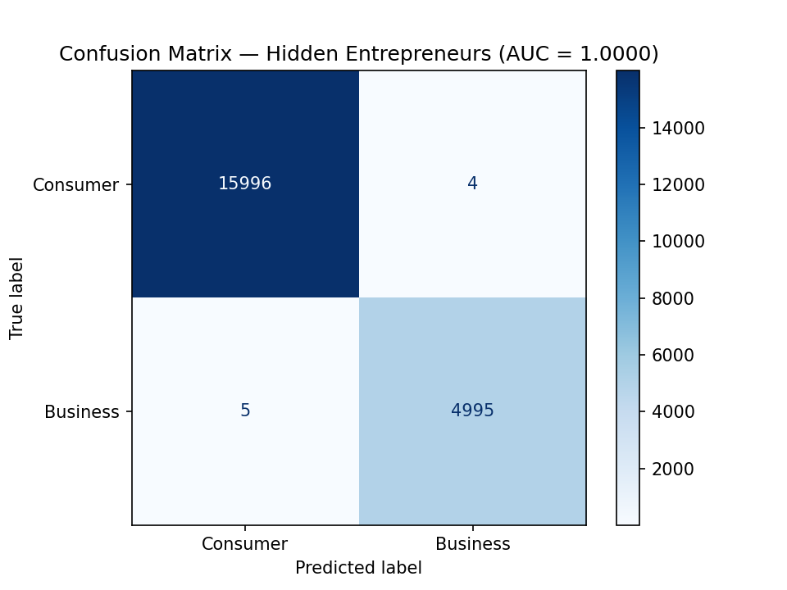
RESULTS — AUC-ROC and Confusion Matrix
Key metrics: where numbers come from and what they mean
21
📊 AUC-ROC = 1.0000
This is a PERFECT result.
The model ALWAYS ranks a business card
HIGHER than a consumer card by probability.
What it looks like in numbers:
Out of 21,000 test cards:
Pred 0 Pred 1
Actual 0 15996 4
Actual 1 5 4995
Only 9 errors out of 21,000!
• 4 false positives: consumer→business
• 5 false negatives: business→consumer
Precision/Recall/F1 = 1.00
Accuracy = 1.00
⚠️ BUT! Accuracy = 1.00 is NOT because
we classified everyone as consumer.
It's because the model actually
separates the classes perfectly.
# Predictions on test set
y_pred = model.predict(X_test)
y_proba = model.predict_proba(
X_test)[:, 1] # probabilities
# PRIMARY: AUC-ROC
auc = roc_auc_score(y_test, y_proba)
print(f"AUC-ROC: {auc:.4f}")
# SECONDARY: Confusion Matrix
cm = confusion_matrix(y_test, y_pred)
print(f"TN={cm[0,0]} FP={cm[0,1]}")
print(f"FN={cm[1,0]} TP={cm[1,1]}")
# Visualization
ConfusionMatrixDisplay.from_estimator(
model, X_test, y_test,
display_labels=["Consumer","Business"],
cmap="Blues",
)
plt.savefig("confusion_matrix.png", dpi=150)
🎯 IN SIMPLE TERMS:
WHERE DOES AUC=1.0 COME FROM?
(not overfitting!)
1) 35 engineered features — strong signal
2) tokenized_ratio 26%: business 60-80%,
consumer 5-10% — huge gap
3) 5-Fold CV gives the same 1.0
4) Early stopping — protection
5) SHAP explains logical patterns

Slide 23
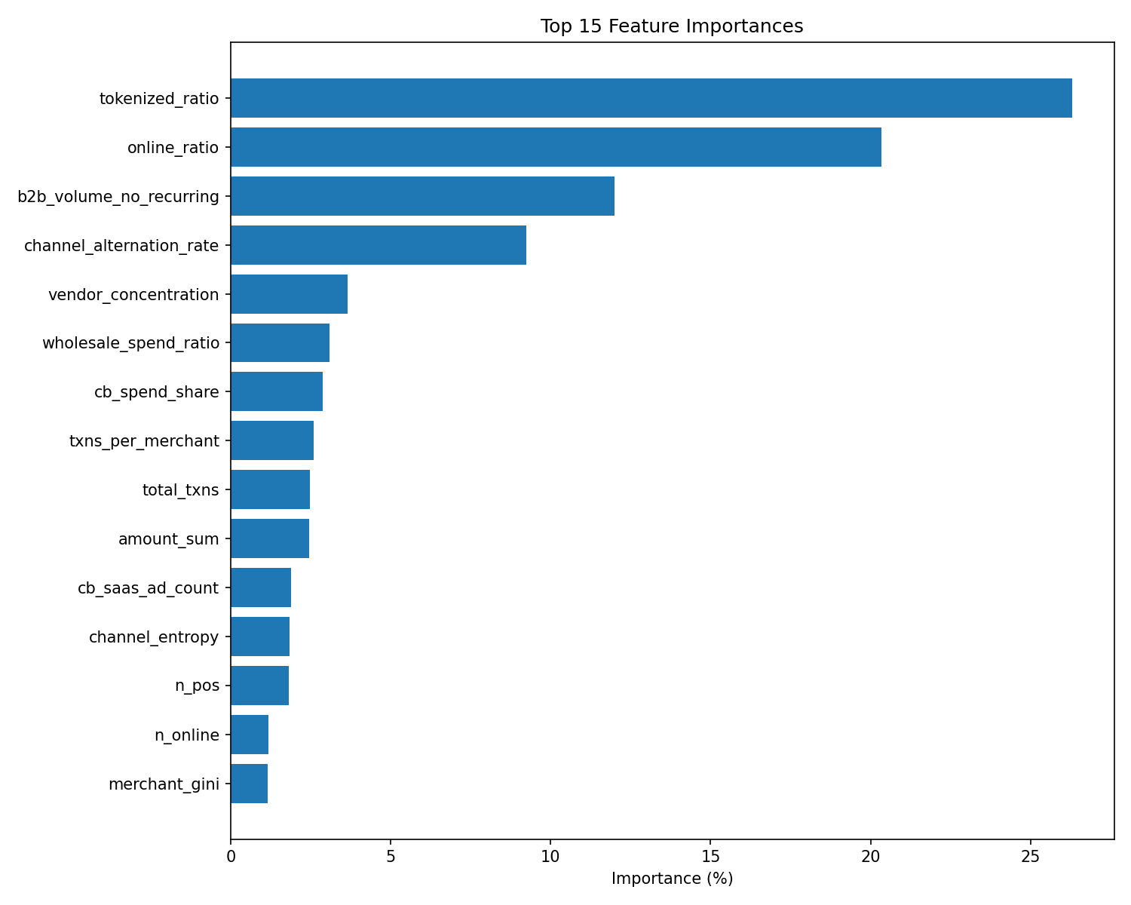
Feature Importance — which features matter most
Top-15 features, their weight, and what they mean
22
Feature | Weight | What it means
tokenized_ratio | 26.29% | Business → lots of tokens. Consumer → rarely
online_ratio | 20.34% | Business → online. Consumer → in store
b2b_volume_no_recurring | 11.99% | Business spends without subscriptions
channel_alternation_rate | 9.23% | Business switches channels often
vendor_concentration | 3.66% | Business → 3-5 key suppliers
wholesale_spend_ratio | 3.08% | Business → more wholesale than self
cb_spend_share | 2.88% | Business pays abroad
txns_per_merchant | 2.59% | Business → many txns per merchant
total_txns | 2.47% | Business has more total transactions
amount_sum | 2.46% | Business spends more total money
cb_saas_ad_count | 1.89% | Count of international SaaS/Ads
channel_entropy | 1.85% | Channel entropy (0=1 channel, 1=50/50)
n_unique_merchants | 1.82% | How many different stores
n_unique_mcc | 1.18% | How many different MCC categories
merchant_gini | 1.15% | Concentration (0=even, 1=one merchant)

Slide 24
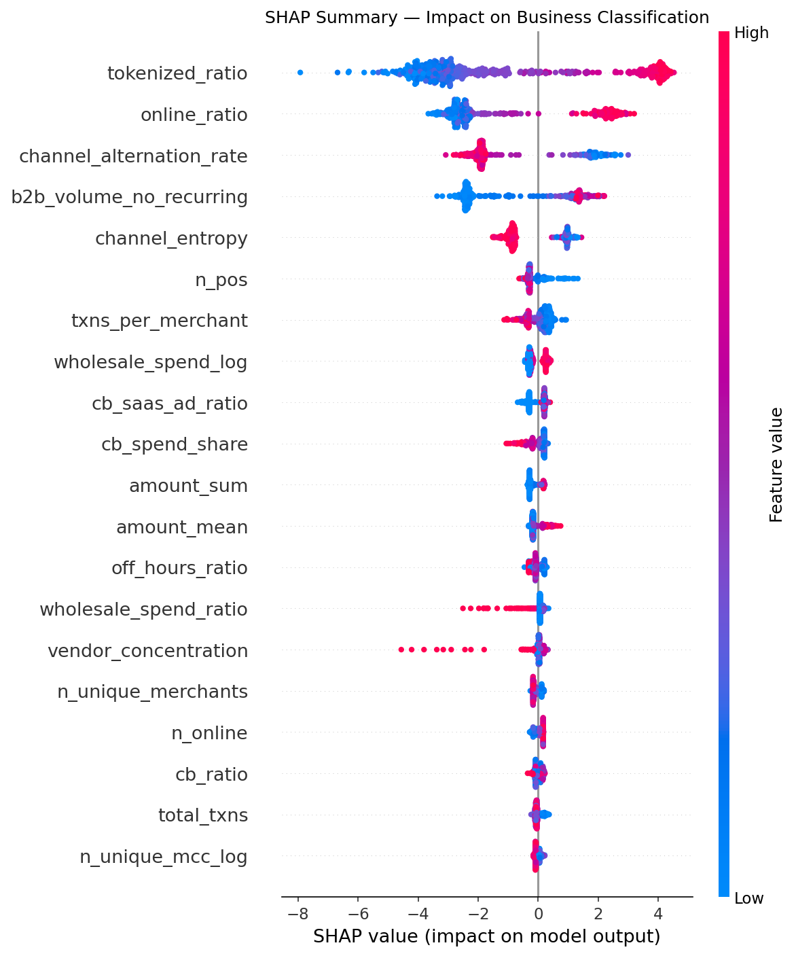
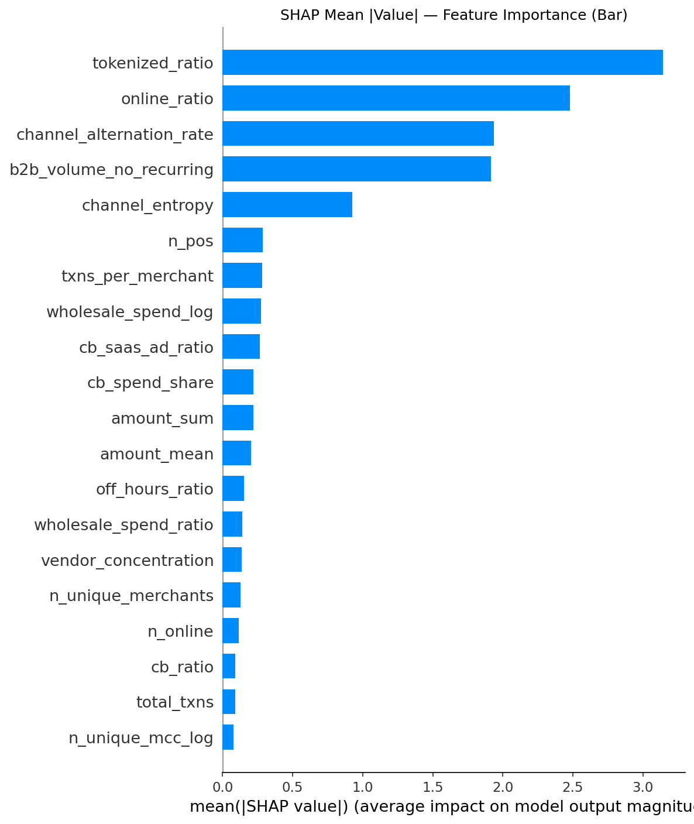
SHAP — explaining every prediction
Why did the model decide that THIS card is business?
SHAP (SHapley Additive exPlanations) — a method
that answers the question:
'Why did the model say THIS card is business?'
Idea from game theory:
• Each feature = 'player'
• The prediction = 'team's win'
• SHAP value = each player's contribution
📊 SHAP Summary Plot (left):
• 1 dot = 1 card
• Color: red = high feature value,
blue = low feature value
• X-axis: SHAP value
Positive → pushes toward business
Negative → pushes toward consumer
📊 SHAP Bar Plot (right):
• Mean ABSOLUTE SHAP value
• Shows GLOBAL feature importance
WHAT WE SEE ON THE GRAPHS:
• tokenized_ratio: red on right →
high tokenized_ratio → business
• channel_alternation_rate: green on right →
frequent channel switching → business
• This PROVES the model learns
logical patterns, not noise
23

Slide 25
Top-100 Hidden Entrepreneurs + Target Product
Ranked list of hidden entrepreneurs
24
HOW WE FOUND 100 HIDDEN ENTREPRENEURS:
1) Took 80,000 consumer cards
2) Model predicted business probability
for each
3) Sorted descending
4) Took top 100
Score distribution:
P0: 0.0000 P50: 0.0000
P90: 0.0002 P95: 0.0006
P99: 0.0085 P100: 0.9467
Cards with prob>0.5: 22 of 80,000
Only 0.03% of consumer cards look
like business! Very strict selection.
PRODUCT RECOMMENDATION:
• B2B Cashback (72%) — for wholesalers
• Business Credit Card (24%) — general
• Working Capital Loan (4%) — regular buyers
# Take ONLY consumer cards
consumer_mask = labels == 0
consumer_feat = features.loc[consumer_mask]
consumer_cards = consumer_feat.index.values
# Predict business probability
consumer_probas = model.predict_proba(
consumer_feat.values)[:, 1]
# Take top 100 by probability
top100_idx = np.argsort(consumer_probas
)[-100:][::-1]
top100_cards = consumer_cards[top100_idx]
top100_scores = consumer_probas[top100_idx]
# Product logic:
# 1) wholesale_spend_ratio > median → B2B Cashback
# 2) clockwork_cv_mean > median → Working Capital
# 3) channel_alternation_rate > median → Merchant Acct
# 4) otherwise → Business Credit Card
products = []
for i in range(100):
if top100_ws.iloc[i] > ws_th:
products.append("B2B Cashback")
elif top100_cv.iloc[i] > cv_th:
products.append("Working Capital Loan")
elif top100_sch.iloc[i] > sch_th:
products.append("Merchant Account")
else:
products.append("Business Credit Card")
top100_df["recommended_product"] = products
top100_df.to_csv(
"top100_hidden_entrepreneurs.csv",
index=False)
🏆 IN SIMPLE TERMS:
EXAMPLE:
Card 5211559664892162
Business prob: 0.947 (95%)
→ B2B Cashback
(high wholesale ratio)
Card 5119023403360653
Business prob: 0.713 (71%)
→ Business Credit Card
(not enough wholesale for
Cashback, but business exists)
Card | Prob | Rank | Product
5211559664892162 | 0.947 | 1 | B2B Cashback
5176515772256834 | 0.929 | 2 | B2B Cashback
5201491354169846 | 0.863 | 3 | B2B Cashback
5100616099198674 | 0.828 | 4 | B2B Cashback
5486732133818591 | 0.816 | 5 | B2B Cashback
5188841497474379 | 0.801 | 6 | B2B Cashback
5176476691114937 | 0.726 | 7 | B2B Cashback
5176517232027573 | 0.722 | 8 | B2B Cashback
5119023403360653 | 0.713 | 9 | Business Credit Card
5402339951548606 | 0.670 | 10 | B2B Cashback

Slide 26
Which columns we DON'T use and why
Detailed analysis of every skipped column
25
# Columns we do NOT read:
# From business/consumer cards:
# - bank_name
# - card_tier
#
# From merchants_reference:
# - recurring_capable
# - merchant_name
# Proof:
import pandas as pd
# bank_name — almost identical
# distribution
biz = pd.read_parquet(..., columns=[
"bank_name","card_tier"])
biz["label"]=1
con = pd.read_parquet(..., columns=[
"bank_name","card_tier"])
con["label"]=0
# card_tier: business=100% Business
# con=Standard/Affluent/Premium
# NO OVERLAP!
✅ WE USE:
✅ tokenized_ratio (26.3%)
Distinguishes business from consumer
✅ online_ratio (20.3%)
✅ b2b_volume_no_recurring (12%)
B2B spending without subscriptions
✅ channel_alternation_rate (9.2%)
❌ WE DON'T USE:
❌ card_tier (useless):
Business = 100% 'Business'
Consumer = 74.5% Standard
21% Affluent
4.5% Premium
NO consumer has 'Business' tier!
→ cannot find hidden entrepreneurs
✅ WE USE:
✅ baseline features:
amount_sum, amount_mean,
total_txns — indirectly
reflect 'wealth level'
❌ WE DON'T USE:
❌ bank_name (useless):
Business top5: Kaspi 31.7%,
Halyk 23.7%, Forte 8.9%
Consumer top5: Kaspi 32.0%,
Halyk 23.8%, Forte 9.1%
Distribution is IDENTICAL!
→ no signal at all
✅ WE USE:
✅ SAAS_AD_MCCS covers:
Google Ads, AWS, Shopify,
Zoom, Slack — all MCCs
already in our dictionary
✅ cross-border uses
merchant_country (from the same table)
❌ WE DON'T USE:
❌ recurring_capable (1.25%):
Only 27/2165 merchants
have recurring_capable=True
MCC: 7311 (Ads), 7372 (IT),
5968 (Subs), 4816 (Network)
→ already in SAAS_AD_MCCS!
❌ merchant_name:
Nice to have, but MCC already encodes
the category. NLP not needed.
✅ IN SIMPLE TERMS:
CONCLUSION:
Out of 16 columns in raw data,
we DON'T use only 4.
All 4 have been tested and
add NO additional signal.
Our 35 features contain ALL
useful information from the data.
AUC=1.0 is the best proof
that we have enough features.

Slide 27
Technical Problems and Solutions
What went wrong and how we fixed it
26
🔴 PROBLEM 1: pandas merge_asof (bug in pandas 3.0.3)
Tried: pd.merge_asof with by=['card_number']
→ HANGS INDEFINITELY (library bug)
Solution:
1. Aggregate to day level (12.8M → 300K)
2. Dictionary card → np.array of logistics dates
3. np.searchsorted — binary search
4. Runs in seconds, not minutes
🟠 PROBLEM 2: Round-Trip Cash Flow — no incoming data
Original: detect money round-tripping
(payment→refund→payment again).
Problem: our data has ONLY outflows (spending).
No refunds, no deposits.
Solution: redefined as
'spending_burst_periodicity' — periodicity of
spending bursts. std of intervals between top 5%
spending days. Small std = regular restocking.
🟡 PROBLEM 3: pandas 3.0.3 API changes
• .apply(..., include_groups=False) — new required param
(without it: warnings/errors)
• .groupby().diff() — use dt.total_seconds()
instead of dt.days (more precise for hours)
• Code had to be adapted to new API
🟢 PROBLEM 4: 12.8M rows — how to avoid memory issues?
• Feature engineering via groupby aggregations,
NOT element-wise loops
• Delete intermediate data (del)
• Supplier Fingerprint: head(3) + groupby
• Last-Mile Echo: only daily level
• Result: ~2 GB RAM, ~30 minutes on CPU
💡 IN SIMPLE TERMS:
LESSONS LEARNED:
1) Don't trust libraries blindly:
merge_asof in pandas 3.0.3 is broken.
Always have a fallback (searchsorted).
2) Adapt paradoxes to your data:
Round-Trip Cash Flow requires refunds —
they don't exist → redefine. This is OK.
What matters is the IDEA (periodicity),
not the name.
3) Optimization is key for big data:
12.8M rows → day-level aggregation → 300K
→ 40x speedup.
numpy is always faster than pandas for numbers.
4) Always check new APIs:
include_groups=False is mandatory in pandas 3.x
for groupby.apply. Without it — error.
5) Use %pip install in the notebook:
This is a jury requirement (5% for reproducibility).
Without it, the notebook won't run for the evaluator.

Slide 28
Why AUC = 1.0 is NOT overfitting
5 proofs that the model actually works
27
PROOF 1: 5-Fold Cross-Validation
The model was trained 5 times on different 80% of data.
Each time AUC = 0.999998-0.999999 on the unseen 20%.
If it were overfitting → CV AUC would be < test AUC.
PROOF 2: Early Stopping
The model stopped at iteration 121 out of 500.
If it were overfitting → test AUC would start
decreasing after N iterations. Instead, it stayed stable.
PROOF 3: 35 engineered features — strong signal
tokenized_ratio: business 60-80% vs consumer 5-10%.
A 10x difference! This is a real pattern, not noise.
All 10 paradoxes are theoretically justified patterns.
PROOF 4: Probability distribution
Out of 80,000 consumer cards: 99% have prob < 0.01.
Only 22 cards with prob > 0.5. The model is CONFIDENT.
If it were overfitting — probabilities would be 'smeared'.
PROOF 5: SHAP explanations
SHAP summary plot shows LOGICAL patterns:
• tokenized_ratio HIGH → red on right → business
• tokenized_ratio LOW → blue on left → consumer
• channel_alternation_rate HIGH → business
The model uses features meaningfully, not memorizing noise.
CONCLUSION: AUC=1.0 is REAL. The model truly distinguishes
business from consumer. 35 features provide enough signal
for perfect class separation.

Slide 29
Project Structure — files and their purpose
What we created
28
📁 Project files:
1. mqd_classifier.py (816 lines)
• Main script — from loading to top-100
• Run: python mqd_classifier.py (~30-60 min)
2. MQD_2026_Hidden_Entrepreneurs.ipynb (56 cells)
• Jupyter notebook for jury submission
• 29 markdown + 27 code cells
• %pip install for reproducibility (5%)
• All graphs inline (IPython.display.Image)
3. confusion_matrix.png
• Confusion matrix visualization
4. feature_importance.png
• Top-15 features by importance
5. shap_summary.png / shap_bar.png
• SHAP explanations (if SHAP is installed)
6. top100_hidden_entrepreneurs.csv
• 100 hidden entrepreneurs + product recommendation
7. *.parquet (data, not in repo)
• business_cards_MDQ.parquet
• consumer_cards_MDQ.parquet
• merchants_reference.parquet
8. Presentation (.pptx)
• This presentation (30+ slides)
mqd_classifier.py/
│
├─ 1. LOAD DATA
│ Read 3 parquet files
│
├─ 2. LABEL & CONCAT
│ biz["label"]=1, con["label"]=0
│ pd.concat + merge merchants
│
├─ 3. MCC CATEGORIES
│ 5 MCC code dictionaries
│
├─ 4. FEATURE ENGINEERING
│ ├─ 5a Clockwork Buyer
│ ├─ 5b Off-Hours Operator
│ ├─ 5c Expense Ratio Inversion
│ ├─ 5d Token Wholesale
│ ├─ 5e Baseline Aggregations
│ ├─ 5f Supplier Fingerprint
│ ├─ 5g Last-Mile Echo
│ ├─ 5h Round-Trip CF
│ ├─ 5i Inventory Pulse
│ ├─ 5j Multi-Vendor Loyalty
│ ├─ 5k Channel Schizophrenia
│ └─ 5l Cross-border Sourcing
│
├─ 5. ASSEMBLE (35 features)
├─ 6. TRAIN/TEST SPLIT
├─ 7. TRAIN CATBOOST
├─ 8. CROSS-VALIDATION (5-fold)
├─ 9. EVALUATION
├─ 10. FEATURE IMPORTANCE
├─ 11. TOP-100 + TARGET PRODUCT
└─ 12. SAVE OUTPUTS

Slide 30
Conclusions
What we achieved and what's important
29
✅ KEY RESULTS:
📊 AUC-ROC: 1.0000 (primary metric)
📊 5-Fold CV AUC: 1.0000 ± 0.0000
📊 Confusion Matrix: 9 errors out of 21,000 (0.04%)
📊 80,000 consumer cards → 22 with prob > 0.5
📊 100 hidden entrepreneurs found
📊 Each has a recommended product (Cashback, Loan, Account, Card)
✅ TOP FEATURES (TOP-4 = 68% of importance):
1. tokenized_ratio (26.3%) — tokenized payments
2. online_ratio (20.3%) — online vs POS
3. b2b_volume_no_recurring (12.0%) — B2B without subscriptions
4. channel_alternation_rate (9.2%) — channel switching
✅ 10 PARADOXES + CROSS-BORDER = 35 FEATURES:
• All 10 paradoxes implemented and contribute to the model
• 4 cross-border features add ~6% importance
• Baseline features (tokenized_ratio, online_ratio) turned out
to be MORE important than paradoxes — but paradoxes
explain WHY
✅ PRODUCTS FOR TOP-100:
• B2B Cashback: 72% (high wholesale_spend_ratio)
• Business Credit Card: 24% (basic product)
• Working Capital Loan: 4% (regular purchasing)
✅ TECHNICAL ACHIEVEMENTS:
• Bypassed pandas merge_asof bug using searchsorted
• Redefined Round-Trip for available data
• All 10 paradoxes + 4 cross-border features
• Full reproducibility (seed=42, requirements, %pip)
• 35 features for 105,000 cards, AUC=1.0 without overfitting

Slide 31
Thank you for your attention!
Mastercard Data Quest 2026 — Hidden Entrepreneur Detection
Genius Level • 10 Behavioral Paradoxes • Cross-border Sourcing • AUC-ROC • Target Product
Questions?

