Slide 1
Information Visualization Project Proposal and Dataset
G14
83416 – Afonso Figueiredo
83420 – Alexandra Figueiredo
83443 – Denis Voicu

Slide 2
DOMAIN
01

Slide 3


Domain
Steam
Their users

Slide 4
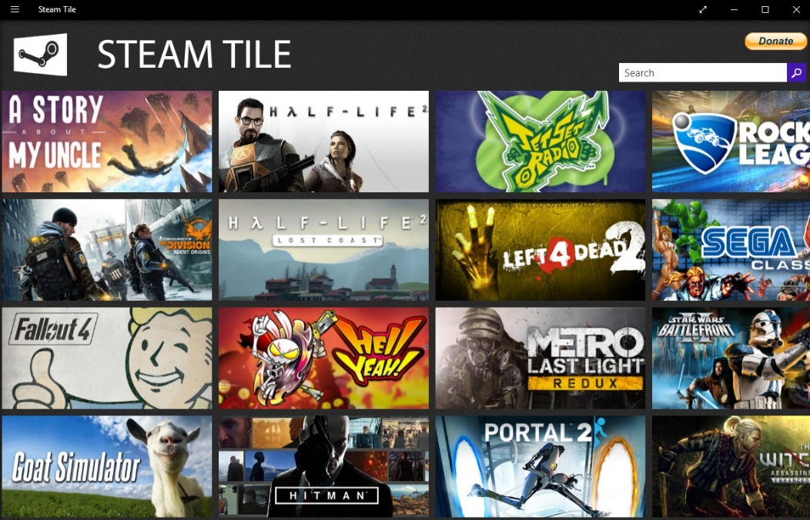
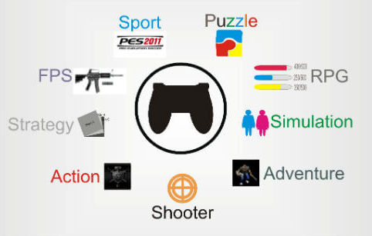
Domain
Their Games
Games Genres

Slide 5
DATASET
02

Slide 6
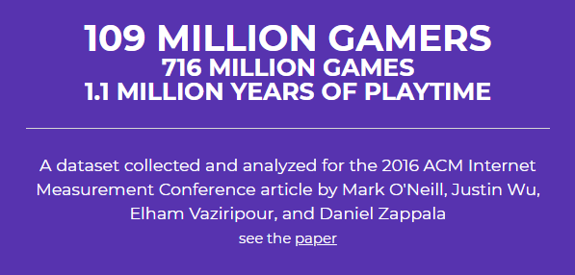

Dataset
Steam Dataset
Steam Spy
https://steamspy.com/
https://steam.internet.byu.edu/

Slide 7
TASKS
03

Slide 8


Tasks
Task 1: Explore the users distribution.
Behavior
Nacionality
Friends

Slide 9




Tasks
Task 2: Analyze the evolution of games, games genres and their users throughout the years.
Developers/Publishers
Games
Users
Hours

Slide 10

Tasks
Task 3: Explore the relationships between publishers, developers and the number and quality of the released games.
Publishers
Developers
Number of games and their quality

Slide 11
Example QUESTIONS
04

Slide 12
Questions
Question 1: What is the distribution of the users and their friends around the world?
Question 2: What is the game genre most succeful in this past years?
Question 3: Is there a relationship between the number of new players, new friendships and released games throughout the years?
Question 4: Which are the publishers and developers with the best released games?
Question 5: Are the publishers and developers that produced the best games have also the ones that release more games?

Slide 13
Data Sample
05

Slide 14
Data Sample
from table APP_ID_INFO
(appid; Title; Type; Price; Release_Date; Rating; Required_Age; Is_Multiplayer)
(63942; ‘Men of War: Vietnam Special Edition Upgrade Pack’, ‘dlc’, 2.99, ‘1970-01-01 00:00:00’, -1, 0, 1)
from GAMES_DEVELOPERS
(appid; Developer)
(932048402394, Valve)

