Slide 1
Information Visualization Project Proposal and Dataset
G14-A
83420 – Alexandra Figueiredo
83443 – Denis Voicu
83416 – Afonso Figueiredo

Slide 2
INITIAL DATASET
01

Slide 3
Initial Dataset
Data about:
Games
Developers
Publishers
Games Genres
Users and their friends

Slide 4
Initial Dataset
Dataset: Steam
Format: .sql
Tables:
App_id_info: game id, title, price, released date, rating, required age and if it is multiplayer
Friends: player id A, player id B, relationship and the date when the users became friends

Slide 5
Initial Dataset
Tables:
Games_developers: game id and the developer
Games_genres: game id and the game genre
Games_publishers: game id and the publisher
Player_summaries: player id, last time the player was online, group assigned as main group, the timestamp when the account was created, the country, state and city where the user resides

Slide 6
Initial Dataset
Dataset: SteamSpy
Format: .csv
Other data about games to complete the steam dataset

Slide 7
Initial Dataset
Dataset: Multiples
Format: .csv
Tables:
Number of Homicides per country per year
Average age per country per year
Percentage of population with depression per country per year
Percentage of population which uses the internet per country per year

Slide 8
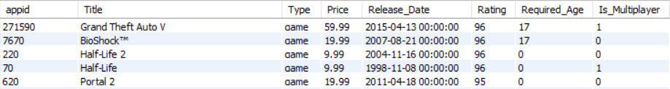
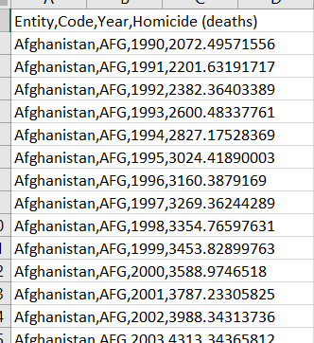
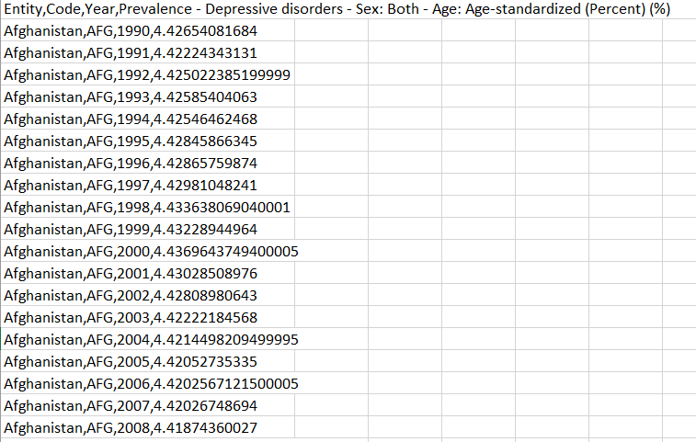
Initial Dataset
Data sample:

Slide 9
Selected / derived data
02

Slide 10
Selected data
We deleted the columns not needed to answer our questions
We also discarded some tables that weren’t useful

Slide 11
Derived data
player_summaries & friends:
- average number of friends per player in each country
player_summaries:
- number of players per country

Slide 12
Derived data
App_id_info & games_genres & steamspy tables:
- average game rating per genre per year
- average game price per genre per year
- number of games per country per year

Slide 13
Derived data
App_id_info & games_genres & games_publishers & steamspy tables
- number of publishers per genre per year
App_id_info & games_genres & games_developers & steamspy tables
- number of developers per genre per year

Slide 14
Derived data
From the previous tables:
- average rating between publishers and developers
- average rating between publishers and developers per year
- number of released games per publisher and developer

Slide 15
Data abstraction
03

Slide 16
Data abstraction
Dataset type: Tables
Tables:
Avg_price_genre_year:
- Item: average genre price per year
- Attributes: Year (Release_Date) – it refers to the year. It is ordered, quantitative and ratio. Genre – Game genre. It is nominal. Avg(Price) – average price. It is ordered, quantitative and ratio.

Slide 17
Data abstraction
Avg_rating_genre_year:
- Item: average genre rating per year
- Attributes: Year (Release_Date) and Genre have the same type as mentioned before. Avg(Price) – average price. It is ordered, quantitative and ratio.

Slide 18
Data abstraction
developer_genre_year:
- Item: number of games per developer per genre and per year
- Attributes: Year (Release_Date) and Genre have the same type as mentioned before. count(*) – number of games. It is ordered, quantitative and ratio.

Slide 19
Data abstraction
games_genre_year:
- Item: number of released games per year.
- Attributes: Year (Release_Date) and Genre have the same type as mentioned before. count(*) – number of games. It is ordered, quantitative and ratio.

Slide 20
Data Abstraction
New_users_country:
- Item: total number of players per country.
- Attributes: loccountrycode – country code. It is nominal. count(*) – number of users. It is ordered, quantitative and ratio.

Slide 21
Data Abstraction
New_users_year:
- Item: total number of players per year
- Attributes: Year (timecreated) - year. It is ordered, quantitative and ratio. count(*) – number of users. It is ordered, quantitative and ratio.

Slide 22
Data Abstraction
New_users_year_country:
- Item: total number of players per country per year
- Attributes: loccountrycode, Year (timecreated), count(*) are the same type as mentioned before.

Slide 23
Data Abstraction
Publisher_developer_rating_games:
- Item: average rating of a specific developer and publisher
- Attributes: Developer and Avg(Rating) are the same type as mentioned before. Publisher is nominal.

Slide 24
Data Abstraction
Publisher_genre_year:
- Item: number of released games per publisher per year
- Attributes: Year(Released_Date), Genre and Publisher are the same type as mentioned before. Count(*) represents the number of released games and has the same type.

Slide 25
Data Abstraction
Games_publisher_year:
- Item: number of released games by a publisher
- Attributes: Publisher and count(*) have the same type as mentioned before.

Slide 26
Data Abstraction
Games_developer_year:
- Item: number of released games by a developer
- Attributes: Developer and count(*) have the same type as mentioned before.

Slide 27
Data Abstraction
Average ages, Number of homicide deaths, share of individuals sharing the internet, share of depression :
- Item: it is self explanatory
- Attributes: Country is nominal and the others are ordered, quantitative and of type racio.

Slide 28
Data Abstraction
Friends_year:
- Item: number of new friendships per year
- Attributes: year and count(*) are both ordered, quantitative and ratio.

Slide 29
Dataset processing
04

Slide 30
Dataset processing
We cleaned the dataset by running some sql queries.
We used an PHP script to insert the data into the tables.
We used data from steamspy to overcome some of our data gaps related to the publishers.
The users without a country were eliminated.

Slide 31
Mapping
05

Slide 32

Mapping
Question 1: What is the game genre with the highest average rating in this past years?

Slide 33

Mapping
Question 2: Which are the publishers and developers that released the highest average rating games?

Slide 34


Mapping
Question 3: Is there any relation between the number of players and the number of homicides?

Slide 35


Mapping
Question 4: Are the publishers and developers that produced the games with the highest average rating also the ones that released more games?

Slide 36

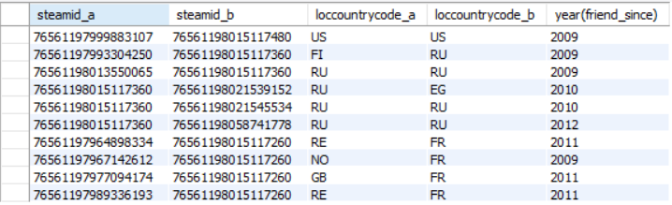

Mapping
Question 5: Is there a relationship between the number of new players, new friendships and released games throughout the years?

Slide 37

Mapping
Question 6: What is the distribution of the users and their friends around the world?

