Slide 1
Information Visualization Visualization Sketch
G14-A
83420 – Alexandra Figueiredo
83416 – Afonso Figueiredo
83443– Denis Voicu

Slide 2
Overview
01

Slide 3
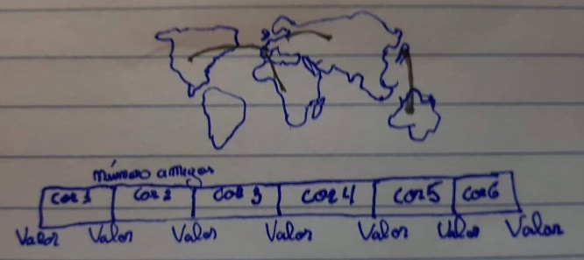
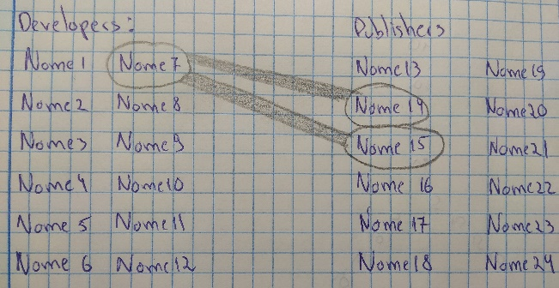
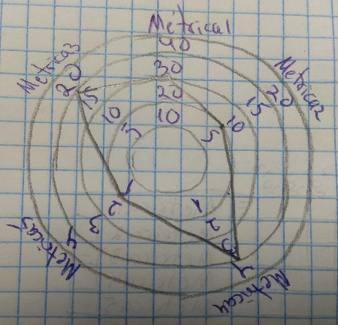
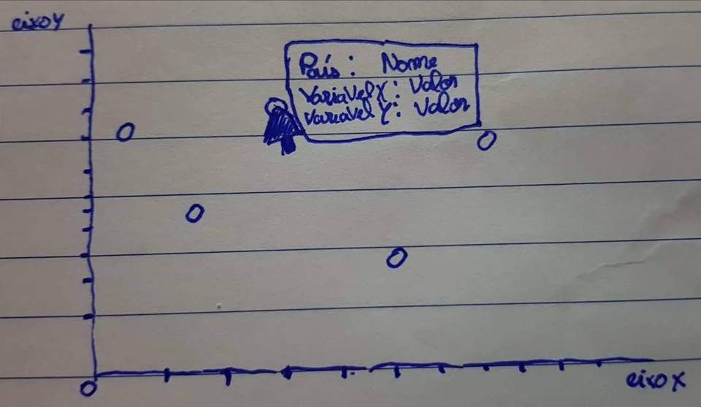
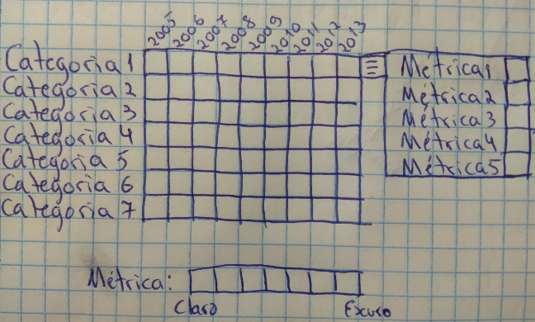
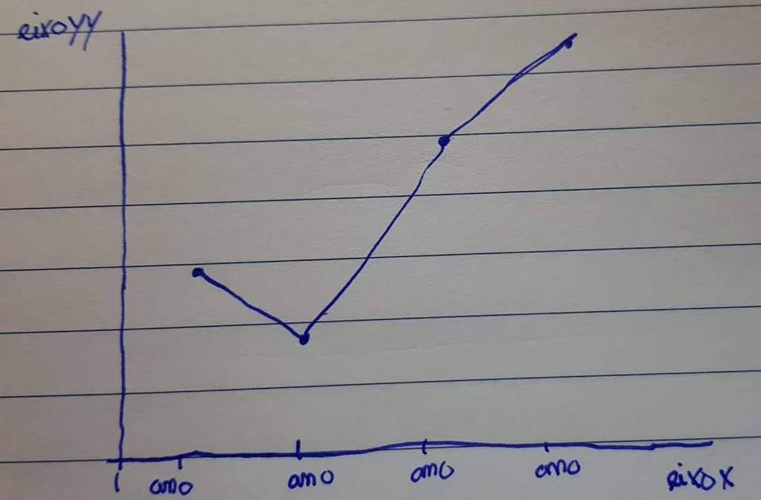
Overview
6 diferente idioms:
1st part
2nd part
3rd part

Slide 4
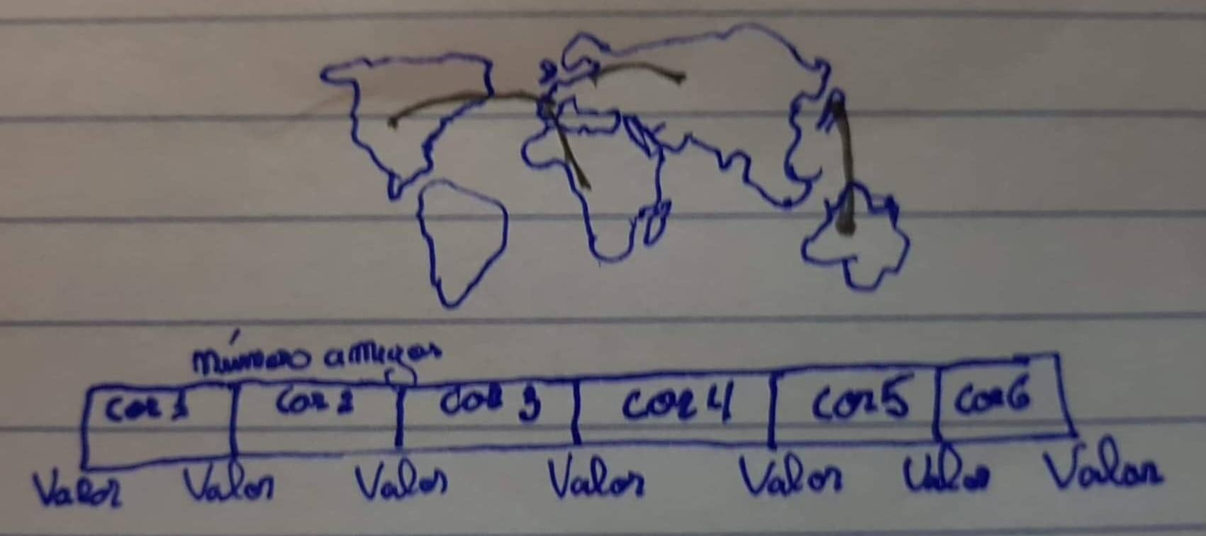
Overview - 1st part
Small multiples with scatter plot
World map
Relate obesity, depression, murders and number of people with access to the internet (Y Axes) with the number of friends and number of users (X axes)
Number of friends of different nationalities

Slide 5
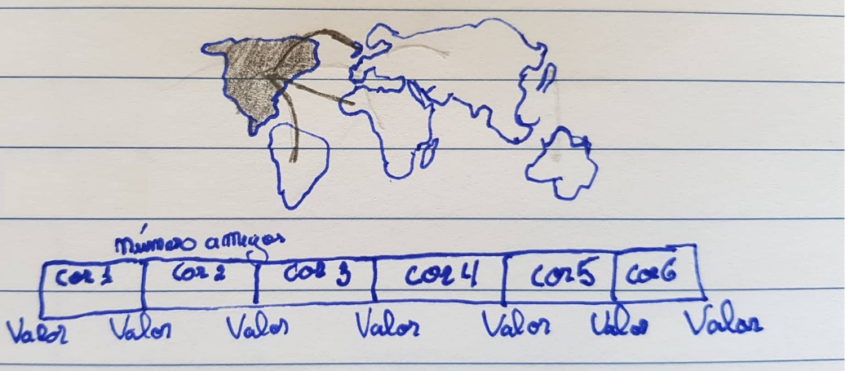
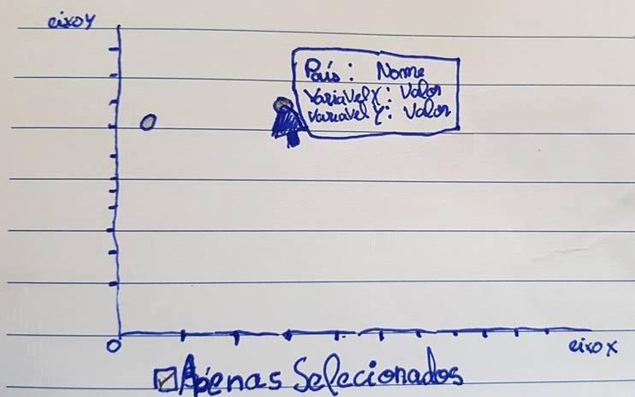
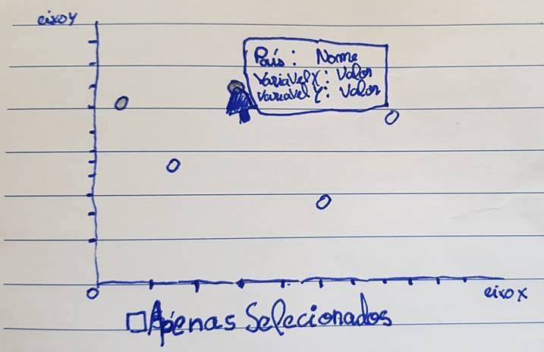
Overview - 1st part
How are they connected?
Select the country (countries)
Appears only the countries selected
Appears the countries selected and the countries which they are connected to

Slide 6
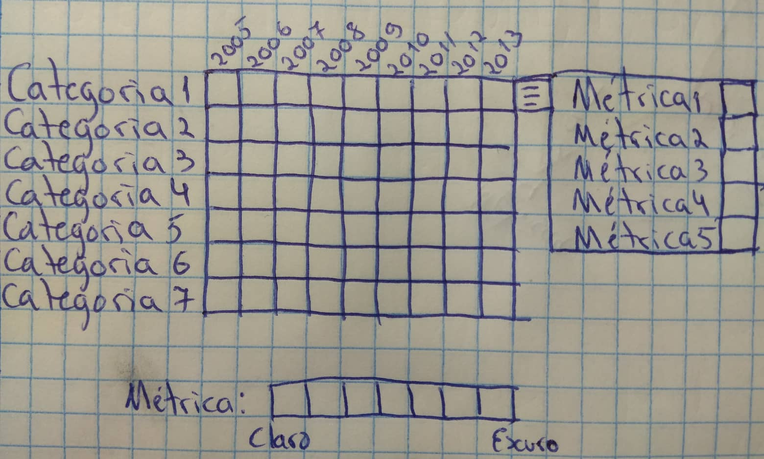

Overview - 2nd part
Heat map
Star plot
Evolution of the average rating, average price, number of released games, number of developers and publishers of each genre throughout the years
All metrics mentioned in the heat map(max 2)

Slide 7

Overview - 2nd part
How are they connected?
Select the genre and the year that you desire (max 2)
It appears the selected genre and year
In this example, metrics about genre 2 in 2007

Slide 8
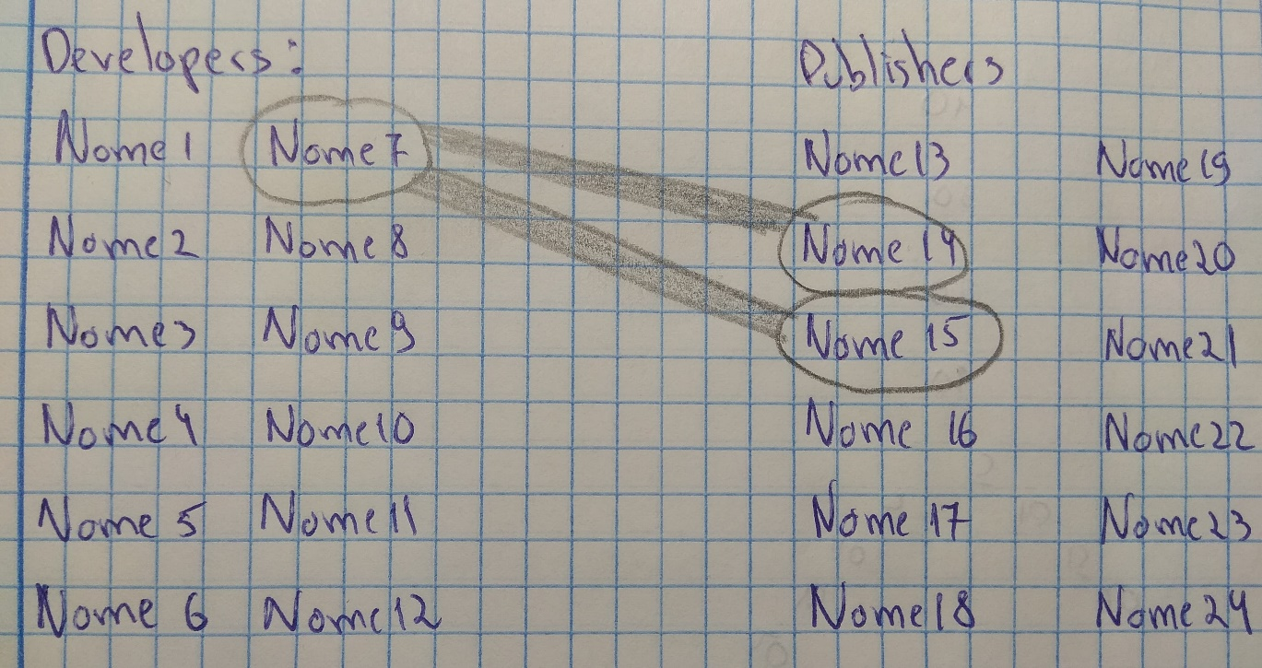
Overview - 2nd part
Average rating between a publisher and different developers and vice versa

Slide 9
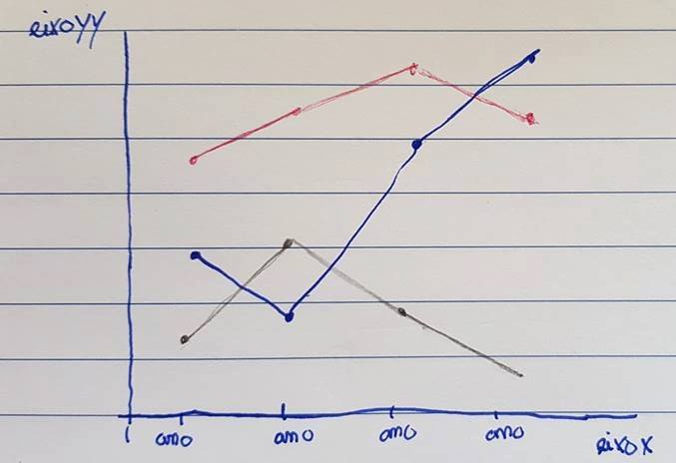
Overview – 3rd part
Overview about the number of users, new friendships and released games

Slide 10
Visual encoding
02

Slide 11
Visual Encoding
Item | Encoding
Year; Genre; Publisher; Developer; Number of games per developer; Number of games per publisher; Number of users; Number of friends | Text Label
Number of Publishers and Developers; Avg Price, Avg Rating and Number of games per genre per developer; Number of friends between countries | Colour, Text Label
Avg game rating between publisher and developer | Largura da linha, Etiqueta
Country | Colour, Text label, Geographical position, Position
Metrics | Text Label, Colour

Slide 12
IDIOM – tasks/questions mapping
03

Slide 13
Task 1 – Analise the evolution of games and genre of games during the years
Question 1: What is the game genre with the highest average rating in this past years?
Heat Map
1. Select in the list box on the right side “Avg rating”
2. Understand which game genre has the highest average rating by looking at the colors
The selected countries appear highlighted (max 2)

Slide 14

Task 1 - Analise the evolution of games and genre of games during the years
Question 2: In the RPG genre, the number of publishers and developers changed between 2010 and 2011? In what way?
Star plot
1. Select RPG 2010 and RPG 2011 in the heat map
2. Compare the number of publishers and developers in the star plot. The selections have different colors.
The subtitle shows the Game genre(s) and year(s) selected.

Slide 15
Task 1 - Analise the evolution of games and genre of games during the years
Question 3: Is there a relationship between the number of new players, new friendships and released games throughout the years?
1. Hover the line to see the concrete value and compare them.

Slide 16
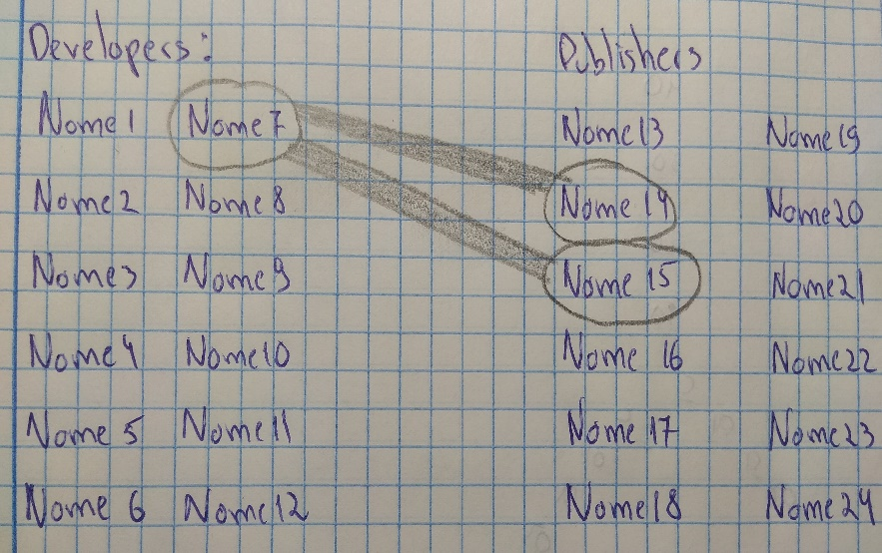
Task 2 – Compare the publishers and developers
Question 4: Which are the publishers and developers with the highest average rating?
1. Select or hover a name to display the partnership between the selected name and it partners.
2. You can see the average game rating by the weight of the lines that connects the partners or by hovering the line.

Slide 17
Task 3 – Analise the number of users of each country with some metrics
Question 5: Is there any relation between the number of players and the number of homicides?
1. Select in the list box the homicide rate.
2. From the second list box select the number of players.
3. Hover the dots to see the information in more detail.

Slide 18
Task 4 – Explore the distribution of the users
Question 6: What are the nationalities of Portuguese user friends?
1. Select Portugal in the map.
2. Obverse the lines and see where the Portuguese users have friends.
3. Hover a line that connects two countries to see the information in more detail.

