Slide 1
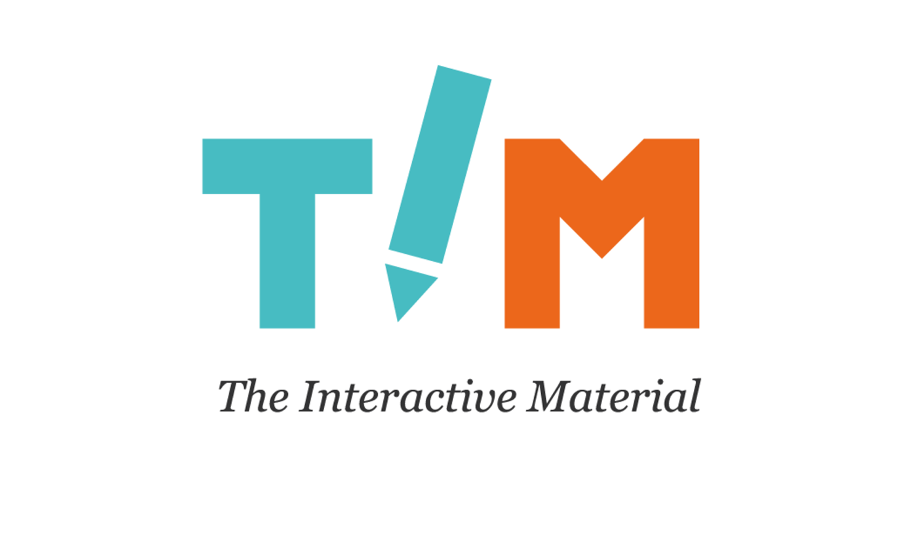
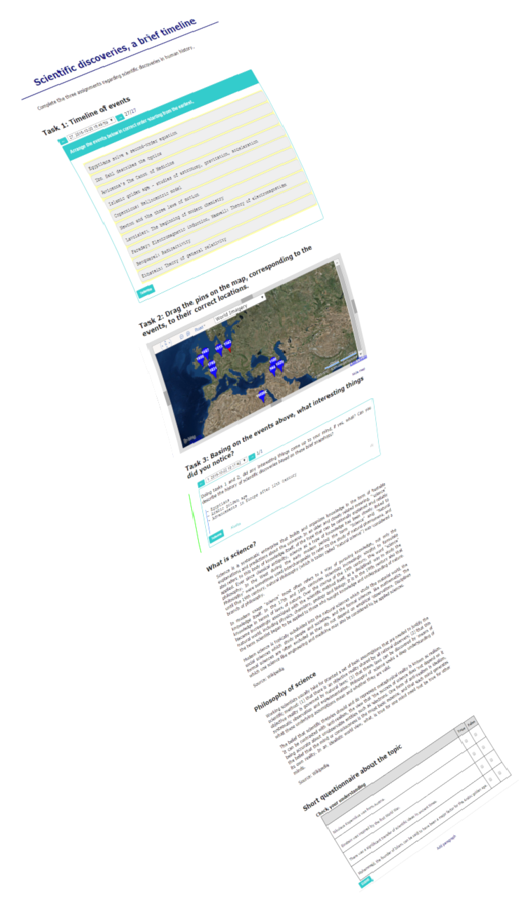
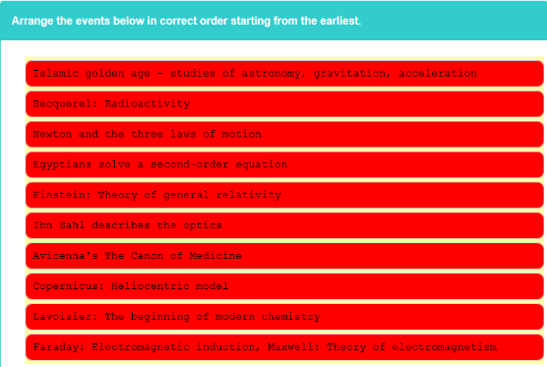
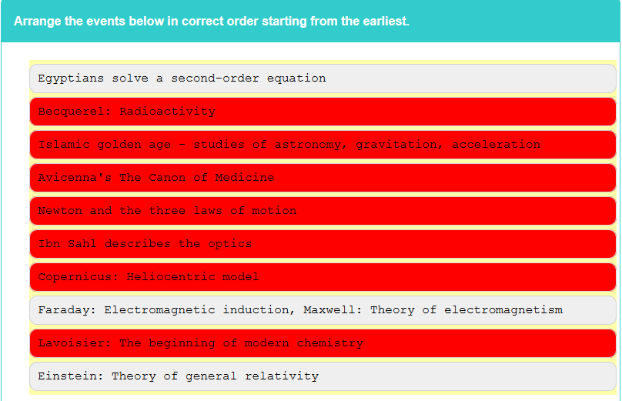
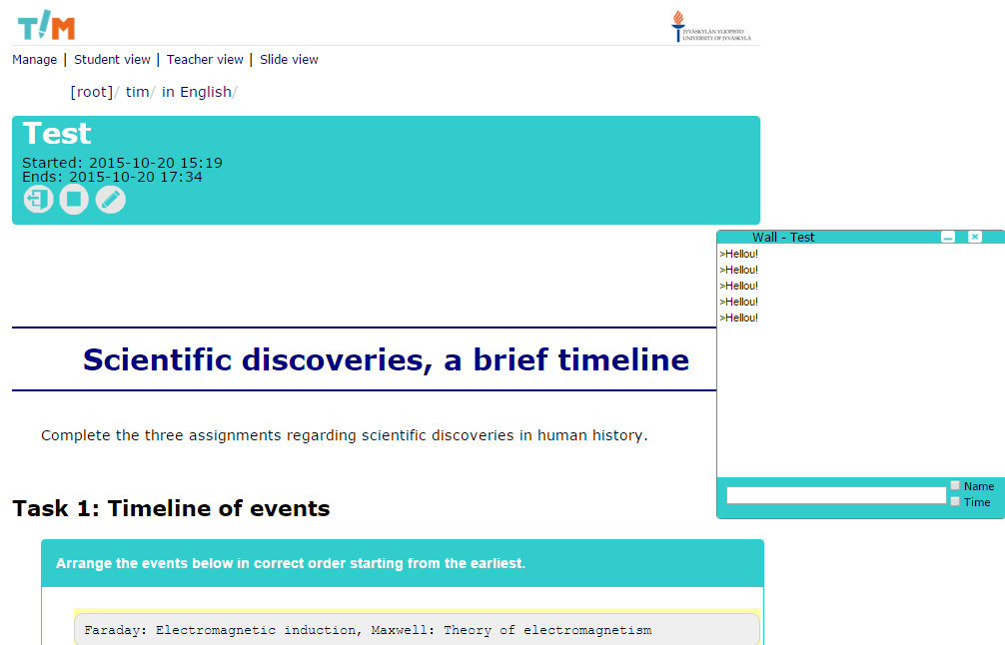
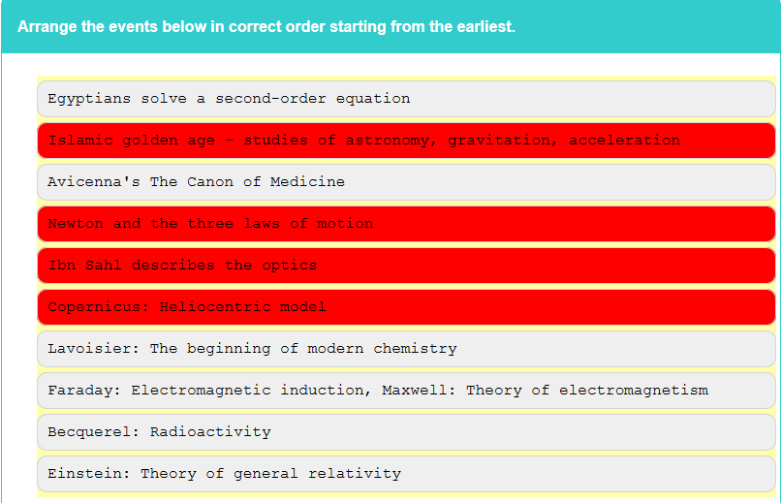
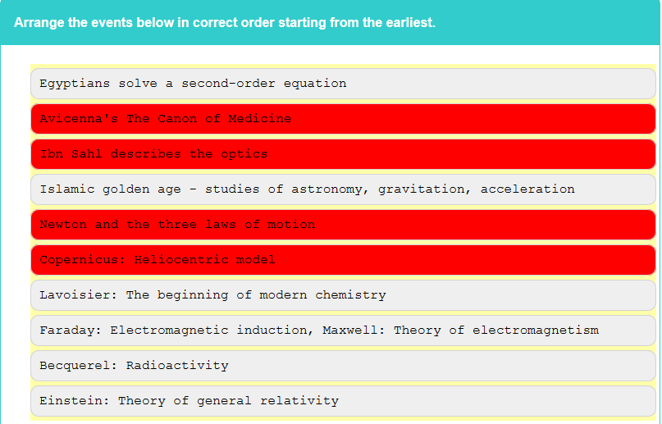
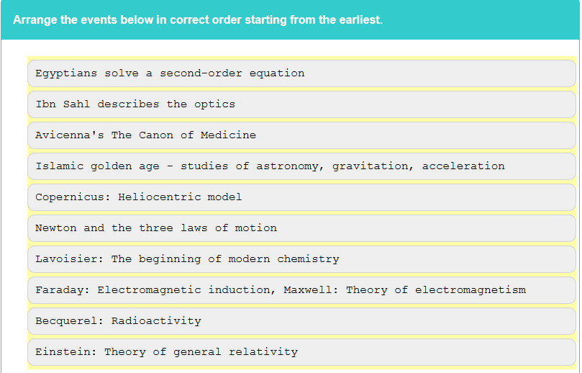

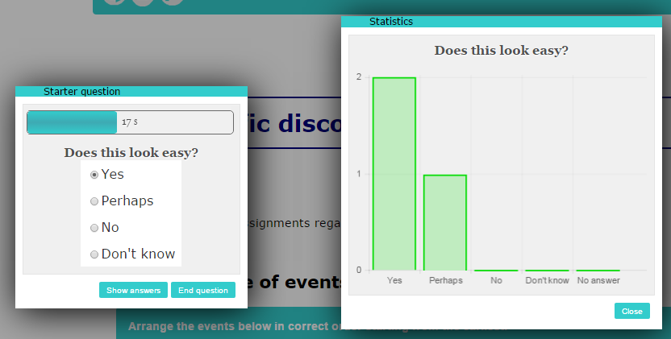
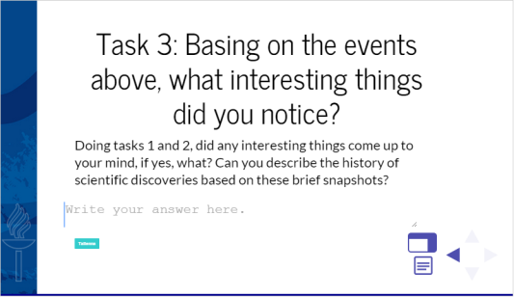
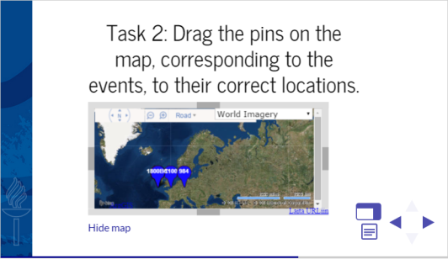
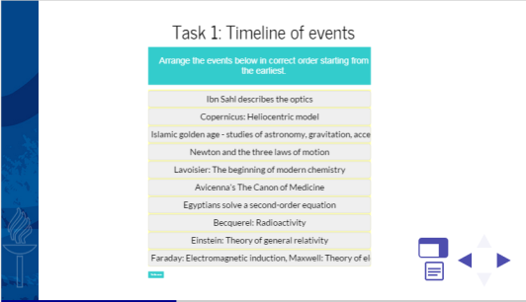
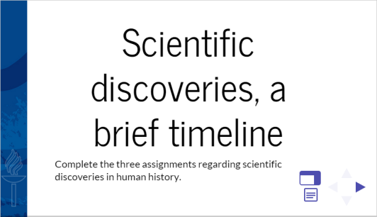
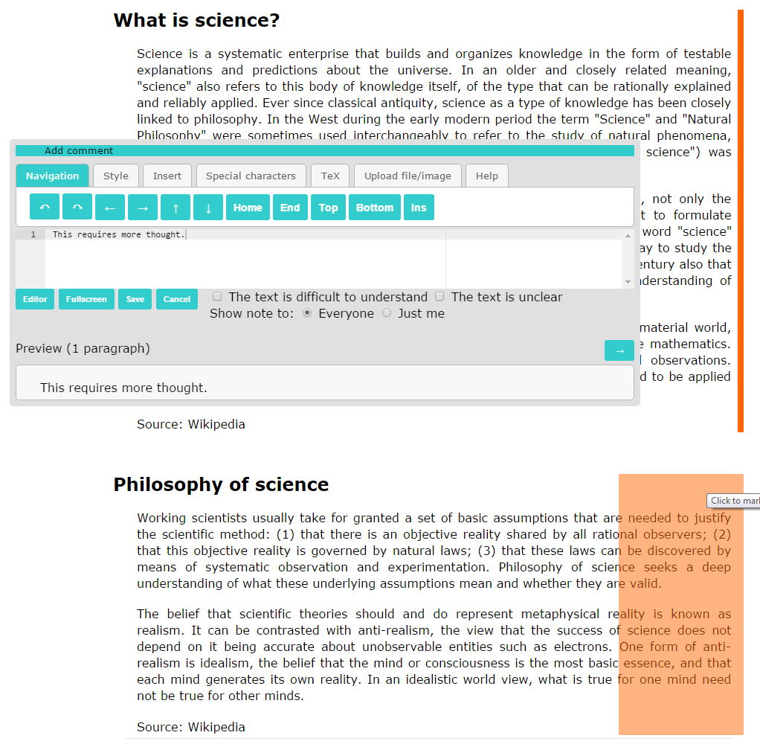
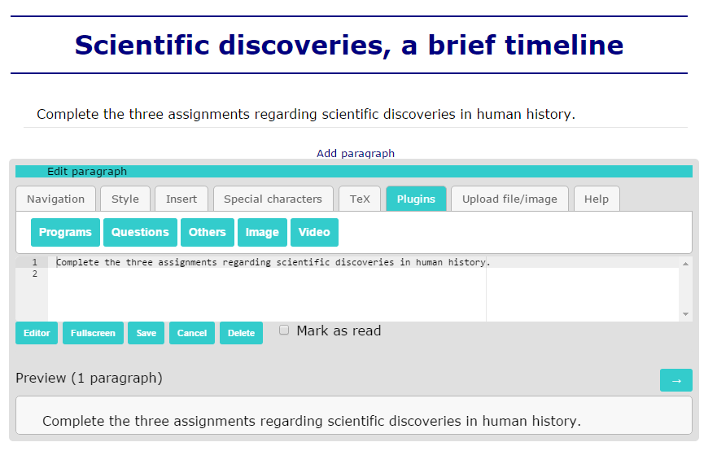

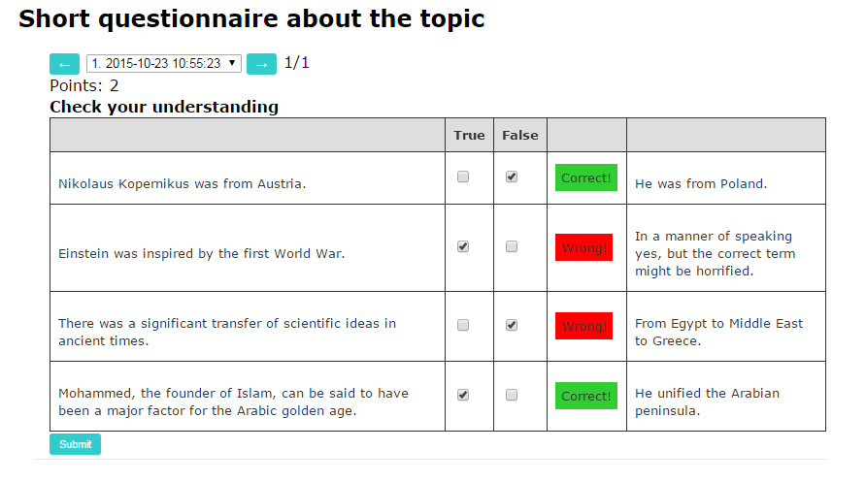
For a teacher
Teacher can browse the full history of submitted assignments of each student, and marks given for each assignment
Teacher is provided with a overall view on how well students succeeded in a particular assignment
A lecture mode of a document can include a lecture wall, a slide show view and clicker question tools
https://tim.jyu.fi tim@jyu.fi
a web browser based electronic learning material, based on the concept of documents.
A document is a continuous stream of elements, such as text, images, and many kinds of interactive components
Creating a TIM document
happens in a web browser.
interactive elements can be added and modified just like text and images.
For a reader
Reader can do the assignments that are embedded in the material
Orange indicators appear next to unread text paragraphs
Material can be commented for the user him/herself or publicly
Faculty of Information Technology UNIVERSITY OF JYVÄSKYLÄ

