Slide 1
Student Performance Dataset
By :
Sami Youcef
Smida Mohamed taher

Slide 2
- Overview :
this database seeks to see if specefic manners affect student performance such as getting helped by parent or go to school or studing more the main thing the data base wants is to check performance (Final grade) to see how we can help students to get better grades
- target :
we can say that this database seeks to see if specefic manners affect student performance such as getting helped by parent or go to school or studing more the main thing the data base wants is to check performance (Final grade) to see how we can help students to get better grades .

Slide 3
The features :
The feature | The meaning
studentID | a numiercal number (float) to tell the specefic student wer working on . and it is not important for predictions
Name | real name (string) for more spefic work also not importnet for predictions
Gender | sex : male or female to see the better one at studying , we can see also that males are slighty more by 5%
AttendanceRate | a float percentage from 0 to 100 to see how often the student go to school to know if going to school helps or no its important for predictions
StudyHoursPerWeek | a number of the hours (float) the student studies each week to see if going more is helpful
PreviousGrade | the student old exam points (float) to see if he changed or still the same

Slide 4
The features :
The feature | The meaning
ExtracurricularActivities | number of activities the student participates in sport.. to see if activies help
ParentalSupport | Level of support at home (Low / Medium / High) to see if getting supported helps we use it in predictions
FinalGrade | the student final score in the class which is the most important thing we are looking for
Study Hours | the study-hours per day this time to see daily vs weekly
Attendance (%) | attendance percentage for online classes
Online Classes Taken | a boolean true or false to see if taking online exams helps the student in points and we use it in predictions

Slide 5
Cleaning data step

Slide 6
Missing data
The feature | Data types | Num missing data
StudentID | float64 | 40
Name | object | 34
Gender | object | 48
AttendanceRate | float64 | 40
StudyHoursPerWeek | float64 | 50
PreviousGrade | float64 | 33
ExtracurricularActivities | float64 | 43
ParentalSupport | object | 22
FinalGrade | float64 | 40
Study Hours | float64 | 24
Attendance (%) | float64 | 41
Online Classes Taken | object | 25

Slide 7
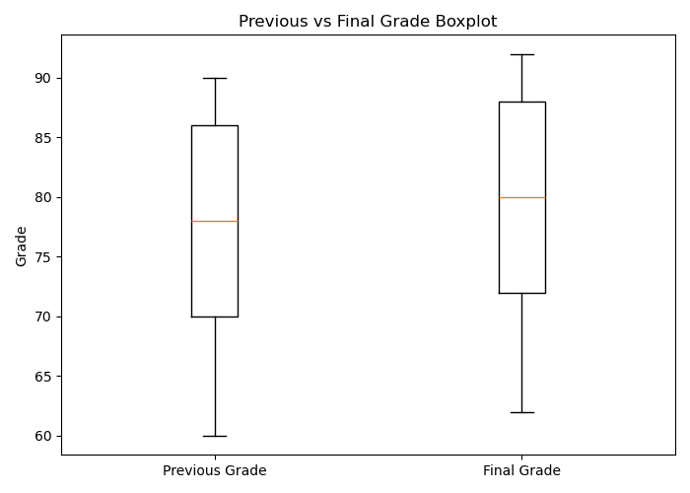
- Cleaning the numerical data :
In the case of digital data, we fill in the missing data with the average in order to maintain the data distribution.
Before
After

Slide 8
- Cleaning the no-numerical data :
In the case of digital data, we fill in the missing data Using two methods :
1 - manual filling :
2 - Remove the less important columns (or those with no effect) :
3 – Filling with the most frequent values to preserve the data distribution :

Slide 9
2 – manual filling :
In our dataset, we have the column 'Gender'; we can infer this column from the 'Name' column , Exam :
Kristina Douglas ➔ Female
Emily Torres ➔ Female
James Anderson ➔ Male
Jeffrey Meyers ➔ Male

Slide 10
2 - Remove the less important columns (or those with no effect) :

Slide 11
3 - Filling with the most frequent values to preserve the data distribution :

Slide 12
Cleaning data step

Slide 13
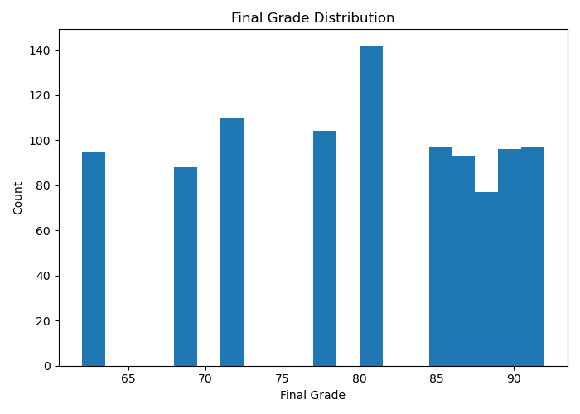
we use it to see distribution of final grade of students and to see if its balanced or not in our case we have good distrubtion and no outliers

Slide 14
to detect outliers and median and to see how is the destrubtion we can see that previious and final grade are close overall

Slide 15
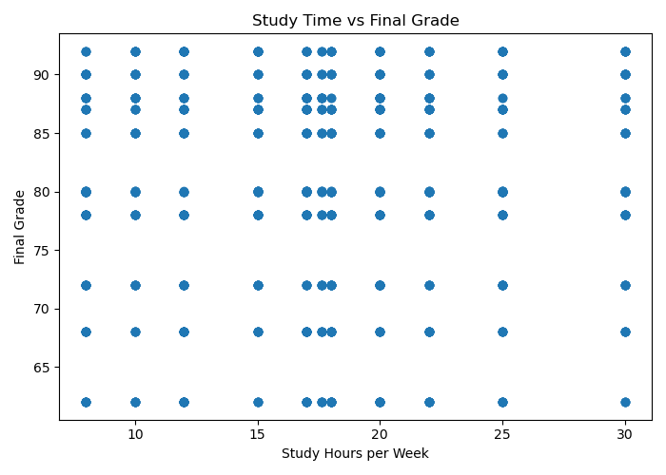
to check relation between study hours / week and the final grades Study hours do not strongly predict final grade

Slide 16
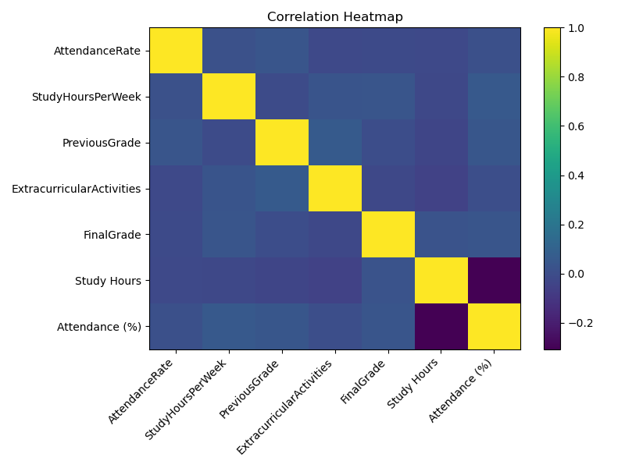
forth Heatmap to see which factors change together and have correlation

Slide 17
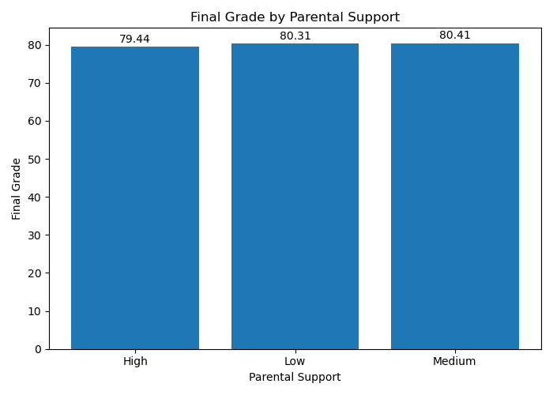
last plot is the bar plot to compare grades of paretnail support to see if it helps with fianl grade

