Slide 1
Agentic Development Practices
in Open-Source Repositories
Adoption, Tooling, and Productivity — An Empirical Study
JetBrains Internship — Task 1 | February 2026
129,134 repos · 73,543 survey responses · 6 data source classes

Slide 2
Research Questions
RQ1
How prevalent is AI agent adoption by project age?
RQ2
What is the competitive structure of the tooling market?
RQ3
Which configuration conventions are gaining traction?
RQ4
What do rigorous studies show about productivity?
RQ5
How fast is automated SE capability improving?

Slide 3
Methodology: Convergent Mixed-Methods Design
Repository Mining
Developer Surveys
Platform Metrics
129,134 GitHub projects (arXiv:2601.18341)
Stack Overflow + JetBrains (73,543 responses)
Official data from GitHub, Anthropic, Cursor
Package Registries
Benchmarks
Community Signals
PyPI + npm monthly downloads
SWE-bench Verified leaderboard
Stars, forks, HN engagement

Slide 4
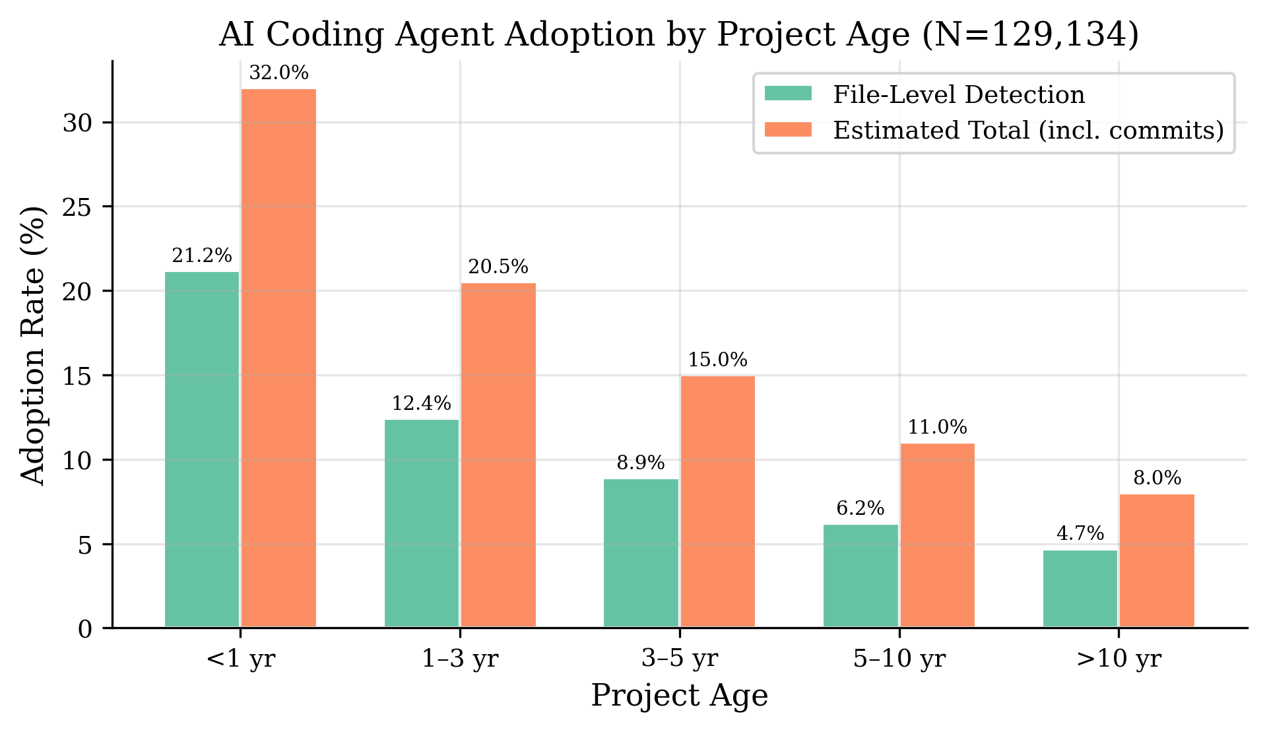
RQ1: Agent Adoption by Project Age
21.17%
Projects < 1 yr
4.69%
Projects > 10 yr
r = −0.86
Age–adoption
correlation

Slide 5
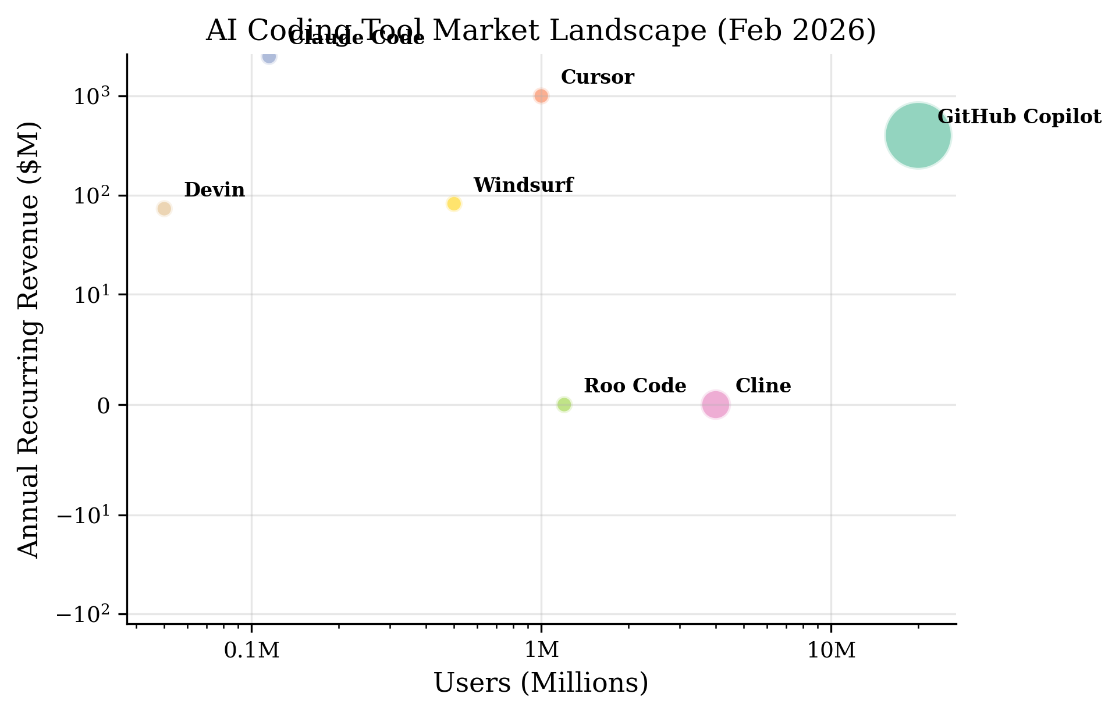
RQ2: Three-Way Oligopoly (HHI = 5,801)
Platform | Users | ARR
Copilot | 20 M | $400M
Cursor | 1 M | $1B
Claude Code | 115 K | $2.5B*
Cline | 4 M inst. | OSS
Windsurf | 500 K | $82M
*Anthropic total ARR
Top 3 = 93.8% of users
HHI > 2,500 = highly concentrated

Slide 6
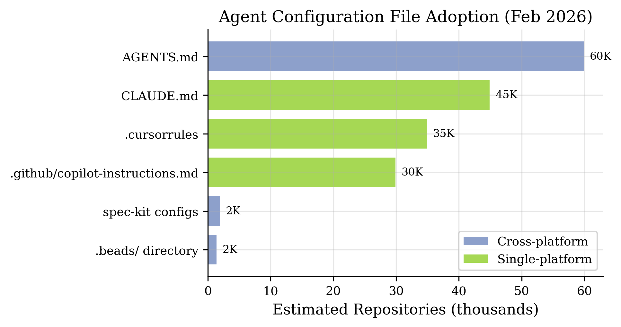
RQ3: AGENTS.md Leads Volume, CLAUDE.md Leads Intensity
Key Findings
AGENTS.md: 60K+ repos, cross-platform standard (Linux Foundation)
CLAUDE.md: 45K repos, 24.1h median update interval (highest intensity)
17% of repos use ALL three major formats simultaneously

Slide 7
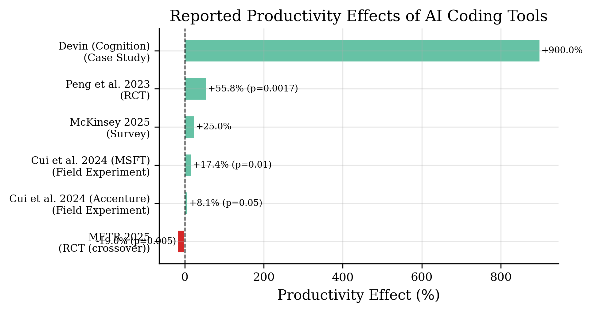
RQ4: The Productivity Paradox
74.8 pp spread
From +55.8% (lab RCT)
to −19% (field RCT)
METR: devs 19% slower
but believed 20% faster
Task type & experience
dominate outcomes

Slide 8
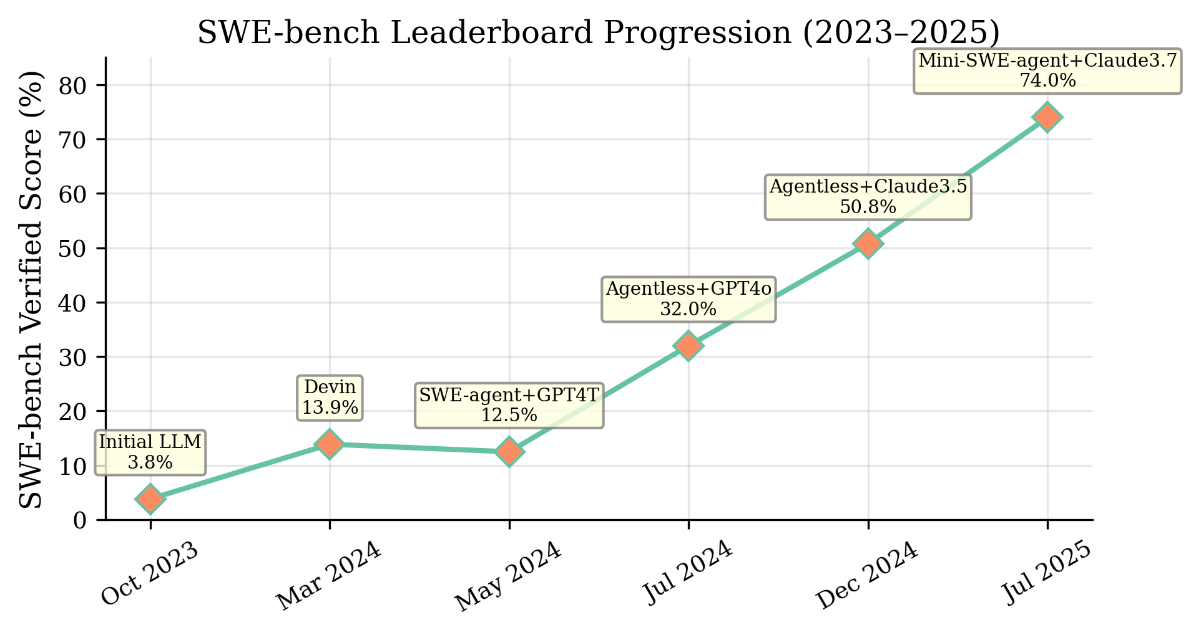
RQ5: Near-Exponential Capability Growth
19.5×
improvement
in 21 months
r = 0.95
log-linear
correlation
p = 0.004
highly
significant

Slide 9
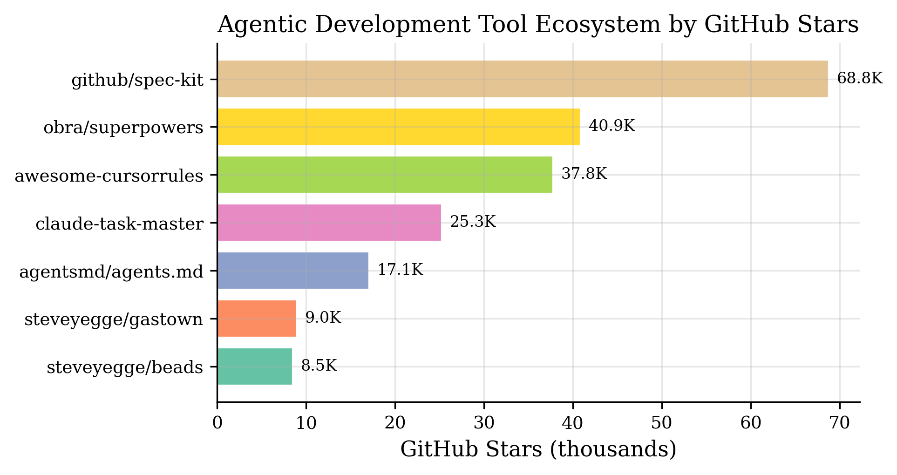
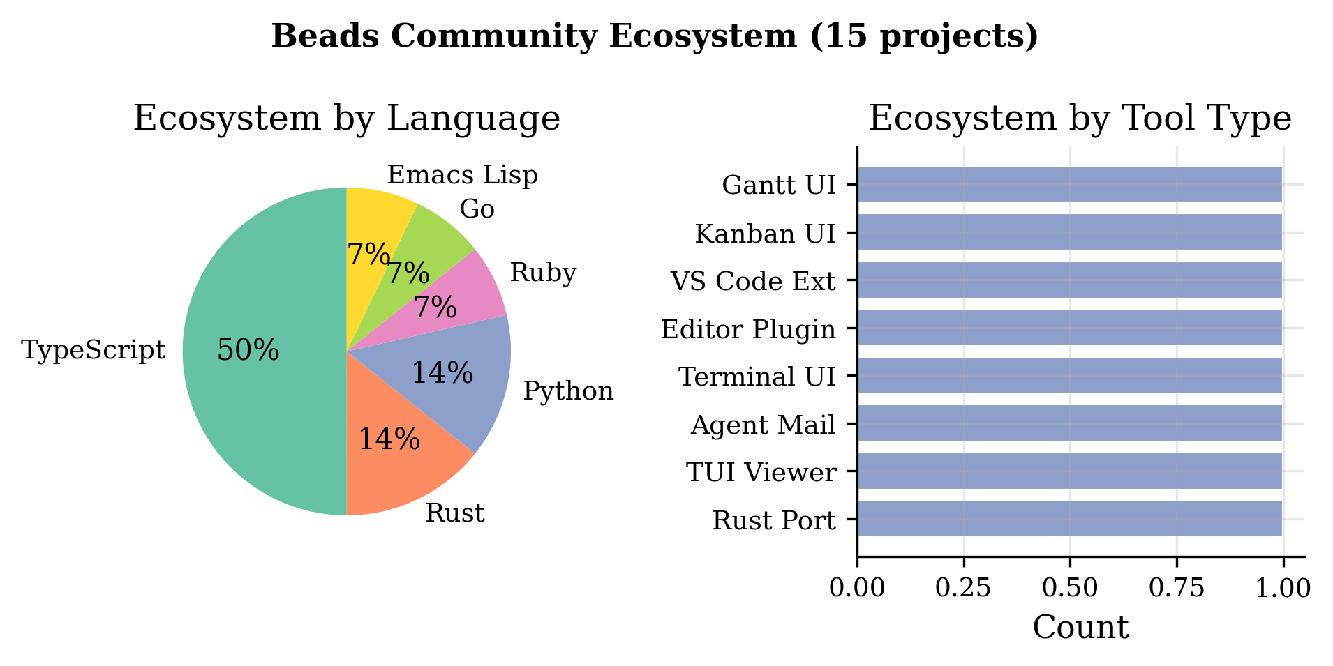
The Agentic Tool Ecosystem & Beads
Beads: 3-layer architecture (CLI → SQLite → JSONL/Git) · 240K lines Go · 175 commands · 15 community tools
Gas Town: Multi-agent orchestrator built on Beads — formulas, gates, slots, wisps, swarm

Slide 10
Hypothesis Test Results
H1
Adoption ↓ with project age
r = −0.86, p = 0.064
Directionally
confirmed
H2
Productivity varies by design
−19% to +55.8%
Confirmed
H3
AGENTS.md vol / CLAUDE.md maint.
60K vs 24.1h updates
Partially
confirmed
H4
Three-platform oligopoly
HHI = 5,801
Confirmed
H5
SWE-bench log-linear growth
r = 0.95, p = 0.004
Confirmed

Slide 11
Implications for JetBrains
1
First-Class AGENTS.md Support
60K+ repos use it. Cross-platform standard backed by Linux Foundation. IntelliJ IDEs should parse, validate, and auto-generate these files.
2
Persistent Memory Integration
Beads-style tools solve the '50 First Dates' problem. IDE hooks for .beads/ directories, dependency visualization, and agent onboarding flows.
3
Benchmark-Aware AI Features
SWE-bench scores growing 19.5× in 21 months. IDE AI features should track this capability frontier and adapt task delegation accordingly.

Slide 12
Conclusion
15.85–22.60% of active GitHub projects now use AI coding agents
Three-platform oligopoly (HHI 5,801) with multi-tool usage (>1.6 agents/project)
Productivity ranges −19% to +55.8% — context and task type dominate outcomes
SWE-bench capability growing near-exponentially (19.5× in 21 months, p=0.004)
AGENTS.md emerging as cross-platform standard; Beads pioneers 'agentic memory'
All code and data are open-source · python src/analyze.py regenerates every result

