Slide 1
Application mobility and service continuity
Jun Cao

Slide 2
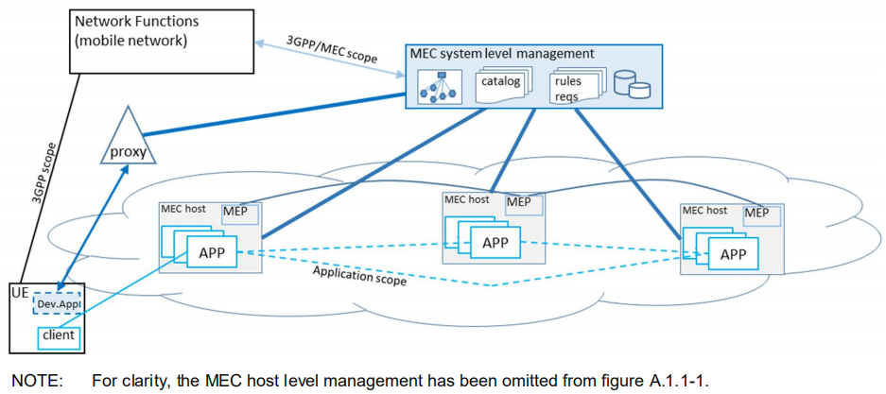
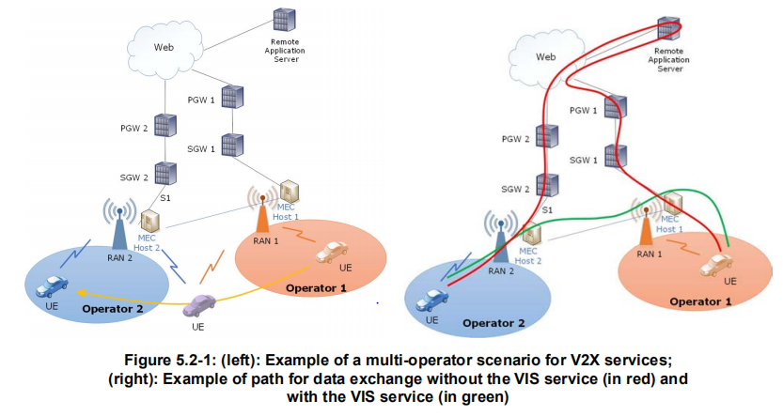
Standard: ETSI MEC
Related work:
MEC 002 Phase 2: Use Cases and Requirements
MEC 003 Framework and Reference Architecture
MEC 018 End to End Mobility Aspects
MEC 021 Application Mobility Service API
MEC 022 Study on MEC Support for V2X Use Cases
MEC 030 V2X Information Service API
MEC 035 Study on Inter-MEC systems and MEC-Cloud systems coordination (draft)

Slide 3
Standard: others
3GPP SA6
GSMA OPG

Slide 4
Scene: Interactive live broadcast/RTC
City
Province
Public cloud
Mobility:
Audience moving(car、train)
migrate application instance to nearby edge
Burst large number of audiences
deploy new application instance on nearby edge
migrate application instance to nearby edge
new host joins
update distribution of mixing task
Switch screen
update distribution of mixing task
other?
Host
Suzhou
mixing
Suzhou
Audience
Suzhou
migration
mixing
migration
Shanghai
migration
Hangzhou
move
mixing
Wuxi
Burst large number of users
new host joins
Audience
Audience
Host
Host
Wuxi
Hangzhou
Shanghai
Notes:
云网融合
网络提供的能力SSC、事件，PaaS对接网络，为应用层提供框架、流程
UPF-UPF互连，PaaS对接
Edge mesh

Slide 5
Scene: Cloud phone、Cloud game
City
Province
Public cloud
Mobility:
User moving(car、train)
migrate cloud phone instance to nearby edge
Edge load is too high
migrate cloud phone instance to higher edge
migrate cloud phone instance to ohter edge
Multiplayer online games - join/quit
User
Cloud phone
Suzhou
Suzhou
The load is too high
Cloud phone
migration
Cloud phone
migration
Shanjhai
移动
Hangzhou
Cloud phone
Wuxi
User
User
Wuxi
Hangzhou

Slide 6
Scene: V2X

Slide 7
Network Overview --- 5G
Public Cloud
Public Cloud
To Cloud network
Gateway
Inner-Operator
BGP
Inter-Operator
POP/Edge
Cloud
POP/Edge
Cloud
IXP
Inter-MEC network
UPF interconnection
UPF
MEC
MEC
UPF
UPF
MEC
MEC
UPF
RAN
RAN
Access network
RAN
RAN
move
move
UE
UE
UE
UE
Inner-Operator
Inter-Operator

Slide 8
Network Overview --- WIFI (TODO)
Public cloud
Public Cloud
To Cloud network
Gateway
Inner-Operator
BGP
Inter-Operator
POD/Edge
Cloud
POD/Edge
Cloud
IXP
Inter-MEC network
Mesh network
Mesh network
WIFI-AP
MEC
MEC
WIFI-AP
WIFI-AP
MEC
MEC
WIFI-AP
Access network
move
Move
UE
UE
UE
UE
Inner-Operator
Inter-Operator

Slide 9
Use Case Overview: UE moving
UE moves inner-operator
MEC
MEC
MEC
MEC
MEC
MEC
APP
APP
APP
APP
√
UPF
UPF
UPF
UPF
UPF
UPF
UE
UE
UE
UE
UE
UE
UE moves inter-operator
UE moves cross cloud and MEC
Operator1
MEC
MEC
MEC
X
MEC
MEC
MEC
MEC
Cloud Edge
APP
APP
APP
APP
APP
√
APP
Operator2
√
Cloud
UPF
UPF
UPF
UPF
UPF
UPF
UPF
?
UE
UE
UE
UE
UE
UE
UE
UE
Switch between 5G and WIFI
UE moves inner-WIFI
UE moves cross cloud and MEC
MEC
Cloud Edge
MEC
MEC
MEC
MEC
MEC
MEC
MEC
APP
APP
APP
APP
APP
APP
APP
√
√
WIFI
WIFI
WIFI
WIFI
WIFI
WIFI
WIFI
?
UPF
WIFI
UE
UE
UE
UE
UE
UE
UE
UE
UE
UE
UE moves cross 5G and WIFI
UE moves cross 5G and WIFI
MEC
MEC
MEC
X
MEC
MEC
MEC
MEC
MEC
X
APP
APP
APP
APP
APP
APP
MEC
MEC
MEC
MEC
√
√
APP
APP
UPF
WIFI
UPF
WIFI
UPF
WIFI
WIFI
UPF
WIFI
UPF
WIFI
UPF
UE
UE
UE
UE
UE
UE
UE
UE
UE
UE
UE
UE

Slide 10
Use case overview: Application migration
Application migration inne-operator
MEC
MEC
MEC
MEC
MEC
MEC
APP
APP
APP
APP
APP
APP
√
MEC
Province
MEC
Province
APP
APP
√
UPF
UPF
UPF
UPF
UPF
UPF
City
City
UPF
UPF
UE
UE
UE
UE
Application migration inter-operator
MEC
MEC
MEC
MEC
MEC
MEC
APP
APP
APP
APP
APP
APP
√
MEC
Province
MEC
√
Province
APP
APP
UPF
UPF
UPF
UPF
UPF
UPF
City
City
UPF
UPF
UE
UE
UE
UE
Application migration cross cloud and edge
MEC
Cloud Edge
MEC
Cloud Edge
MEC
Cloud
MEC
Cloud
APP
APP
APP
APP
APP
APP
APP
APP
√
√
UPF
?
UPF
?
UPF
?
UPF
?
Operator1
UE
UE
UE
UE
Operator2
Cloud

Slide 11
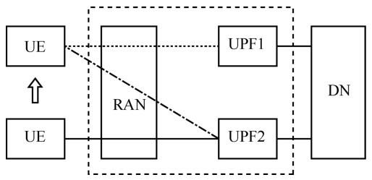
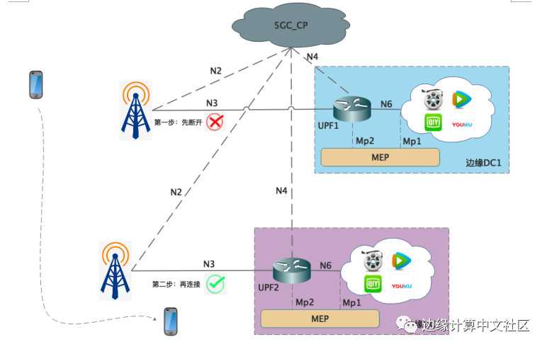
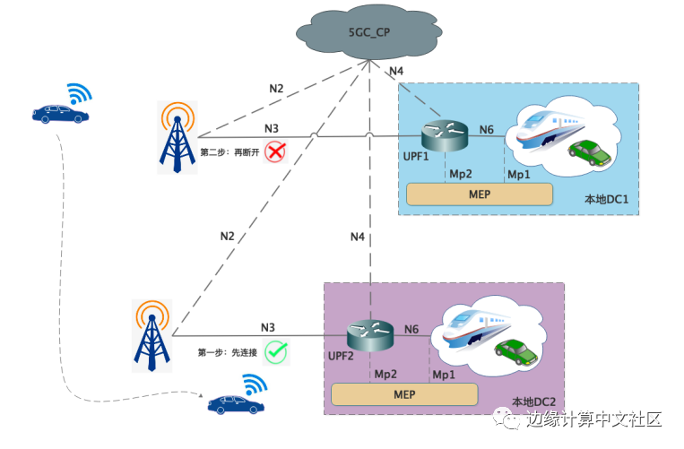
5G network SSC
SSC mode | Characteristic | Scene
SSC mode1 | Always keep the UPF of the protocol data unit (PDU) when the session is established unchanged. The terminal IP address does not change | Delay insensitive and session continuity demanding services: carrier voice, video, etc
SSC mode2 | The anchor UPF of the PDU session can be changed. The network triggers the release of the PDU session and instructs the UE to immediately establish new PDU session. The terminal IP address will change | Delay insensitive and session continuity less demanding services: Internet browsing data, etc
SSC mode3 | The anchor UPF of PDU session, can be changed. First, a new PDU session is established, then the original PDU session is released, and the business is maintained. The terminal IP address will change | Business perception (business needs to participate in process) and business with strict business continuity requirements
SSC 2
SSC 3
Notes:
https://www.sohu.com/a/432882553_734726?spm=smpc.author.fd-d.6.1610355291806h7HH1VX

Slide 12
Mobility Support on PaaS
PAAS layer formulates the framework and process for the application, helping the application solve the service continuity in the scenarios of UE mobility and application migration
Key issues on PaaS:
Cooperate with SSc and location service of wireless network, provides event mechanism
Subscribing events from a wireless network system
Prediction of terminal moving trajectory
Provide different levels of application migration mechanism
Helping UE access service after application migration
Notes:
高可靠保障：结合uRLLC双链路特性，采用双PDU会话不同切片，UE和DN间使用两条独立的网络路径，一条路径上任意网络节点故障，包括RAN、UPF、交换机、路由器等设备，UE和DN间数据帧零丢失。

Slide 13
Mobility Support on Application
Application should consider:
Stateless，Reduce the amount of state data that needs to be migrated，Using central / cloud storage to ensure the final consistency of application state
Subscribe events，Adjust the output content (such as reducing the bit rate) to ensure the user experience

Slide 14
Fuction overview (TODO)
APP Control plane
Public Cloud
NaaS
Traffic Management(Device\Edge\Cloud)
Resource and application management
Capacity exposure
(Location、QOS)
UE Info
(Location、network)
Edge traffic dispatch
(Service discovery)
mobility and continuity
(edge - edge network、application migration)
Inter-MEC network
Inner-Operator Network
Inter-Operator Network
Cloud network
3rd network
Mesh network
Gateway
UPF interconnection
BGP
POP/Edge
IXP
WIFI Mesh
APP
APP
MEC
Edge Gateway
(Data traffic、control flow)
Edge Enabler
(Capacity exposure：Location、QOS、traffic steering)
Application migration
(workload migration、state synchronization)
Contanier engine
container network
container storage
Edge - Edge network
Infrastucture
4G
5G
WIFI
Access network
5GC(Control plane)
UPF(data plane, ULCL、SSC)
Gateway
RAN
WIFI-AP
UE
Android
IOS
XXX OS
Client APP
Client APP
Client APP
SDK(service discovery)
SDK(service discovery)
SDK(service discovery)
network(4G,5G,WIFI)
network(4G,5G,WIFI)
network(4G,5G,WIFI)

Slide 15
DEMO (TODO)
Options
1: WIFI AP + UE Reports Location Reporting(GPS)
2: CPE + 5GC simulator(Location service)
3: 5G Networkt(UPF + Location service)
Scene and application：
1. Website
2. Cloud phone/Cloud game
3. ?
Public Cloud
5GC simulator
(Location Service)
Public Cloud
Gateway
Gateway
Gateway
Mesh network
WIFI-AP
MEC
MEC
WIFI-AP
MEC
UPF
MEC
CPE
CPE
move
move
UE
UE
GPS
UE
UE
GPS
GPS
GPS
Notes:
gs_MEC013v020101p对Location服务有定义，可以参考实现相关的API。

Slide 16
Flow( TODO )
Cloud
5GC
Edge Enabler/CAPIF
(5G Capacity exposure)
Traffic Management(Device\Edge\Cloud)
APP管理面
NEF
mobility and continuity
(edge - edge network、application migration)
Global Manager
UE Info
(Location、network)
Edge traffic dispatch
(Service discovery)
PCF
UDM
Subscribe to UE location tracking events
Cluster
AMF
SMF
Edge Site
Edge Site
4. Start application migration process
5. deploy new application instance
UPF
MEC
UPF
MEC
APP
APP
Application migration
6. state synchronization
Application migration
Edge - Edge network
Edge - Edge network
Edgecore
Edgecore
First access
Optional：Report network information, signal strength, delay
1. Gets the address of the edge service instance
Acess after migration
7. Gets the address of new edge service instance
UE
Client APP
UE
Client APP
8. Establish session 2 to new edge UPF (wireless network data plane)
SDK/Envoy-mobile
2. Establish session 1 to edge UPF (wireless network data plane)
OS/Network/Driver
3. Connect to service instance on the edge
SDK/Envoy-mobile
9. Connect to new service instance on the edge
move
OS/Network/Driver

Slide 17
Data Model(TODO)
Detail object and data model
Edge site
Location
Coverage
xxx
Application
xxx
UE
Location
xxx

Slide 18
Application migration mechanism and flow
Provide different levels of application migration mechanism
(1)<stateful + ?>Do not migrate application instance and state，UE access old edge and application insatnce
(2)<stateless + share>Do not migrate application instance and state，UE access new edge and application insatnce
(3)<stateful + share>Do not migrate application instance, Migrate state to new application instance，UE access new edge and application insatnce
(4)<stateless + non-share>Migrate applicatin instance to new edge，Do not migrate state，UE access new edge and application insatnce
(5)<stateful + non-share>Migrate applicatin instance to new edge, Migrate state to new application instance，UE access new edge and application insatnce
TODO：Detail progress，includes application instance migration fow(UE track prediction、migration policy decision、Container image preloading and etc)、state synchronization (edge - edge data synchronization、distributed file system、distributed database and etc)

Slide 19
Edge - Edge network(TODO)
TODO:
L1-L4：Inter-MEC network(Shorter network path，Network management<SDN，EVPN...>)
L3-L4：Container network coordination with Inter-MEC network
L7：Inter-MEC service discovery and access(Edgemesh)
Network
Network
Inter-MEC virtual network
VPN/EVPN
Gateway
Endpoint - Endpoint
NAT
Gateway
Inter-MEC container network
Cilium Cluster Mesh
MEC Host A
MEC Host B
MEC Host A
MEC Host B
Notes:
https://zhuanlan.zhihu.com/p/137934225

Slide 20
Detail Design:Framework、module、event/msg(TODO)

