Slide 1








Overall
Vehicle Type
Revenue
Cancellation
Ratings

Slide 2
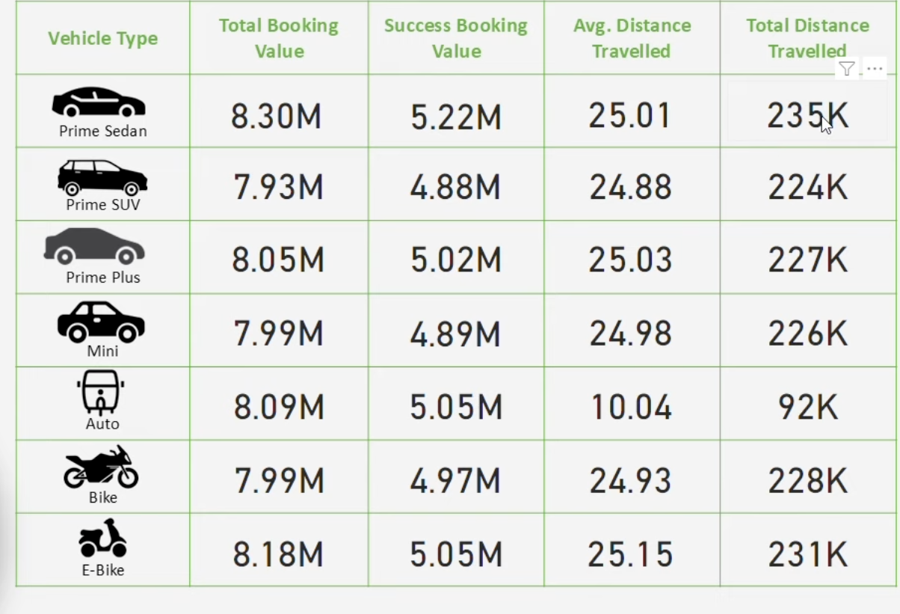


Overall
Vehicle Type
Revenue
Cancellation
Ratings

Slide 3
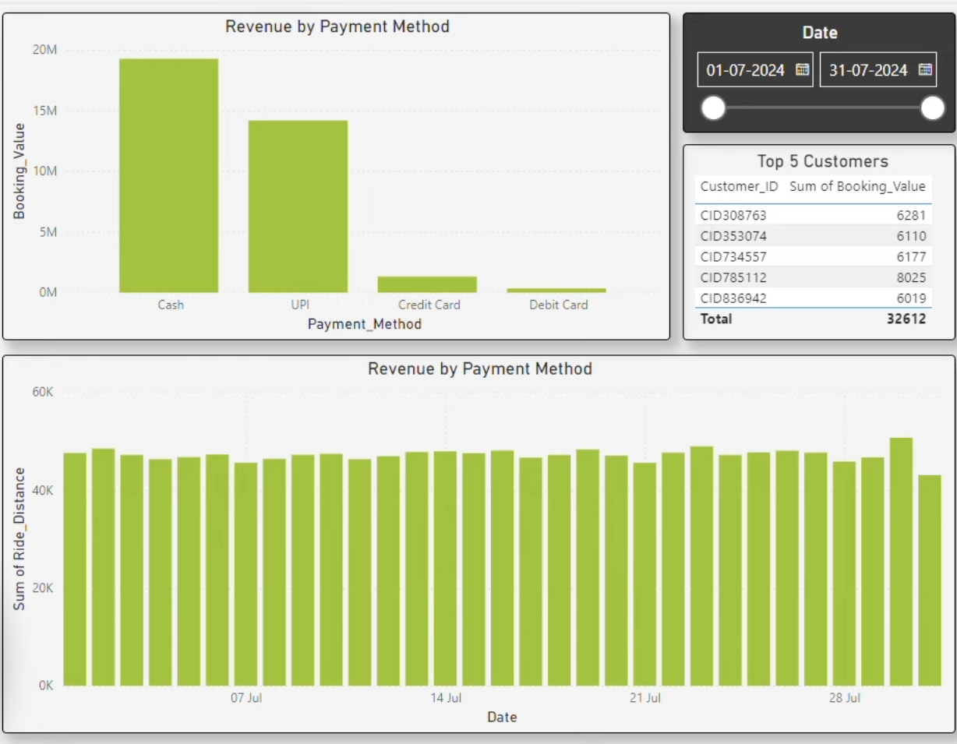

Overall
Vehicle Type
Revenue
Cancellation
Ratings

Slide 4
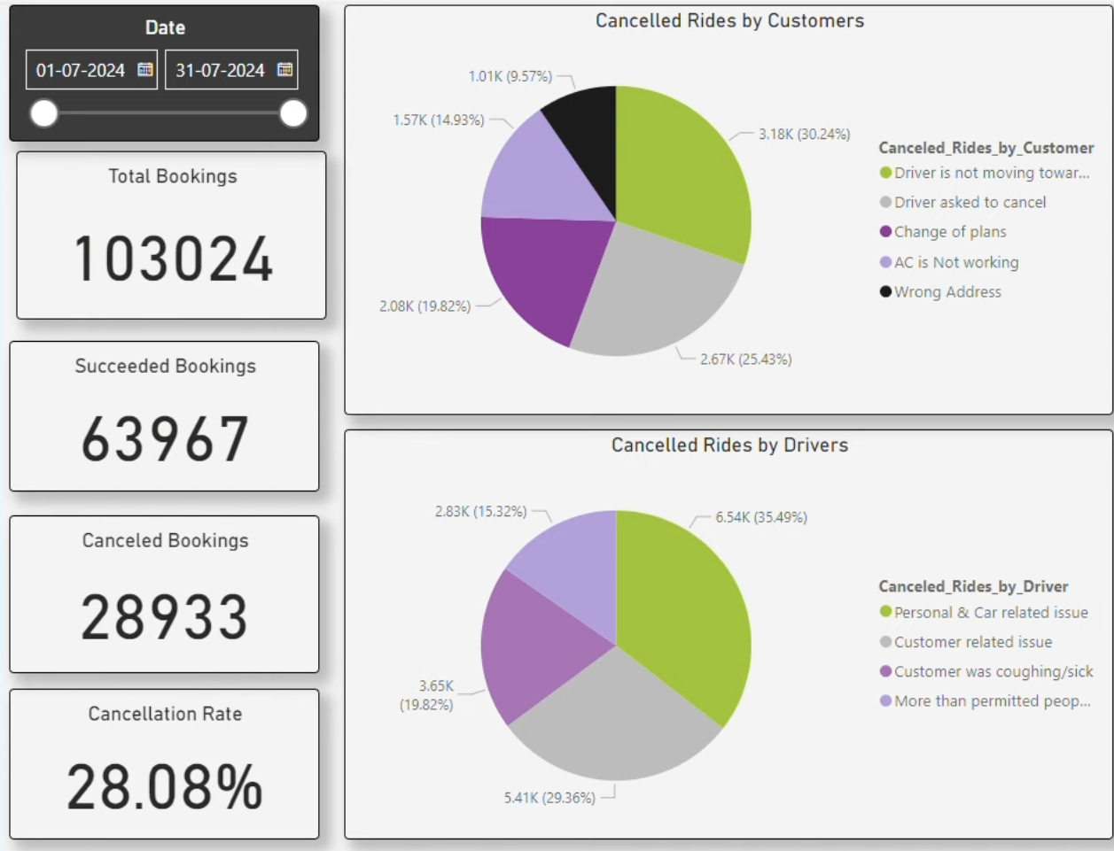

Overall
Vehicle Type
Revenue
Cancellation
Ratings

Slide 5
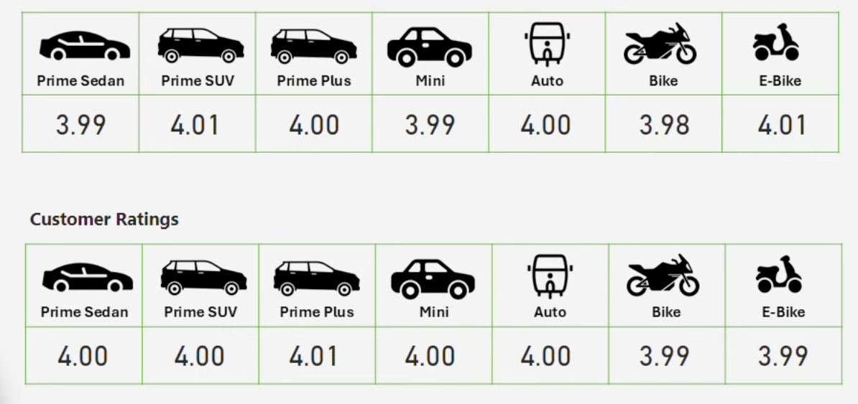

Overall
Vehicle Type
Revenue
Cancellation
Ratings

