Slide 1
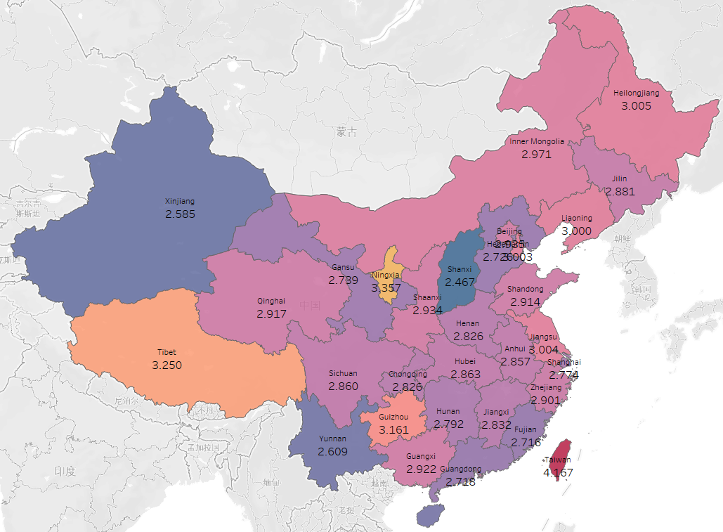

AGG(real average score)
Hainan
2.625

