Slide 1

Presented by Samia Islam Monira Mukta

Slide 2

“House Rent Service”
Rent House

Slide 3

Time
Complexity
Labour

Slide 4

“House Rent Service”
Saves Time
Reduces complexity
Simple

Slide 5

Stakeholders
House Owner
Tenants
Users
Admin
System Developer

Slide 6
Requirements
Non-Functional Requirements
Functional Requirements

Slide 7
Post Advertise
See Advertise
Comment on post
It is reliable
Deployed by C#
Secured
Functional Requirements
Non-Functional Requirements

Slide 8
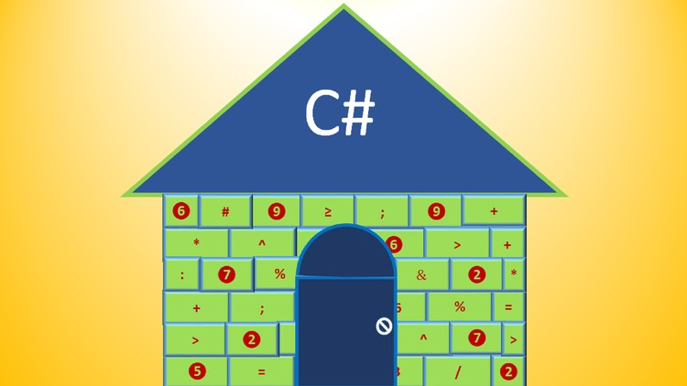
Implementation
User
Admin
Tenant
House Owner

Slide 9
Admin
- Controls the Software.
- Authenticate user subscription
User
-Search
-Post
-Comment

Slide 10

Limitation
Admin has less Functionality
UI design is not Attractive
Comment can not be edited

Slide 11

Future Work…….
Turn into Android Application Format
Apply Machine Learning Algorithm & Technique

Slide 12


Thank You

