Slide 1
College Event Website
Group 18

Slide 2
Group Members
Alex Phillips
Luis Casanova
Jonathon Towne

Slide 3
Project Summary
Our project allows student organizations to publish event for students at specific universities. The website also allows students to browse these events that will occur at their university. The students can become admins by creating petitions for new student organizations. Which become RSOs after five unique signatures applied to the petition. The RSO admin create events for their organizations. Events are also pulled from university event feeds.

Slide 4


Description of the App
Development of the website was made on a WAMP server.
With that said we used windows machine, apache, MySQL, PHP.
For the website we wrote it in HTML, CSS and JavaScript.

Slide 5
ER Model

Slide 6
Relational Data Model

Slide 7
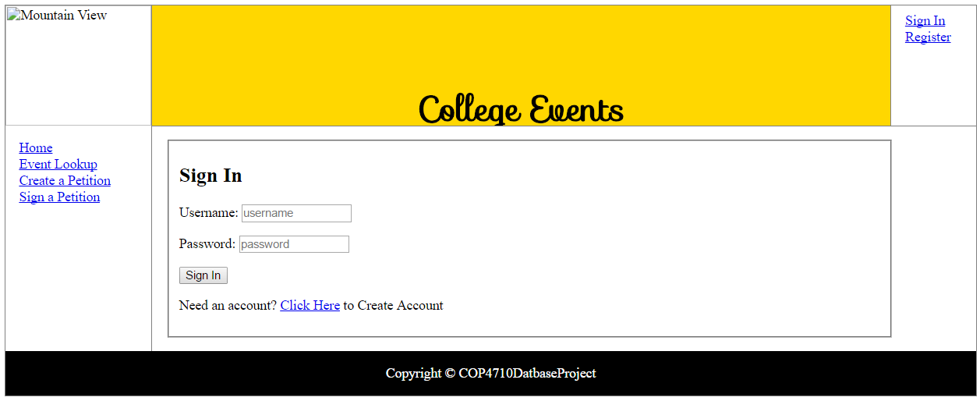
Screenshot GUI

Slide 8
Screenshot Database

Slide 9
Screenshot Event Creation

Slide 10
Screenshot Event Shown to User

Slide 11
Screenshot Event Details

Slide 12
Additional Features
Our project uses a live search feature that changes display of the events as you type into the search bar.

Slide 13
Conclusion

