Slide 1
Caffeine Machine
A WebGL Based Visualization
By Sarah Miles

Slide 2
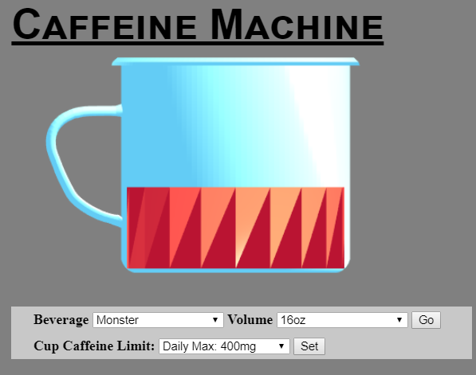
Introduction
Interactive data visualization of the amount of caffeine in beverages
Visualized as a coffee cup filling for caffeine input the user selects
Intent is to inform the user of the scale of a person’s caffeine intake and the relative amounts of caffeine in products

Slide 3
Functional Requirements
Caffeine amount is displayed proportionate to the cup’s volume
By default, volume of the cup represents maximum daily recommended intake
User may select beverage to display
Amount is selected in ounces
User may set a custom cup “volume”
All caffeine inputs will scale accordingly

Slide 4
Materials and Resources
The program is written using a combination of JavaScript, HTML, and CSS
The coffee cup model is imported from free3D.com, and converted to an .off file in MeshLab
The cylinder used to represent the beverage amount was created in maya and converted in Meshlab

Slide 5
Design Overview
Based off of WebGL library
Caffeine amounts are hard-coded per ounce
This amount corresponds to the height of the cylinder
The user sets the cup limit through a dropdown of values

Slide 6
Detailed Design:
Object Rendering I
Parsed converted .obj files of cup and cylinder to derive vertex and face arrays
Files loaded as resources from gitHub
Vertex and face arrays run through createMesh via parameters

Slide 7
Detailed Design: Object Rendering II
Mesh and normals returned from createMesh() allocated space in GPU with bufferData()
Buffered data sent to GPU with render()
Lightning model and physical transformations called before each object rendered

Slide 8
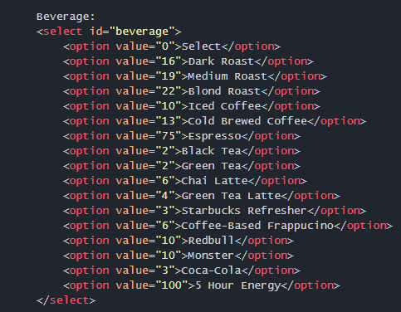
Detailed Design:
Caffeine Calculation I
Caffeine amounts hardcoded into selection boxes

Slide 9

Detailed Design: Caffeine Calculation II
“Go” >> beverage caffeine per ounce multiplied by volume chosen
createProportionateCyl() called
If overflow,, message generated

Slide 10
Detailed Design: Interface
Dropdowns
Functionality of “Go” button
Drop-downs selected in any order
Consistency of interface
Color scheme

