Slide 1

Extractive Text Summarization
Group members
Ashwin Sankarasubramanian
Niket Kathiriya
Purvang Shah

Slide 2
Introduction
What is Extractive Text Summarization?
In Extractive Text Summarization, important information(sentences) is extracted from the given text or a document.

Slide 3
Q-Learning Introduction
Quality Learning is a Reinforcement Learning algorithm.
For understanding Q-Learning, we need to understand the following concepts:
State
Action
Environment
Reward

Slide 4
Q-Learning Introduction
It seeks to maximize the cumulative reward.
Steps that are followed in Q-Learning are:
Exploring - Finding more information about the environment.
Exploiting - Exploiting the environment to maximize the rewards.
Basically, Q-Learning uses future rewards to impact present actions in a particular state, assisting the agent in selecting the optimum actions that maximize total reward.

Slide 5
Implementation
To fit the text summarization problem in the Q-learning algorithm, the attributes are configured as below:
Environment = Input text
Each sentence in the environment has two possibilities. 1)Chosen or 2)Not chosen for the candidate summary.
Thus, State = candidate summary (where different states refer to different combinations of sentences chosen for the summary)
Action = Selection of a sentence to be added to candidate summary
Reward = (Similarity between the candidate summary and input text – redundancy within the candidate summary)
The similarity and redundancy are measured by cosine_similarity.

Slide 6
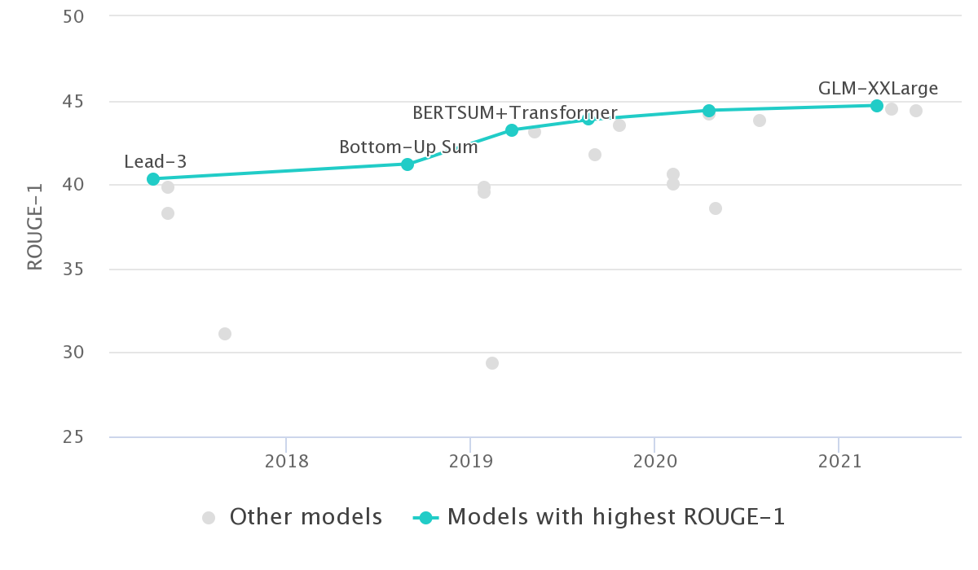
Results
Dataset = CNN-DailyMail News Text Summarization/test.csv
Evaluation metric: ROUGE-1
State of the art algorithms for the same dataset shows the maximum score of 45.
Our implementation resulted in a score of 31.8
Figure: https://paperswithcode.com/sota/document-summarization-on-cnn-daily-mail

Slide 7
Problems in this approach
The solution has a loop that has exponential runtime (2^{no. of sentences}). If the input text was having more than 20 sentences, the program did not terminate.
To get the scores, we changed the loop condition as below:
If (number of sentences > 15), then execute the loop only 2¹⁵ times.
If (number of sentences < 15), then execute the loop for the entire 2^{no. of sentences} times.
With this change, for the test dataset having 11k+ texts, we received a Rouge-1 score of 31.7 after 3 hours of execution.
This result also includes the sub-optimal summaries of input texts having more than 15 sentences.
When we performed this experiment only on the texts having less than 15 sentences, we received a Rouge-1 score of 37.8
Moreover, in another experiment, we increased the threshold from 15 to 18 and then executed the algorithm for all the 11k+ texts. (The result calculation includes sub-optimal summaries)
The Rouge-1 score was 31.8 (not enough change)
The execution time was 18 hours!!
The algorithm does not scale well.

Slide 8
TextRank Introduction
Two major components of Text summarization evaluation:
Accuracy: Whether the content in the document has been captured by the summary.
Fluency: Whether the produced summary has sentence and grammatical fluency.
GLoVe: Global Vectors for Word representations
We use glove.6B.100D: Word vectors pre-trained unsupervised on a vocabulary consisting of 6 Billion words and having 100-dimensions.
These word representations capture the similarity in meaning between different words.
NLTK Stopwords:
Stopwords are words that are not significant to the summary from the document.
Used to produce a more accurate and concise summary for the document.

Slide 9
TextRank Implementation
Sentence vectors are produced using the remaining words and their GLoVE representations.
A similarity matrix of the document is calculated using cosine similarity measure between the produced sentence vectors.
Scores for the sentences are calculated from the similarity matrix.
The best 5 sentences are chosen to be included in the summary.
By comparing the accuracy of this summary against the highlights label available in the dataset, the average ROUGE F1 statistic for the testing dataset is obtained.

Slide 10
Results
Execution on whole CNN Daily Mail Test Dataset: 11490 articles.
Execution on articles containing up to 100 sentences.
Evaluation metric: ROUGE-1
Achieved an average score of 27.7.

Slide 11
Thank you

