Slide 1


What is Microservices architecture?
Microservices is a subset of SOP architecture that consists of decomposing an application into a set of independent and self-contained services communicating between each other.
Each service should be
small-sized,
independently deployable, and loosely coupled

Slide 2

Why Microservices architecture?
continious delevery
our project is unlimited with unfixed functional requirements in fact, for now, we're starting with portfolios’ management including equities however there is several types of assets besides the equity where each has its own way of doing and its own data structure so for each we should create a customized service also since we're dealing with a very delicate data having an isolated one allows us to protect it from threads’ spreading
supporting heterogeneity (diff languages and platforms)
room to independently devlop and deploy services
Fault isolation which leads to a higher error tolerance
scalability and integration with third-party services
Notes:
Microservices architecture has a lot of benefits some of them are listed below
Threads isolation
room to independently devlop and deploy services
continious delevery/ error tolerance
scalability and integration with third-party services
supporting heterogeneity (diff languages and platforms)
better security monitoring thanks to services isolation (threads are limited in the attacked service's zone)

Slide 3


Angular vs react
Type
Type
Front-end framework
Front-end Javascript library
data flow
data flow
Unidirectional
Bidirectional
Written in
Written in
JavaScript XML
TypeScript
Architecture
Architecture
Combined with Flux
Component-based
Learning curve
Learning curve
Medium
Low
Brands
brands
SONY, Nike and YouTube
Dropbox, Netflix, Instagram, and PayPal

Slide 4
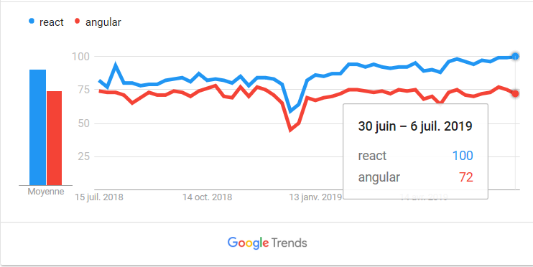
Angular vs react
React has been well established in the market since it is older than angular also as mentioned in the previous slide React has lower learning curve than Angular which makes it easier to use and this explains the increased interest of developers in leaning it as shown in this next diagram.

Slide 5
Angular vs react
Unlike the bidirectional data flow, The unidirectional one doesn’t decrease the performance in complex applications so we don’t need to focus on that issue with react as much as with Angular also react uses virtual DOM elements which lighten the content thus shorten the loading time besides that it provides a great packaging and free space to experiment which allows as to enjoy a better customization experience
Therefore we concluded that React is much more adequate than Angular for such an incremental project as ours

