Slide 1
Advertising’s criticism
Higher Institute of computer science
Eya TAIEB
Houyem BARAKETI
Monia GHOUILI
Yosra GOUAIED
2017 ~ 2018

Slide 2
General presentation
Advertising’s description
criticism & consequences
New proposition
Conclusion

Slide 3


General presentation

Slide 4
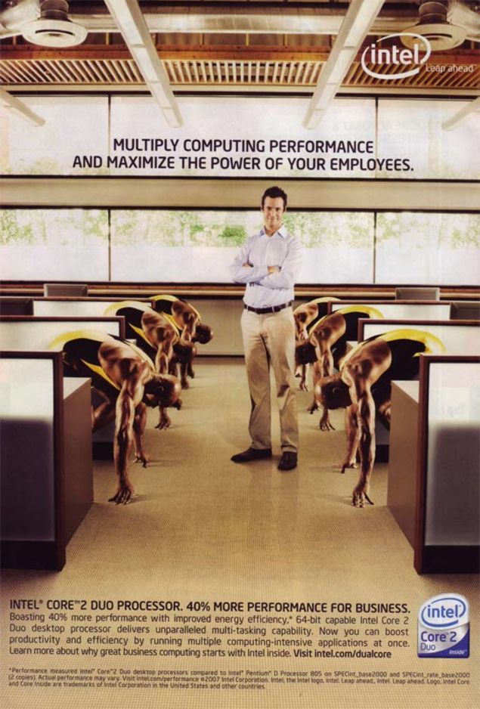

Advertising’s description

Slide 5
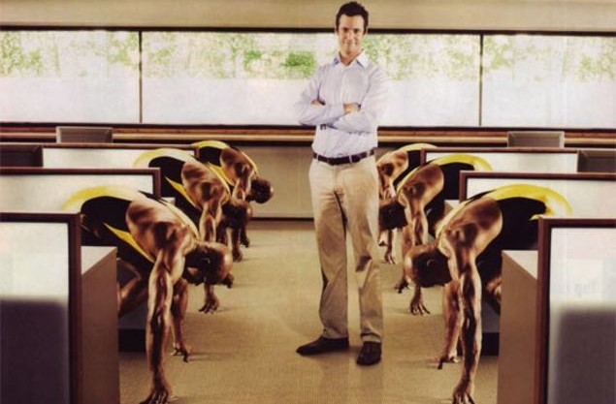

Our criticism
Notes:
Kol point bech n’inseri image w mdaawra feha l7aja eli bech non9doha fil ad lbe9i lkol will be

Slide 6
Consequences
"Unfortunately, this ad
using African-American sprinters did not deliver our intended message, and in fact proved to be culturally insensitive and insulting."
pulling the ad lost of money
“We made a bad mistake. I know why and how, but that simply doesn't make it better.”
racist accusations
Rejection from costumers

Slide 7
New proposition

Slide 8






Slide 9

Conclusion

Slide 10
THANK YOU FOR YOUR ATTENTION

