Slide 1



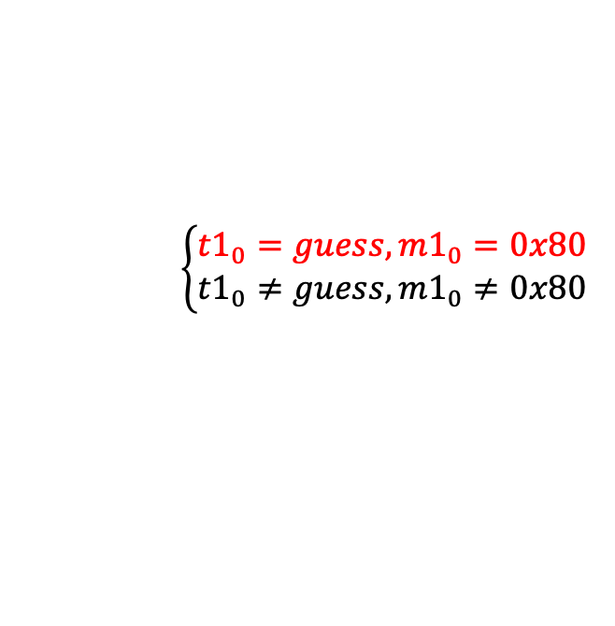
$$(guess)⊕0x80$$
IV
C0
C1
Dec Function
Dec Function
t0
t1
$$\left({t1}_{0}\right)⊕\left(guess\right)⊕0x80$$
$$\left\{\begin{aligned}{t1}_{0}=guess, {m1}_{0}=0x80 \\ {t1}_{0}≠guess,{m1}_{0}≠0x80\end{aligned}\right.$$
m0
m1
$$Finally: {m1}_{0}={t1}_{0}⊕{C0}_{0}$$

Slide 2




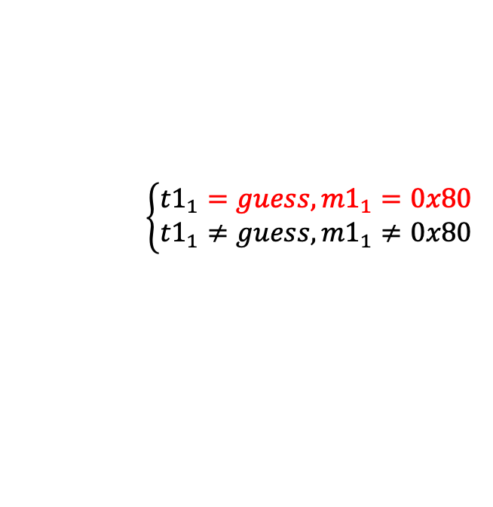

$$\left(guess\right)⊕0x80$$
$$\left(mod_{C0}_{0}\right)=({t1}_{0})$$
IV
C0
C1
$$Finally: {m1}_{1}={t1}_{1}⊕{C0}_{1}$$
Dec Function
Dec Function
t0
t1
$$\left(mo{d_C0}_{0}\right)⊕\left({t1}_{0}\right)=0x00$$
m0
m1
$$\left({t1}_{1}\right)⊕\left(guess\right)⊕0x80$$
$$\left\{\begin{aligned}{t1}_{1}=guess, {m1}_{1}=0x80 \\ {t1}_{1}≠guess,{m1}_{1}≠0x80\end{aligned}\right.$$

Slide 3


$$(guess)⊕0x80$$
A*16
IV
C0
Dec Function
Dec Function
t0
t1
$$\left({t1}_{0}\right)⊕\left(guess\right)⊕0x80$$
$$\left\{\begin{aligned}{t1}_{0}=guess, {m0}_{0}=0x80 \\ {t1}_{0}≠guess,{m0}_{0}≠0x80\end{aligned}\right.$$
Don’t care
m0
$$Finally: {m0}_{0}={t1}_{0}⊕{IV}_{0}$$

