Slide 1


Earthquake Prediction Model using Python

Slide 2
Problem Statement
Investigate the essential elements of earthquake data, such as the date, time, latitude, longitude, depth, and magnitude, and create an object for each. Visualise the data on a globe map to get a full picture of where earthquake frequency would be greater before creating the prediction model. For validation, divide the data into a training set and a test set. Finally, create a neural network to suit the training set's data.

Slide 3
Earthquake Prediction – the problem
The physics governing earthquakes is currently not well understood.
Deploying good sensors is challenging, because earthquakes last for a very long time, it is difficult to compile extensive data.

Slide 4
Our Approach
Use long-term information since weather changes and seismic events are quite long-term.
Seismologists extract useful traits; make use of them.
To determine the location, features, and classifiers to use, show the data in a more visible manner.

Slide 5
Hypothesis
We assume two different categories of events:pressure that occasionally releases because the local area of the earth is in a "loop" and does so.
This occurrence follows a period of local "silence" and involves a rapid release of a significant quantity of pressure.
Pressure builds up on earth due to obstructions, which prevent it from dissipating. Eventually, a significant quantity of pressure is released. This often results in a major earthquake.

Slide 6
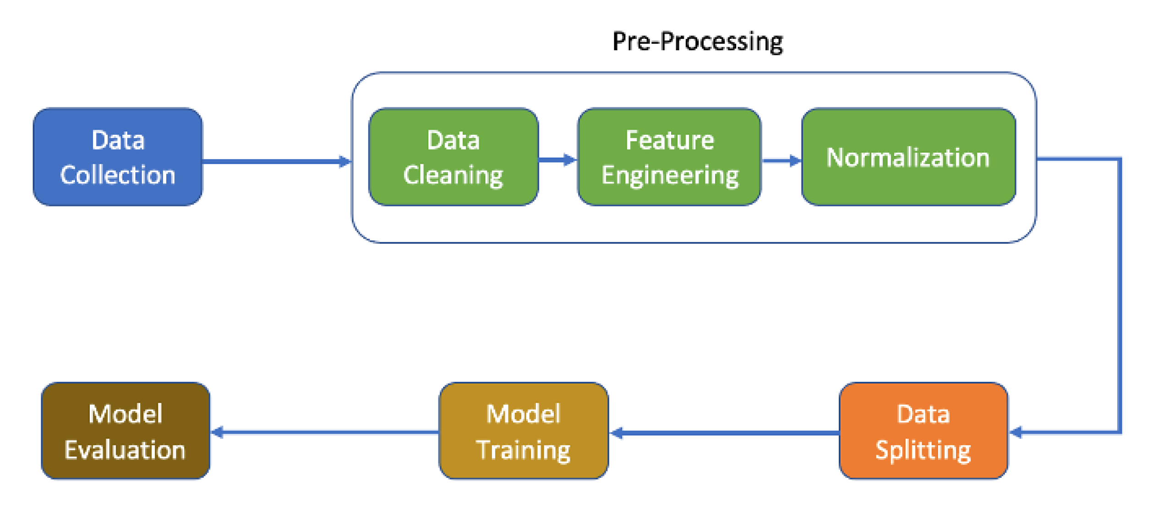
Flow of the Methodology

Slide 7
Data Collection
We have gathered our dataset from the publicly available domain Kaggle.
In particular we have used the “Significant Earthquakes, 1965-2016” dataset from Kaggle.
It includes a record of the date, time, location, depth, magnitude, and source of every earthquake with a reported magnitude 5.5 or higher since 1965.

Slide 8
Data Preprocessing
Several methods to clean the data were implemented to preprocess the data before use.
The data was preprocessed by handling missing values, then scaling and normalization were done.
The dates in the data were parsed, character encoding was done and inconsistent data entry was handled.

Slide 9
Methodology
After being randomly shuffled, the data was split into two distinct sets:
A training set is used to build the classification model (80%).
A test group (20%) - Used to evaluate the model.
Only the training set was used to build the model, and the testing set was used to evaluate it.

Slide 10
Methodology
To create our data model, we have opted to employ the Random Forest algorithm.
Leo Breiman and Adele Cutler are the creators of the widely used machine learning technique known as random forest, which mixes the output of several decision trees to produce a single outcome.

Slide 11
Methodology
The Random Forest method consists of the following four steps:
1. Select an n-piece random bootstrap sample (n samples randomly selected with replacement from the training set).

Slide 12
Methodology
2. Utilising the bootstrap sample, create a decision tree.
a. Randomly choose d features without replacement for each node.
b. Use the feature that, according to the goal function, yields the optimal split between the nodes.
3. Repetition of steps 1 and 2.
4. Combine predictions from each tree to get the class label that received the highest support.

Slide 13
Data Visualization
We have built a heatmap of the earthquake prone zones on the world map using data visualization methods provided in MatplotLib.
The heatmap can be seen in the following slide.

Slide 14
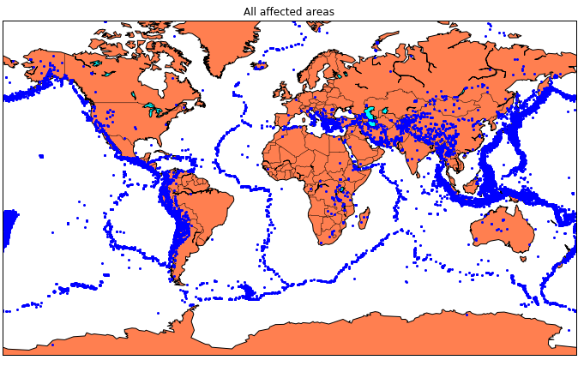
Data Visualization

Slide 15
Data Model
The Random Forest data model was built using TensorFlow and Keras over 20 epochs of training.
We were able to achieve an accuracy of 92.41% and a loss of 0.50 in our testing.
The accuracy and loss graph can be seen in the following slide.

Slide 16
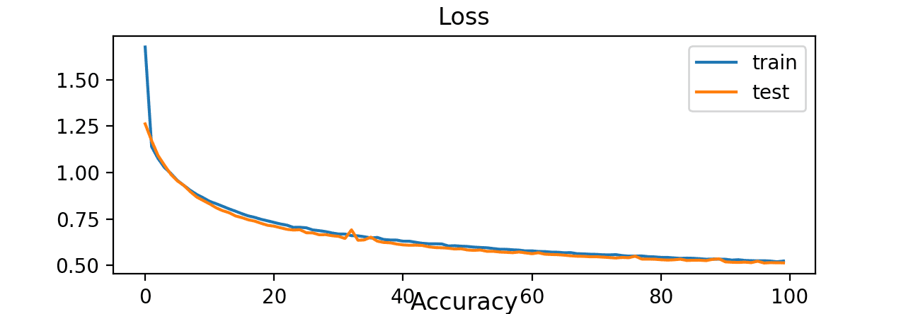
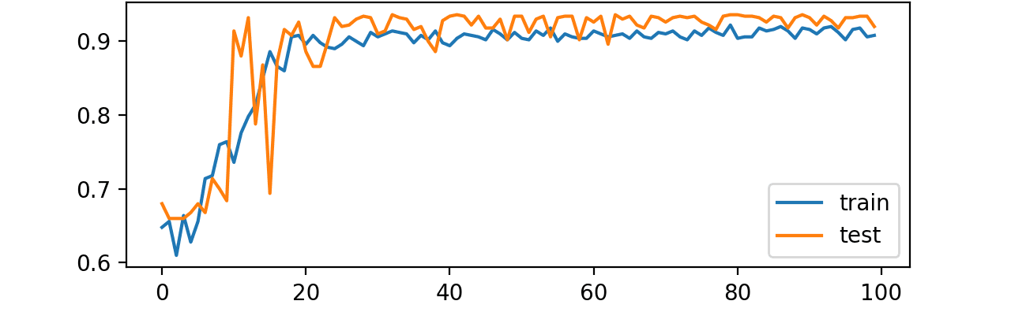
Data Model

Slide 17
Conclusion
We have successfully built a data model for the prediction of earthquakes in a given area with the latitudinal and longitudinal data of the area.
The model performs well in our test with an accuracy of about 92.41%.
This could prove to be helpful for people deciding what cities to move into knowing the safety issues in certain areas.
Furthermore, a graphical user interface (GUI) can be built to implement the prediction functionality of the data model that we have built.

