Slide 1
CAPSTONE PROJECT PROPOSAL
INTEGRATED DISASTER INCIDENT
RECORD MANAGEMENT AND
AUTOMATED SITUATION REPORT
GENERATION SYSTEM
Katrina Mae D.G. Perez | RJ P. Somosa
Computer Science Department
Bachelor of Science in Information Technology
Adviser: Precious T. Opinion
September 9, 2026
Zamboanga City
Notes:
Cover details follow the title page of Perez and Somosa's revised capstone proposal. The work is presented as a proposal. Describe all system capabilities, testing and benefits in future or intended terms unless later implementation evidence is available.

Slide 2
PRESENTATION FLOW
Presentation Flow
01
RA 10121: the mandate
10
Proposed system flowchart
19
Entity Relationship Diagram
02
Situation Report
11
Proposed system modules overview
20
Relational Data Model
03
Current workflow
12
Existing systems
21
Purok user flow
04
Implications of the current workflow
13
Problem, objectives, and modules
22
Barangay user flow
05
Possible solutions and why they are insufficient alone
14
Users and characteristics
23
DRRM Administrator user flow
06
Problem statement
15
Scope and limitations
24
Development plan
07
Workflow gaps and mandated practice
16
Architectural design
25
Technicalities: stack, testing, and AI use
08
Proposed system
17
Detailed modules: how and why
26
Significance of the project
09
Proposed system objectives
18
Data Flow Diagram
27
Summary
Outline follows the requested order and the revised manuscript
02
Notes:
This route begins with the legal and operational context, then moves through the problem, system design, module behavior, data models, user flows, development plan, and expected significance.

Slide 3
RA 10121 | THE MANDATE
Local DRRM offices have information and coordination duties
Consolidate
local disaster risk information
Maintain
risk maps and databases of resources and critical infrastructure
Monitor
hazards, vulnerabilities and local conditions
Disseminate and coordinate
information and DRRM activities across local institutions
The system is proposed as an information-management aid. Public agencies retain verification, approval, disclosure, and response authority.
Sources: revised paper, Chapter 1; Republic Act No. 10121, Section 12
03
Notes:
RA 10121 Section 12 establishes Local Disaster Risk Reduction and Management Offices and Barangay Disaster Risk Reduction and Management Committees. Within their jurisdictions, the paper identifies duties to consolidate local DRRM information, maintain maps and databases, monitor hazards and vulnerabilities, disseminate information, coordinate DRRM activities, and operate local centers. The law establishes responsibilities. It does not prescribe this particular web platform or transfer statutory authority to a technical operator.

Slide 4
SITUATION REPORT
A SitRep changes as verified information develops
01
Document control and identification
02
Situation overview
03
Preparedness measures
04
Consolidated effects
05
Response actions
06
Issues and concerns
07
Recommendations
08
Sources, approval and annexes as applicable
Reporting stages
Initial | Progress | Terminal | Final
Sources: revised paper, Chapter 1; NDRRMC NDRRMOC SOPG (2024)
04
Notes:
The manuscript describes Initial, Progress, Terminal and Final reporting under the 2024 NDRRM Operations Center Standard Operating Procedures and Guidelines. Initial information may be incomplete. Progress reports update the situation and actions. Terminal and Final reports close response and preserve final impacts and outcomes. The paper identifies prevailing situation, preparedness measures, response actions, consolidated effects, issues and concerns, and recommendations as core SitRep content. Document control, source references, approval and annexes support traceability and should follow the applicable official template. Do not claim that RA 10121 mandates this exact eight-part software form.

Slide 5
CURRENT WORKFLOW
The current reporting path uses several hand-offs
PUROK
Observe and record
location, time, hazard,
initial exposure
BARANGAY
Receive notice, check
incident area, prepare
initial information
ZCDRRMO OPERATIONS
Request clarification or
field checks, consolidate
separate records
SMS, telephone calls,
online messages
Calls, requests,
field information
Manual consolidation
Messages, documents, drives, spreadsheets
Prepare and submit
City Situation Report
Submission status and the relationship between changing versions are difficult to see across separate channels.
Source: revised paper, Figure 1 and Chapter 1 workflow description
05
Notes:
The manuscript's current-process diagram shows Purok personnel gathering event location, time and hazard details, then communicating initial information to the Barangay through existing channels. Barangay personnel check the incident area and prepare an initial account. The ZCDRRMO Operations Department may request a response or further clarification, and staff may collect information in the field. Personnel then manually consolidate messages, documents, drives and spreadsheets before preparing and submitting the City SitRep. The slide summarizes the stated process and does not imply that every incident follows an identical path.

Slide 6
IMPLICATIONS OF THE CURRENT WORKFLOW
Repeated follow-up and re-entry affect the reporting chain
Timeliness
Calls and clarification requests add hand-offs before staff can consolidate a sufficiently documented incident picture.
Staff effort
The same information may be edited, summarized and re-entered for different recipients.
Record continuity
Separate messages and files make it harder to identify the current report version and its source.
Verification load
Personnel may need repeated follow-up or field checks while covering several operational duties.
Controlled sharing
Information needs to reach report preparers, but access cannot be unrestricted because records may contain protected details.
Source: revised paper, Statement of the Problem and ZCDRRMO interview
06
Notes:
These implications synthesize the interview account and workflow described in the paper. The paper does not quantify delay or error rates. Keep the discussion qualitative unless the research team has additional measurements.

Slide 7
POSSIBLE SOLUTIONS AND WHY NOT
Useful tools are insufficient when used alone
Approach | What it supports | Why it is not sufficient alone
Calls, SMS, radio, messaging | Fast contact and urgent coordination | Status, source, correction and version history remain spread across channels
Paper forms and spreadsheets | Flexible local capture and manual review | Copies require manual reconciliation and repeated summary work
Single-level reporting app | Structured electronic submission | May not represent Purok to Barangay to DRRM review and cumulative SitRep history
Proposed integrated web system | Role-based reporting, verification, history and SitRep preparation | Still depends on connectivity and central service, so contingency channels remain necessary
Source: revised paper, current workflow and rationale for the proposed system
07
Notes:
The alternatives are not dismissed. Calls, radio, telephone and paper remain necessary contingency channels during outages. Their limitation is that they do not by themselves provide the proposed shared status, version, source and review history. Shared documents and spreadsheets are flexible but do not automatically establish a controlled reporting hierarchy or a verified SitRep source set. A standalone reporting form improves capture but may not support profile aggregation, tiered human verification, historical catalogs and template-based SitRep preparation as one workflow. The proposed platform also has limitations, notably its dependence on internet access and a centralized database.

Slide 8
PROBLEM STATEMENT
The paper identifies four distinct operational problems
01
Communication delay
02
Manual record management
Submission, acknowledgement and clarification depend on follow-up.
Staff combine records and may summarize the same information again.
03
Limited data sharing
04
Inefficient verification
Separate office functions do not always share the information needed for SitRep preparation.
Incomplete or inconsistent details prompt additional calls or field checks.
The paper describes an information-governance problem, not a lack of communication channels alone.
Sources: revised paper, Statement of the Problem; A. Kanti, second interview, 26 March 2026
08
Notes:
The source paper identifies four related but distinct issues. Communication delays occur through indirect reporting and follow-up. Manual record management requires consolidation and re-summarization. Limited data sharing makes it harder for operational knowledge to reach report preparers. Inefficient verification leads to clarification calls and possible field checks. These findings come from the qualitative account reported in the manuscript, not from a measured system-wide time study.

Slide 9
WORKFLOW GAPS AND MANDATED PRACTICE
The proposed workflow supports existing public responsibilities
Evidence or mandate | Gap described in the paper | Design response
RA 10121, Section 12 | Local information is collected and handled across jurisdictions and office functions | Shared records scoped by role and jurisdiction
NDRRMOC SOPG (2024) | Initial, Progress, Terminal and Final reporting update the situation over time | Versioned reports retain source, cutoff and status
Validation before official dissemination | Clarification and verification depend on calls and staff follow-up | Human review records a decision, reason and correction history
RA 10121 does not require this specific digital platform.
Sources: RA 10121, Section 12; NDRRMC NDRRMOC SOPG (2024); revised paper, Chapter 1
09
Notes:
RA 10121 Section 12 establishes local information, monitoring, dissemination and coordination functions. The NDRRMOC SOPG describes progressive reports and validation before official dissemination. The current workflow relies on separate channels and manual consolidation, according to the interview account. The design response is a role-governed record with source attribution, visible status, human verification and version history. The proposal supports these duties. It does not make the software a legal mandate and does not let automated checks decide whether reported facts are true.

Slide 10
PROPOSED SYSTEM
A role-based web system links local reporting to SitRep preparation
PUROK
BARANGAY
DRRM ADMINISTRATOR
Monthly aggregate profile
Initial incident report
Verify Purok records
Consolidate reports
Verify Barangay records
Prepare and route SitRep
Correction requests return to the originating level. Verified information moves upward with its source and version.
REPORT HISTORY
ROLE-BASED DASHBOARD
EDITABLE SITREP DRAFT
Human reviewers determine factual accuracy. Approval and release remain with authorized officials.
Source: revised paper, General Objective, Scope and Limitations
10
Notes:
The proposed system is a centralized, responsive web platform configured for participating DRRM organizations. It uses separate Purok, Barangay and DRRM Administrator roles. It supports community profile capture, incident reporting, verification at each level, report history and SitRep preparation. Purok records are aggregate community counts rather than named household case files. The adopting public organization retains authority over jurisdictions, users, verification, approvals, disclosure and official submissions.

Slide 11
PROPOSED SYSTEM OBJECTIVES
The objectives connect module development to evaluation
GENERAL OBJECTIVE
Design, develop and evaluate a centralized, role-based online system for grassroots incident reporting and NDRRMC SitRep consolidation.
Build
17 distinct modules for account administration, profiles, incident reporting, verification, histories, hazards, dashboard and SitRep.
Preserve
required fields, jurisdiction, provenance, decisions, correction history and report versions.
Consolidate
verified Barangay incident reports into editable, template-based Situation Report drafts.
Evaluate
functionality, integration, security, responsive behavior, acceptance and usability.
Targets in the manuscript are planned acceptance criteria, not results.
Source: revised paper, General and Specific Objectives
11
Notes:
The general objective in the paper is to design, develop and evaluate a centralized, role-based online system that streamlines grassroots disaster reporting and automates NDRRMC SitRep consolidation for LGUs. Specific objectives cover the 17 named modules. Their criteria include required-field storage, correct account routing, version retrieval, verification decisions, role-based access and report completeness. The numerical targets in the objectives are proposed test criteria. They are not achieved results.

Slide 12
PROPOSED SYSTEM FLOWCHART
Review gates govern upward reporting
Sign in with issued account
Purok submits
profile or initial report
Barangay verifies
Purok submission
Accepted?
Barangay consolidates
verified Purok data
YES
RETURN
Return to Purok
with reason
DRRM Administrator
verifies Barangay report
Accepted?
Prepare and edit
SitRep draft
Authorized review,
approval and export
YES
RETURN
Return to Barangay
with reason
Source: revised paper, Figure 2 and module flowcharts
12
Notes:
This readable overview summarizes the manuscript's Figure 2. Users sign in with issued credentials. Higher-level authorized personnel create accounts, so the flow does not include public self-registration. Purok users submit profiles and initial reports. Barangay personnel verify Purok submissions and consolidate accepted reports. DRRM Administrators verify Barangay submissions and route the resulting SitRep draft through authorized human review and approval. A return decision sends the record back for correction. The full system flowchart is included in the appendix as Figure 2.

Slide 13
PROPOSED SYSTEM MODULES | OVERVIEW
Modules remain separate by reporting level
PUROK
BARANGAY
DRRM ADMINISTRATOR
01
Purok User Management
01
Barangay User Management
01
System User Management
02
Purok Profile Creation
02
Barangay Profile Creation
02
Hazard Creation
03
Purok Profile Verification
03
Barangay Profile Verification
03
Situation Report Generation
04
Purok Incident Reporting
04
Barangay Incident Reporting
04
Situation Report Historical Catalog
05
Purok Incident Report Verification
05
Barangay Incident Report Verification
05
System Dashboard
06
Purok Incident Report History
06
Barangay Incident Report History
Verification decisions remain human decisions at each authorized level.
Source: revised paper, Specific Objectives and Table 3
13
Notes:
The system contains 17 distinct modules, six at Purok level, six at Barangay level and five system-level functions. The levels are intentionally segregated because Purok profile data informs Barangay profiling and because account management and verification responsibilities differ by level. The overview groups modules for readability while retaining their exact names.

Slide 14
EXISTING SYSTEMS
Related systems solve different parts of the reporting problem
System reviewed | Focus described in the paper | Relevance to the proposed system
Bandilyo App | Mobile incident reporting, geolocation and SMS-based communication | The paper distinguishes its proposed tiered verification and SitRep lifecycle
AGAPP | Near-real-time disaster information reporting with basic review | The paper identifies a gap in standardized, retrievable SitRep history
IRespondPH | Citizen reporting, LGU review, public-facing information and heatmaps | The paper focuses the proposal on administrative jurisdictional reporting and template-based SitReps
Mamamayan | Resident reports routed to an emergency operations center for response | The paper focuses the proposal on formal SitRep preparation and report history
Comparison is limited to the related work reviewed in the manuscript.
Source: revised paper, Sections 2.6–2.7 and Table 1
14
Notes:
The comparisons summarize the related work as described in the revised paper. They are not an independent, exhaustive audit of every current feature in each system. The paper identifies Bandilyo with mobile or SMS incident reporting and geolocation, AGAPP with near-real-time disaster reporting and review, IRespondPH with citizen reporting and LGU validation, and Mamamayan with community-to-dispatcher emergency reporting. SitRepO's proposed distinction is the jurisdictional Purok, Barangay and DRRM workflow with verification, history and structured SitRep preparation.

Slide 15
PROBLEM, OBJECTIVES, AND MODULES
Each reported problem has a corresponding design response
Problem | Objective response | Responsible modules
Communication delay | Provide structured submission, routing and visible status | Purok and Barangay Incident Reporting; report history
Manual record management | Reuse verified, versioned records in an editable SitRep draft | Incident histories; Situation Report Generation; Historical Catalog
Limited data sharing | Share source-attributed information under role and jurisdiction limits | Three user-management levels; role-specific Dashboard
Inefficient verification | Record evidence, decision, reason, version and correction path | Purok and Barangay profile and incident verification
Automated checks support completeness and consistency. Human reviewers decide factual accuracy.
Source: revised paper, Statement of the Problem, Specific Objectives and Table 3
15
Notes:
This traceability matrix synthesizes the manuscript's four problem themes, objective responses and responsible modules. It is a design mapping, not an evaluation result. Role-specific reporting, profile and incident verification, histories, SitRep preparation and dashboard functions are kept distinct so data ownership and review responsibility remain visible.

Slide 16
USERS AND CHARACTERISTICS
The interface follows each role's work and device context
PUROK PERSONNEL
Mobile-first browser use. Enters aggregate community profile values and initial incident information. Tracks submission status and corrections.
BARANGAY PERSONNEL
Mobile and desktop browser use. Reviews Purok submissions, consolidates verified data, adds Barangay-level assessment and tracks report history.
DRRM ADMINISTRATOR
Desktop-capable administrative work. Manages accounts and hazard types, verifies Barangay submissions, prepares SitReps and views system-level summaries.
Source: revised paper, Table 2, Scope and module descriptions
16
Notes:
The paper distinguishes Purok, Barangay and Administrator roles. The proposed interface is browser-based. Purok use is mobile-first. Barangay and DRRM administration must also support desktop work such as verification, consolidated reporting and SitRep preparation. The paper does not provide user age, formal education, disability or digital-literacy data, so the presentation does not invent these characteristics. The manuscript's Table 2 access wording should be aligned with the role-specific dashboard description before defense.

Slide 17
SCOPE AND LIMITATIONS
The proposal covers response and recovery reporting
IN SCOPE
LIMITATIONS
01
Purok, Barangay and DRRM Administrator roles
01
Internet and central database are required
02
Profile and incident reporting with verification
02
No offline synchronization or SMS fallback
03
Response and recovery SitReps
03
No native mobile app or public announcement module
04
Role-based history, dashboard and exports
04
Pre-disaster preparedness and risk monitoring are excluded
Before defense, align the multi-organization scope, access matrix and Figure 25 with the stated web-only design.
Source: revised paper, Scope and Limitations
17
Notes:
The system is a responsive browser-based service, originally studied with the ZCDRRMO and described as configurable for participating organizations. It covers reporting for response and recovery, including Initial, Progress, Terminal and Final SitReps. It does not cover pre-disaster preparedness reporting, continuous risk monitoring, a native mobile application, offline synchronization or SMS fallback. Access depends on internet connectivity and the centralized VPS-hosted database. Radio, phone and paper procedures must remain available for outages. Before defense, reconcile the multi-organization statement in paragraph 323 with the exclusive-ZCDRRMO wording in paragraph 333. Figure 25 also depicts mobile applications and offline relay while the text excludes them. The access matrix should be aligned with paragraph 330's role-specific dashboard scope. The objectives repeat Barangay Incident Report History at paragraphs 314 and 315.

Slide 18
ARCHITECTURAL DESIGN
Four layers separate interface, workflow, network and storage
PRESENTATION
Responsive browser interface
Purok: mobile-first | Barangay and DRRM: desktop-capable
↓
APPLICATION
Role-specific workflows, required-field checks, verification, aggregation and SitRep editing
↓
NETWORK
REST API over HTTPS; real-time data operations while connected
↓
DATA
Centralized PostgreSQL records, report versions and audit history
The service does not promise operation during internet, power or telecommunications failures.
Source: revised paper, Chapter 3 system architecture and technical specifications
18
Notes:
The architecture slide follows the system description in the revised paper rather than the earlier Figure 25 graphic, which appears to include offline and native-app components not supported by the scope statement. The described stack uses React.js and Next.js, HTML and Tailwind CSS at the browser interface, Node.js and PostgREST for application and API functions, OpenAuth for authentication, HTTPS for network transmission, PostgreSQL for centralized persistence, and a VPS with CDN for deployment. The centralized database and internet dependency are limitations, not guarantees of high availability.

Slide 19
PROPOSED SYSTEM MODULES | DETAILED
Purok accounts and profile modules
MODULE
HOW IT WORKS
WHY IT EXISTS
Purok User Management
Authorized Barangay personnel create a Purok account, assign its Barangay and issue credentials.
Correct jurisdiction routes submissions to the responsible reviewer.
Purok Profile Creation
Record Purok identity and monthly aggregate population, housing, vulnerability and hazard exposure values.
Establishes the baseline for exposure analysis and Barangay consolidation. No named household records are required.
Purok Profile Verification
A Barangay reviewer compares the submitted profile with reference information and approves or returns it with a reason.
Keeps unverified baseline data from being treated as confirmed.
Source: revised paper, Specific Objectives 303–305 and Table 3
19
Notes:
Purok User Management
HOW: Authorized Barangay personnel create a Purok account, assign its Barangay and issue credentials.
WHY: Correct jurisdiction routes submissions to the responsible reviewer.
Purok Profile Creation
HOW: Record Purok identity and monthly aggregate population, housing, vulnerability and hazard exposure values.
WHY: Establishes the baseline for exposure analysis and Barangay consolidation. No named household records are required.
Purok Profile Verification
HOW: A Barangay reviewer compares the submitted profile with reference information and approves or returns it with a reason.
WHY: Keeps unverified baseline data from being treated as confirmed.
These module descriptions summarize the revised paper's functional requirements. Verification decisions remain with authorized people. The specified system checks concern structure, range, consistency and possible duplicates, not factual truth.

Slide 20
PROPOSED SYSTEM MODULES | DETAILED
Purok incident reporting modules
MODULE
HOW IT WORKS
WHY IT EXISTS
Purok Incident Reporting
Submit hazard, location, observed date and time, initial situation and affected or exposure-unit totals. Keep later changes as versions.
Captures a useful first report without making Purok complete the full SitRep assessment.
Purok Incident Report Verification
Barangay reviewers compare sources and versions, flag possible duplicates or conflicts, then validate, partially validate, return or reject with a reason.
Makes review and correction accountable. Automated checks do not decide factual accuracy.
Purok Incident Report History
Retrieve current and prior versions of Purok incident reports with their status.
Shows what changed as the event developed and preserves the originating record.
Source: revised paper, Specific Objectives 306–308 and Table 3
20
Notes:
Purok Incident Reporting
HOW: Submit hazard, location, observed date and time, initial situation and affected or exposure-unit totals. Keep later changes as versions.
WHY: Captures a useful first report without making Purok complete the full SitRep assessment.
Purok Incident Report Verification
HOW: Barangay reviewers compare sources and versions, flag possible duplicates or conflicts, then validate, partially validate, return or reject with a reason.
WHY: Makes review and correction accountable. Automated checks do not decide factual accuracy.
Purok Incident Report History
HOW: Retrieve current and prior versions of Purok incident reports with their status.
WHY: Shows what changed as the event developed and preserves the originating record.
These module descriptions summarize the revised paper's functional requirements. Verification decisions remain with authorized people. The specified system checks concern structure, range, consistency and possible duplicates, not factual truth.

Slide 21
PROPOSED SYSTEM MODULES | DETAILED
Barangay accounts and profile modules
MODULE
HOW IT WORKS
WHY IT EXISTS
Barangay User Management
Authorized DRRM Administrators create Barangay accounts and issue system-generated credentials.
Keeps account creation under the level responsible for citywide user administration.
Barangay Profile Creation
Consolidate verified Purok profile records into the Barangay profile.
Builds the higher-level baseline from its constituent Purok data instead of re-entering it.
Barangay Profile Verification
An authorized DRRM reviewer checks the consolidated profile against references and records the decision.
Adds a higher-level review before the Barangay profile is treated as verified.
Source: revised paper, Specific Objectives 309–311 and Table 3
21
Notes:
Barangay User Management
HOW: Authorized DRRM Administrators create Barangay accounts and issue system-generated credentials.
WHY: Keeps account creation under the level responsible for citywide user administration.
Barangay Profile Creation
HOW: Consolidate verified Purok profile records into the Barangay profile.
WHY: Builds the higher-level baseline from its constituent Purok data instead of re-entering it.
Barangay Profile Verification
HOW: An authorized DRRM reviewer checks the consolidated profile against references and records the decision.
WHY: Adds a higher-level review before the Barangay profile is treated as verified.
These module descriptions summarize the revised paper's functional requirements. Verification decisions remain with authorized people. The specified system checks concern structure, range, consistency and possible duplicates, not factual truth.

Slide 22
PROPOSED SYSTEM MODULES | DETAILED
Barangay incident reporting modules
MODULE
HOW IT WORKS
WHY IT EXISTS
Barangay Incident Reporting
Consolidate eligible verified Purok reports, add Barangay-level assessment, and return unverified source reports for correction.
Produces a multi-Purok incident account with more aggregated effects.
Barangay Incident Report Verification
DRRM reviewers check new or modified submissions, compare sources, flag conflicts, and verify, partially verify, return or reject with a reason.
Only reviewed Barangay reports are eligible for SitRep consolidation.
Barangay Incident Report History
Retrieve current and earlier versions of consolidated Barangay reports.
Supports review, correction and tracing of SitRep source data over time.
Source: revised paper, Specific Objectives 312–314 and Table 3
22
Notes:
Barangay Incident Reporting
HOW: Consolidate eligible verified Purok reports, add Barangay-level assessment, and return unverified source reports for correction.
WHY: Produces a multi-Purok incident account with more aggregated effects.
Barangay Incident Report Verification
HOW: DRRM reviewers check new or modified submissions, compare sources, flag conflicts, and verify, partially verify, return or reject with a reason.
WHY: Only reviewed Barangay reports are eligible for SitRep consolidation.
Barangay Incident Report History
HOW: Retrieve current and earlier versions of consolidated Barangay reports.
WHY: Supports review, correction and tracing of SitRep source data over time.
These module descriptions summarize the revised paper's functional requirements. Verification decisions remain with authorized people. The specified system checks concern structure, range, consistency and possible duplicates, not factual truth.

Slide 23
PROPOSED SYSTEM MODULES | DETAILED
DRRM administration and hazard modules
MODULE
HOW IT WORKS
WHY IT EXISTS
System User Management
DRRM Administrators view, edit, activate or suspend accounts across all three levels.
Controls access while preserving authorship and approval history when an account changes.
Hazard Creation
Authorized users record hazard details and classify entries against the participating organization's CDRA types, adding a type when needed.
Keeps hazard terminology consistent with local assessment practice. The system records the chosen type and does not independently classify events.
Source: revised paper, Specific Objectives 316–317 and Table 3
23
Notes:
System User Management
HOW: DRRM Administrators view, edit, activate or suspend accounts across all three levels.
WHY: Controls access while preserving authorship and approval history when an account changes.
Hazard Creation
HOW: Authorized users record hazard details and classify entries against the participating organization's CDRA types, adding a type when needed.
WHY: Keeps hazard terminology consistent with local assessment practice. The system records the chosen type and does not independently classify events.
These module descriptions summarize the revised paper's functional requirements. Verification decisions remain with authorized people. The specified system checks concern structure, range, consistency and possible duplicates, not factual truth.

Slide 24
PROPOSED SYSTEM MODULES | DETAILED
DRRM reporting and analytics modules
MODULE
HOW IT WORKS
WHY IT EXISTS
Situation Report Generation
Select an incident and cutoff, retrieve verified Barangay reports, build an editable template-based draft, then route it for authorized review, approval and export.
Reduces repeated summarization while retaining source attribution and human authority.
Situation Report Historical Catalog
Search, filter, compare, export, correct or supersede reports while retaining prior approved versions and record controls.
Preserves continuity and supports audit, retention and later retrieval.
System Dashboard
Show role-specific incident, population, report-status, verification, SitRep-coverage and processing summaries, with filters and last-update time.
Gives each level relevant operational visibility and distinguishes provisional from verified data.
Source: revised paper, Specific Objectives 318–320 and Table 3
24
Notes:
Situation Report Generation
HOW: Select an incident and cutoff, retrieve verified Barangay reports, build an editable template-based draft, then route it for authorized review, approval and export.
WHY: Reduces repeated summarization while retaining source attribution and human authority.
Situation Report Historical Catalog
HOW: Search, filter, compare, export, correct or supersede reports while retaining prior approved versions and record controls.
WHY: Preserves continuity and supports audit, retention and later retrieval.
System Dashboard
HOW: Show role-specific incident, population, report-status, verification, SitRep-coverage and processing summaries, with filters and last-update time.
WHY: Gives each level relevant operational visibility and distinguishes provisional from verified data.
These module descriptions summarize the revised paper's functional requirements. Verification decisions remain with authorized people. The specified system checks concern structure, range, consistency and possible duplicates, not factual truth.

Slide 25
DATA FLOW DIAGRAM
Level 0 separates three actors and seventeen processes
PUROK
Creates aggregate profile data and initial incident reports. Barangay verification produces a review state and correction path.
BARANGAY
Verifies Purok submissions, consolidates verified records and submits the Barangay incident report to DRRM.
DRRM
Manages system users and hazards, verifies Barangay reports, and generates and stores Situation Reports.
Accounts
Purok Profile
Barangay Profile
Hazards
Purok Incident
Barangay Incident
Situation Report
DATA STORE
DATA STORE
DATA STORE
DATA STORE
DATA STORE
DATA STORE
DATA STORE
Interpretation: the DFD shows what data each process receives and returns. It does not by itself specify the relational keys or database constraints.
Source: revised paper, Figure 27
25
Notes:
The Level 0 DFD names the Purok User, Barangay User and DRRM Administrator as external entities. Its numbered processes separate account management, profiling, verification, incident reporting, hazard creation, report history, login, SitRep generation and system administration. The data stores shown are Accounts DB, Purok Profile DB, Barangay Profile DB, Hazards DB, Purok Incident DB, Barangay Incident DB and Situation Report DB. Data move upward only after the applicable verification step. Status and correction information return to the originating level. The original full diagram follows in the appendix.

Slide 26
ENTITY RELATIONSHIP DIAGRAM
The ERD separates account roles and operational record families
IDENTITY
PROFILES
INCIDENTS
SITUATION REPORT
Account
Purok account
Barangay account
DRRM account
Purok profile
Barangay profile
Housing summary
Hazard exposure
Hazard
Incident report
Report version
Affected population
Casualty and damage
Situation report
Report version
Response actions
Issues and recommendations
Effects and assistance
ERD convention
Account is modeled as a supertype. Purok, Barangay and DRRM are role subtypes. Primary identifiers are underlined. Relationships are shown without adding FK attributes to the conceptual ERD.
Source: revised paper, Figure 40 and the ERD convention discussed in the project
26
Notes:
Figure 40 organizes the data concepts that support the modules. Account is the common account entity with Purok, Barangay and DRRM account subtypes. Separate profile entities retain baseline data and supporting housing and hazard-exposure details. Hazard records and characteristics support CDRA-aligned configuration. Incident reports preserve versions and related population, casualty and damage records. Situation Reports relate to their report versions and structured effect, action and recommendation records. Follow the adviser-guided ERD notation: underline primary identifiers and express relationships with connectors. The ERD does not need to list foreign-key fields as attributes. The full Figure 40 appears in the appendix.

Slide 27
RELATIONAL DATA MODEL
The RDM maps entities into connected relations
ACCOUNT AND JURISDICTION
Account identity and its Purok, Barangay or DRRM role records. Jurisdiction links support routing and access scope.
PROFILE AND HAZARD
Purok and Barangay profile records, supporting exposure summaries, hazard data and configured CDRA types.
INCIDENT AND SITREP
Incident versions and verification history, linked to affected-population, casualty, damage and Situation Report records.
Read Figure 40 for the entity view. Read Figure 41 for the connected relational tables and key structure.
Source: revised paper, Figure 41 and database design
27
Notes:
The Relational Data Model translates the conceptual entities and relationships into tables and relational keys. The paper's Figure 41 shows the table-level structure and connections. The ERD and RDM serve different purposes: the ERD explains entities and relationships for the academic model, while the RDM prepares the implementable relational organization. Foreign-key attributes and key constraints belong in the schema or RDM representation as required by the chosen notation, even when the academic ERD omits FK attributes. The full Figure 41 appears in the appendix.

Slide 28
USER FLOW
Purok user flow
01
02
03
Sign in with credentials issued by an authorized higher-level user
Review the current verified monthly profile
Enter aggregate population, housing, vulnerability and hazard-exposure values
04
05
06
Submit the profile to Barangay review and correct it if returned
For an incident, submit hazard, location, date and time, initial situation and affected or exposure counts
Update the report as information changes and review status and prior versions
Purok input is deliberately an initial, aggregate report. It does not require named household records or a complete city-level damage assessment.
Source: revised paper, Purok module flowcharts and role scope
28
Notes:
1. Sign in with credentials issued by an authorized higher-level user
2. Review the current verified monthly profile
3. Enter aggregate population, housing, vulnerability and hazard-exposure values
4. Submit the profile to Barangay review and correct it if returned
5. For an incident, submit hazard, location, date and time, initial situation and affected or exposure counts
6. Update the report as information changes and review status and prior versions
Purok input is deliberately an initial, aggregate report. It does not require named household records or a complete city-level damage assessment.

Slide 29
USER FLOW
Barangay user flow
01
02
03
Sign in and open the Purok profile and incident review queues
Compare submitted information with available references
Verify or return Purok profile and incident records with a recorded reason
04
05
06
Build the Barangay profile from verified Purok profile data
Consolidate verified Purok incident reports and add Barangay-level affected-population, casualty and damage assessment
Submit the Barangay report to DRRM and consult status and report history
Barangay reporting increases aggregation and assessment detail. The system should keep the Purok source and the Barangay contribution distinguishable to reduce double counting and preserve provenance.
Source: revised paper, Barangay module flowcharts and role scope
29
Notes:
1. Sign in and open the Purok profile and incident review queues
2. Compare submitted information with available references
3. Verify or return Purok profile and incident records with a recorded reason
4. Build the Barangay profile from verified Purok profile data
5. Consolidate verified Purok incident reports and add Barangay-level affected-population, casualty and damage assessment
6. Submit the Barangay report to DRRM and consult status and report history
Barangay reporting increases aggregation and assessment detail. The system should keep the Purok source and the Barangay contribution distinguishable to reduce double counting and preserve provenance.

Slide 30
USER FLOW
DRRM Administrator user flow
01
02
03
04
Sign in to the administrative workspace
Create or maintain Purok, Barangay and administrator accounts
Configure hazard types according to the participating organization's CDRA
Review Barangay profiles and incident reports, then verify or return with a reason
05
06
07
Select an incident and reporting cutoff to retrieve eligible verified Barangay reports
Prepare and edit the SitRep draft, route it for authorized review and approval, then export
Use the dashboard and historical catalog to monitor status and retrieve prior versions
The user-flow description does not assume that the same administrator must prepare and approve a SitRep. The paper assigns both actions to authorized personnel and the implementing organization should define its separation of duties.
Source: revised paper, System User Management, Hazard Creation and Situation Report modules
30
Notes:
1. Sign in to the administrative workspace
2. Create or maintain Purok, Barangay and administrator accounts
3. Configure hazard types according to the participating organization's CDRA
4. Review Barangay profiles and incident reports, then verify or return with a reason
5. Select an incident and reporting cutoff to retrieve eligible verified Barangay reports
6. Prepare and edit the SitRep draft, route it for authorized review and approval, then export
7. Use the dashboard and historical catalog to monitor status and retrieve prior versions
The user-flow description does not assume that the same administrator must prepare and approve a SitRep. The paper assigns both actions to authorized personnel and the implementing organization should define its separation of duties.

Slide 31
OVERVIEW OF THE DEVELOPMENT PLAN
The proposal uses iterative development and staged evaluation
01
Requirements
Confirm roles, reporting fields, authority and mandated templates.
02
Design
Finalize workflows, data model, access and interface prototypes.
03
Build
Implement role-specific modules and integrate shared records.
04
Alpha
Run unit, integration, system and security tests.
05
Beta and refine
Evaluate acceptance and usability, then address findings.
The paper names an iterative method but does not specify sprint duration or release dates.
Source: revised paper, Chapter 3, Development Methodology and Testing
31
Notes:
The manuscript identifies an Agile software development lifecycle. This slide summarizes the proposed sequence without inventing sprint lengths, dates or completed milestones. Requirements and mandate review inform design. Implementation proceeds by modules and integration. Alpha testing covers unit, integration, system and security work. Beta testing evaluates acceptance and usability with intended users. Feedback informs revisions. State clearly that development and testing remain planned activities until evidence shows they have occurred.

Slide 32
TECHNICALITIES | TECHNOLOGY STACK
The proposed stack centers on a browser client and PostgreSQL
Frontend
React.js, Next.js, HTML, Tailwind CSS
Backend and API
Node.js, PostgREST, REST API over HTTPS
Authentication
OpenAuth
Database
PostgreSQL, centralized storage
Deployment
Virtual Private Server with Content Delivery Network
Access
Responsive web browser on desktop, laptop and mobile devices
Source: revised paper, Scope and Limitations and Technical Requirements
32
Notes:
The revised paper names React.js and Next.js, HTML and Tailwind CSS for the front end; Node.js and PostgREST for the backend and REST API; PostgreSQL for persistence; OpenAuth for authentication; and a VPS with CDN for deployment and static asset delivery. It describes access through supported desktop and mobile browsers. It does not specify exact framework versions in the cited scope paragraph. Avoid promising offline synchronization, native push notifications, distributed database availability or AI behavior that the paper does not specify.

Slide 33
TECHNICALITIES | TESTING
Testing is planned before external deployment
ALPHA TESTING
BETA TESTING
01
Unit and component checks: Jest
01
User acceptance with intended roles
02
Backend API checks: Jest and Supertest
02
10-item System Usability Scale
03
End-to-end responsive checks: Cypress
03
Proposed mean score target: 68 or higher
04
System integration and security testing
04
Proposed exit: zero unhandled crashes or render failures on tested views
The manuscript gives target criteria. It does not report completed test results.
Source: revised paper, Alpha and Beta Testing, Tables 4–6
33
Notes:
Alpha testing includes unit, integration, system and security testing. The paper names Jest for frontend unit and component tests, Jest with Supertest for backend unit and API tests, and Cypress for browser end-to-end tests across desktop and mobile viewports. Beta testing includes user acceptance, usability and a 10-item System Usability Scale questionnaire. The paper proposes mean SUS of at least 68 and zero unhandled crash or render failures across tested browser views as exit criteria. These are planned targets, not achieved measurements.

Slide 34
TECHNICALITIES | AI USAGE
The current paper does not specify an AI feature
SYSTEM
No AI function is specified in the current proposal. Hazard classification follows the organization's CDRA and an authorized user's selection.
VALIDATION
Automated checks can flag missing, out-of-range, inconsistent or possibly duplicated information. They do not establish factual truth.
DISCLOSURE
Report any actual AI assistance in research or development according to institutional requirements. Do not imply a system AI capability that the paper does not contain.
Source: review of the revised paper's objectives, scope, architecture and testing sections
34
Notes:
The revised paper does not specify AI or machine-learning functions in the proposed product. Its validation checks concern syntax, domain, range, consistency and possible duplicates. Human reviewers retain responsibility for factual accuracy and report approval. If AI tools assisted drafting, coding or presentation preparation, disclose the actual use according to the university's policy. Do not claim the system uses AI for hazard classification, casualty estimation, report generation or decision-making unless the approved paper and implementation explicitly add and evaluate those functions.

Slide 35
SIGNIFICANCE OF THE PROJECT
The intended contribution is a traceable reporting process
PUROK
A clearer path to submit aggregate community information and track its review.
BARANGAY
A place to review source records and consolidate eligible Purok information.
DRRM ORGANIZATION
A structured source set for verification, operational monitoring and SitRep preparation.
RESEARCH
Versioned records may support later study of local DRRM information practices.
These benefits remain to be evaluated with intended users.
Source: revised paper, Significance of the Project
35
Notes:
The paper describes intended value for Purok personnel through structured mobile-accessible initial reporting, Barangay personnel through consolidated local information, participating DRRM organizations through a more visible verification and SitRep preparation workflow, and future researchers through structured historical data. These are expected contributions, not measured outcomes. The system does not guarantee faster response, more accurate relief allocation or improved disaster outcomes without evaluation and operational adoption.

Slide 36
SUMMARY
The proposal joins grassroots reports to controlled SitRep preparation
Purok submits an initial aggregate record.
Barangay reviews and consolidates verified information.
DRRM personnel prepare and route a source-linked SitRep for authorized approval.
The system supports the process. Public officials retain the decisions.
Source: synthesis of the revised paper, Chapters 1–3
36
Notes:
The core proposition is a shared, role-based record from Purok observations through Barangay consolidation to authorized DRRM SitRep preparation. The design separates modules by jurisdiction, preserves source and report history, and treats verification as a human responsibility. The main dependencies are consistent mandated fields, clear local authority, careful access control, reliable connectivity and successful evaluation with intended users.

Slide 37
REFERENCES
Selected authorities and studies cited in the revised paper
01
Republic Act No. 10121 (2010), Philippine Disaster Risk Reduction and Management Act, Section 12.
02
NDRRMC. (2024). NDRRM Operations Center Standard Operating Procedures and Guidelines.
03
Republic Act No. 10173 (2012), Data Privacy Act, and its Implementing Rules and Regulations.
04
Republic Act No. 9470 (2007), National Archives of the Philippines Act; Republic Act No. 12254 (2025), E-Governance Act.
05
De Los Santos et al. (2020), Bandilyo App; Philippine Disaster Response Management Bureau (2024), AGAPP.
06
Montefalcon et al. (2021), IRespondPH; Calanog et al. (2024), Mamamayan.
07
A. Kanti, second ZCDRRMO interview, 26 March 2026, as reported in the revised manuscript.
Full bibliographic details are in the revised manuscript's References section
37
Notes:
The slide lists selected sources that anchor the presentation. The complete bibliographic information remains in the revised paper. Verify each reference entry and citation style against the university's required format before defense.

Slide 38
DISCUSSION
Questions
Integrated Disaster Incident Record Management and Automated Situation Report Generation System
Katrina Mae D.G. Perez | RJ P. Somosa
Capstone project proposal | September 2026
Notes:
Invite questions. If asked about AI, offline operation, multi-organization scope, evaluation outcomes or official report approval, answer only from the revised paper and identify unresolved manuscript decisions clearly.

Slide 39
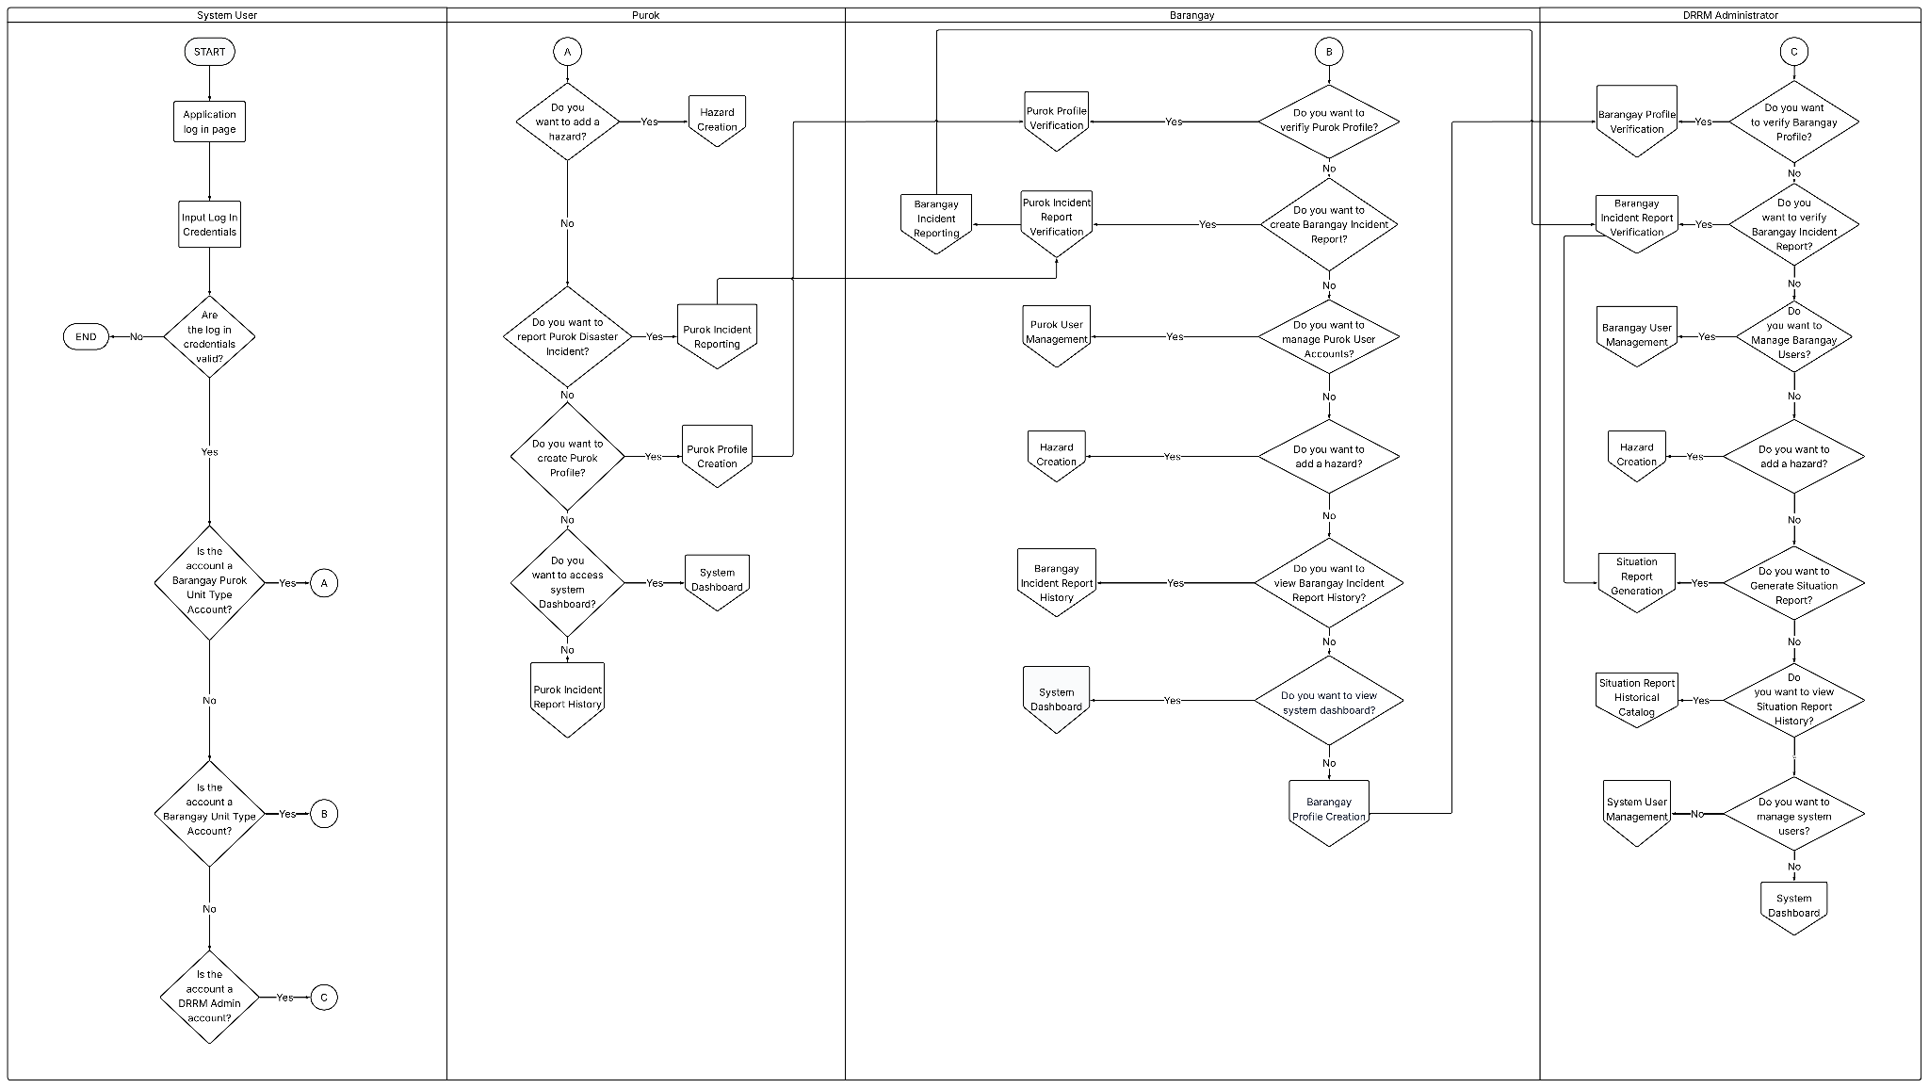
APPENDIX | SOURCE DIAGRAM
Figure 2 | Proposed System Flowchart
Source: revised paper, Figure 2
39
Notes:
The full proposed-system flowchart reproduced from Figure 2 of the revised manuscript. The original figure is preserved without redrawing. Use PowerPoint zoom or consult the source manuscript for detailed labels. The readable overview and explanation appear in the main presentation.

Slide 40
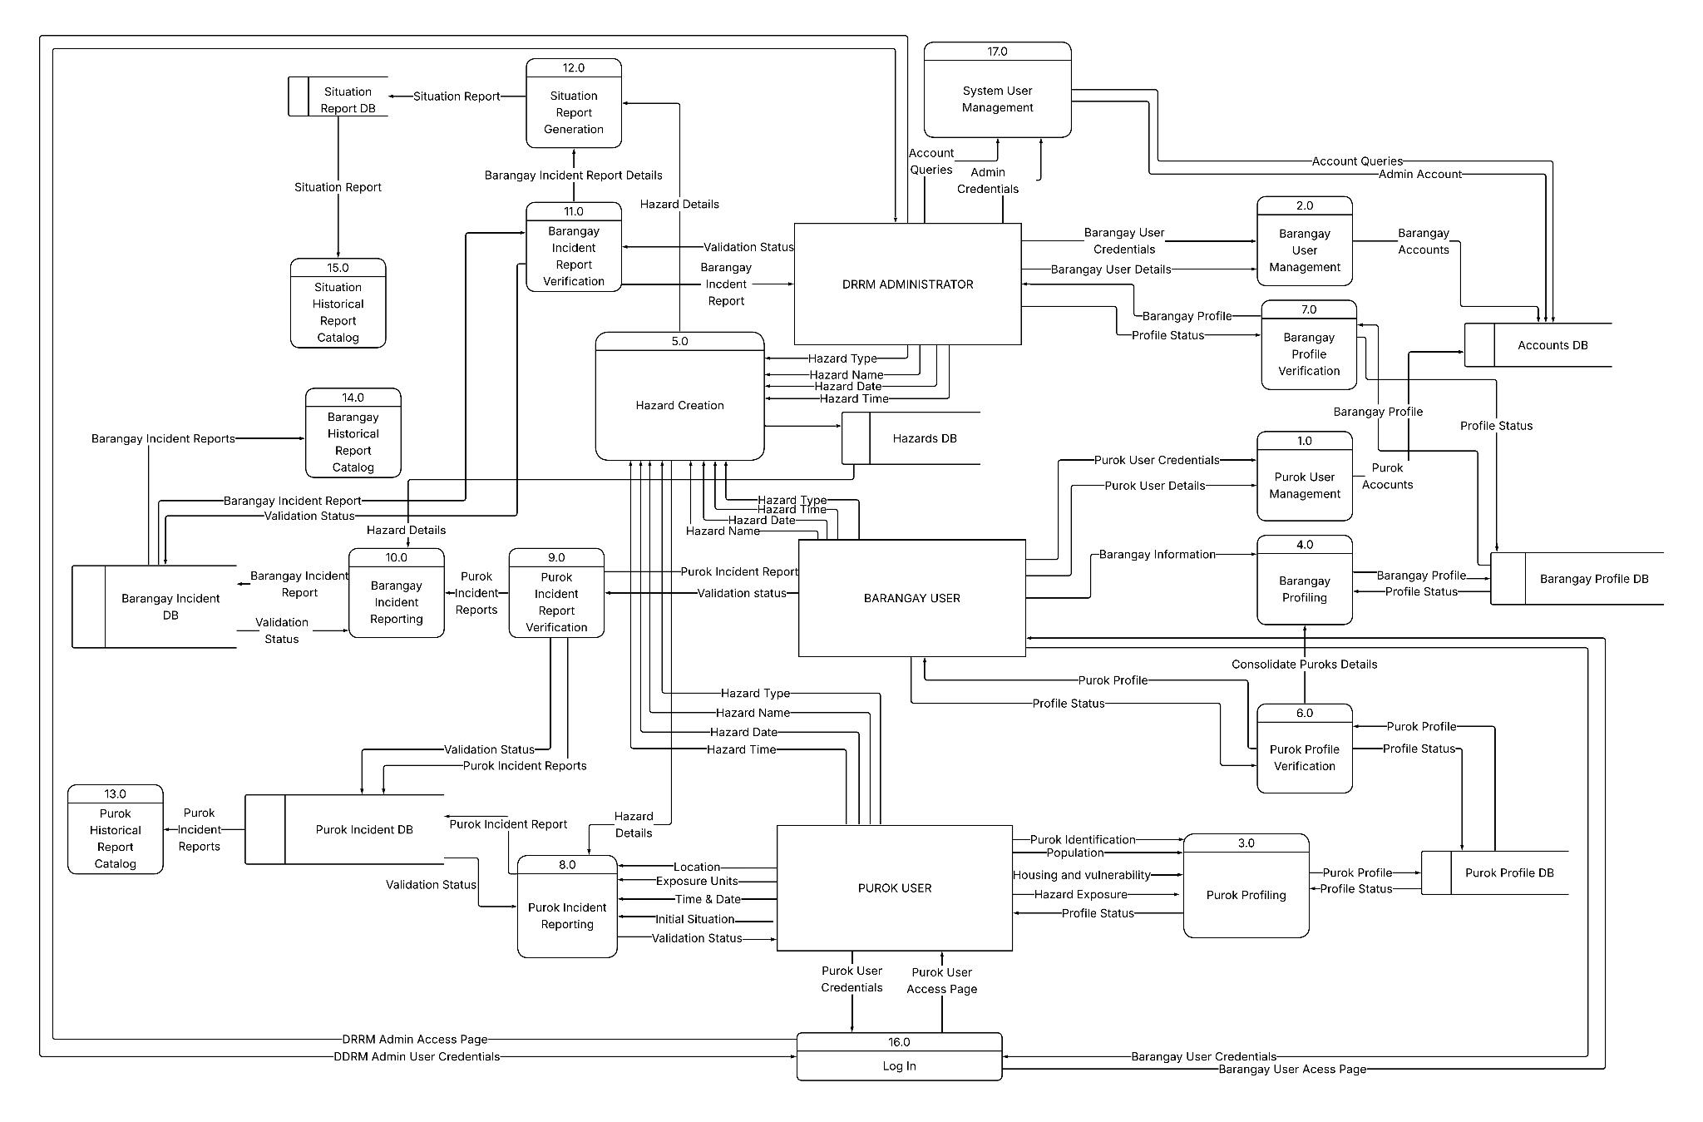
APPENDIX | SOURCE DIAGRAM
Figure 27 | Level 0 Data Flow Diagram
Source: revised paper, Figure 27
40
Notes:
The full Level 0 Data Flow Diagram reproduced from Figure 27 of the revised manuscript. The original figure is preserved without redrawing. Use PowerPoint zoom or consult the source manuscript for detailed labels. The readable overview and explanation appear in the main presentation.

Slide 41
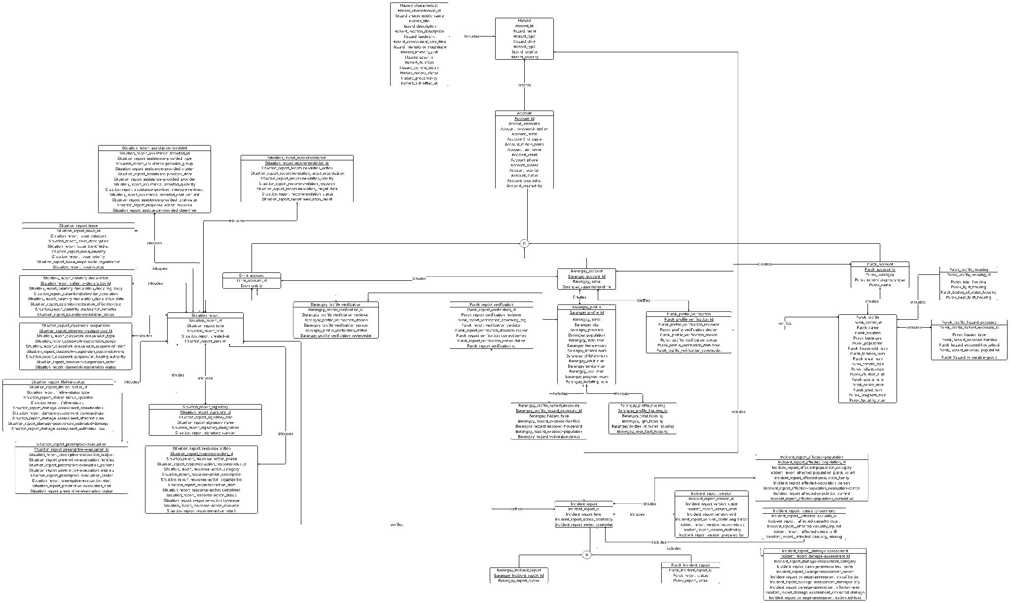
APPENDIX | SOURCE DIAGRAM
Figure 40 | Entity Relationship Diagram
Source: revised paper, Figure 40
41
Notes:
The full ERD reproduced from Figure 40 of the revised manuscript. The original figure is preserved without redrawing. Use PowerPoint zoom or consult the source manuscript for detailed labels. The readable overview and explanation appear in the main presentation.

Slide 42
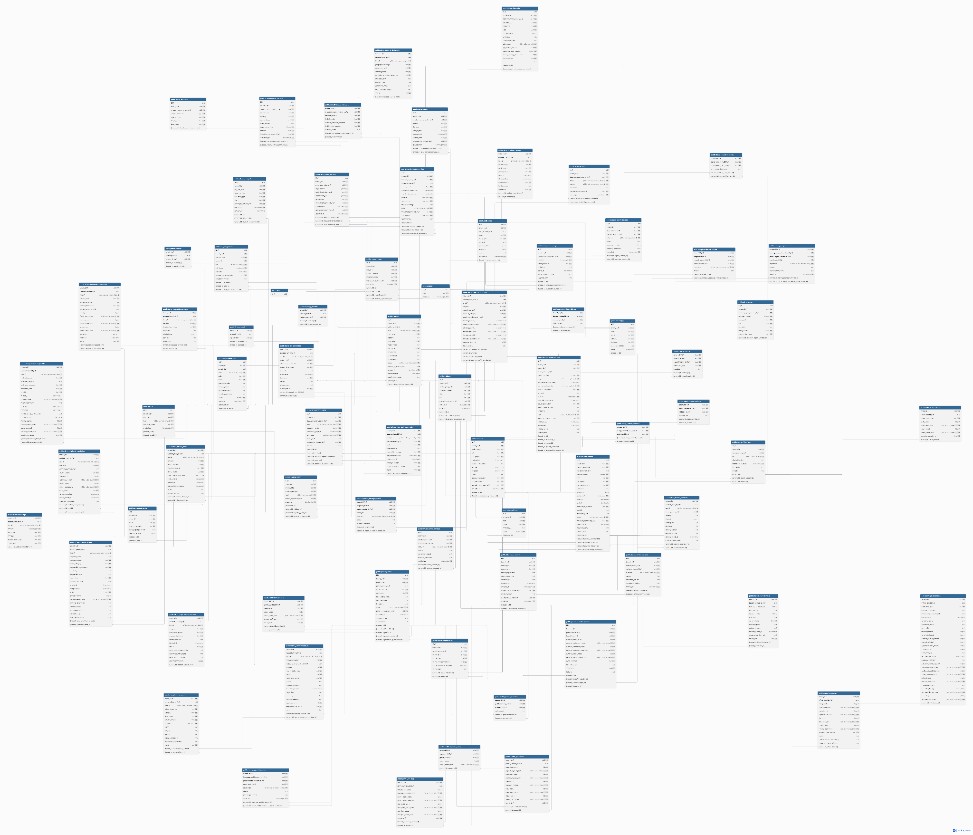
APPENDIX | SOURCE DIAGRAM
Figure 41 | Relational Data Model
Source: revised paper, Figure 41
42
Notes:
The full RDM reproduced from Figure 41 of the revised manuscript. The original figure is preserved without redrawing. Use PowerPoint zoom or consult the source manuscript for detailed labels. The readable overview and explanation appear in the main presentation.

