Slide 1


Alina Smirnova and Reyna Gaoaen
Analysis of Cryptocurrency market

Slide 2
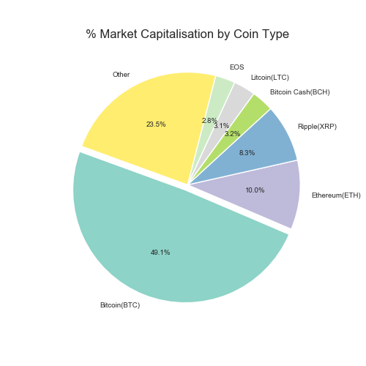
What is cryptocurrency..
a digital currency in which encryption techniques are used to regulate the generation of units of currency and verify the transfer of funds, operating independently of a central bank.
Interesting facts:
The first cryptocurrency named Bitcoin appeared in 2009
Satoshi Nakamoto, the unknown inventor of Bitcoin
$184.5 Billions - Cryptocurrency market capitalization
The most expensive coin Bitcoin - 5032 $
Cheapest coin Jingtum Tech – 0,000891 $
There are 1,658 cryptocurrencies, according to investing.com
There will only ever be 21 million bitcoins
Bitcoins don’t grow on trees.
$184.5Billions

Slide 3

Hypothesis
Cryptocurrency market is affected by the strength of the other markets, as well as of the google search popularity.
Goal:
Investigate and find the relationship between cryptocurrency market, stock market and google search popularity.
That we use:
Pytrends (google trend's data)
Cryptory (cryptocurrency data)
Coinmarketcap.com API (Market capitalization data)
https://www.alphavantage.co (stock data)
Investing.com; MarketWatch.com (Major Indices)
DXY – US Dollar Index
DJIA - The Dow Jones Industrial Average
VIX – CBOE Volatility Index (fear index)
Notes:
DXY: The US Dollar Index (USDX, DXY) is an index (or measure) of the value of the United States dollar relative to a basket of foreign currencies, often referred to as a basket of US trade partners' currencies.
DJIA: The Dow Jones Industrial Average, or simply the Dow, is a stock market index that indicates the value of 30 large, publicly owned companies based in the United States, and how they have traded in the stock market during various periods of time. The value of the Dow is not a weighted arithmetic mean and does not represent its component companies' market capitalization, but rather the sum of the price of one share of stock for each component company. The sum is corrected by a factor which changes whenever one of the component stocks has a stock split or stock dividend, so as to generate a consistent value for the index.
VIX: The CBOE Volatility Index, known by its ticker symbol VIX, is a popular measure of the stock market's expectation of volatility implied by S&P 500 index options. It is calculated and disseminated on a real-time basis by the Chicago Board Options Exchange, and is commonly referred to as the fear index or the fear gauge.

Slide 4
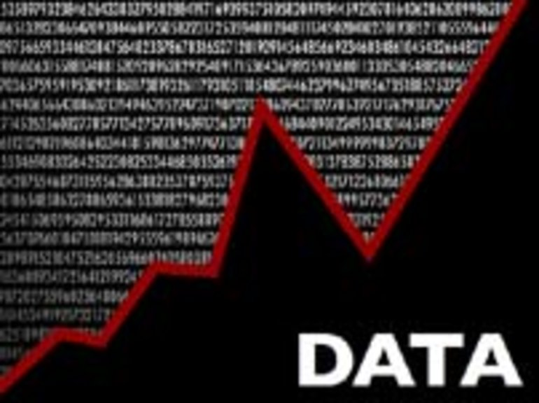
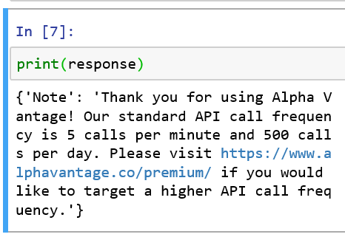
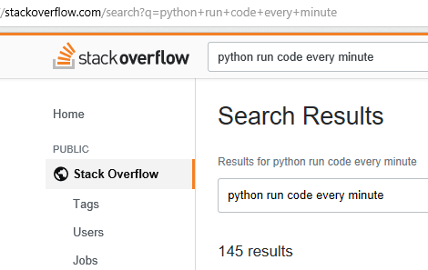
Data Exploration & Clean-up
Browsing data can be too inspirational: the process of finding just the right combination for successful analysis can become very compelling which could be a challenge for time-sensitive projects.
The API challenge: configuring the schema that handles the request and responses then ensuring there are no silent errors.
Beating the learning curve: thank you Google, thank you StackOverflow!

Slide 5

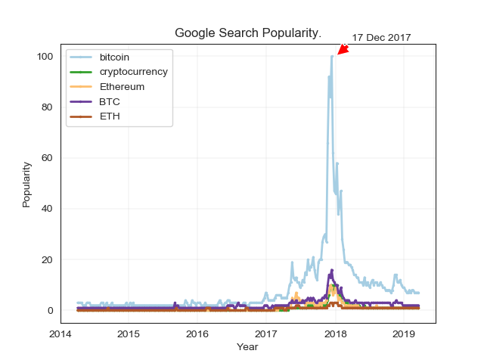
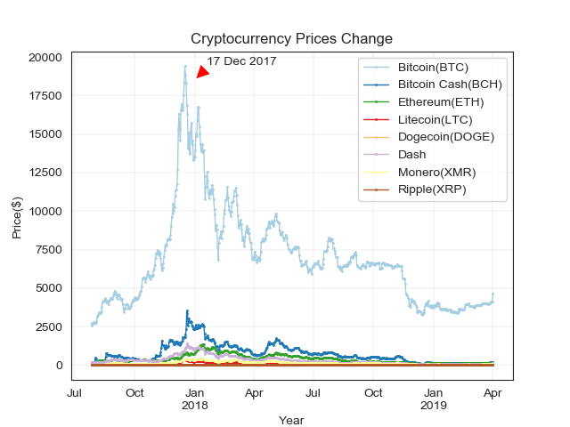
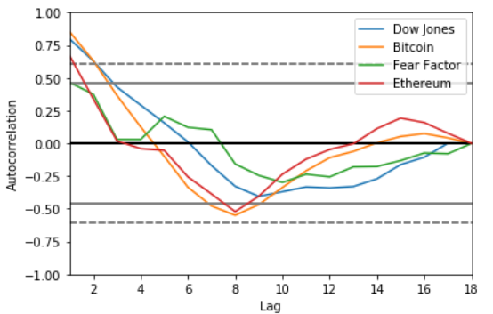
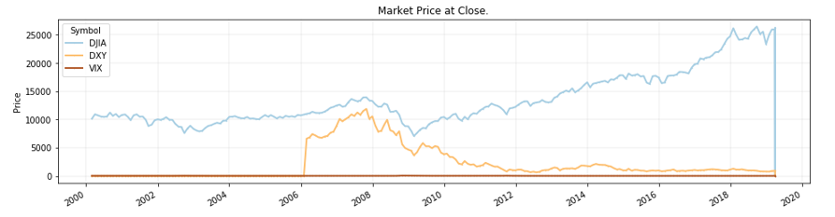
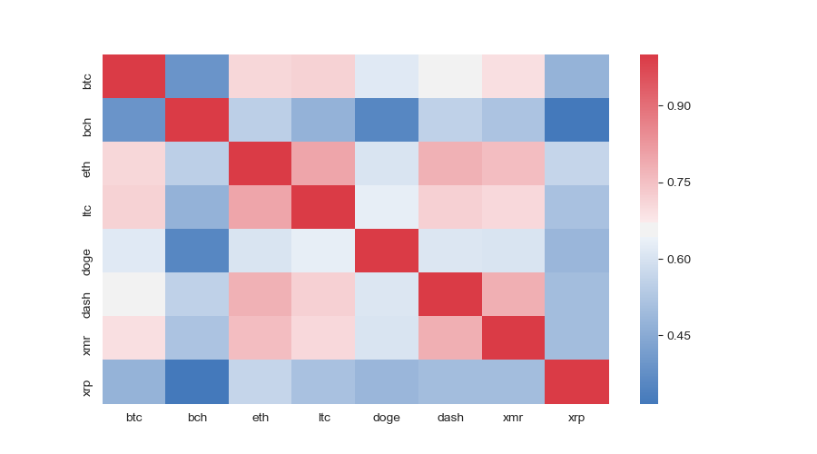
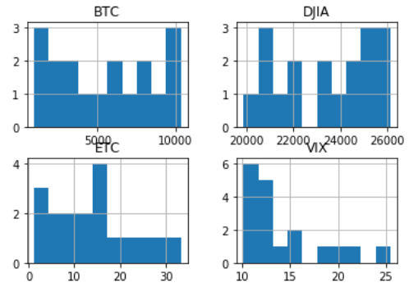
Observations:
Google trends shows relative popularity (average total monthly/average monthly search volume for keyword. The most popular search keywords have been chosen.
Most of the cryptos are correlated with each other - they tend to spike and crash collectively
2017 and 2018 saw the boom and crash of Bitcoin. Other cryptocurrency followed.
There are difference in scales on price of chosen market indexes.

Slide 6
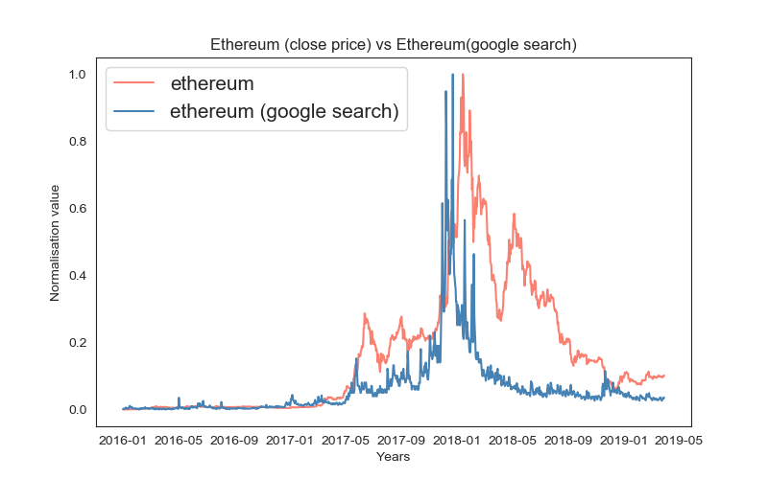
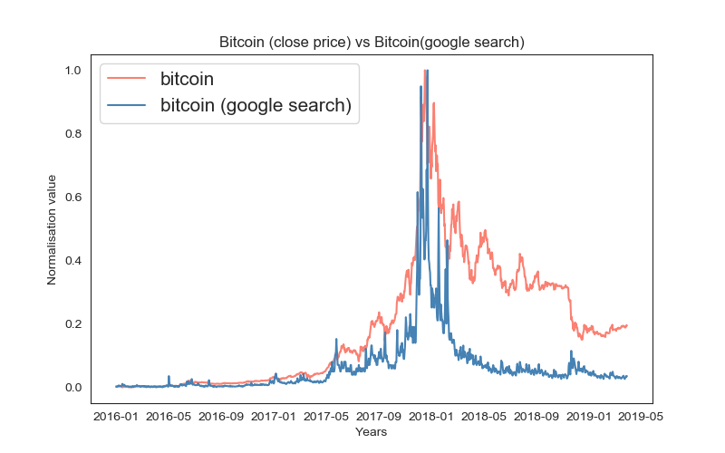
crypto price VS google search popularity.
.
Strong correlation between google search and coin prices

Slide 7
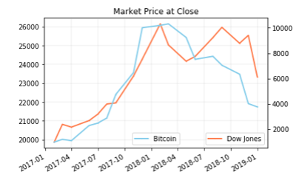
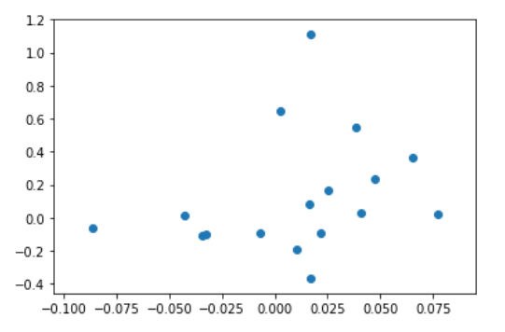

crypto VS stock market
.
Using Dow Jones Industrial Average for “Market” and Bitcoin for “Cryptocurrency,” we conclude that there is no strong correlation between the two

Slide 8
For Further Consideration
Global trends
Influence of major players in the currency market to cryptocurrency
The relationship between cryptocurrency, technology (e.g. machine learning), and social trust
Currency regulation and timing
“Stock market prediction is the act of trying to determine the future… The successful prediction of a stock's future price could yield significant PROFIT” –Wikipedia.
Pie Charts
Histograms
Boxplot
scipy.stats

Slide 9


Slide 10
Appendixes

Slide 11
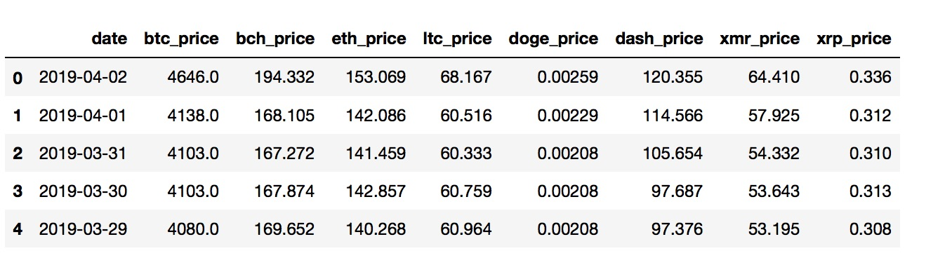
Cryptocurrency market analysis (historical data)
Shows price changes for most popular cryptocurrencies
demonstrates trends
Rapid grow by Dec 17 2017
Is there correlation between different cryptocurrencies???

Slide 12
Google search popularity
Google trends shows relative popularity (average total monthly/average monthly search volume for keyword
Chose the most popular search keywords

Slide 13
Check for the correlation
each currency is, obviously, strongly correlated with itself
Most of the cryptos are correlated with each other - they tend to spike and crash collectively
Except XRP from Ripple and BCH (Bitcoin Cash) - weak interconnection with others cryptos.

Slide 14
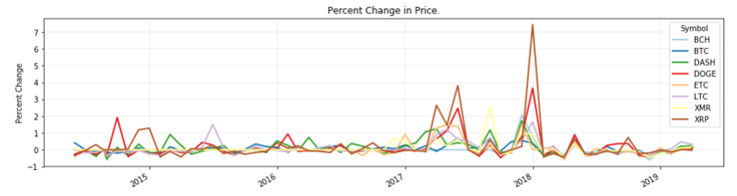
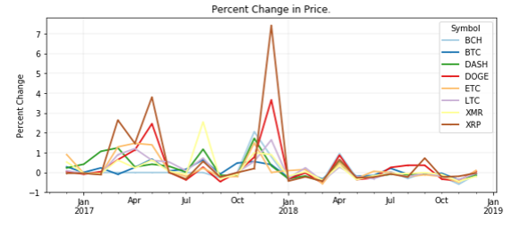
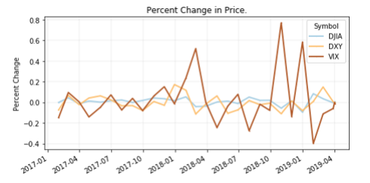
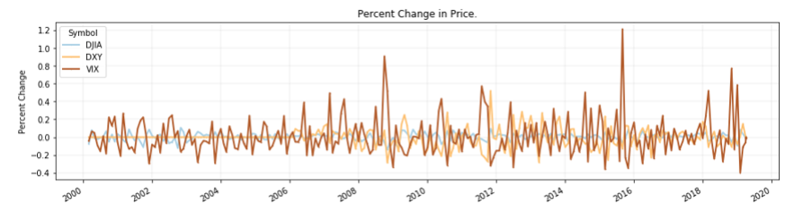
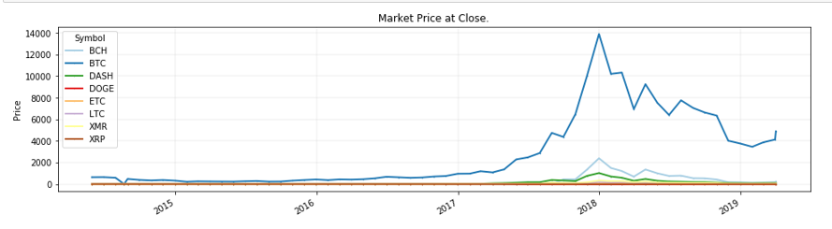
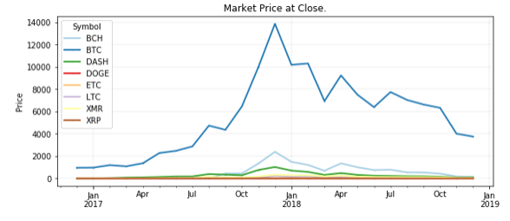
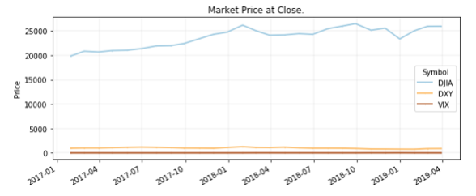
Data Exploration Continued…
Notes:
When looking at close price, each market index may have be graphed separately or on a separate y-axis
Timeframe: 2017 and 2018 to match the cryptocurrency Boom and Crash

