Slide 1


Alina Smirnova and Reyna Gaoaen
Analysis of Cryptocurrency market

Slide 2

What is cryptocurrency..
a digital currency in which encryption techniques are used to regulate the generation of units of currency and verify the transfer of funds, operating independently of a central bank.
437,53 Billions
Interesting facts:
The first cryptocurrency named Bitcoin appeared in 2009
Satoshi Nakamoto, the unknown inventor of Bitcoin
$437,53 Billions - Cryptocurrency market capitalization
The most expensive coin RSK Smart Bitcoin - 5032 $
Cheapest coin Jingtum Tech – 0,000891 $
There are 1,658 cryptocurrencies, according to investing.com
There will only ever be 21 million bitcoins
Bitcoins don’t grow on trees)))

Slide 3

Hypothesis
Cryptocurrency market is affected by the strength of the other markets, as well as of the google search popularity.
Goal:
Investigate and find the relationship between cryptocurrency market, stock market and google search popularity.
That we use:
Pytrends (google trend's data)
Cryptory (cryptocurrency data)
Coinmarketcap.com API (get market capitalization data)
…

Slide 4
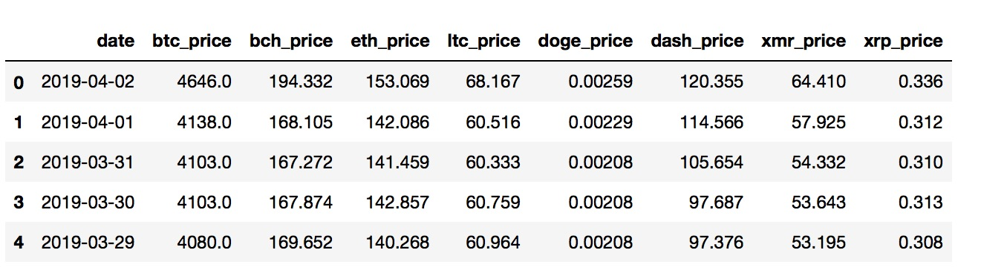
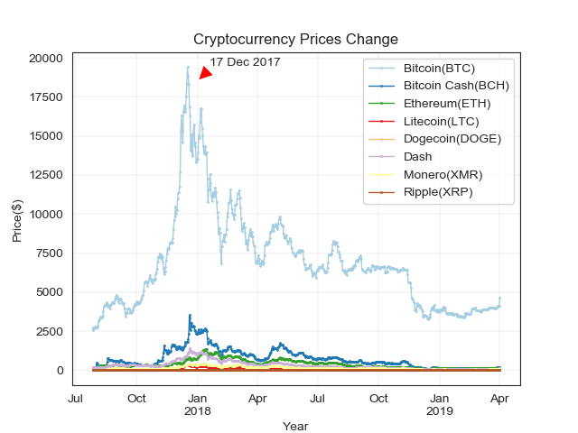
Cryptocurrency market analysis (historical data)
Shows price changes for most popular cryptocurrencies
demonstrates trends
Rapid grow by Dec 17 2017
Is there correlation between different cryptocurrencies???

Slide 5
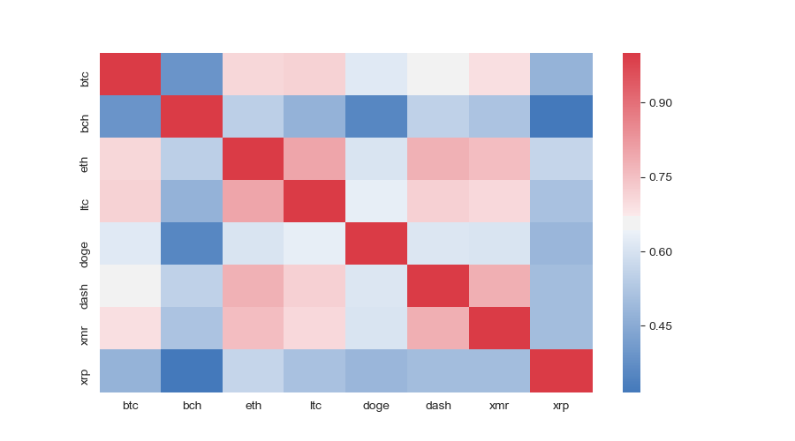
Check for the correlation
each currency is, obviously, strongly correlated with itself
Most of the cryptos are correlated with each other - they tend to spike and crash collectively
Except XRP from Ripple and BCH (Bitcoin Cash) - weak interconnection with others cryptos.

Slide 6

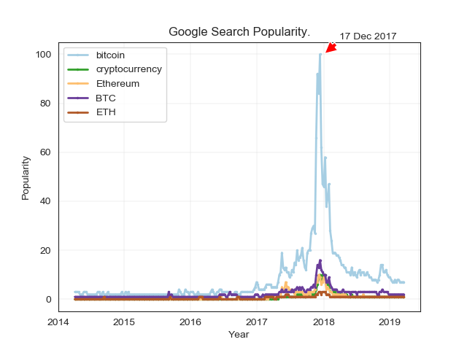
Google search popularity
Google trends shows relative popularity (average total monthly/average monthly search volume for keyword
Chose the most popular search keywords

Slide 7
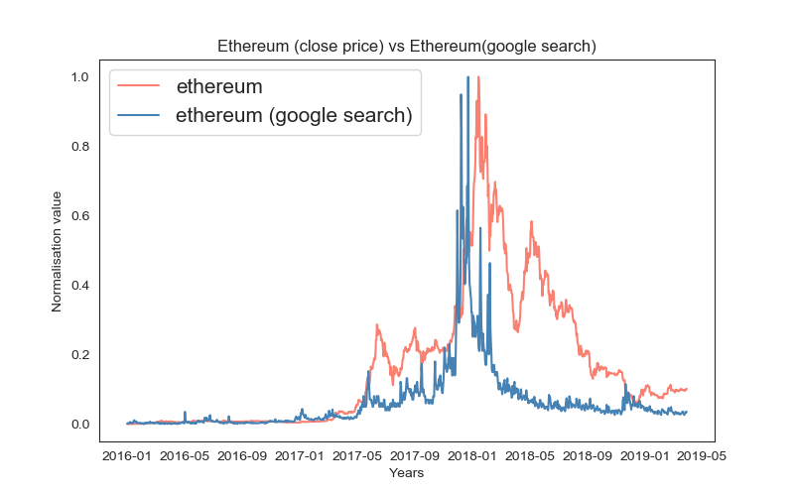
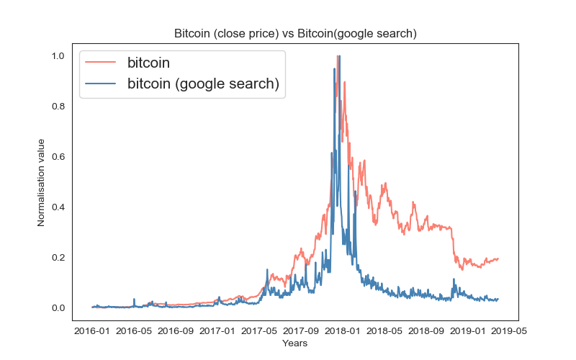
crypto price VS google search popularity.
.
Strong correlation between google search and coin prices

