Slide 1
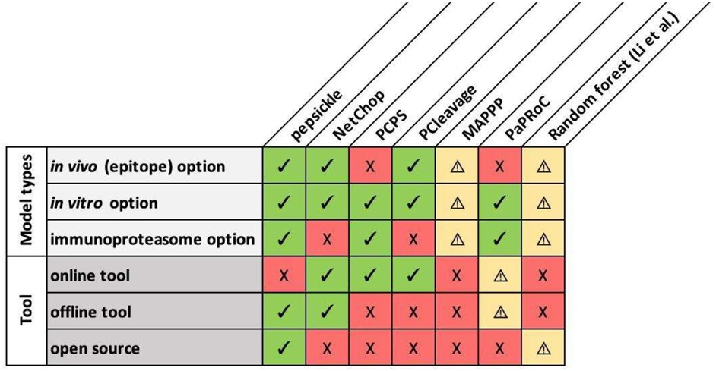

Fig. 2. Comparison matrix of available proteasomal cleavage tools and their features. Eight proteasomal cleavage tools are shown (columns) along with their corresponding features (rows). Specific tools are as follows: pepsickle (presented here), NetChop 3.1 (Nielsen et al., 2005), the Proteasomal Cleavage Prediction Server (PCPS) (Gomez-Perosanz et al., 2020), PCleavage (Bhasin and Raghava, 2005), MAPPP (Holzhütter and Kloetzel, 2000), PAProC (Nussbaum et al., 2001) and the random forest-based model described in Li et al.(2012) Check marks (green) represent available features for each tool while X’s (red) represent unavailable features. Warning signs (yellow) represent missing information, or features that are mentioned but not currently available. For MAPPP, the referenced web server is no longer available and therefore we were unable to confirm tool features. For PaPRoC, we were unable to obtain the model despite repeated requests. For the random forest model proposed by Li et al., model weights for the proposed model are given, but source code is not available and the type of cleavage sites used (in vivo versus in vitro) are undefined
Notes:
Fig. 2. Comparison matrix of available proteasomal cleavage tools and their features. Eight proteasomal cleavage tools are shown (columns) along with their corresponding features (rows). Specific tools are as follows: pepsickle (presented here), NetChop 3.1 (Nielsen et al., 2005), the Proteasomal Cleavage Prediction Server (PCPS) (Gomez-Perosanz et al., 2020), PCleavage (Bhasin and Raghava, 2005), MAPPP (Holzhütter and Kloetzel, 2000), PAProC (Nussbaum et al., 2001) and the random forest-based model described in Li et al.(2012) Check marks (green) represent available features for each tool while X’s (red) represent unavailable features. Warning signs (yellow) represent missing information, or features that are mentioned but not currently available. For MAPPP, the referenced web server is no longer available and therefore we were unable to confirm tool features. For PaPRoC, we were unable to obtain the model despite repeated requests. For the random forest model proposed by Li et al., model weights for the proposed model are given, but source code is not available and the type of cleavage sites used (in vivo versus in vitro) are undefined
Unless provided in the caption above, the following copyright applies to the content of this slide: Published by Oxford University Press 2021.This work is written by US Government employees and is in the public domain in the US.

