Slide 1
Term Project
Group 9
Smit Patel (300309459)
Jayshil Patel (300312550)
Applied Machine Learning
- Prof. Murat Simsek

Slide 2
Defining Problem
Mobile Crowd Sensing
Mobile Crowd Sensing is a technique where a large group of individuals having mobile devices sense and collectively share data using ICT.
MCS enables a people to share local knowledge (e.g., local information, ambient context, noise level, and traffic conditions) collected by phone sensors (e.g., GPS, digital compass, microphone, light sensor, and accelerometer).
This shared sensor data provides useful insights for smart urban space monitoring that can create impact on communications technologies, network connectivity in the smart city, transportation, traffic management etc. and can improve efficiency of the decisions taken by the authorities to offer the best environment for their citizens.

Slide 3
Goal: To automate the legitimacy checking process
Mobile Crowd Sensing
Smart City
Legitimate Task
Creating the Dataset with labels
1
0
Applying EDA on the data
Urban Space Monitoring
Inputs
Grid
Creating ML model
Illegitimate Task
Fig. 1

Slide 4
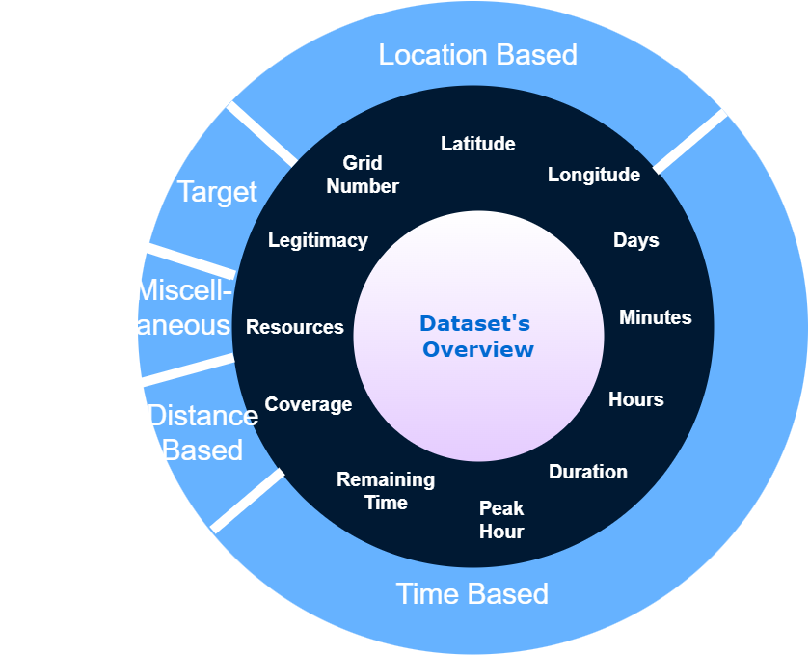
Features
-90 to 90 Degree
>= 1
-180 (E) to +180(W) Degree
0 or 1
(Output)
1 to 6 days
0 to 59 minutes
1% to 10%
0 to 100
0 to 23 hours
0 to 60
Minutes
0 to 60 Minutes
0 or 1
Fig. 2

Slide 5
Roadmap
Analysing the data and performing EDA on it
Applying dimensionality reduction and feature selection methods on the best baseline model
Applying RF and ensemble learning methods
1
3
5
2
4
6
Applying baseline models on it
Updating the dataset with best set of features obtained from step 3
Tuning the hyperparameters of the best model

Slide 6
Feature Selection
Decision Tree Model
Dimensional Reduction
Parameter Tuning
Wrapper
Filter
GridSearchCV
PCA
Auto Encoder
Sequential Feature Selector
Mutual Information
Classification
Random
Forest
Final Model
Dataset with 12 Features
New Dataset
KNN
(86.93%)
Best Features
Logistic Regression (86.94%)
RF
(98.99%)
EDA
Updating the Database
Best Model
SVM (86.94)
Best Model Among
Baseline
AdaBoost
(95.06%)
Split into Training and Testing
Decision Tree Classifier (94.41%)
Wrapper Method with 4 features
Gradient Boosting
(97.75%)
Naive Bayes Classifier (86.90%)
TSNE Plots
Fig. 3

Slide 7
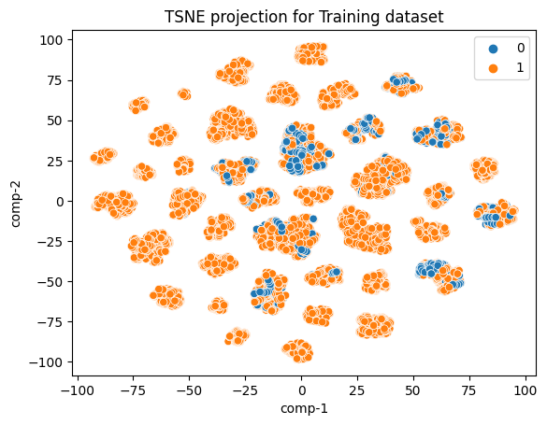
Fig 4
TSNE Plot for Training Set

Slide 8
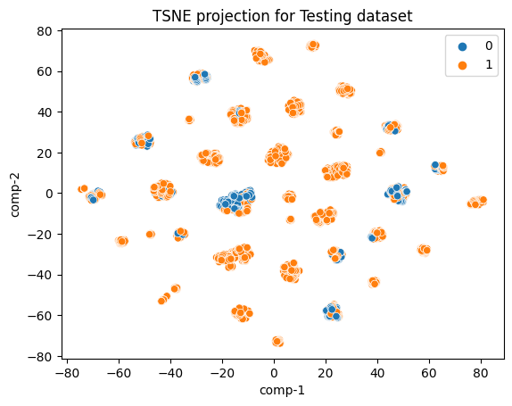
Fig 5
TSNE Plot for Testing Set

Slide 9
Dataset Description

Slide 10
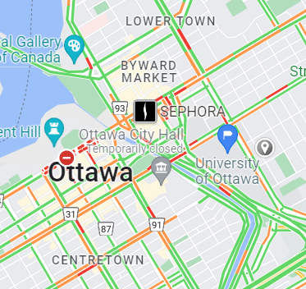
Features
Location Based
1) Latitude
- gives the North-South position of the subject
- Range: -90 to +90 degree
2) Longitude
- gives the East West position)
- Range: +180(E) to -180(W)
- GPS coordinates (Latitude, Longitude)
3) Grid Number
- obtained by splitting sensing city map to small grids
- Starts from 1)
Fig 6

Slide 11
Features
Time Based
Publish Time: The following three features show the time at which task was published
4) Day
- Range: 0 to 6 days
5) Hours
- Range: 0 to 23 hours
6) Minutes
- Range: 0 to 59 minutes
7) Duration
- the time task was remained active
- measured in terms of minutes
8) Remaining Time
- the remaining time in the completion of a task
- measured in terms of minutes
9) OnPeakHours
- to check whether the task was done
between 7 am to 11 am
- Range: 0 or 1

Slide 12
Features
Distance Based
Miscellaneous
10) Coverage
- the quantity that measures the distance when the subject was performing the task
11) Resources
- Shows the percentage of battery required to complete the task

Slide 13
Features
Target (label)
12) Legitimacy
- the quantity to determine whether the task is legitimate or not
- Range – 0 or 1

Slide 14
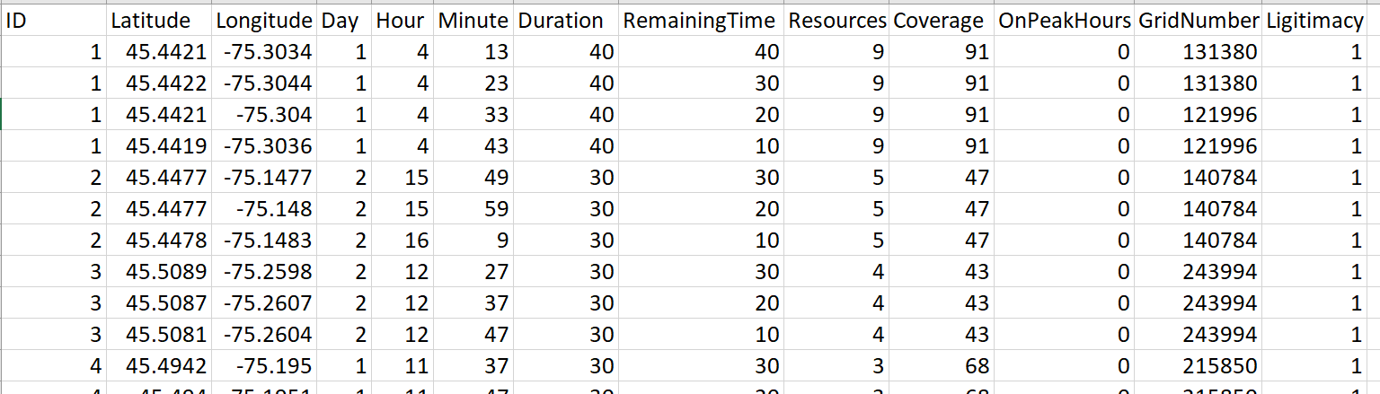
Sample Data
Fig 7

Slide 15
Exploratory Data Analysis
Correlation Metrix
Skewness Plots

Slide 16
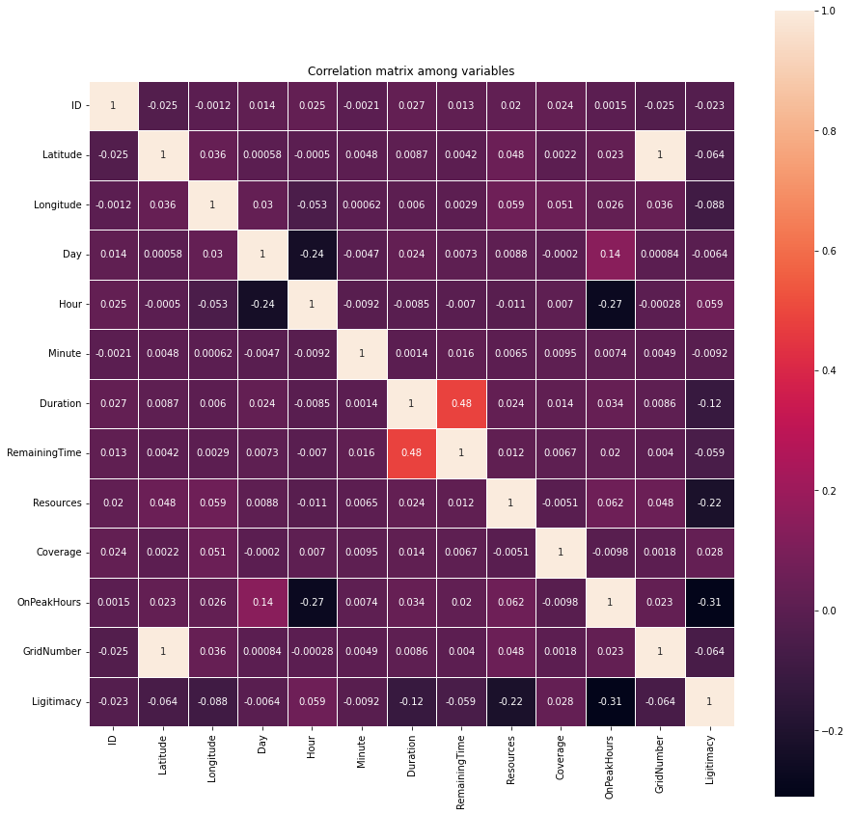
Correlation Metrix
Fig 5
Fig. 8

Slide 17
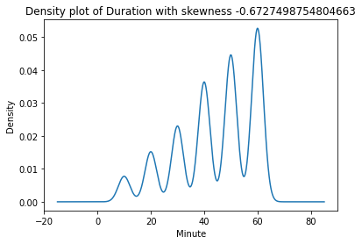
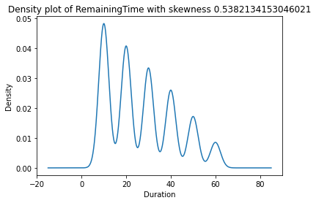
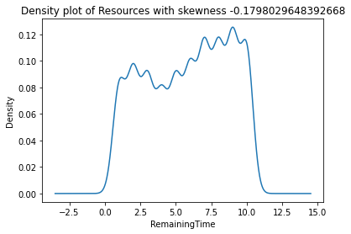
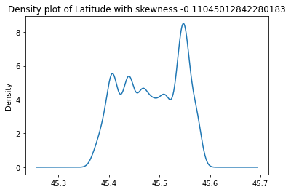
Fig 9
Fig 10
Fig 11
Fig 12
Skewness Plots

Slide 18
Model Development

Slide 19
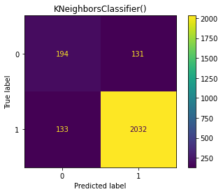
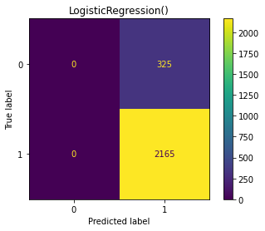
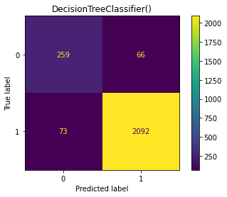


Model | Accuracy
KNN | 89.39%
LR | 86.94%
Decision Tree | 86.94%
SVM | 94.41%
GaussianNB | 86.90%
Table 1
Fig 13
Applying Baseline Models

Slide 20
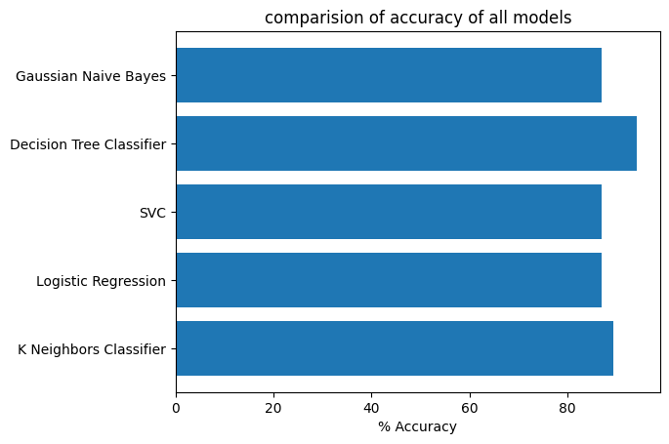
Fig 14
Determining the Best Model

Slide 21
Dimensionality Reduction
Principle Component
Analysis
Auto Encoder

Slide 22
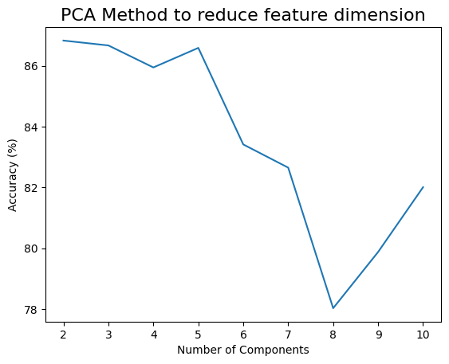
PCA
Fig 15

Slide 23
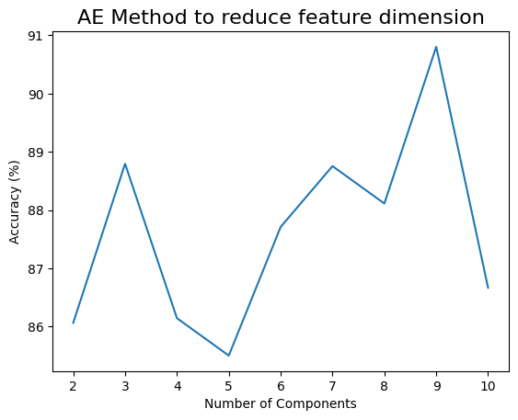
Auto Encoder
Fig 16

Slide 24
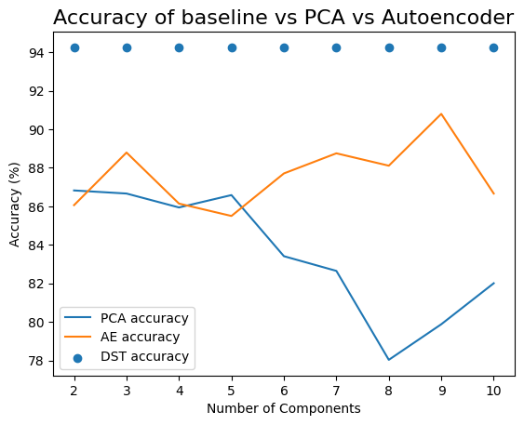
Model | Accuracy
PCA | 87.82%
AutoEncoder | 90.80%
Table 2
Comparing 3 Methods
Fig 17

Slide 25
Feature Selection
Wrapper Method
Filter Method

Slide 26
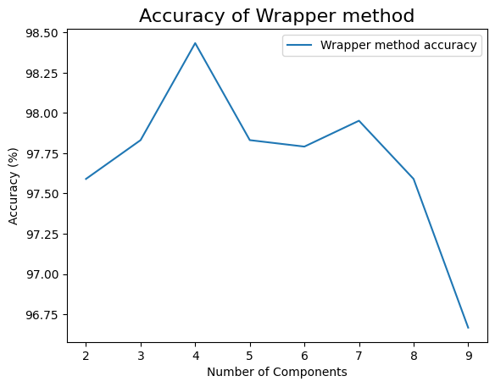
Wrapper Method
Fig 18

Slide 27
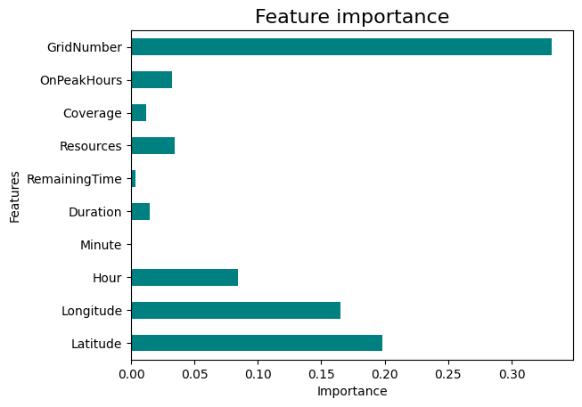
Filter Method
Fig 19

Slide 28
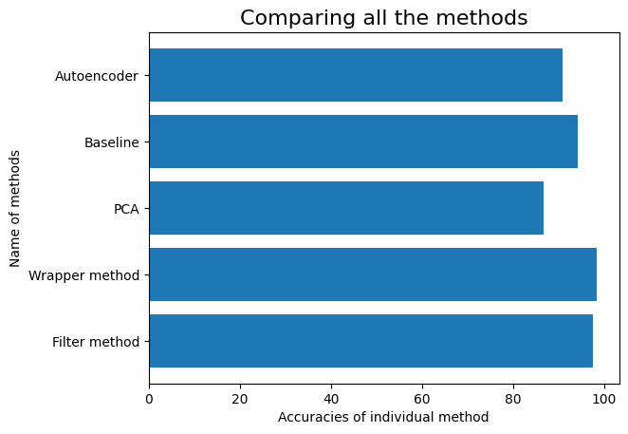
Model | Accuracy
Wrapper | 98.43%
Filter | 97.67%
Table 3
Comparing 5 methods
Fig 20

Slide 29
TSNE Plots of Updated Datasets

Slide 30
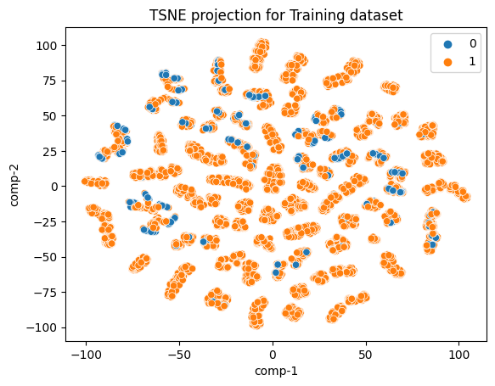
Training Set
Fig 21

Slide 31
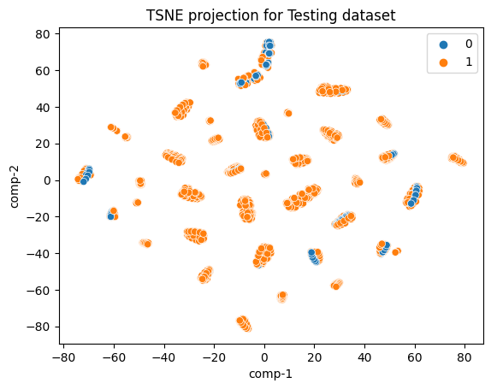
Testing Set
Fig 22

Slide 32
Applying New Models
to Updated Dataset
Random Forest
Ensemble Models
AdaBoost
Gradient Boosting

Slide 33
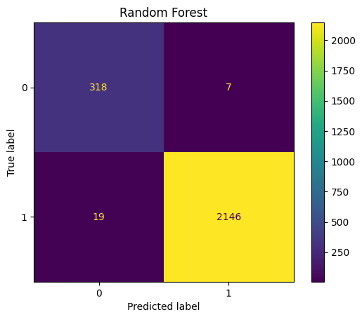
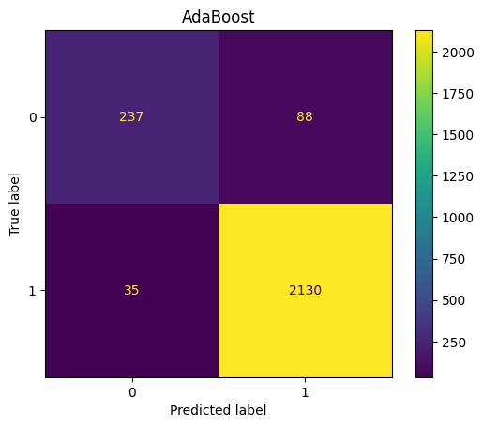

Model | Accuracy
RF | 98.95%
AdaBoost | 95.06%
GB | 97.75%
Fig. 23
Fig. 24
Table 4
Applying Baseline Models
Fig. 25

Slide 34
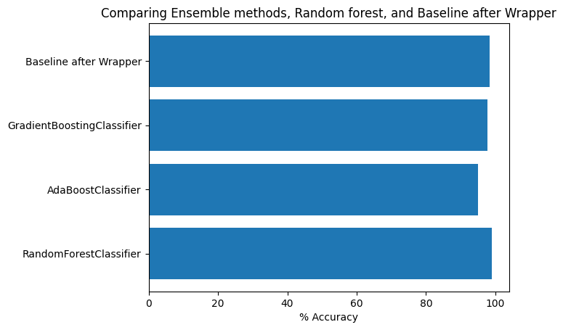
Fig 26
Comparing 4 models

Slide 35
Hyper Parameter Tuning
Applying Randomized
Search CV on Random Forest

Slide 36
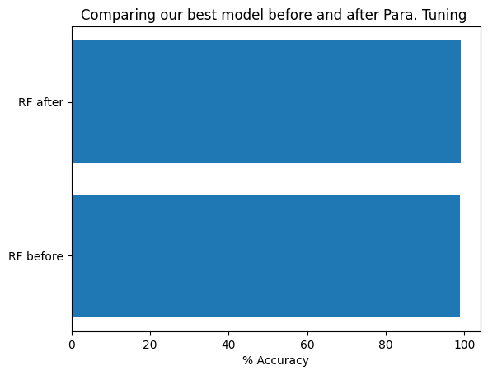
Model | Accuracy
RF before | 98.95%
RF after | 99.07%
Table 5
Fig 27
Comparing 2 Methods

Slide 37
Conclusion
1
- For the given binary classification problem, decision tree classifier gives the best accuracy on the row data; however, this performance is topped by employing feature selection methods. After generating the final dataset with most relevant features, random forest with tuned hyper parameters works the best at detecting whether the task submitted by a subject in the MCS is legitimate or not.

Slide 38
Future Work
2
Since the problem was of imbalanced domain lerning; oversampling, undersampling, or methods for generating synthetic data can be applied before the model development stage.

Slide 39
References
3
- Fiandrino, Claudio, et al. "Crowdsensim: a simulation platform for mobile crowdsensing in realistic urban environments." IEEE Access 5 (2017): 3490-3503.
- Y. Zhang, B. Kantarci "AI-based Security Design of Mobile Crowdsensing Systems: Review, Challenges and Case Studies ," 13th IEEE International Conference on Service-Oriented System Engineering (SOSE), San Francisco East Bay, CA, USA, Apr. 2019

Slide 40
Thanks!
Any questions?

