Slide 1

CollabCanvas: Empowering Collaborative Learning
Unveiling CollabCanvas, a revolutionary platform designed to transform group study experiences for students worldwide. This presentation will explore how CollabCanvas leverages cutting-edge technology to foster seamless collaboration and enhance learning outcomes.

Slide 2
MERN Stack: The Backbone of Seamless Collaboration
Frontend: React.js
Backend: Node.js & Express.js
Intuitive and responsive user interface.
Robust API for data handling and user authentication.
Real-time updates for collaborative activities.
Dynamic rendering of study materials.
Efficient communication between client and server.
Scalable architecture for growing user base.
CollabCanvas is built on the powerful MERN stack, ensuring a fluid and interactive experience. React.js powers the dynamic frontend, while Node.js and Express.js provide a robust and scalable backend for all collaborative functionalities.

Slide 3



Intelligent Python Integration: Enhancing Study Resources
CollabCanvas integrates advanced Python-powered APIs to provide intelligent study tools that automate tedious tasks and generate valuable insights.
Web Scraping
PPT Summarization
Question Generation
Effortlessly gather information from various online sources for research and content creation.
Quickly condense lengthy presentations into concise summaries, saving valuable study time.
Automatically generate relevant questions from study materials to test comprehension and facilitate active recall.

Slide 4
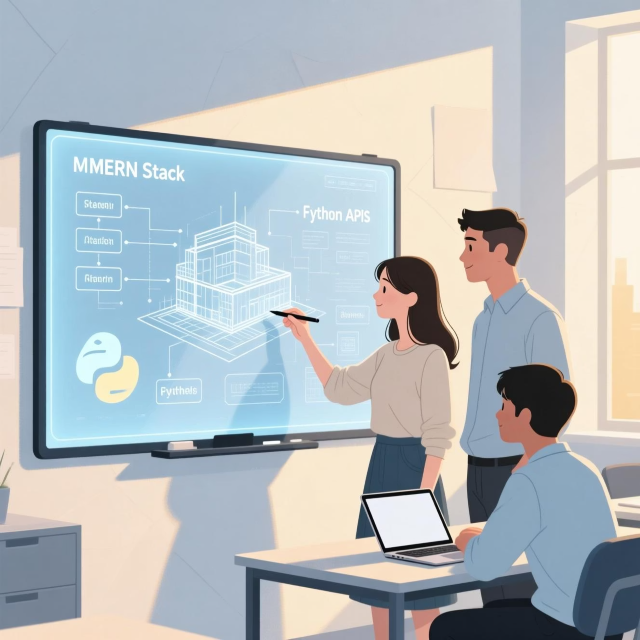
Unlocking Collaborative Learning: Features & User Experience
Real-time Collaboration
Synchronous editing and interaction on a shared digital canvas, fostering dynamic teamwork.
Comprehensive Resource Sharing
Seamlessly upload, share, and annotate documents, videos, and links within study groups.
Integrated Study Tools
Utilise built-in features like mind mapping, note-taking, and flashcards for comprehensive learning.
Intuitive User Interface
Designed for ease of use, ensuring a smooth and engaging experience for students of all tech proficiencies.

Slide 5


Impact & Future Roadmap: Empowering Global Learning
CollabCanvas empowers students to learn together, anywhere.
CollabCanvas aims to democratise access to collaborative study environments, breaking down geographical barriers and fostering a global learning community.
Future Enhancements
Increased Accessibility
Planned features include AI-driven personalized learning paths and integration with popular educational platforms.
Enhanced Learning Outcomes
Enabling students from diverse locations to participate in group study sessions.
Improved comprehension and retention through active, collaborative engagement.

