Slide 1

Multi-Vendor Procurement
& Purchase Order Management System
Database Management Tools | Final Project | Team 3
Python Flask · SQLite · Firebase Auth · Vercel
procurement-system-peach.vercel.app

Slide 2

Project Overview
What we built & why
THE PROBLEM WE SOLVED
The Problem:
• Organizations lose visibility once a purchase request leaves an employee's desk.
• No enforced budget tracking per department.
• No reliable audit trail — who approved what, and when?
Our Solution:
• A 6-role enterprise procurement platform with full lifecycle tracking.
• Rigid state-machine: requests cannot skip steps.
• Every action logged with user, IP address, and timestamp.
Live URL: procurement-system-peach.vercel.app

Slide 3

The Procurement State Machine
5 phases · 16 tables · 6 roles
Phase 1 — Employee:
• Submits item request → Status: PENDING
Phase 2 — Manager:
• Approves or rejects → Status: APPROVED / REJECTED
Phase 3 — Procurement:
• Assigns vendor, issues PO → Status: PO_ISSUED
Phase 4 — Vendor:
• Ships goods, creates receipt → Status: SHIPPED
Phase 5 — Finance:
• Processes invoice & payment → Status: INVOICED → PAID

Slide 4
System Entry: Authentication
FIREBASE AUTH + SQLITE ROLE LOOKUP
How the Login Works:
• Firebase Auth SDK verifies email/password client-side.
• Flask backend queries: SELECT * FROM Users JOIN Roles WHERE email=?
• On match → Flask-Login creates a secure session cookie.
→ Audit_Log: INSERT (user_id, action='LOGIN', ip, timestamp)
Test Credentials (password: 123456):
• employee@test.com
• manager@test.com | procurement@test.com
• vendor@test.com | finance@test.com | admin@test.com
DB Tables: Users · Roles · Audit_Log

Slide 5
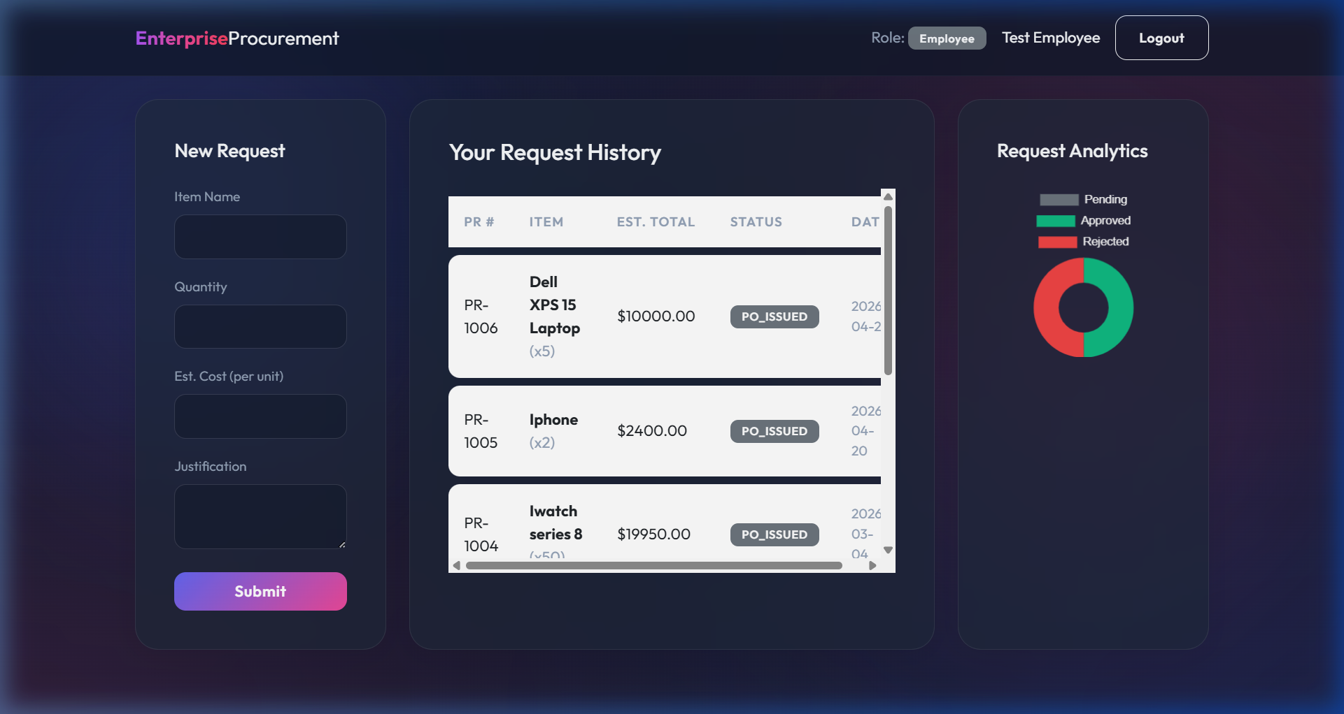
PHASE 1 — Employee Dashboard | employee@test.com
Shows: New Request form · Request History (Dell XPS 15 — $10,000 — PO_ISSUED) · Analytics doughnut chart

Slide 6
Phase 1: Employee Submits a Request
LOGGED IN AS: EMPLOYEE@TEST.COM
Data Entered (Live Demo):
• Item Name: Dell XPS 15 Laptop
• Quantity: 5 units
• Est. Cost per unit: $2,000.00
• Total Estimated Value: $10,000
• Justification: Required for new IT hires in Q3 expansion
What Happened in the Database:
• INSERT into Purchase_Requests (employee_id, dept_id, item_name, qty, cost)
• status defaulted to 'PENDING'
• INSERT into PR_Status_History: NONE → PENDING
DB Tables: Purchase_Requests · PR_Status_History

Slide 7
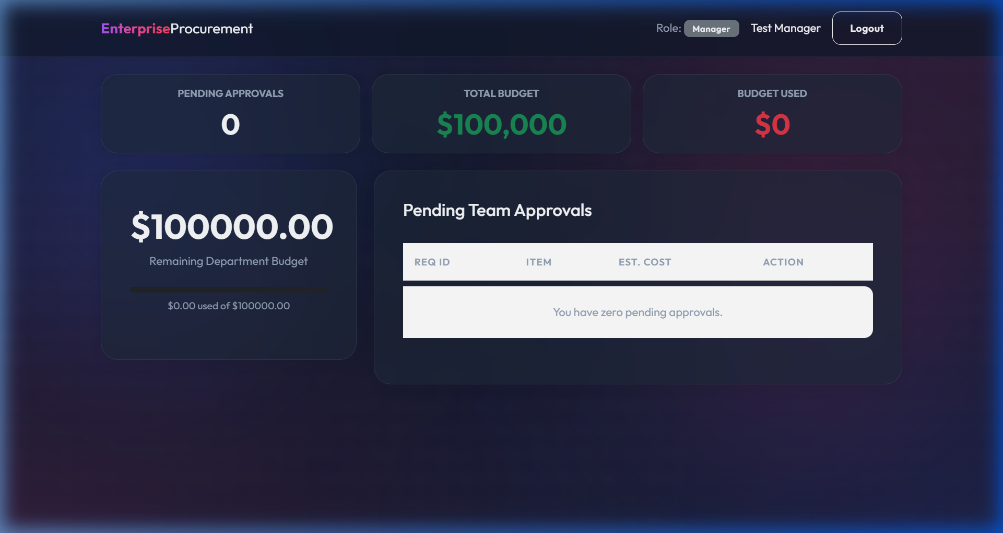
PHASE 2 — Manager Dashboard | manager@test.com
Shows: Pending Approvals=0 · Total Budget=$100,000 · Budget Used=$0 · Remaining=$100,000.00

Slide 8
Phase 2: Manager Reviews & Approves
LOGGED IN AS: MANAGER@TEST.COM
Manager Sees on Dashboard:
• KPI: Total Budget = $100,000 (green)
• KPI: Budget Used = $0 (safe — room to approve!)
• Pending Team Approvals table listing employee requests
Action Taken:
• Identifies the Dell XPS 15 Laptop — $10,000 request
• Adds comment: 'Approved for Q3 expansion — budget confirmed'
• Clicks APPROVE
Triggered SQL:
• UPDATE Purchase_Requests SET status='APPROVED' WHERE pr_id=?
• INSERT into PR_Approvals (pr_id, manager_id, decision, comments)
• INSERT into PR_Status_History: PENDING → APPROVED
DB Tables: Purchase_Requests · PR_Approvals · PR_Status_History

Slide 9
Phase 3: Procurement Generates a PO
LOGGED IN AS: PROCUREMENT@TEST.COM
Dashboard Shows:
• Approved Requests waiting for a Purchase Order
• Active POs list with vendor names and total amounts
• KPI: Total PO Value in the pipeline
Action Taken:
• Finds the approved Dell XPS 15 ($10,000)
• Selects Vendor: Tech Supplies Inc
• Sets Delivery Date and clicks Generate PO
Triggered SQL:
• INSERT into Purchase_Orders (pr_id, vendor_id, officer_id, delivery_date, total_amount)
• UPDATE Purchase_Requests SET status='PO_ISSUED'
DB Tables: Purchase_Orders · Purchase_Requests · Vendors

Slide 10
Phase 4: Vendor Ships the Goods
LOGGED IN AS: VENDOR@TEST.COM
Critical Role Restriction:
• Vendor's dashboard query filters by their own vendor_id.
• They CANNOT see other vendors' orders.
Dashboard Shows:
• KPI: Open Orders | Orders to Ship | Total Order Value
• The Dell XPS 15 PO for $10,000 is listed as ISSUED
Action Taken:
• Vendor clicks 'Mark as Shipped'
Triggered SQL:
• UPDATE Purchase_Orders SET status='SHIPPED'
• INSERT into Goods_Receipt (po_id, received_by, notes='Shipped by Vendor')
DB Tables: Purchase_Orders · Goods_Receipt

Slide 11
Phase 5: Finance Processes Invoice
LOGGED IN AS: FINANCE@TEST.COM
Dashboard Shows:
• Shipped Goods Receipts ready for invoicing
• All Invoices with PENDING / PAID status
• KPI: Total Accounts Payable
Action Taken:
• Finance sees the Dell XPS 15 goods receipt
• Clicks 'Process Invoice'
Triggered SQL:
• INSERT into Invoices (po_id, vendor_id, amount=$10,000, status='PENDING')
• UPDATE Purchase_Orders SET status='INVOICED'
• department.budget_used += $10,000
• Audit_Log: CREATE_INVOICE logged with IP + timestamp
DB Tables: Invoices · Payments · Budget_Transactions · Audit_Log

Slide 12
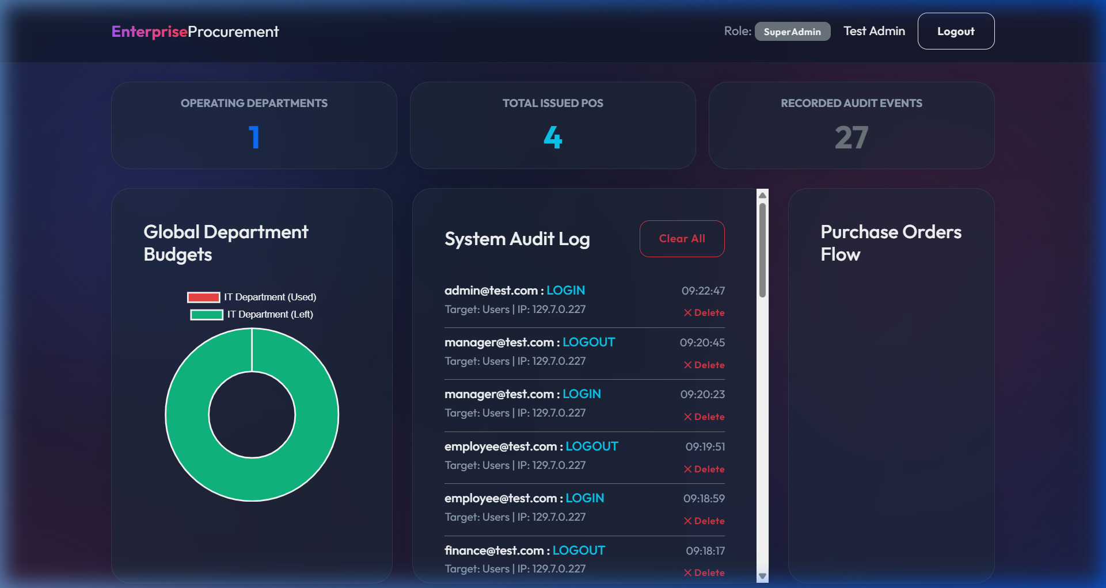
SUPER ADMIN Dashboard | admin@test.com
Shows: 1 Department · 4 Total POs · 27 Audit Events · Live System Audit Log · Budget Donut Chart

Slide 13
Super Admin: Global Oversight
LOGGED IN AS: ADMIN@TEST.COM
Live KPIs Shown (Real Data):
• Operating Departments: 1
• Total Issued POs: 4
• Recorded Audit Events: 27
System Audit Log (real entries):
• admin@test.com: LOGIN at 09:22:47
• manager@test.com: LOGOUT at 09:20:45
• employee@test.com: LOGIN at 09:18:59
• finance@test.com: LOGOUT at 09:18:17
Admin Powers:
• Delete individual log entries
• 'Clear All' wipes entire Audit_Log table
DB Tables: Audit_Log · Departments · Purchase_Orders

Slide 14
Database Architecture
16 Tables · 3NF · Full FK Integrity
Identity Module:
• Roles, Users, Departments
Procurement Workflow:
• Purchase_Requests, PR_Approvals, PR_Status_History
Vendor Management:
• Vendors, Vendor_Categories, Contracts
Order Fulfillment:
• Purchase_Orders, PO_Line_Items, Goods_Receipt
Finance & Compliance:
• Invoices, Payments, Budget_Transactions, Audit_Log
Paste ERD diagram screenshot on a dedicated slide after this

Slide 15
SQL Implementation Highlights
DDL · DML · ADVANCED JOIN QUERIES
Table Creation (setup_db.py):
• 16 tables with NOT NULL, UNIQUE, FK constraints
• Auto-translates SQLite → PostgreSQL for Vercel
Data Population (populate_db.py):
• DML INSERTs simulating 30 days of prior history
• Covers all statuses from PENDING through PAID
Example Advanced Query:
• 4-table JOIN: Users → Purchase_Requests → Purchase_Orders → Invoices
• Returns: name, item, amount, invoice status
• Proves end-to-end traceability through SQL alone
Paste your SQL JOIN query screenshot after this slide

Slide 16
Challenges & Solutions
Challenge 1 — Vercel Read-Only Filesystem:
• SQLite cannot write to disk on serverless Vercel.
• Fix: Custom DBWrapper routes all writes to /tmp/.
On DATABASE_URL env → auto-translates to PostgreSQL syntax.
Challenge 2 — Enforcing the State Machine:
• An invoice should never exist before an approval.
• Fix: Role-based route guards — Finance only sees SHIPPED receipts.
Challenge 3 — Audit Log Timestamps:
• Default SQLite used UTC; business needed US/Central.
• Fix: pytz forces all Audit_Log INSERTs to US/Central timezone.

Slide 17
Conclusion & Future Scope
What We Built:
A production-deployed, 6-role enterprise procurement system backed by a 16-table 3NF-normalized relational database — proving real-world business logic can be modeled precisely in SQL.
Key Learnings:
Translating complex state-machine rules into FK constraints. Bridging SQLite and PostgreSQL with a single abstraction layer. Deploying full-stack to production serverless infrastructure.
Future Improvements:
Full PostgreSQL migration. ML-based vendor rating. Auto-generate PDF invoices. Email notifications per role.

