Slide 1

Multi-Vendor Procurement
& Purchase Order Management System
Database Management Tools | Final Project | Team 3
Python Flask · SQLite · Firebase Auth · Vercel
🌐 Live at: procurement-system-peach.vercel.app

Slide 2

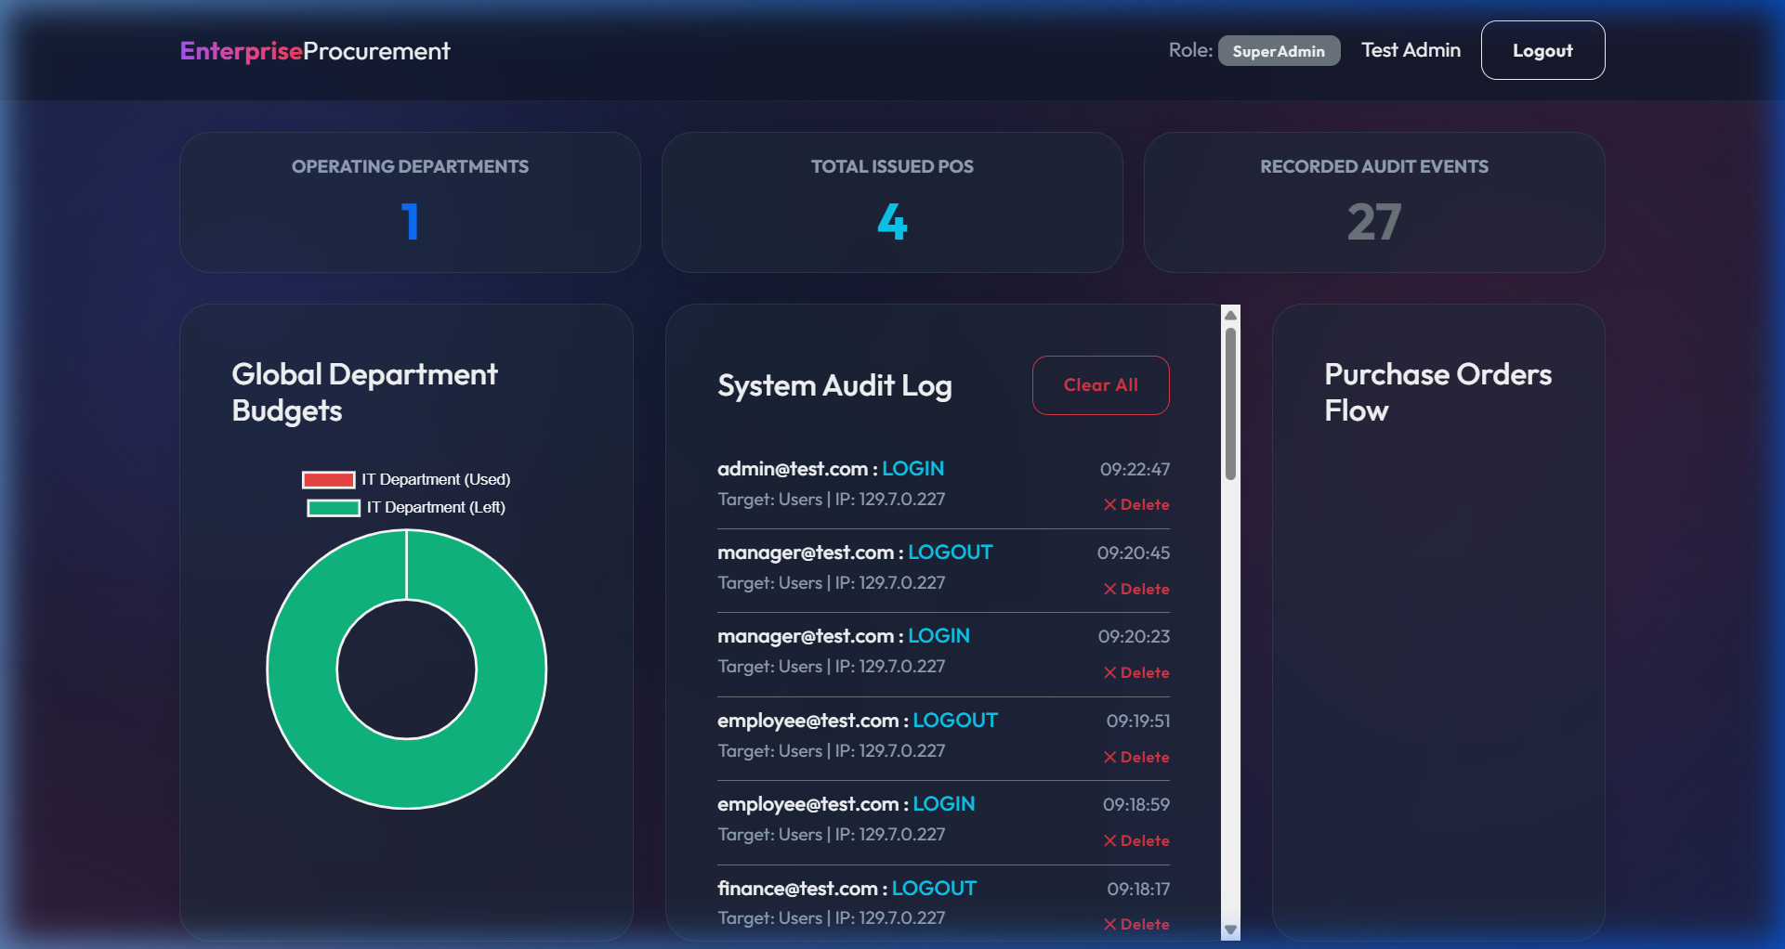
Project Overview & Objectives
The Problem We Solved:
• Large organizations have fragmented procurement — no single source of truth.
• Budgets bleed without real-time tracking per department.
• No enforced audit trail — who approved what and when?
Our Solution:
• A 6-role enterprise procurement platform with full lifecycle tracking.
• Rigid state-machine preventing any out-of-order transactions.
• Every action logged with IP, user, and timestamp.

Slide 3

The Procurement State Machine
5 PHASES · 16 TABLES · 6 ROLES
Phase 1 – Employee Request:
• PR created → Status: PENDING
Phase 2 – Manager Approval:
• Decision logged → Status: APPROVED / REJECTED
Phase 3 – Purchase Order:
• Vendor assigned → Status: PO_ISSUED
Phase 4 – Vendor Ships:
• Goods Receipt created → Status: SHIPPED
Phase 5 – Finance Pays:
• Invoice processed → Status: INVOICED → PAID

Slide 4
Live Demo: The System Login
AUTHENTICATION GATEWAY
Live Site: procurement-system-peach.vercel.app
What Happens in the Database:
• Firebase Auth verifies email/password on the client side.
• Flask backend then queries the Users + Roles tables by email.
• On match → session created via Flask-Login.
• Audit_Log table receives an INSERT:
→ user_id, action='LOGIN', ip_address, timestamp (CT)
Test Credentials (all roles use password: 123456):
• employee@test.com | manager@test.com
• procurement@test.com | vendor@test.com
• finance@test.com | admin@test.com
📋 DB Tables: Users · Roles · Audit_Log

Slide 5
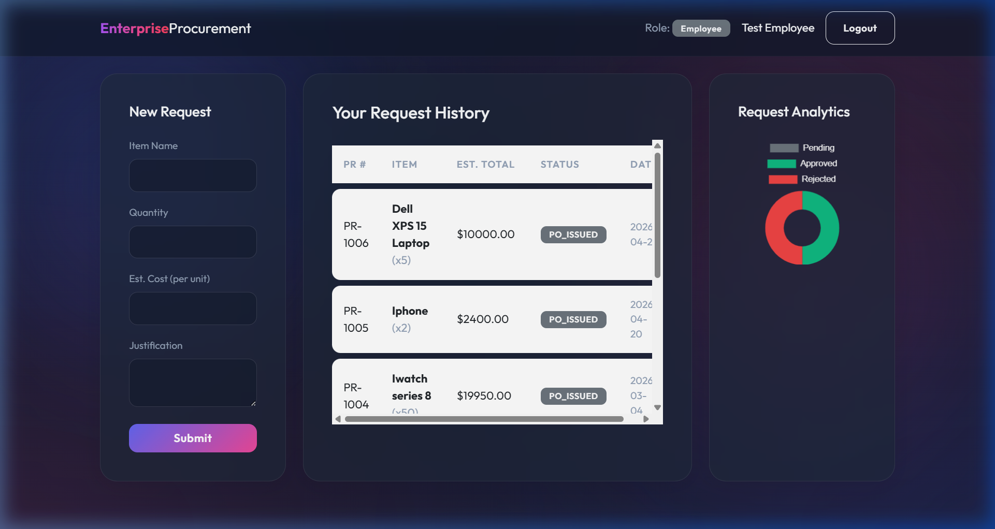
Phase 1: Employee Submits a Request
LOGGED IN AS: EMPLOYEE@TEST.COM
Data Entered (Live Demo):
• Item: Dell XPS 15 Laptop
• Quantity: 5 units
• Est. Cost per unit: $2,000
• Total Est. Value: $10,000
• Justification: Required for new IT hires
What Happened in the Database:
• INSERT into Purchase_Requests table.
• status automatically set to 'PENDING'.
• INSERT into PR_Status_History (NONE → PENDING).
• Employee dashboard shows doughnut chart updating.
📋 DB Tables: Purchase_Requests · PR_Status_History

Slide 6
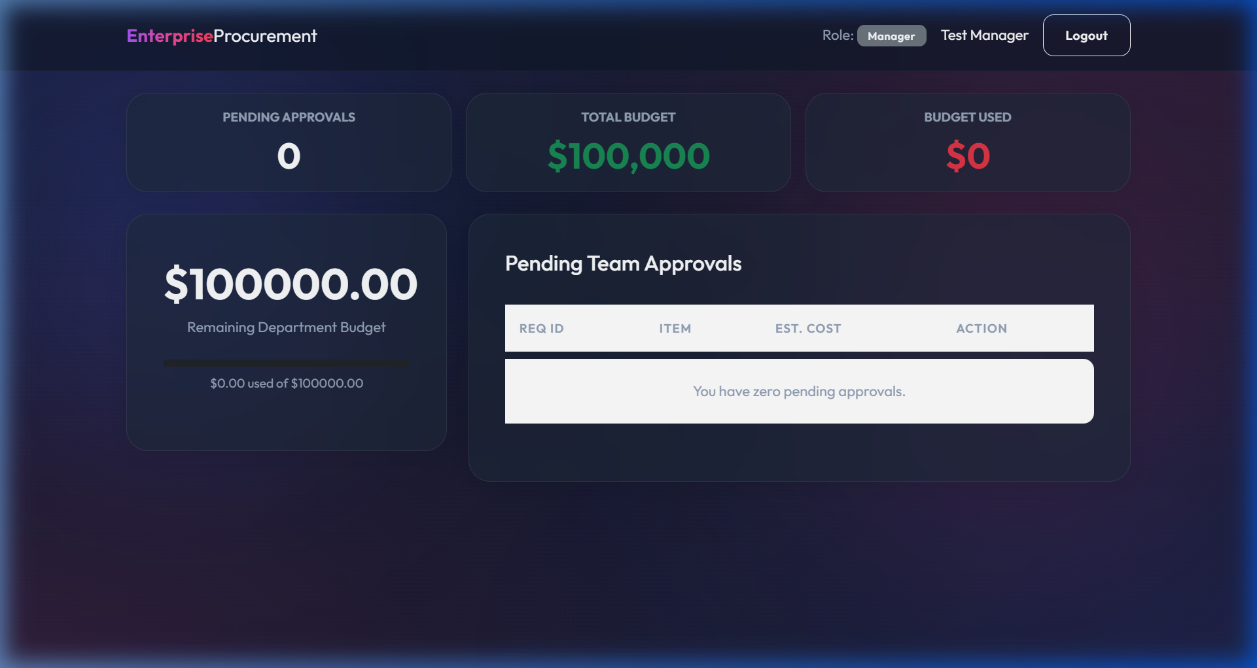
Phase 2: Manager Reviews & Approves
LOGGED IN AS: MANAGER@TEST.COM
Manager's Dashboard Shows:
• Total Budget: $100,000 (green)
• Budget Used: $0 (red — safe to approve!)
• Pending Team Approvals list
Action Taken (Live Demo):
• Manager reviews Dell XPS 15 ($10,000 request)
• Adds comment: 'Approved for Q3 expansion - budget confirmed'
• Clicks the APPROVE button
What Happened in the Database:
• UPDATE Purchase_Requests SET status='APPROVED'
• INSERT into PR_Approvals (decision, manager_id, timestamp)
• INSERT into PR_Status_History (PENDING → APPROVED)
📋 DB Tables: Purchase_Requests · PR_Approvals · PR_Status_History

Slide 7
Phase 3: Procurement Generates Purchase Order
LOGGED IN AS: PROCUREMENT@TEST.COM
Dashboard Shows:
• All APPROVED requests pending a PO.
• Active POs with total value and vendor names.
Action Taken (Live Demo):
• Procurement Officer sees the approved Dell XPS 15 request.
• Selects Vendor: Tech Supplies Inc
• Sets delivery date & clicks Generate PO
What Happened in the Database:
• INSERT into Purchase_Orders (pr_id, vendor_id, officer_id, amount)
• UPDATE Purchase_Requests SET status='PO_ISSUED'
• The PO now appears in the Procurement active orders list.
📋 DB Tables: Purchase_Orders · Purchase_Requests · Vendors

Slide 8
Phase 4: Vendor Ships the Order
LOGGED IN AS: VENDOR@TEST.COM
Role-Based Restriction:
• Vendor can ONLY see POs assigned to their vendor_id.
• No access to other vendors' orders or internal budgets.
Action Taken (Live Demo):
• Vendor sees the Dell XPS 15 PO for $10,000.
• Clicks 'Mark as Shipped' button.
What Happened in the Database:
• UPDATE Purchase_Orders SET status='SHIPPED'
• INSERT into Goods_Receipt:
→ po_id, received_by, quantity_received=0, notes='Shipped by Vendor'
• The PO is now visible to Finance for invoicing.
📋 DB Tables: Purchase_Orders · Goods_Receipt

Slide 9
Phase 5: Finance Processes the Invoice
LOGGED IN AS: FINANCE@TEST.COM
Dashboard Shows:
• Goods Receipts ready for invoicing.
• Existing invoices with PENDING / PAID status.
• Total Accounts Payable value.
Action Taken (Live Demo):
• Finance team sees the shipped Dell XPS 15 goods receipt.
• Clicks 'Process Invoice' to generate the $10,000 invoice.
What Happened in the Database:
• INSERT into Invoices (po_id, vendor_id, amount=$10,000, status='PENDING')
• UPDATE Purchase_Orders SET status='INVOICED'
• Department budget_used increments by $10,000
• Audit_Log receives a CREATE_INVOICE event.
📋 DB Tables: Invoices · Payments · Budget_Transactions · Audit_Log

Slide 10
Super Admin: The God View
LOGGED IN AS: ADMIN@TEST.COM
Admin KPI Cards Show (Real Data):
• Operating Departments: 1
• Total Issued POs: 4
• Recorded Audit Events: 27
The System Audit Log (live):
• admin@test.com: LOGIN at 09:22:47
• manager@test.com: LOGOUT at 09:20:45
• employee@test.com: LOGIN at 09:18:59
Every single action is permanently traceable.
Admin can delete individual log entries or Clear All.
📋 DB Tables: Audit_Log · Departments · Purchase_Orders

Slide 11
Database Architecture
16 TABLES · 3NF NORMALIZED · FULL FK INTEGRITY
Identity Module:
• Roles, Users, Departments
Procurement Workflow:
• Purchase_Requests, PR_Approvals, PR_Status_History
Vendor Management:
• Vendors, Vendor_Categories, Contracts
Order Fulfillment:
• Purchase_Orders, PO_Line_Items, Goods_Receipt
Finance & Compliance:
• Invoices, Payments, Budget_Transactions, Audit_Log
➔ Insert ERD Diagram on the right side of this slide

Slide 12
SQL Implementation Highlights
DDL · DML · JOIN QUERIES
Table Creation (setup_db.py):
• 16 tables with NOT NULL, UNIQUE, FK constraints.
• Auto-translates SQLite → PostgreSQL for cloud.
Data Population (populate_db.py):
• DML INSERTs simulating 30 days of history.
• Randomized statuses across the full pipeline.
Advanced Query Example:
• 4-Table JOIN: Users → Purchase_Requests → Purchase_Orders → Invoices
• SELECT name, item_name, total_amount, invoice status
• Demonstrates real end-to-end traceability via SQL alone.
➔ Paste your most complex JOIN query snippet on the right side

Slide 13
Challenges & Solutions
Challenge 1 – Vercel Read-Only File System:
• SQLite cannot write to disk on serverless Vercel.
• Solution: Custom DBWrapper routes writes to /tmp/.
On PostgreSQL env, auto-translates all SQL syntax.
Challenge 2 – Preventing Status Skipping:
• An invoice should never exist before approval.
• Solution: Role-based route guards + state-machine logic.
Finance only sees 'SHIPPED' goods receipts.
Challenge 3 – Synchronized Audit Timestamps:
• Default SQLite timestamps used server UTC time.
• Solution: pytz forces all Audit_Log entries to US/Central.

Slide 14
Frontend & Deployment (Extra Credit)
LIVE ON VERCEL · GITHUB CI/CD
Tech Stack:
• Flask + Jinja2 server-side templates
• Bootstrap 5 grid, glassmorphism dark UI
• Chart.js — doughnut & pie charts per dashboard role
• Google Fonts (Inter) for premium typography
Deployment Pipeline:
• Code pushed to GitHub triggers auto-deploy on Vercel.
• Environment variables (DATABASE_URL, VERCEL=1) control DB mode.
Database Connectivity:
• /api/auth reads Users table → creates Flask session
• Every dashboard route executes targeted SQLite queries
• All writes pass through the DBWrapper for portability.

Slide 15
Conclusion & Future Scope
What We Built:
A production-deployed, 6-role enterprise procurement system backed by a 16-table, 3NF-normalized relational database proving real-world business logic can be precisely modeled in SQL.
Key Learnings:
Translating complex state machine rules into relational integrity constraints. Bridging SQLite/PostgreSQL with a single Python abstraction layer. Deploying a full-stack system to production serverless infrastructure.
Future Improvements:
Migrate fully to PostgreSQL. Add ML-based vendor rating. Auto-generate PDF invoices. Role-level email notifications.

