Slide 1
Setup

Slide 2
Requirements (windows setup)
Git & Git Bash
Oracle Virtual Box (download)
To setup ubuntu dev env.
Vagrant (download)
To configure virtual box.
Note: the alternate of vagrant and virtual box is docker.
Note: It’s command line tool. Access it using command prompt and/or git bash

Slide 3
Requirements (Windows setup)
Atom (download)
Text Editor for coding
ModHeader Extension (install)
Chrome extension to add headers to APIs (authentication headers)

Slide 4
Initial Setup
Git Setup.
Setup Git to atom editor for easy access of git and github for the project.
Vagrant Setup:
Open git bash in your project folder.
Type command: vagrant init ubuntu/bionic64 to initialize ubuntu image
A vagrant file will be created. Customize it according to your requirements.
Type the command: vagrant up. It downloads the based image that we specified in our vagrant file, and it’ll create virtual box to create new virtual machine and run scripts when we starts the machine.
Note: You might get an error with the latest image files. If that’s a case and you can’t find any solution from the internet, email the error to this id: sshah1885@conestogac.on.ca

Slide 5
Cont.
Vagrant Setup(cont.):
Once the virtual machine is being setup, to connect the vm, type the command: vagrant ssh
To disconnect, use command: exit.
Note: now the vagrant ( ubuntu server) is linked to your local project.
Any changes made from ubuntu server will affect local files and vis a versa.

Slide 6
Django Setup
To setup Django, We’ll have to setup python virtual environment, add python packages, setup Django project and app, and enable app in Django settings.
Python Virtual environment setup:
Open git bash in project folder and run the vagrant. (vagrant ssh)
Go to the vagrant directory. (cd /vagrant)
To confirm that you’re synced with the local code, type ls command to see all the files on vagrant directory (server).
Create python virtual environment (python –m venv ~/env)
It’ll create new file folder in vagrant’s home/env directory. ( we do not need this environment to be synced with our project.)
Activate: source ~/env/bin/activate Deactivate: deactivate

Slide 7
Cont.
Once you’ll have the virtual environment setup, we’ll go ahead and install all the packages we’ll need to setup this project.
Python packages:
django==2.2
djangorestframework==3.9.2
Note: this are not latest packages, to know more, visit this website.
Installation: (make sure python virtual environment is activated)
There are 2 ways to install these packages.
individually, pip install <module name> == <version>
All together, create requirements.txt and add all modules shown above. Then use the command pip install –r requirements.txt. It’ll install all the modules specified in the requirements.txt file.

Slide 8
Cont.
Now that we have full python pipeline installed. Let’s create Django project and app.
Setup the Django project:
Run this command: django-admin.py startproject profiles_project .
This script will create new project with the name: profile_project.
Setup the Django App:
The Django project consist of one or more apps to allow separation of the functionalities.
Run the command: python manage.py startapp profile_api
This script will create new folder profile_api as an application folder.

Slide 9
Cont.
Remember, previously we installed rest framework using requirements.txt file? And in previous step we also created the Django project and app. Now it’s time to link those installs.
Django Project settings:
Go to settings.py from the project folder.
Navigate to the INSTALLED_APPS = [ … ]
Add these modules there: [ …, 'rest_framework', 'rest_framework.authtoken', 'profile_api’, ]
First 2 modules from the above mentioned step is related to rest framework. And last module is the Django app.

Slide 10
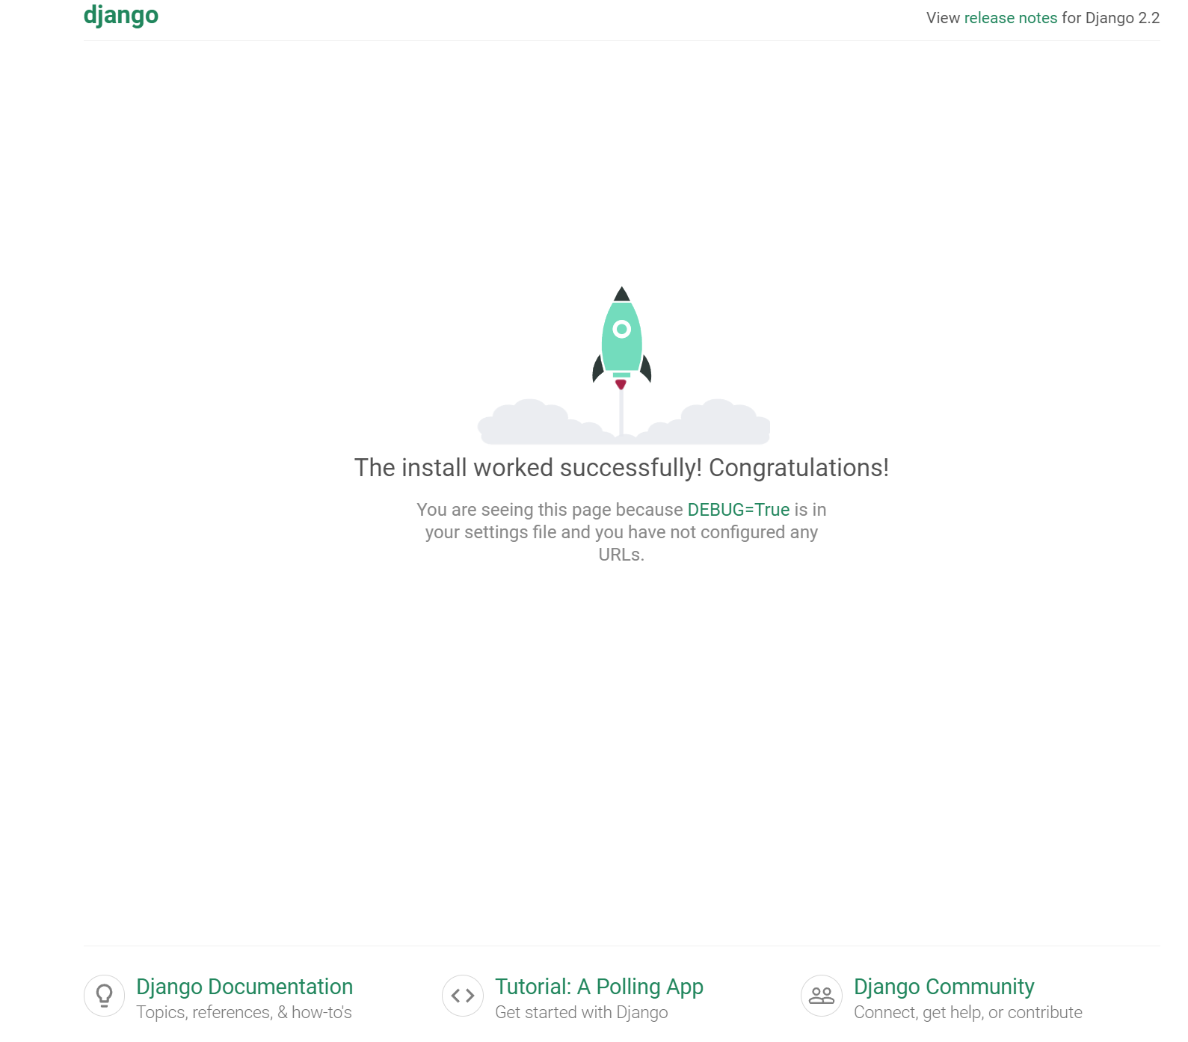
Cont.
Finally You’ve completely setup your Django rest app project. Don’t believe it? Try this:
Run this script: python manage.py runserver 0.0.0.0:8000
Note: change the port number according to your own specified port. Go to the vagrant file and check which port are you using for the host and guest network.
Ignored the unapplied migrations. We’ll deal with that later.
Open the browser and search the url: localhost:8000
If you see something like this shown in the right side, yey! Everything worked as expected.

Slide 11
Database Setup
To setup database, we’ll be using models & managers
( Models <=> Managers <=> Databases)
Customize models.py file available in Django app folder.
Apply appropriate settings. (link models in the settings file of the Django project)
Create Migration File. ( every time you change the model or add a new model, You’ll have to create a migration file. Migration file allow us to sync database tables to our custom Django models.
Use command line tool (git bash): python manage.py makemigrations profile_api
Note: make sure you’re in the vagrant ssh -> in vagrant directory -> activated python venv
To Apply migrate for all models: python manage.py migrate

Slide 12
Admin Setup <superuser>
Django admin feature allow admin privileges to the user. This means admin user can inspect the databases, see models and can modifies them.
Pre-requirement: superuser (user with a max privileges)
To create superuser, script this: python manage.py createsuperuser
Enable Django admin for the model.
Open the admin.py file (from the Django app dir), and register the model.
from profile_api import models
admin.site.register(models,UserProfile)
Confirm changes
Open up the terminal: python manage.py runserver 0.0.0.0:8000
Browser: localhost:8000/admin

Slide 13
Django REST Framework Views
2 ways to create an API. (APIView and a ViewSet)
APIView
Most basic
Gives most control over application login
Reasons to use it:
Full control over the logic
Processing files and rendering async response
Calling other APIs/services
Access local files or data

Slide 14
Django REST Framework Views
APIView
Create an APIView:
Add api logic to the views.py
Create urls.py in Django app
Add url to the urls.py file in Django project
Note: needs to add include module
Run the server to confirm the changes
Add serializers file and setup serializers for post/put requests.

Slide 15
Django REST Framework Views
2 ways to create an API. (APIView and a ViewSet)
APIView ( previously learned )
ViewSet
Takes care of a lot of typical logic for us
Perfect for standard database operations
Fastest way to make a database interface
Reasons to use it:
Simple CRUD on database
Simple API for objects
Little or no customization on the logic
API with standard database structure.

Slide 16
Django REST Framework Views
ViewSet
Create a ViewSet API:
Add api logic to the views.py
Create urls.py in Django app (or use the existing if you already have one)
Add url to the urls.py file in Django project ( if new urls.py file is created)
Note: needs to add include module
Run the server to confirm the changes
Add serializers file and setup serializers for post/put requests.

Slide 17
General Steps
Add a new model ( In case you’d have database)
Run Migration (to reflect model to the database)
python manage.py makemigrations
python manage.py migrate
Register the model (in admin file)
Setup serializer class
Create View for API
Setup url
Setup permissions if required

Slide 18
Notes
Add Serializers to validate API data.
Add Models to
Register Models
Add ModelManagers to access database
Add API logic in views.js using ViewSet or APIView
Register URLs to access API logic

