Slide 1

Canadian Job Satisfaction Insights
Dataset: Job satisfaction, by gender and province
Created by Smit Soni

Slide 2
Introduction
Job satisfaction is a key indicator of well-being within the workplace and a vital part of Canada's Quality of Life Framework.
It reflects how content individuals are with their jobs and can be influenced by factors such as gender, region, and overall employment conditions.
In this presentation, we will explore job satisfaction by gender across Canadian provinces, using data from Statistics Canada.
The goal is to analyze how satisfaction levels vary between men and women and identify provinces with the highest and lowest satisfaction rates, helping us understand regional and gender-based disparities in work life.

Slide 3
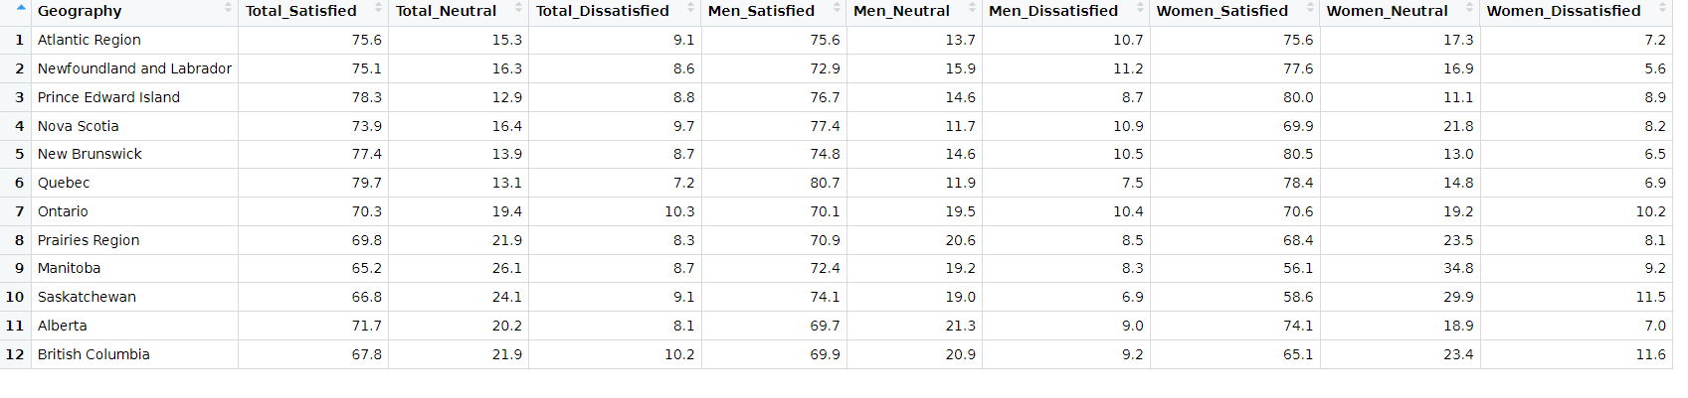
About Data:
Domain =Prosperity
Indicator= Job Satisfaction

Slide 4
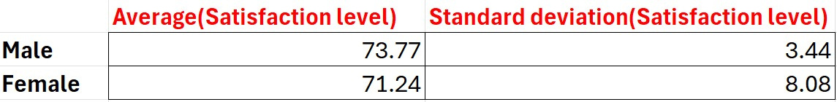
About Data
Domain =Prosperity
Indicator= Job Satisfaction

Slide 5
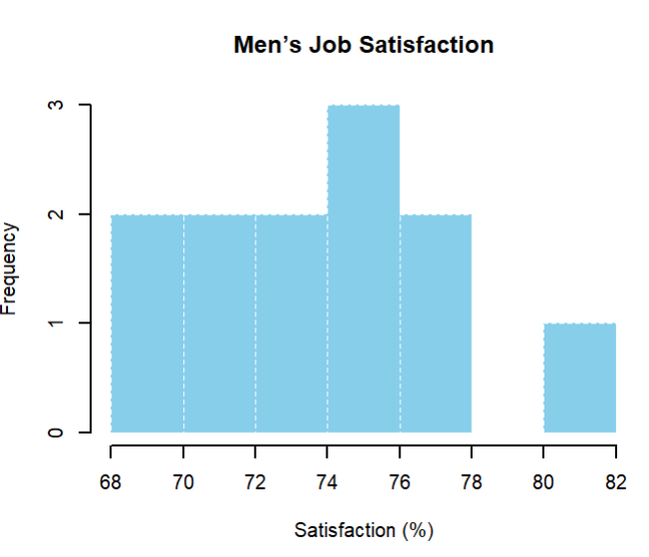
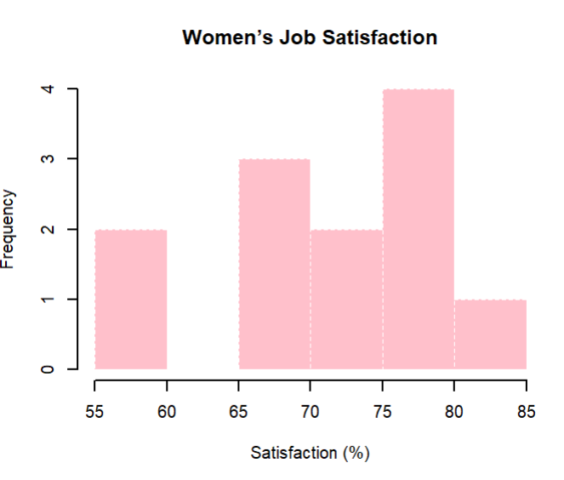
Histogram
Most men report job satisfaction between 74% and 76%, and is uniformly distributed
Women’s satisfaction levels vary more widely, with a concentration between 75% and 80%.

Slide 6
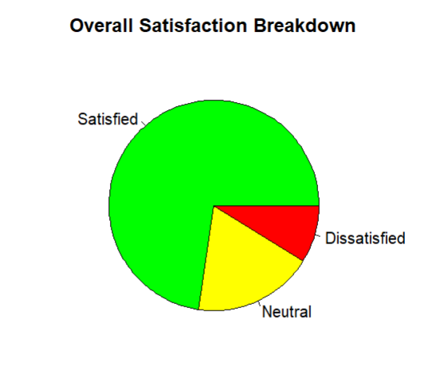
Pie Chart
Overall Job Satisfaction Breakdown
A majority of respondents report being satisfied, with a smaller portion feeling neutral or dissatisfied.

Slide 7
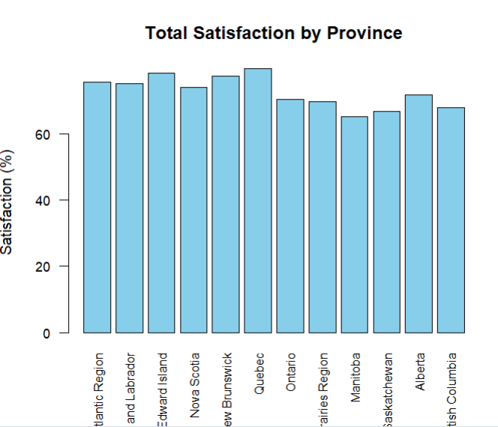
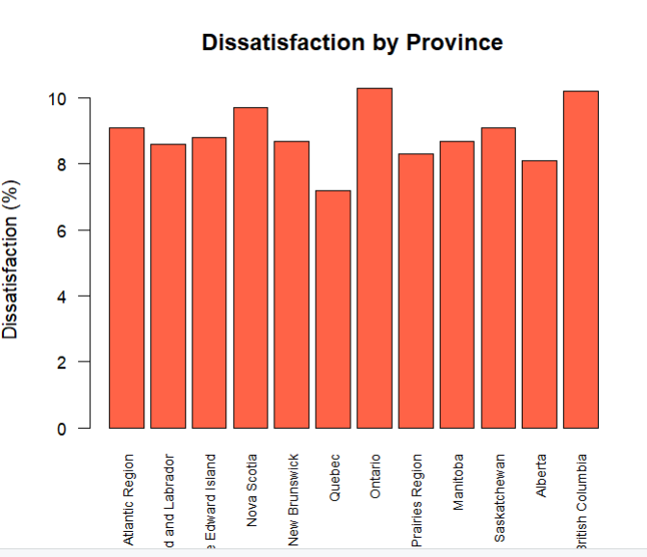
Bar Chart:
Total Satisfaction and disatisfaction by Province

Slide 8
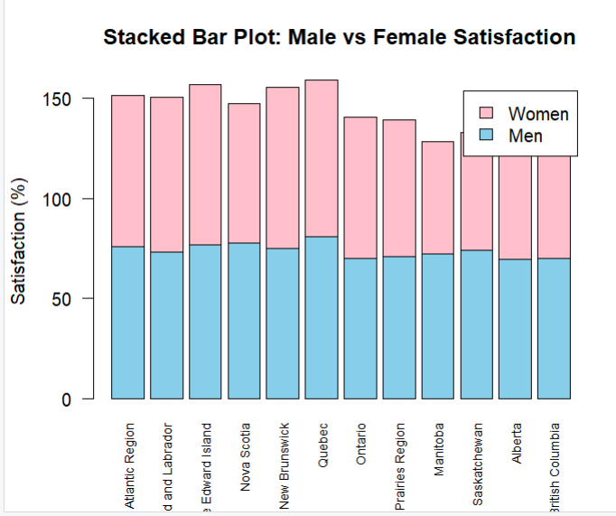
Stacked Bar Chart
Gender Comparison: Satisfaction by Province
Across most provinces, men report slightly higher job satisfaction than women.

Slide 9
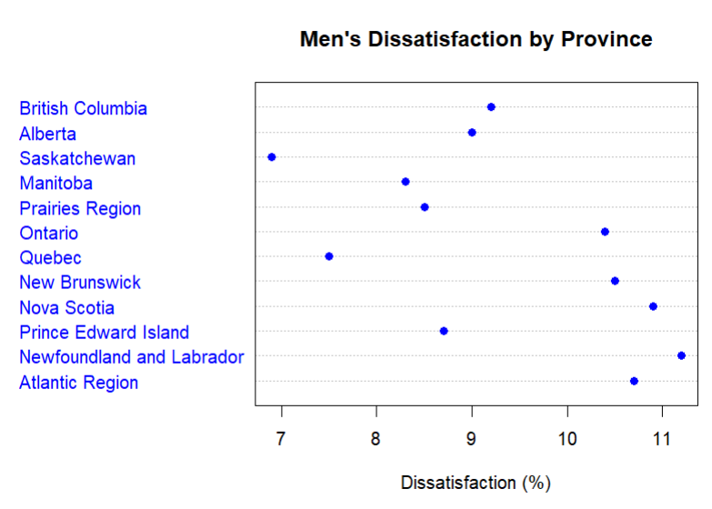
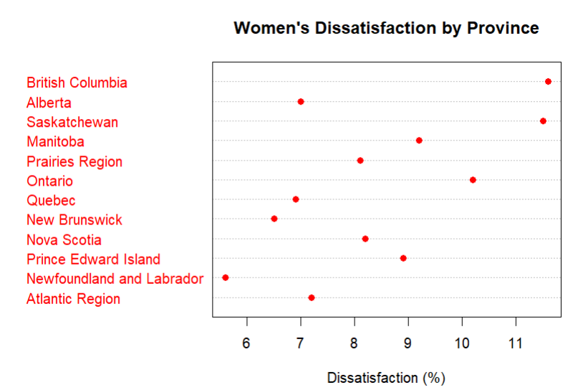
Dot Chart
Men’s Job Dissatisfaction by Province: We can see man in New founland and labrador has highest dissatisfaction rate
Women’s Job Dissatisfaction by Province: The highest levels are seen in British Columbia and Saskatchewan, while the lowest dissatisfaction is found in Newfoundland and Labrador

Slide 10
Conclusion
The analysis revealed that job satisfaction varies significantly across provinces and between genders in Canada.
Men generally reported higher satisfaction levels than women, with the gap being more pronounced in some regions.
These findings highlight the importance of implementing region-specific and gender-sensitive workplace policies to enhance employee well-being and support equitable labor market participation across the country.

Slide 11
Thank you

