Slide 2
M

Slide 3
M
THE MILLENNIALS
FREEDOM FROM BOREDOM

Slide 4
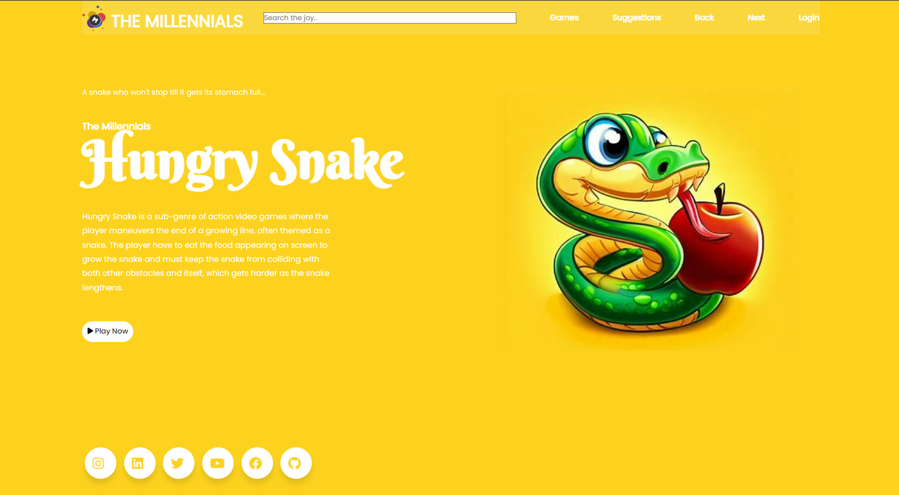

Slide 5
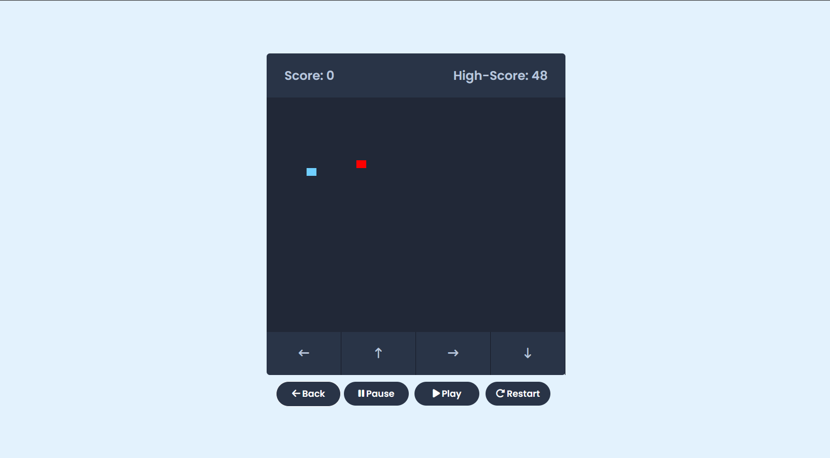

Slide 6
