Slide 1
Advance Ambulance-Alert Corridor Simulator
Microscopic Simulation of Emergency Vehicle Corridors & Driver Awareness Systems
Project Team Members & Contributions:
• Member A: Simulation Core (simulator.py, config.py, test_simulator.py)
• Member B: Experiments & Analytics (experiments.py, summary.txt, CSV data)
• Member C: Interactive Demo, Report & Viva Preparation (notebook, report, slides)

Slide 2
ADVANCE AMBULANCE-ALERT CORRIDOR SIMULATOR
Problem Statement & Project Objectives
The Problem:
• In congested cities, ambulances get delayed because drivers react late to physical sirens.
• Sudden braking and blocked lanes trap ambulances in critical traffic bottlenecks.
• Advance digital alert systems give upstream drivers early awareness to yield proactively.
Objectives:
• To simulate ambulance movement through a 1D traffic corridor.
• To model the effect of advance alerts on driver behavior (cooperation factor α, horizon H).
• To quantify reduction in ambulance travel time due to advance alerts.

Slide 3
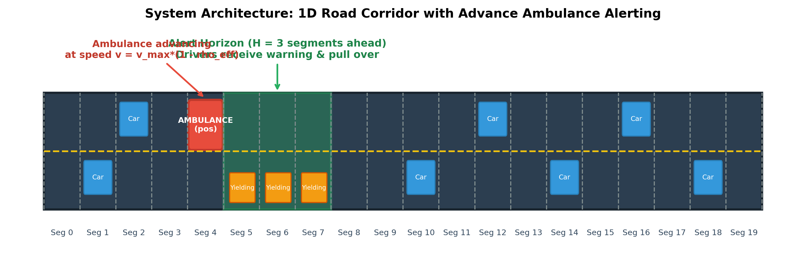
ADVANCE AMBULANCE-ALERT CORRIDOR SIMULATOR
System Model & Corridor Architecture
Model Specifications:
• Corridor: 1D road divided into N = 20 segments | Density: 0.2 to 0.8 (increasing).
• Ambulance Speed Model: v = v_max · (1 - ρ_eff[next_idx]), where v_max = 1.0 segment/step.
• Alert Logic: Alert horizon H = 3 segments ahead; Cooperation factor α = 0.5.

Slide 4
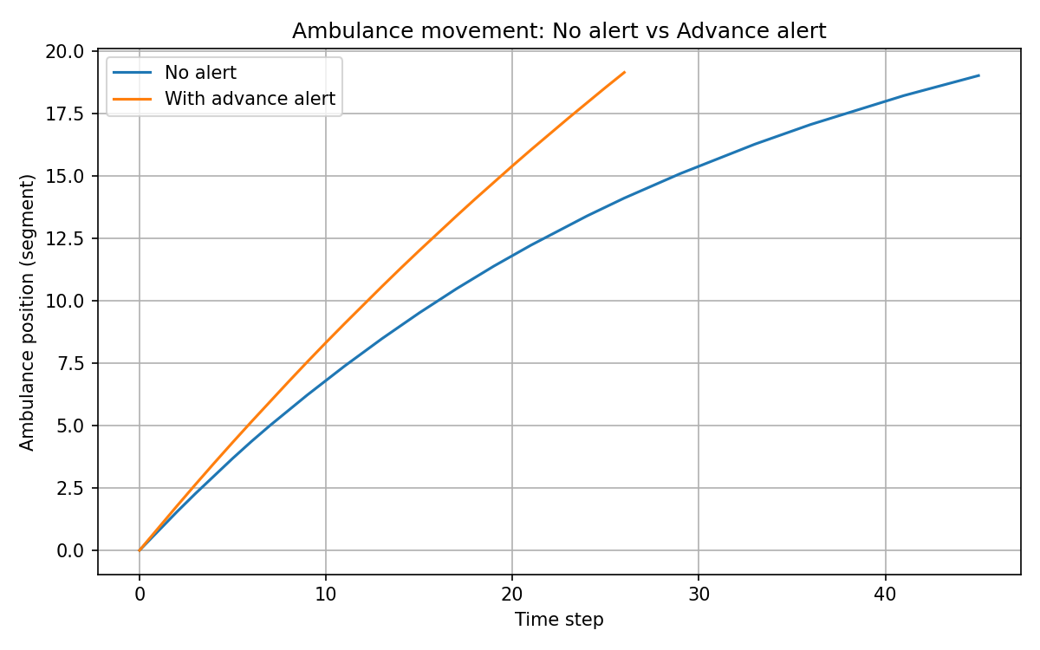
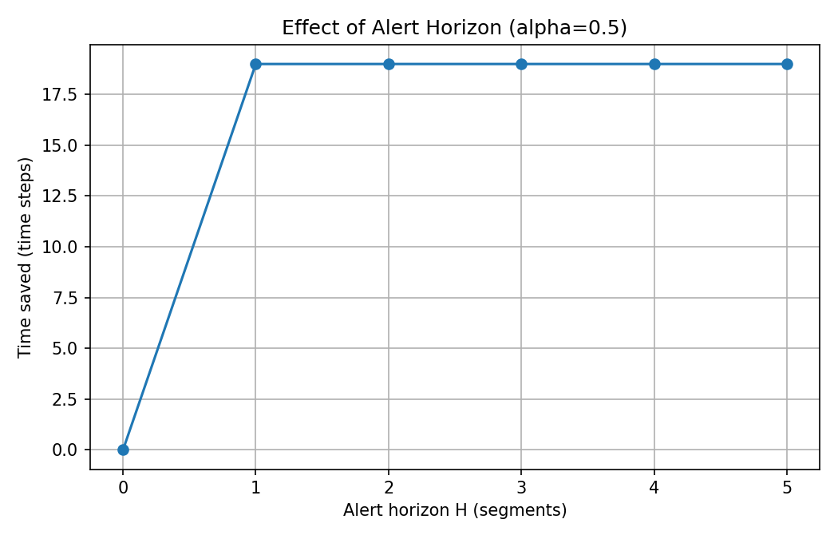
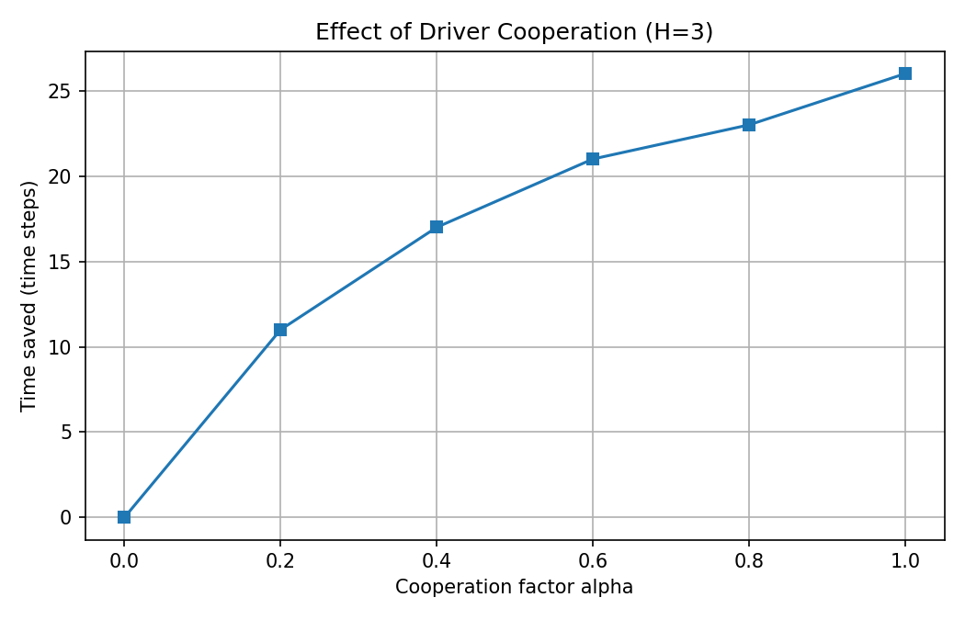
ADVANCE AMBULANCE-ALERT CORRIDOR SIMULATOR
Experimental Simulation Results

Slide 5
ADVANCE AMBULANCE-ALERT CORRIDOR SIMULATOR
Insights & Real-World Impact
Key Observations & Findings:
• 42.22% Measured Improvement: Travel time dropped from 45 to 26 time steps (19 steps saved).
• Advance Clearing Efficiency: Warning H ≥ 1 segments ahead completely eliminates upcoming congestion blockages.
• Cooperation Sensitivity: Higher compliance (α=0.0 to 1.0) monotonically saves up to 26 time steps (57.8% speedup).
Real-World Delivery Channels:
• Navigation apps (Google Maps, Waze) providing upstream notifications.
• Digital road signboards (VMS) on overhead expressway gantries.
• SMS/cell-broadcast to phones in targeted emergency geo-areas.

Slide 6
ADVANCE AMBULANCE-ALERT CORRIDOR SIMULATOR
Limitations & Future Work
Limitations:
• Synthetic traffic pattern, not real empirical road sensor data.
• 1D corridor without multi-lane details, merging, or traffic lights.
• Driver behavior modeled with simple deterministic cooperation factor.
Future Work:
• Use real city maps and traffic data via microscopic simulators (SUMO / CORSIM).
• Model multiple ambulances and complex interconnected urban corridors.
• Integrate with real alert channels (APIs, smart traffic signals, Green Corridors).

