Slide 1
Create a Website Scraper Delivered By Aishwarya Bhosale Jeet Patankar PG Diploma in Cybersecurity School of Computer Engineering and Technology MIT World Peace University, Pune Under Supervision of Name of the Guide KPMG in India
Progress Review

Slide 2
Contents
Objectives
Introduction
Literature Review
Working
Techniques Learned
Outcomes
Case Studies
Conclusion/ Future Scope
References

Slide 3

Objectives of Project Work
Project Statement- Making a web scraping tool that goes through the entire website and gives email ids and phone numbers found on it.
Objective- Build a web scraping tool to extract specific data from one or more websites.

Slide 4
Introduction
In the age of digitalization, data is a valuable resource, and contact information, including email addresses and phone numbers, are crucial for businesses, researchers, and marketers. Manual collection of this information from websites can be time-consuming and error-prone. This is where automated web scraping comes into play.
Our project which involves the creation of an E-mail and phone number web scraper aims to provide a tool for automatic email extraction and the same for phone numbers from a website in a way that it is robust and efficient in performing the given task with as much accuracy and consistency as it can manage to find on the websites.

Slide 5

Literature Review
Web scraping has gained significant importance in various fields due to its ability to automate data collection from websites. Extracting email addresses and phone numbers is a common use case for web scraping, with applications ranging from lead generation to contact information compilation.
Web Scraping Techniques:
Web scraping techniques have evolved over the years, from simple HTML parsing to more advanced methods. Researchers have explored various approaches, including:
HTML Parsing: Basic scraping techniques that involve parsing the HTML structure of web pages to locate and extract email addresses and phone numbers.
DOM Traversal: Techniques that involve navigating the Document Object Model (DOM) of web pages to access and extract data.
JavaScript Rendering: Strategies for handling websites with dynamic content generated by JavaScript, which may require tools like Selenium or Puppeteer.
Regular Expressions: Utilizing regular expressions (regex) to identify and extract email addresses and phone numbers based on specific patterns.

Slide 6
Tools and Frameworks:
A significant body of research focuses on tools and frameworks for web scraping, including:
Beautiful Soup: A Python library commonly used for parsing HTML and XML documents.
Scrapy: An open-source web crawling framework for Python that offers versatility and scalability.
Selenium: A browser automation tool often employed for scraping dynamic websites.
Puppeteer: A headless browser library for Node.js suitable for JavaScript-rendered pages.
Data Validation and Cleaning:
Ensuring the quality of scraped data is a critical concern. Studies have discussed methods for:
Data Validation: Verifying the format and integrity of extracted email addresses and phone numbers.
Data Cleaning: Techniques for cleaning and deduplicating collected data to enhance accuracy.
Ethical and Legal Considerations:
Ethical and legal aspects of web scraping have garnered attention, emphasizing the need to:
Comply with website terms of service and robots.txt files.
Respect privacy policies and data protection regulations, such as GDPR.
Recognize the legal implications of web scraping activities.

Slide 7

Scalability and Performance:
Scalability is crucial for large-scale data extraction projects. Methods include:
Parallel processing and distributed systems for efficient scraping.
Load balancing to prevent overloading websites.
Conclusion:
This literature review highlights the diverse range of techniques, tools, and best practices associated with web scraping for email addresses and phone numbers. It underscores the importance of ethical and legal considerations, data validation, and data security in such projects.

Slide 8
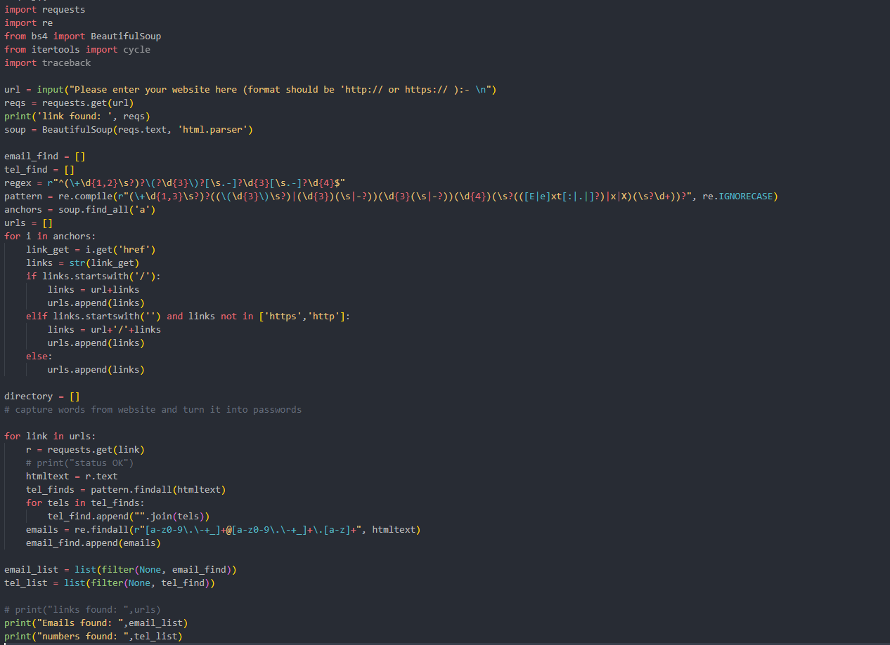
The Working
In order to better understand the process of web scraping, let’s segment this code into 3 parts
1
Finding the links present on the website.
Requesting each link and scraping the data.
Filtering the data and storing it in a list.
2
3

Slide 9
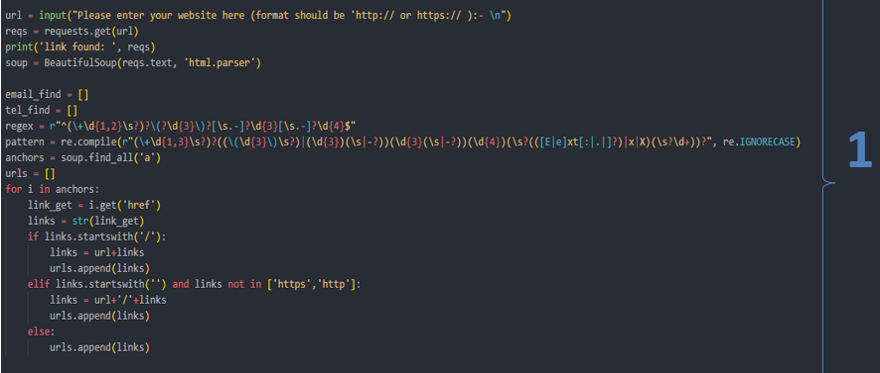
First, we accept user input while also specifying what format they should enter it in.
We then request this URL in order to parse it using BeautifulSoup module.
We then create 3 lists for later usage and a regex pattern which, when compiled, will be used to find phone numbers.
Next we store the result of a BeautifulSoup command ‘find_all’ into a variable. This command finds every part of the current html which includes the anchor (<a>) tag.
The next step focuses on going through the anchor list and finding every attribute to the anchor tag which includes hypertext reference (href) which contains the other links into the website we need.
All this data that we clean up and collect will then be appended to another variable URLS which collects each one of them as a list.

Slide 10
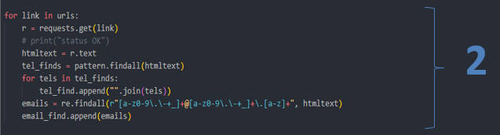
In the next fragment, we are now going through the new list of URLs we have found.
Using a for loop, we go through each link requesting it, getting the HTML and finding the telephone numbers and emails found on it using the regex patterns for the corresponding usage.
In the telephone numbers, there is another for loop being applied due to the regex basically grouping the numbers into different tuples. This for loop helps to join them back together so the data is not as cluttered.
This gets appended to the lists we made previously and goes on till the URL list runs out of data.

Slide 11
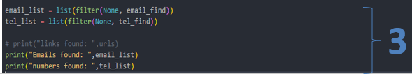
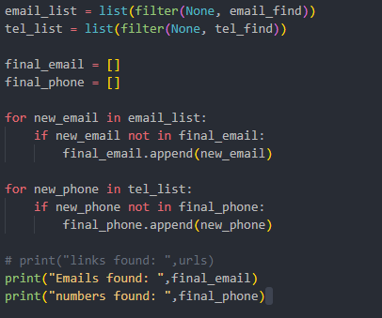
This is the final fragment of the code which includes cleaning of the data before it gets presented to the user.
Using the filter command, if data ends up being NULL or blank, it is removed and turns into the final list we need.
An extra added step is the addition of 2 for statements that can help get rid of duplicate entries in the final list of emails and phone numbers.
The output presented is: URLs found first, emails found second and telephone numbers found last.

Slide 12
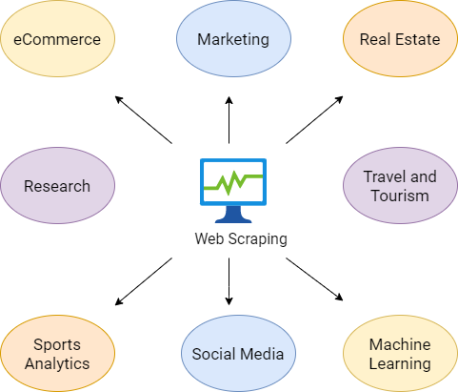
Techniques Learned
This project helped us by providing an insight into the technicalities of python scripting and how versatile it really is. With the use of few simple modules, we were able to craft a simple web scraper that could find emails and possibly phone numbers found on a website with ease. We learnt how versatile web scraping is as well since, apart from emails, it can also be used to analyse social media data, gather specified web keywords, extract a person's contact information and monitor the pricing of an e-commerce platform. Web scraping scripts can just be customized to suite the needs of the user.

Slide 13
Outcomes
Data Acquisition and Enrichment
Scalability and Performance
Time and Resource Efficiency
Ethical and Legal Compliance
Documentation and Reporting
Future Development and Expansion

Slide 14
Case Studies
Web scraping is a popular method for lead generation, which involves collecting data on potential customers or clients that could be interested in a company's products or services. Web scraping allows companies to gather this data from various websites and platforms efficiently, saving time and resources while providing more potential leads than traditional methods.
Web scraping allows businesses to gather information from diverse sources with ease and efficiency—so much so that some companies have begun using it exclusively for market research purposes.
By collecting job postings from various sources, web scraping allows companies to gain insights into industry trends and shifts in demand for specific skills or positions. This data can be used by firms to make informed decisions about hiring and marketing strategies.
One of the top use cases for web scraping is product data extraction, which involves extracting product information from different sources like e-commerce websites, social media platforms, and review websites.

Slide 15

Conclusion / Future Scope
Conclusion: In this web scraper project, we have successfully developed a tool capable of extracting valuable data from websites. Throughout the development process, we encountered various challenges such as handling different website structures, dealing with rate limitations, and ensuring data integrity. However, we have overcome these challenges and created a functional web scraper that can be used for a variety of purposes.
Future Scope: The web scraping field is constantly evolving, and there are numerous opportunities to enhance and expand the capabilities of our web scraper. Here are some potential future directions for this project:
User-Friendly Interface
Advanced Data Analysis
Machine Learning Integration
Proxy Support
Scalability
Data Storage and Management
Scheduled Scraping
Legal and Ethical Considerations

Slide 16

References
Real Python (2023) A practical introduction to web scraping in Python, Real Python. Available at: https://realpython.com/python-web-scraping-practical-introduction/ (Accessed: 20 September 2023).
Web scraping use cases: Top - 10 in 2023 (no date) Web Scraping Use Cases: Top - 10 in 2023. Available at: https://dataforest.ai/blog/top-10-web-scraping-use-cases-in-2023 (Accessed: 20 September 2023).

Slide 17
Thank You

