Slide 1
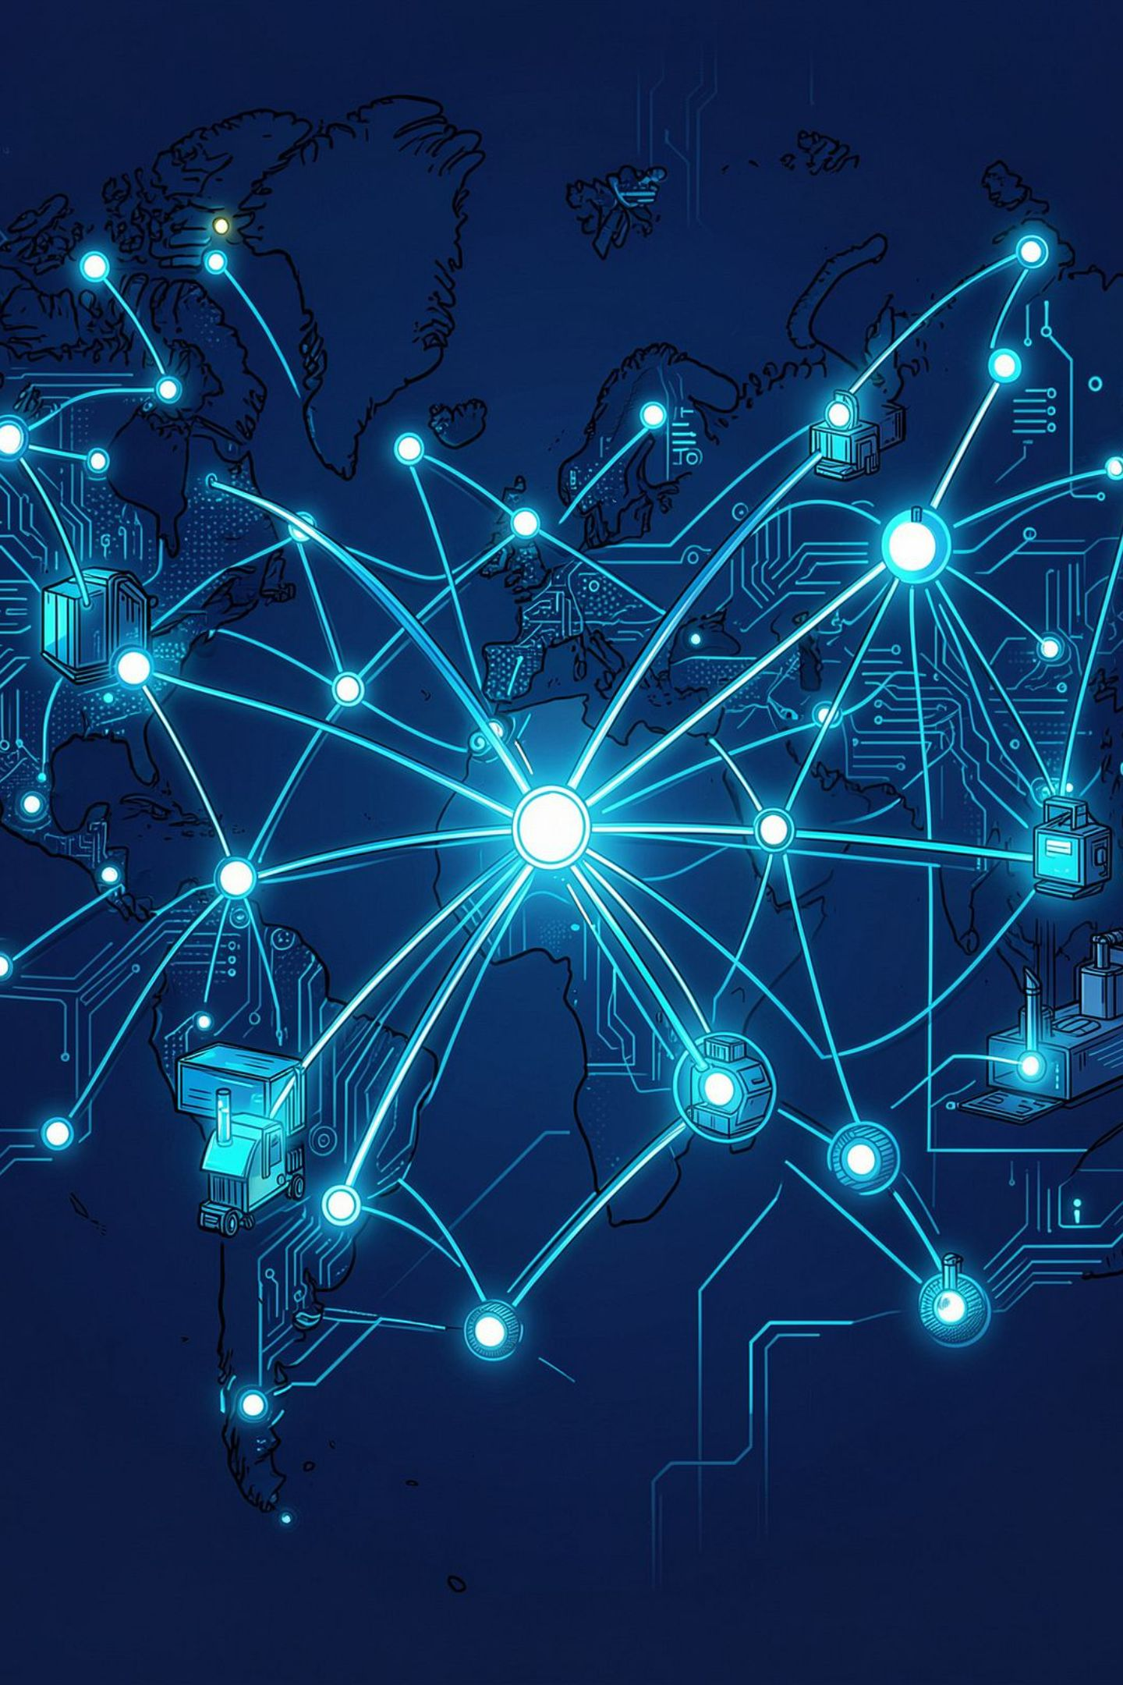
ChainMind AI
Supply Chain Crisis Simulator
Predict. Simulate. Compare. Optimize. Recover.
Team Y2MS · AI Track

Slide 2
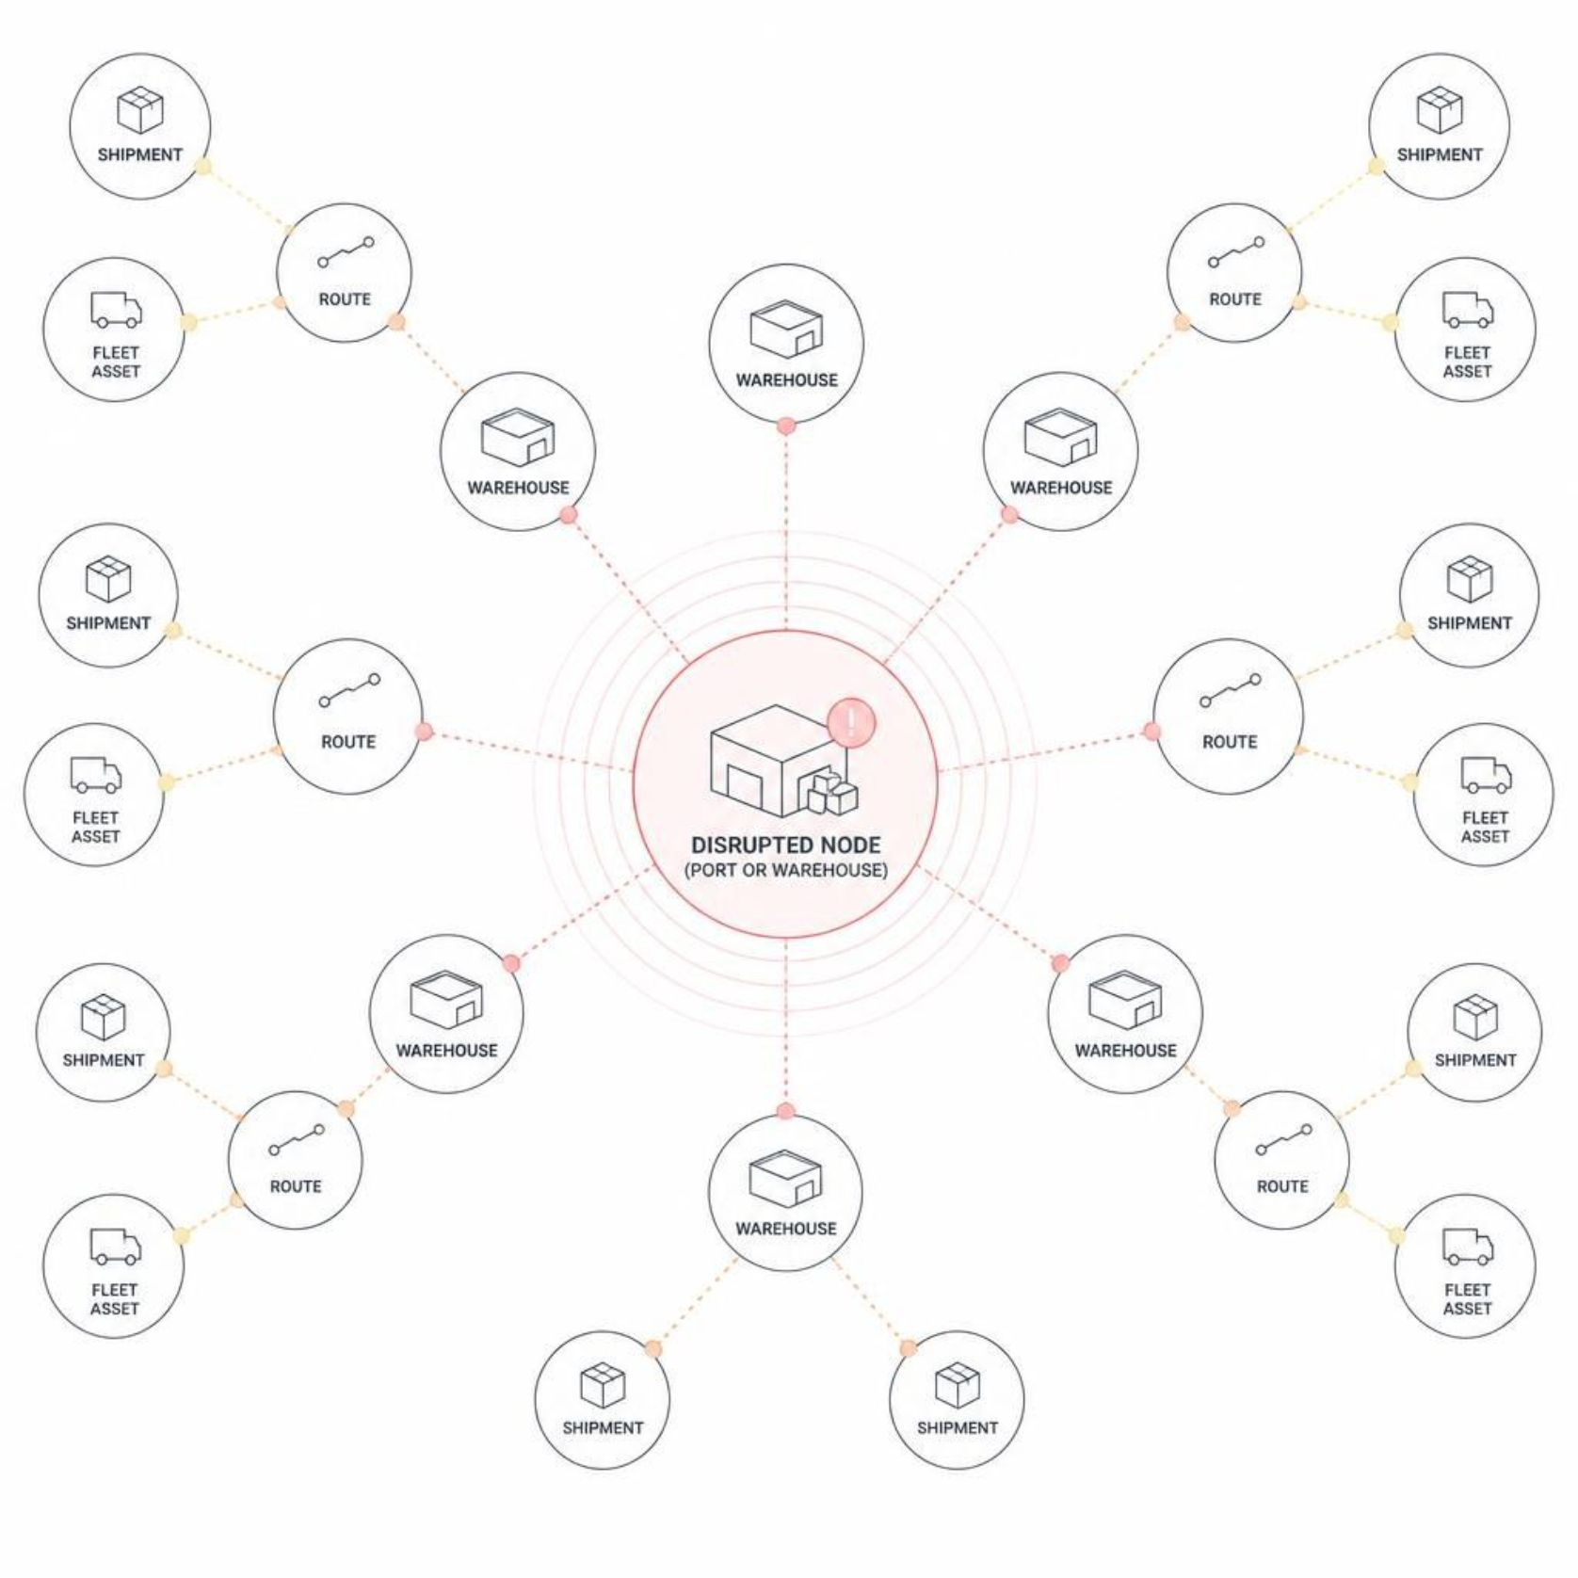
THE PROBLEM
When One Node Fails, the Whole Supply Chain Can Feel It
Modern supply chains are deeply interconnected networks — a disruption at any single node propagates downstream
Traditional monitoring shows current or historical conditions, not potential consequences
The real challenge is not detecting a crisis — it's deciding what to do next
Decision-makers need to understand downstream effects before committing to a response

Slide 3
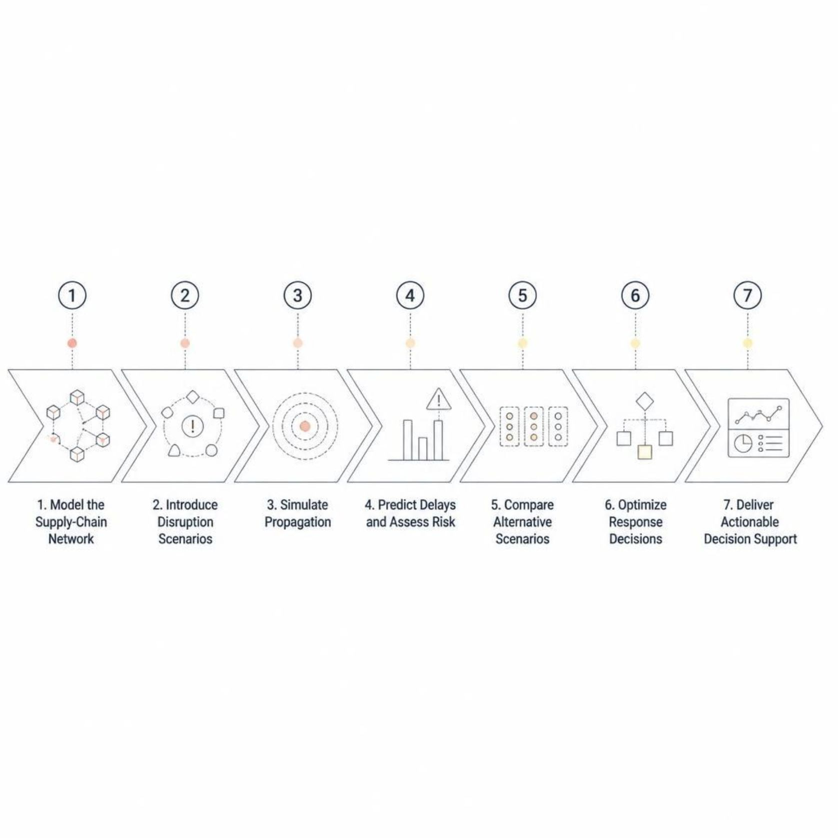
OUR SOLUTION
ChainMind AI Turns Crisis Uncertainty Into Simulatable Decisions
ChainMind is an AI-powered supply-chain crisis simulator — a digital twin that models your network, introduces disruption scenarios, and simulates how those disruptions propagate. Instead of asking "What is happening?", ChainMind asks "What happens if we change the decision?"

Slide 4
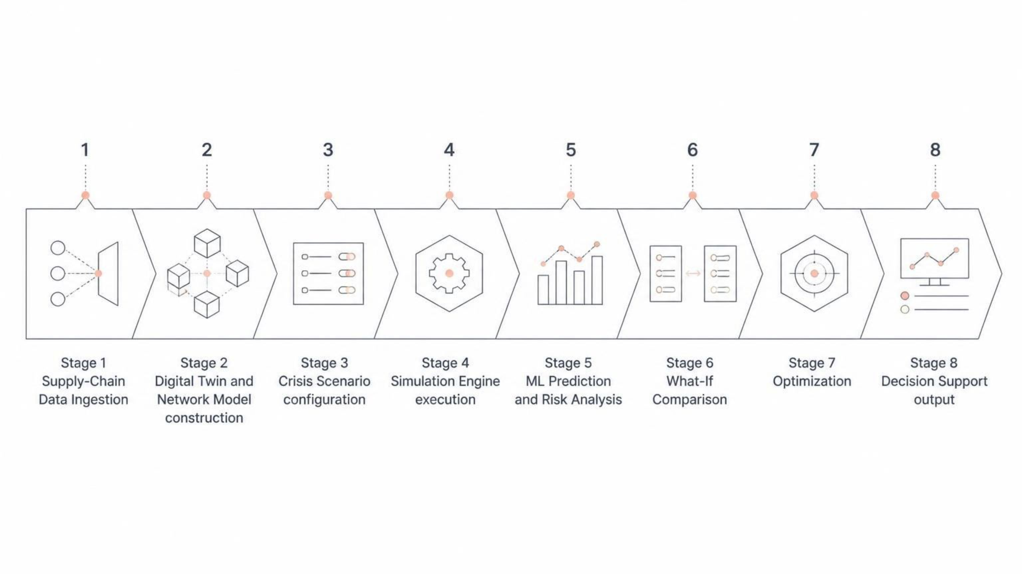
HOW IT WORKS
From Supply-Chain Data to Action
Each stage transforms raw data into progressively more actionable intelligence — from network modeling through simulation, ML-based risk assessment, and scenario comparison, all the way to optimized decision support.

Slide 5
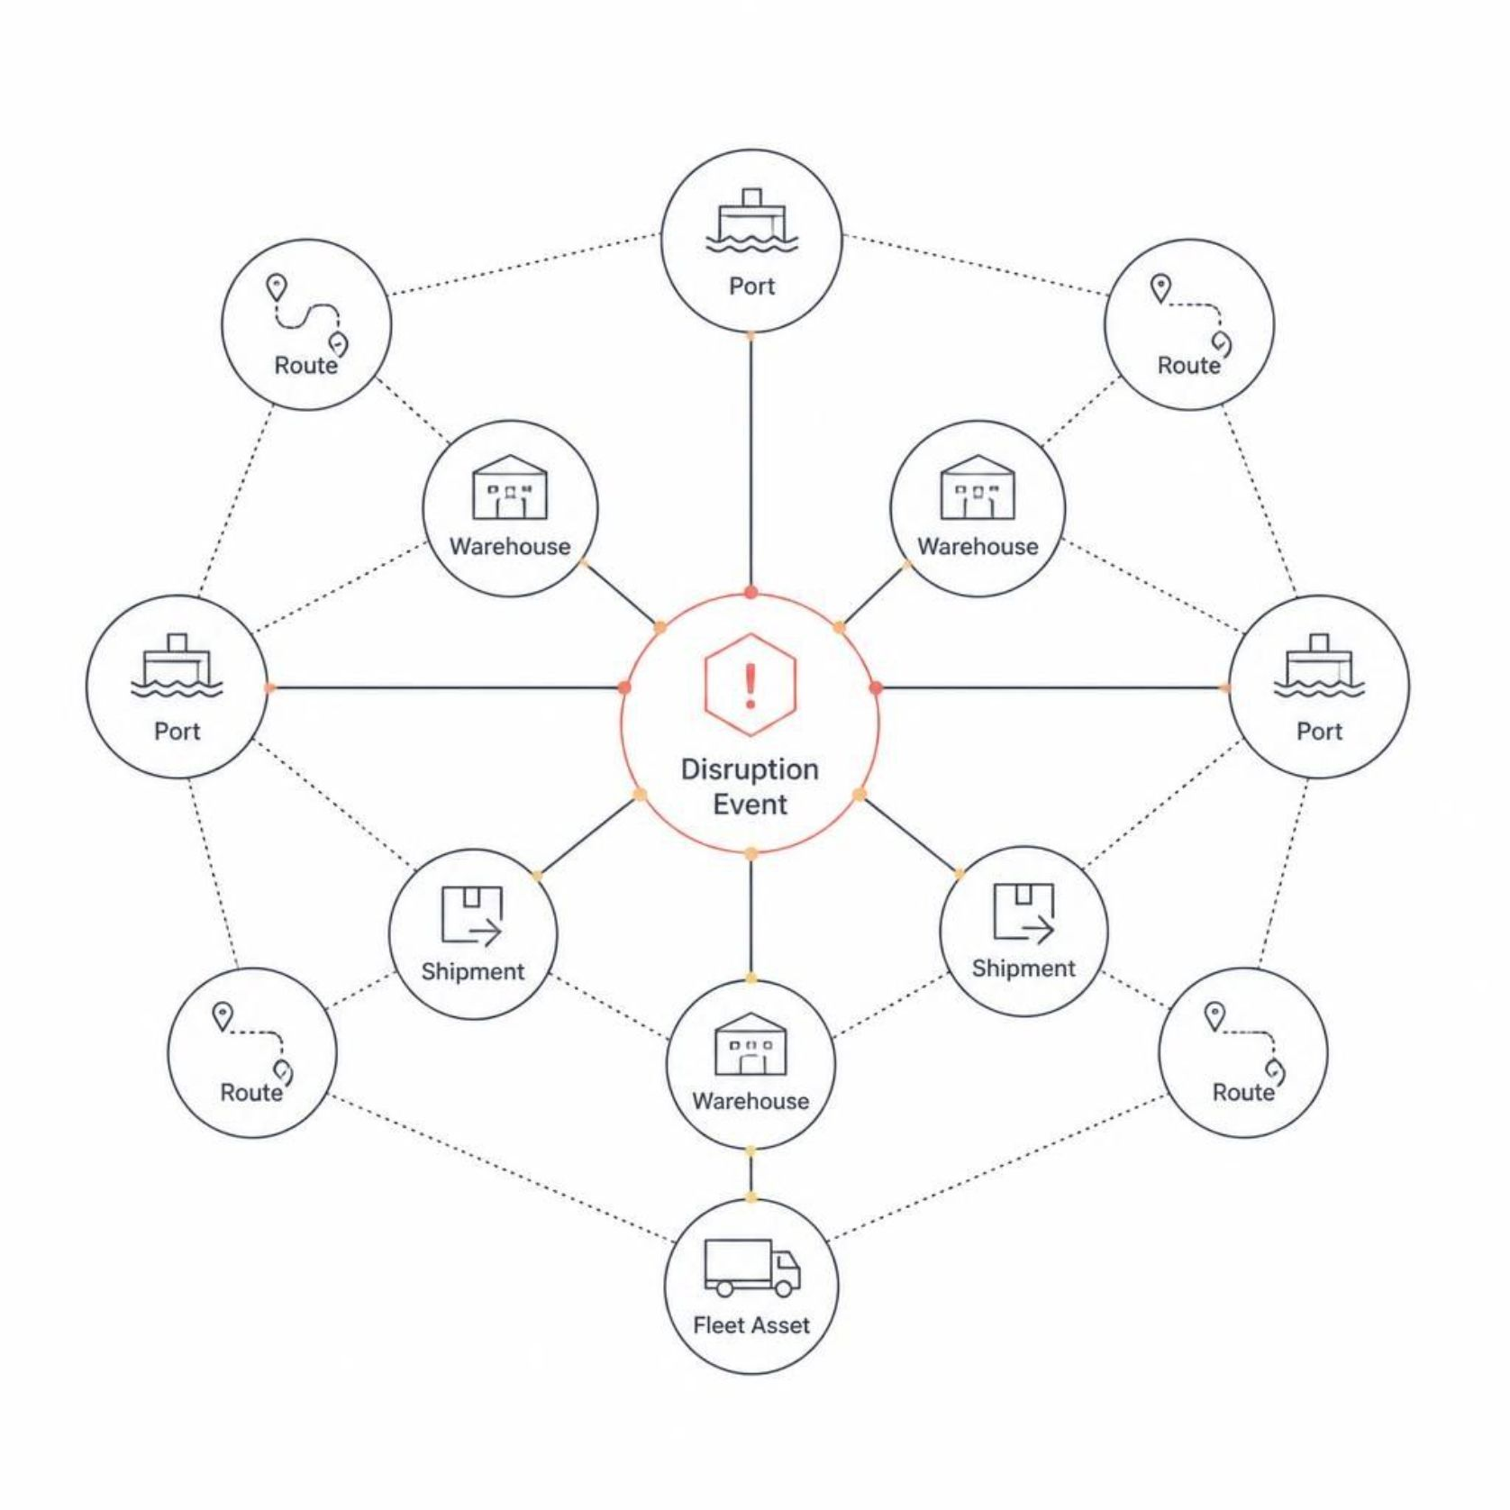
DIGITAL TWIN
A Living Model of the Supply Chain
ChainMind models all interconnected supply-chain components as a unified network graph. A disruption is evaluated as a network event — downstream effects are analyzed across the entire system, not in isolation.
Ports · Warehouses · Routes
Shipments · Fleet assets
Weather & disruption events
Operational & IoT-style readings

Slide 6
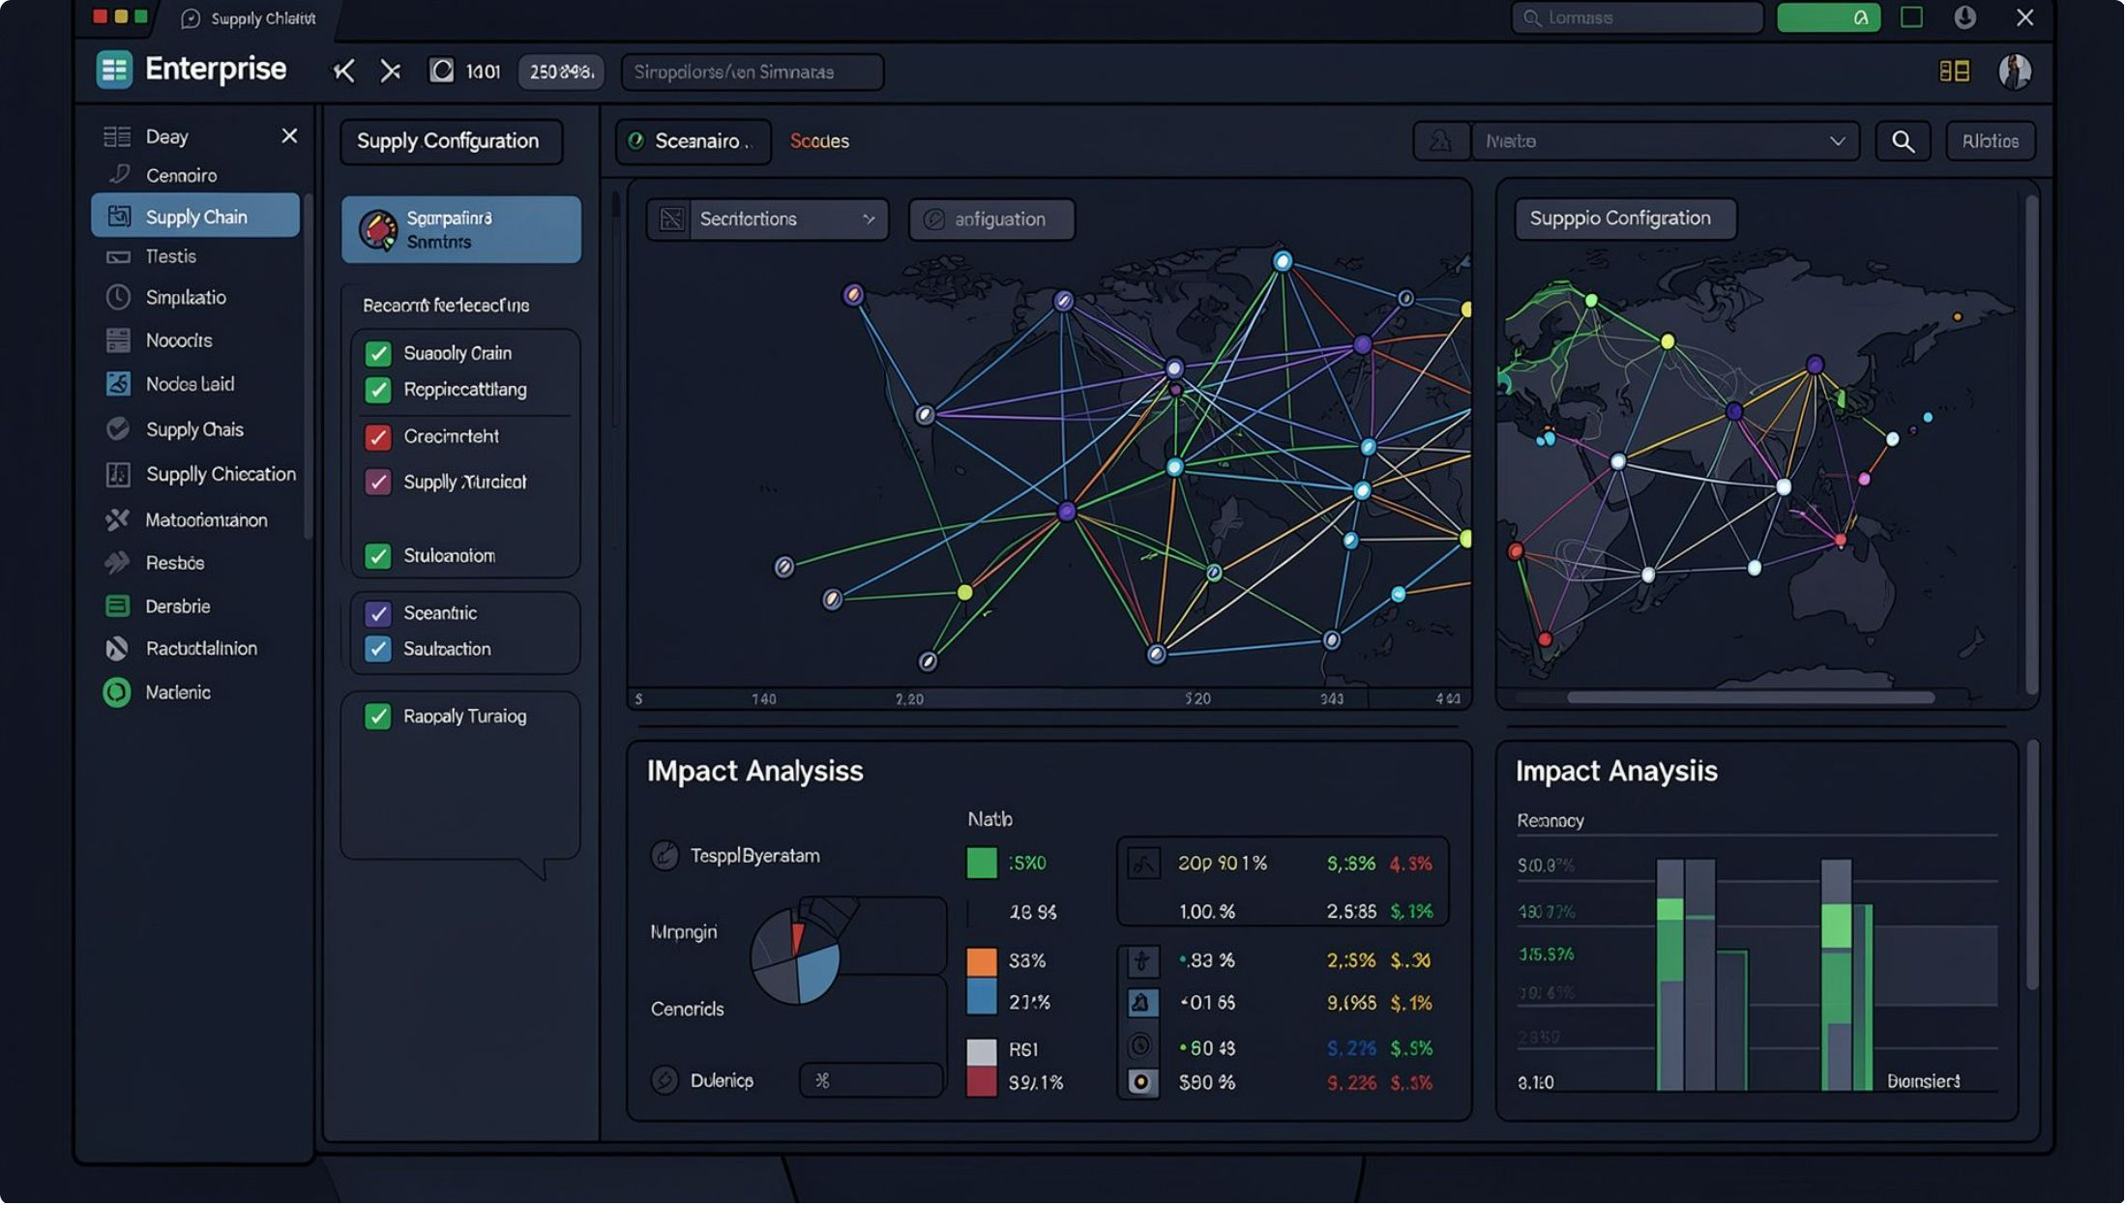

CRISIS SIMULATION
Simulate the Crisis Before Making the Decision
Configure a disruption scenario, run the simulation, and immediately see which components are affected — with estimated impact and risk surfaced before any real-world action is taken.
"What happens if this disruption occurs?" — ChainMind answers before you act.
01
02
03
Configure Crisis Scenario
Run Simulation
Identify Affected Components
04
05
Estimate Impact & Risk
Examine Possible Responses

Slide 7
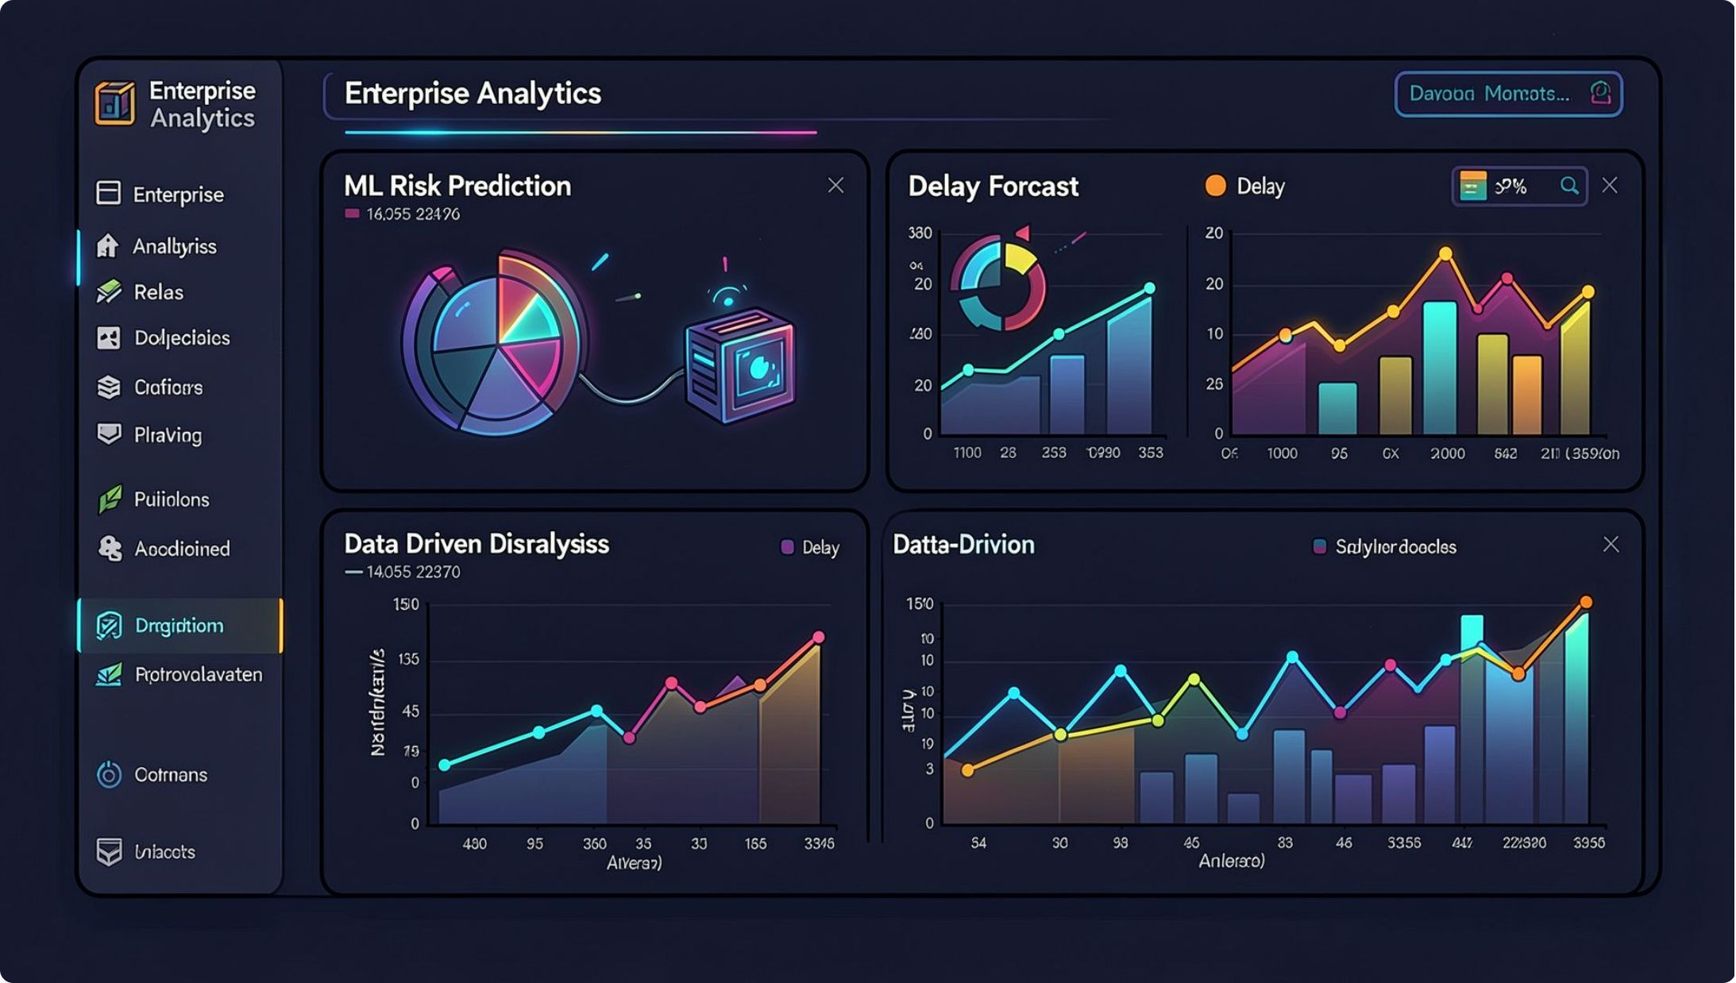

AI / ML RISK & PREDICTION
Prediction + Risk Analysis
ML models are integrated into the simulation workflow to estimate disruption impact. A deterministic fallback ensures the system operates even when trained models are unavailable.
ML helps estimate risk and impact; the simulation engine models system behavior.
Delay Prediction
Risk Assessment
Disruption Analysis
Deterministic Fallback

Slide 8
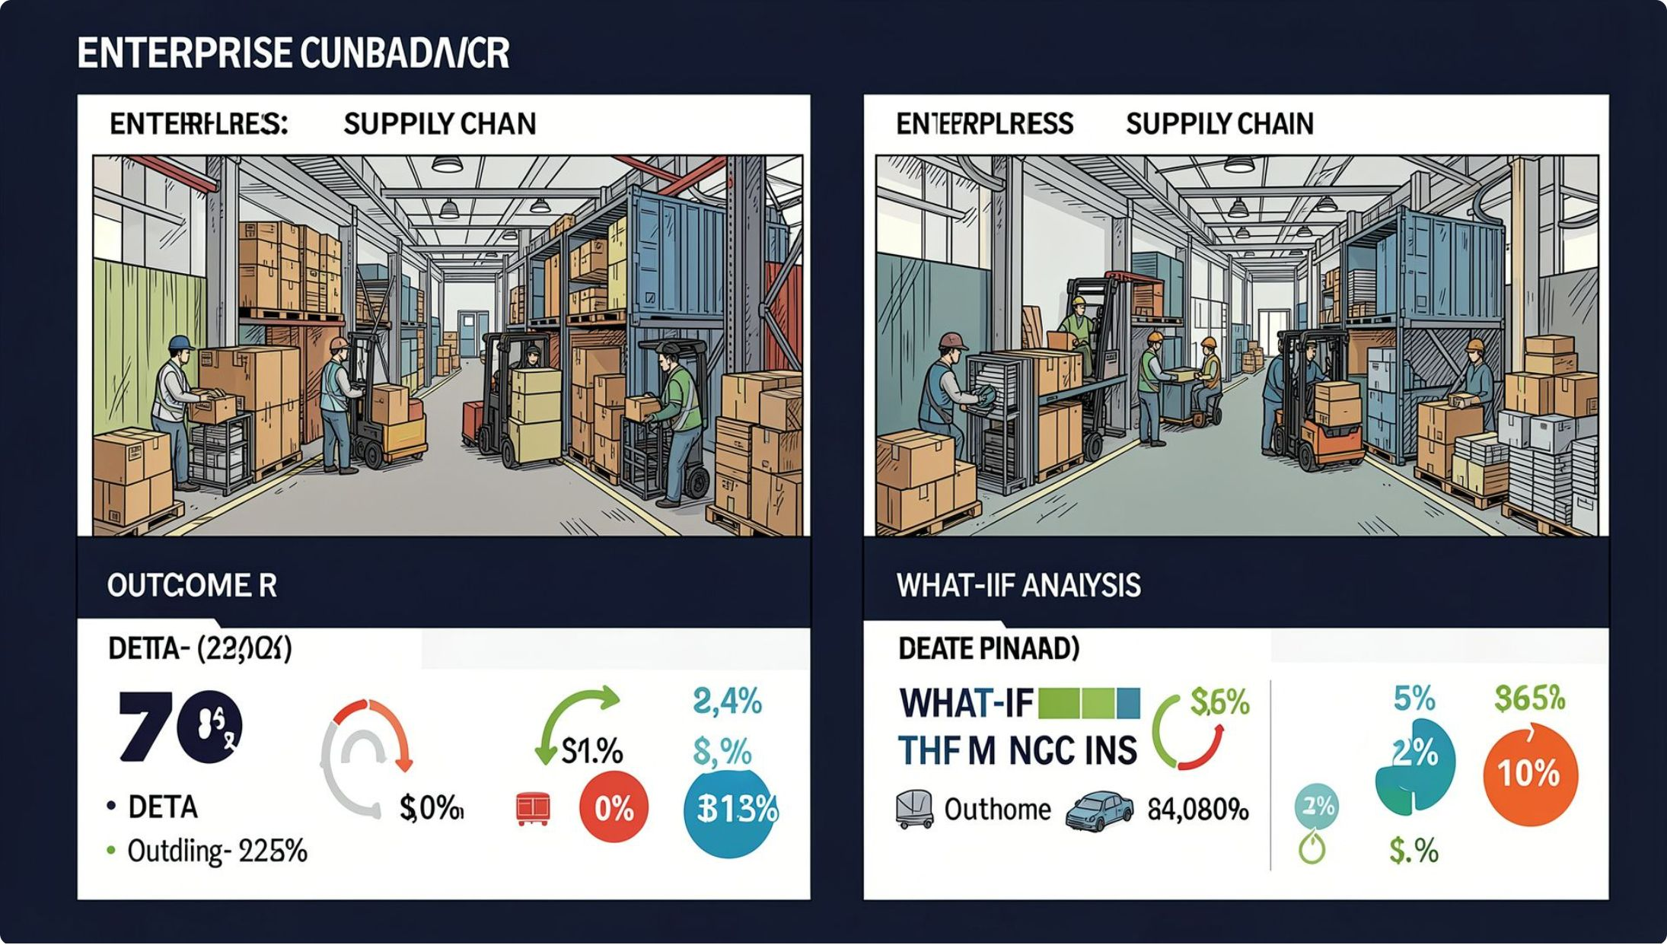
WHAT-IF ANALYSIS
What If We Make a Different Decision?
ChainMind's most powerful differentiator: modify scenario assumptions, run parallel simulations, and compare outcomes — with delta analysis showing the impact of each decision path.
Outcome A vs. Outcome B → Delta / Impact Comparison → Better Decision
Scenario A
Scenario B
Simulate → Outcome A
Simulate → Outcome B

Slide 9
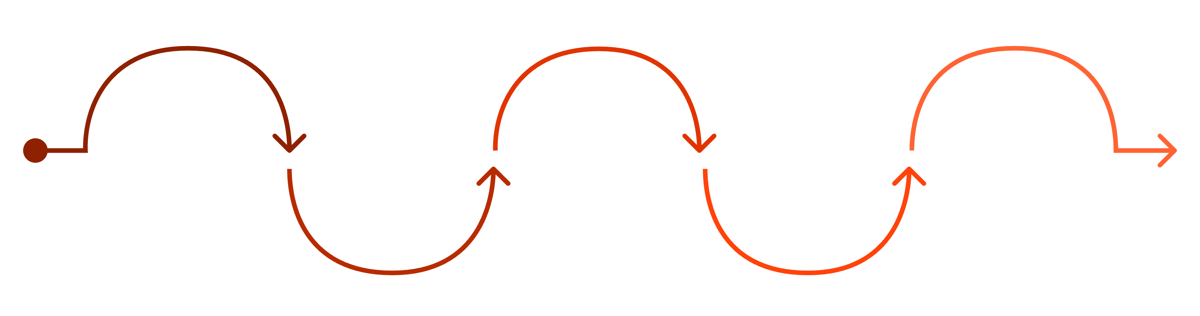

OPTIMIZATION & DECISION SUPPORT
From Prediction to Action
Compare Consequences
Evaluate Responses
Crisis Detected
Simulate Options
Recommended Action
List feasible mitigation options
Assess outcomes and trade-offs
Identify disruption from predictions
Run scenario models for each
Deliver optimized decision
ChainMind doesn't stop at predicting disruption. It evaluates response strategies, simulates each option, and surfaces optimized recommendations — giving decision-makers a clearer path from uncertainty to confident action.
ChainMind provides decision support, not autonomous decision-making. Human judgment remains central.

Slide 10
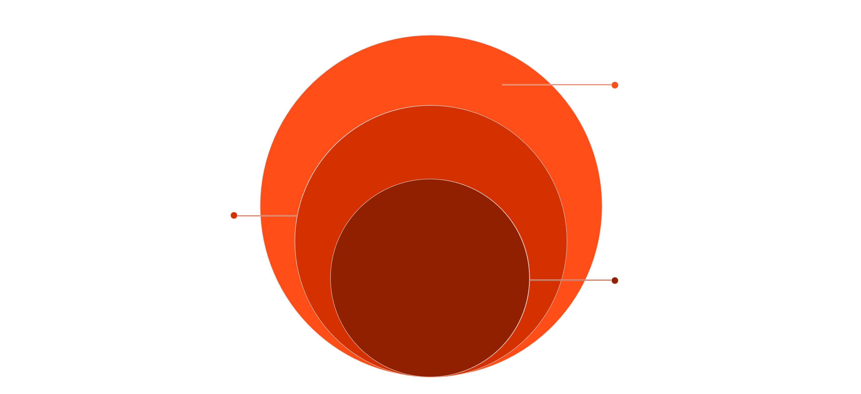





ARCHITECTURE & DIFFERENTIATION
Built as a Real End-to-End AI Application
Simulation & AI
NetworkX, custom optimization, scikit-learn, optional LLM; SQLite/Postgres; Vercel/Render
Backend API
FastAPI Python with SQLAlchemy
Frontend
React TypeScript (Vite, Tailwind, Recharts, React Leaflet)
Frontend: React · TypeScript · Vite · Tailwind CSS · Recharts · React Leaflet · Backend: FastAPI · Python · SQLAlchemy · Simulation: NetworkX · Custom logic · AI/ML: scikit-learn · Database: SQLite · PostgreSQL-ready · Deployment: Vercel · Render
Why ChainMind Is Different
Simulate, Not Just Monitor
Network-Aware
AI + Simulation
Explore consequences before acting
Model interconnected effects
ML prediction meets system simulation
What-If Decision Support
Optimization
Compare scenarios before committing
From "what might happen" to "what should we do"

