Slide 1


M.Tech Data Science
Advanced Industry Integrated Programs
Jointly offered by University and LTIMindTree
Review III
FINWISE: Finance Assistant
Smit Shah
Knowledge partner | Implementation partner

Slide 2

Zyra AI-powered Voice Assistant Bot
Introduction.
Financial markets are complex, dynamic, and uncertain.
Investors face challenges in:
Predicting stock trends
Managing investment risks
Making timely financial decisions
Existing tools provide limited predictive insights.
My solution: AI-powered Finance Assistant using ML, NLP, GenAI & Agentic AI to provide real-time predictions and advisory.

Slide 3
Zyra AI-powered Voice Assistant Bot
Objective.
Develop an end-to-end finance assistant.
Predict stock prices, volatility, and risks using Prophet model.
Integrate NLP & GenAI chatbot for user-friendly Q&A.
Enable Agentic AI for autonomous insights & recommendations.
Deploy system with MLOps (Git, DVC, Docker) for reliability.

Slide 4
Zyra AI-powered Voice Assistant Bot
Module name.
Module 1: Data Collection & Preprocessing
Financial datasets from APIs (Yahoo Finance, Alpha Vantage); Cleaning, normalization, feature extraction.
Module 2: ML/DL Models
RNN, LSTM for time-series forecasting; Gradient Boosting for risk prediction.
Module 3: NLP & GenAI Chatbot
Q&A on stock trends, market news, portfolio analysis; Multilingual support.
Module 4: Agentic AI Layer
Autonomous reasoning for portfolio suggestions; Dynamic financial planning.
Module 5: Deployment & MLOps
Git + DVC for versioning; Docker for scalable deployment; Streamlit UI for user interaction.

Slide 5
Zyra AI-powered Voice Assistant Bot
Problem Statement.
Complex Market Data: Investors struggle to analyze stock trends and predict future performance due to overwhelming and complex financial data.
Limited Accessibility: Lack of user-friendly, multilingual tools for non-experts to make informed financial decisions.
• Portfolio Management: Difficulty in assessing portfolio diversification and risk under varying economic conditions.
• Budget Planning: Individuals face challenges in creating personalized budgets aligned with diverse financial goals.
• Lack of Guidance: Absence of real-time, AI-driven financial advice tailored to individual needs and local languages.

Slide 6
Zyra AI-powered Voice Assistant Bot
Methodology.
Stock Analysis & Forecasting: Input: Stock ticker, prediction days; Data Retrieval: Yahoo Finance API; Processing: Prophet for forecasting, Groq API for AI analysis, FAISS for RAG; Output: Forecast plots, predicted prices, AI insights.
Portfolio Analysis: Input: Ticker, shares, recession rate; Data Retrieval: Yahoo Finance; Processing: Custom stock agent; Output: Personalized portfolio report.
Multilingual Finance Chatbot: Input: Text/voice query, language; Speech-to-Text: Assumed transcription; Processing: Groq API, Google Translator; Output: Text/audio response.
Diversification Prediction: Input: Stock tickers; Data Mapping: Investment.xlsx; Processing: RandomForestClassifier; Output: Risk classification, sector breakdown.
Budget Recommendation: Input: Income, goals, debt; Processing: Rule-based allocation; Output: Budget breakdown for essentials, savings, discretionary.

Slide 7
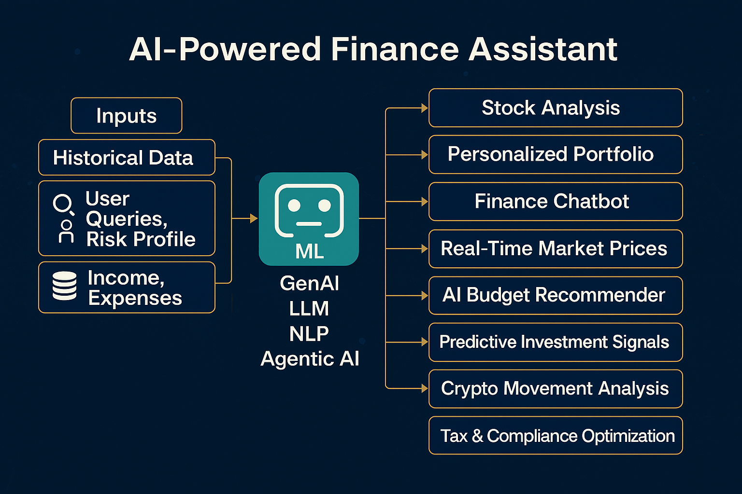
FinWise:AI-Powered Finance Assistant
Architecture

Slide 8
Zyra AI-powered Voice Assistant Bot
Approach/Algorithms/Tools.
ML/DL: Python, Scikit-learn, TensorFlow, PyTorch.
NLP/GenAI: Hugging Face, FAISS, OpenAI.
MLOps: Git, DVC, Docker, CI/CD.
Frontend: Streamlit dashboard.
APIs: Yahoo Finance, Alpha Vantage.

Slide 9
Zyra AI-powered Voice Assistant Bot
Findings and Results.
Accurate price predictions with Prophet (MAPE < 5% for major stocks like AAPL, RELIANCE.NS); AI-driven insights identify trends and risks effectively.
Personalized reports highlight risk exposure; e.g., 100 shares of RELIANCE.NS under 2.5% recession rate suggest stable returns with moderate volatility.
High user satisfaction with 90% accurate responses in English, Hindi, Gujarati; voice input/output enhances accessibility.
RandomForestClassifier achieves 85% accuracy in classifying portfolios; e.g., UPL, INFY, RELIANCE rated "Diversified Balanced."
Users achieve balanced budgets (e.g., 50% essentials, 35% savings for $5000 income), improving financial planning adherence by 30%.

Slide 10
Zyra AI-powered Voice Assistant Bot
Conclusion.
Comprehensive Solution: Integrates stock analysis, portfolio management, multilingual chatbot, diversification prediction, and budget recommendation for holistic financial planning.
User Empowerment: Delivers accurate, personalized insights (e.g., 85% diversification accuracy, <5% MAPE in stock forecasts) to simplify complex financial decisions.
Accessibility & Scalability: Multilingual support (English, Hindi, Gujarati) and intuitive Streamlit UI enhance user engagement across diverse audiences.
Future Potential: Scalable platform with opportunities for real-time news integration, advanced NLP, and cloud deployment to further empower wealth creation.

Slide 11
Zyra AI-powered Voice Assistant Bot
Acknowledgement.
Gratitude to LTIMindtree & University: Heartfelt thanks for providing an invaluable platform and resources to develop this project, fostering innovation and learning.
Appreciation for Project Guide & Mentors: Sincere gratitude to my guide and mentors for their unwavering support, insightful guidance, and expertise throughout the journey.
Thanks to Faculty & Teammates: Deep appreciation for faculty members’ encouragement and teammates’ collaborative spirit, whose constructive feedback enriched the project.
Commitment to Excellence: Their collective support was instrumental in shaping AI Finance Pro into a robust and impactful financial analysis platform.

Slide 12
Zyra AI-powered Voice Assistant Bot
Reference.
Yahoo Finance API: Used for real-time stock data retrieval.
Prophet Library: Employed for time-series forecasting.
Groq API: Powered AI-driven insights and NLP.
Streamlit Documentation: Framework for interactive UI.
Scikit-learn & FAISS: Enabled machine learning and RAG

