Slide 1

Cryptocurrency
Smita Kulkarni-Pai

Slide 2
Cryptocurrency
A cryptocurrency, crypto-currency, or crypto is a digital currency designed to work as a medium of exchange through a computer network that is not reliant on any central authority, such as a government or bank, to uphold or maintain it.
It is a decentralized system for verifying that the parties to a transaction have the money they claim to have, eliminating the need for traditional intermediaries, such as banks, when funds are being transferred between two entities.
Individual coin ownership records are stored in a digital ledger, which is a computerized database using strong cryptography to secure transaction records, control the creation of additional coins, and verify the transfer of coin ownership.

Slide 3
Cryptocurrency
Despite their name, cryptocurrencies are not considered to be currencies in the traditional sense, and while varying treatments have been applied to them, including classification as commodities, securities, and currencies, cryptocurrencies are generally viewed as a distinct asset class in practice.
Some crypto schemes use validators to maintain the cryptocurrency.
In a proof-of-stake model, owners put up their tokens as collateral.
In return, they get authority over the token in proportion to the amount they stake.
Generally, these token stakers get additional ownership in the token over time via network fees, newly minted tokens, or other such reward mechanisms.[

Slide 4
Cryptocurrency
Cryptocurrency does not exist in physical form (like paper money) and is typically not issued by a central authority.
Cryptocurrencies typically use decentralized control as opposed to a central bank digital currency (CBDC).
When a cryptocurrency is minted, or created prior to issuance, or issued by a single issuer, it is generally considered centralized.
When implemented with decentralized control, each cryptocurrency works through distributed ledger technology, typically a blockchain, that serves as a public financial transaction database.

Slide 5
Cryptocurrency
The first cryptocurrency was Bitcoin, which was first released as open-source software in 2009.
As of March 2022, there were more than 9,000 other cryptocurrencies in the marketplace, of which more than 70 had a market capitalization exceeding $1 billion.
1. Bitcoin (BTC) Price: $29,295 Market cap: $570 billion | 2. Ethereum (ETH) Price: $1,860 Market cap: $224 billion | 3. Tether (USDT) Price: $1.00 Market cap: $83 billion
4. XRP (XRP) Price: $0.7002 Market cap: $37 billion | 5. BNB (BNB) Price: $237.77 Market cap: $37 billion | 6. USD Coin (USDC) Price: $1.00 Market cap: $27 billion

Slide 6
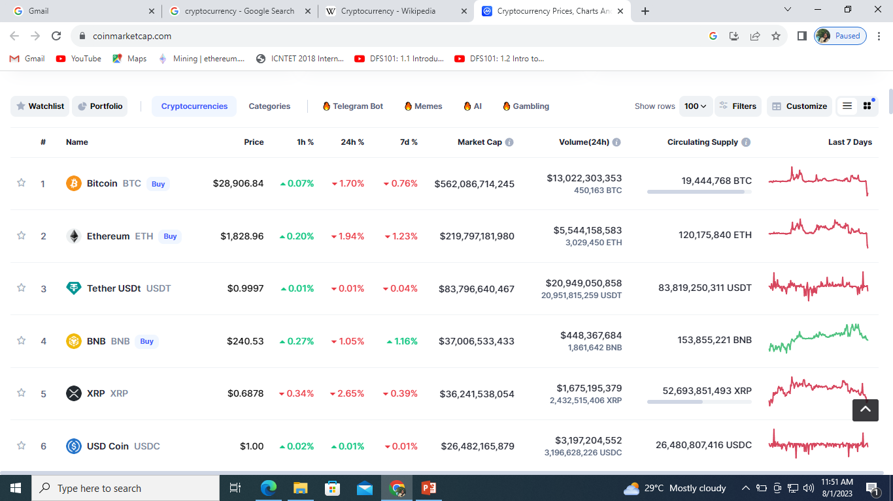

Slide 7
History
In 1983, American cryptographer David Chaum conceived of a type of cryptographic electronic money called ecash.
Later, in 1995, he implemented it through Digicash, an early form of cryptographic electronic payments.
Digicash required user software in order to withdraw notes from a bank and designate specific encrypted keys before it can be sent to a recipient.
This allowed the digital currency to be untraceable by a third party.
In 1996, the National Security Agency published a paper entitled How to Make a Mint: The Cryptography of Anonymous Electronic Cash, describing a cryptocurrency system.
The paper was first published in an MIT mailing listand later in 1997 in The American Law Review.

Slide 8
History
In 1998, Wei Dai described "b-money", an anonymous, distributed electronic cash system. Shortly thereafter, Nick Szabo described bit gold.
Like Bitcoin and other cryptocurrencies that would follow it, bit was described as an electronic currency system which required users to complete a proof of work function with solutions being cryptographically put together and published.
In January 2009, Bitcoin was created by pseudonymous developer Satoshi Nakamoto.
It used SHA-256, a cryptographic hash function, in its proof-of-work scheme.
In April 2011, Namecoin was created as an attempt at forming a decentralized DNS.
In October 2011, Litecoin was released which used scrypt as its hash function instead of SHA-256.
Peercoin, created in August 2012, used a hybrid of proof-of-work and proof-of-stake

Slide 9
Formal definition(Wiki)
A cryptocurrency is a system that meets six conditions:
The system does not require a central authority; its state is maintained through distributed consensus.
The system keeps an overview of cryptocurrency units and their ownership.
The system defines whether new cryptocurrency units can be created. If new cryptocurrency units can be created, the system defines the circumstances of their origin and how to determine the ownership of these new units.
Ownership of cryptocurrency units can be proved exclusively cryptographically.
The system allows transactions to be performed in which ownership of the cryptographic units is changed. A transaction statement can only be issued by an entity proving the current ownership of these units.
If two different instructions for changing the ownership of the same cryptographic units are simultaneously entered, the system performs at most one of them.

Slide 10
Altcoins
Tokens, cryptocurrencies, and other digital assets other than Bitcoin are collectively known as alternative cryptocurrencies, typically shortened to "altcoins" or "alt coins“
Altcoins often have underlying differences when compared to Bitcoin. For example, Litecoin aims to process a block every 2.5 minutes, rather than Bitcoin's 10 minutes, which allows Litecoin to confirm transactions faster than Bitcoin.
Another example is Ethereum, which has smart contract functionality that allows decentralized applications to be run on its blockchain. Ethereum was the most used blockchain in 2020, according to Bloomberg News.
In 2016, it had the largest "following" of any altcoin, according to the New York Times.
Significant rallies across altcoin markets are often referred to as an "altseason".

Slide 11
Stablecoins
Stablecoins are cryptocurrencies designed to maintain a stable level of purchasing power.
Notably, these designs are not foolproof, as a number of stablecoins have crashed or lost their price.
For example, on 11 May 2022, Terra's stablecoin UST fell from $1 to 26 cents.
The subsequent failure of Terraform Labs resulted in the loss of nearly $40B invested in the Terra and Luna coins.
In September 2022, South Korean prosecutors requested the issuance of an Interpol Red Notice against the company's founder, Do Kwon.
In Hong Kong, the expected regulatory framework for stablecoins in 2023/24 is being shaped and includes a few considerations.

Slide 12
Architecture(Managing the currency)
Cryptocurrency is produced by an entire cryptocurrency system collectively, at a rate which is defined when the system is created and which is publicly stated.
In centralized banking and economic systems such as the US Federal Reserve System, corporate boards or governments control the supply of currency.
In the case of cryptocurrency, companies or governments cannot produce new units, and have not so far provided backing for other firms, banks or corporate entities which hold asset value measured in it.
The underlying technical system upon which cryptocurrencies are based was created by Satoshi Nakamoto.

Slide 13
Architecture
Within a proof-of-work system such as Bitcoin, the safety, integrity and balance of ledgers is maintained by a community of mutually distrustful parties referred to as miners.
Miners use their computers to help validate and timestamp transactions, adding them to the ledger in accordance with a particular timestamping scheme.
In a proof-of-stake blockchain, transactions are validated by holders of the associated cryptocurrency, sometimes grouped together in stake pools.

Slide 14
Architecture
Most cryptocurrencies are designed to gradually decrease the production of that currency, placing a cap on the total amount of that currency that will ever be in circulation.
Compared with ordinary currencies held by financial institutions or kept as cash on hand, cryptocurrencies can be more difficult for seizure by law enforcement.

Slide 15
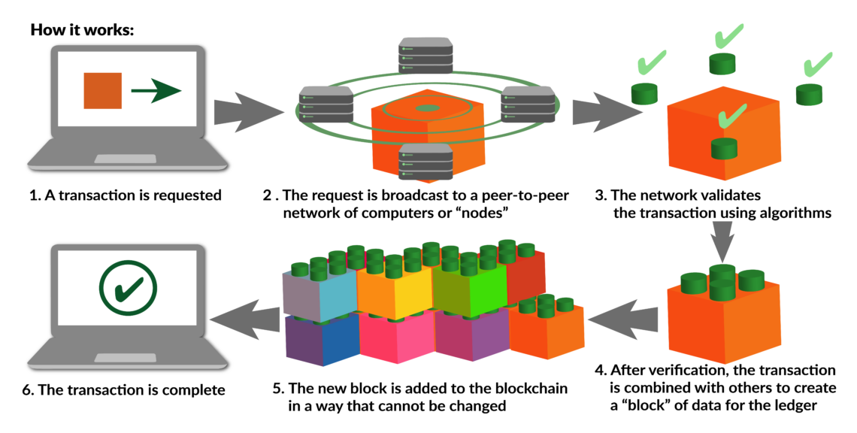
Architecture
Components/Building Blocks/Terminology
Blockchain
The validity of each cryptocurrency's coins is provided by a Blockchain.
https://www.gisreportsonline.com/r/blockchain-decentralized-ledger-transactions/

Slide 16

Architecture
Components/Building Blocks/Terminology
Nodes
A node is a computer that connects to a cryptocurrency network. The node supports the cryptocurrency's network through either relaying transactions, validation, or hosting a copy of the blockchain.
In terms of relaying transactions, each network computer (node) has a copy of the blockchain of the cryptocurrency it supports.
When a transaction is made, the node creating the transaction broadcasts details of the transaction using encryption to other nodes throughout the node network so that the transaction (and every other transaction) is known.
Node owners are either volunteers, those hosted by the organization or body responsible for developing the cryptocurrency blockchain network technology, or those who are enticed to host a node to receive rewards from hosting the node network.

Slide 17

Architecture
Components/Building Blocks/Terminology
Timestamping
Cryptocurrencies use various timestamping schemes to "prove" the validity of transactions added to the blockchain ledger without the need for a trusted third party.
The first timestamping scheme invented was the proof-of-work scheme. The most widely used proof-of-work schemes are based on SHA-256 and scrypt.
Some other hashing algorithms that are used for proof-of-work include CryptoNote, Blake, SHA-3, and X11.
Another method is called the proof-of-stake scheme. Proof-of-stake is a method of securing a cryptocurrency network and achieving distributed consensus through requesting users to show ownership of a certain amount of currency.

Slide 18
Architecture
Components/Building Blocks/Terminology
Mining
On a blockchain, mining is the validation of transactions. For this effort, successful miners obtain new cryptocurrency as a reward.
The reward decreases transaction fees by creating a complementary incentive to contribute to the processing power of the network.
The rate of generating hashes, which validate any transaction, has been increased by the use of specialized machines such as FPGAs and ASICs running complex hashing algorithms like SHA-256 and scrypt.
This arms race for cheaper-yet-efficient machines has existed since Bitcoin was introduced in 2009. Mining is measured by hash rate typically in TH/s.

Slide 19
Architecture
Components/Building Blocks/Terminology
Mining
With more people venturing into the world of virtual currency, generating hashes for validation has become more complex over time, forcing miners to invest increasingly large sums of money to improve computing performance.
Consequently, the reward for finding a hash has diminished and often does not justify the investment in equipment and cooling facilities (to mitigate the heat the equipment produces), and the electricity required to run them

Slide 20
Architecture
Components/Building Blocks/Terminology
Mining
Some miners pool resources, sharing their processing power over a network to split the reward equally, according to the amount of work they contributed to the probability of finding a block.
A "share" is awarded to members of the mining pool who present a valid partial proof-of-work.

Slide 21
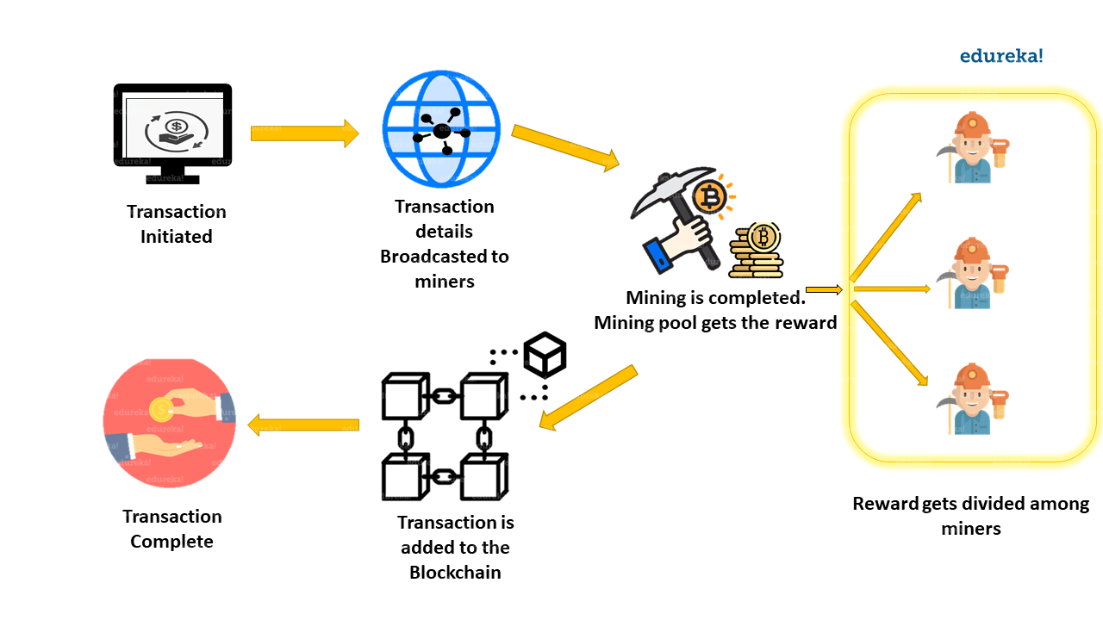
Architecture

Slide 22
What is a crypto wallet
Crypto wallets store your private keys, keeping your crypto safe and accessible. They also allow you to send, receive, and spend cryptocurrencies like Bitcoin and Ethereum.
They come in many forms, from hardware wallets like Ledger (which looks like a USB stick) to mobile apps like Coinbase Wallet, which makes using crypto as easy as shopping with a credit card online.
The main types of wallets you can choose from include:
Paper wallets, Hardware wallets, Online wallets

Slide 23
What is a crypto wallet?
Paper wallets: Keys are written on a physical medium like paper and stored in a safe place. This of course makes using your crypto harder, because as digital money it can only be used on the internet.
Hardware wallets: Keys are stored in a thumb-drive device that is kept in a safe place and only connected to a computer when you want to use your crypto. The idea is to try to balance security and convenience.
Online wallets: Keys are stored in an app or other software – look for onethat is protected by two-step encryption. This makes sending, receiving, and using your crypto as easy as using any online bank account, payment system, or brokerage.

Slide 24
Hot Wallet vs. Cold Wallet
Hot and cold wallets are the primary means for storing and exchanging cryptocurrencies and tokens. It’s necessary to distinguish between a hot wallet and a cold wallet to identify which works best for you.
A hot crypto wallet is connected to the internet, while a cold wallet is entirely offline, usually linked and accessible through hardware devices.
Hot wallets are internet-enabled and online, while cold wallets are offline and come in the form of a physical device, such as a USB stick.

Slide 25
Hot Wallet vs. Cold Wallet
The primary benefit of using a hot wallet is its level of convenience: It can provide ease of use and a well-designed interface.
A cold wallet offers more security benefits because it’s less possible to hack and is therefore less vulnerable to loss of digital assets.

Slide 26
Hot Wallet
Hot crypto wallets are connected to the internet. They offer a series of features, from storing, sending, and receiving tokens to managing and viewing all available tokens in one place.
Hot wallets are accessible from internet-enabled devices such as cellular phones, tablets, and laptops.
Hot wallets have been widely adopted because of the ease of transferring and receiving funds on demand.
It stores the private keys to your cryptocurrencies after purchasing or mining them.
When a cryptocurrency transaction needs to be completed, private keys are required.

Slide 27
Hot Wallet
A hot wallet acts as the interface for completing crypto transactions and is responsible for recording these transactions on the decentralized public blockchain ledger.
In a cryptocurrency wallet, two key components keep your digital assets safe: the private and public keys, made of a cryptographic string of letters and numbers responsible for successful crypto transfers into your wallet
Types of Hot Wallets
Hot wallets come in different types and have various purposes. Some are used as mobile applications, web-only wallets, or even ecosystem-specific wallets.
Some of the most common examples of hot wallets include Coinbase Wallet, MetaMask, Trust Wallet, Exodus Wallet, Robinhood, Edge, and more.

Slide 28
Hot Wallet
Hot Wallet Pros and Cons
Advantages
Internet-based so they allow easy access and perform several activities efficiently and from a range of devices
Primarily free to use; some also require paying interest on the stored crypto
Disadvantages
Unencrypted hot wallets are vulnerable to hacks because they are internet-enabled. Unauthorized parties target these because they contain both public and private keys.
Some are accepted and accessible only in specified locations due to legal restrictions

Slide 29
Cold Wallets
Cold wallets differ from hot wallets in that they’re not internet-enabled.1 Hence, they’re less susceptible to hacking.
This fact is why cold wallets have gained rapid adoption and more popularity after the implosion of FTX, which was a large centralized crypto exchange that collapsed in November 2022, went bankrupt, and reported an alleged hack that left many users’ digital assets frozen or gone.
These wallets come as hardware devices—usually like a USB stick—costing $50 to $200. Hardware wallets and paper wallets are examples of cold-storage wallets.
An added security layer stems from the fact that the private keys of cold wallets are entirely offline—compared with those of hot wallets—and are required to complete a crypto exchange from the wallet.

Slide 30
Cold Wallets
Exchanging crypto from a cold wallet starts online, but one must sign off digitally offline to complete the transaction.
Types of Cold Wallets
Cold wallets are also available in different types; some of the most common examples include:
Paper wallet: This is a document that has public and private keys printed on it. There’s also a quick response (QR) code embedded in the paper to facilitate crypto transactions. The downside is that it’s rendered useless once the document is damaged.
Hardware wallet: This is a ubiquitous cold-wallet type. They are offline devices used to store private and public keys.
They come in the form of USBs or smart cards, without which you would have no access to your crypto.
Commonly available hardware wallets are Trezor, Ledger, and KeepKey.

Slide 31
Cold Wallets
Types of Cold Wallets
Deep cold storage: This type of wallet takes extra steps to make access to your wallet very difficult. An analogy would be keeping your cold wallet in a physical vault or safe deposit box at a bank. These wallets are designed for those requiring minimal access to their wallet.
Other types of cold wallets available are sound wallets and offline software wallets.

Slide 32
Cold Wallets
Cold Wallet Pros and Cons
Advantages
Enhanced security benefits mean there is no way to get hacked
Full possession of your tokens because the private and public keys are in your control
Portable
Disadvantages
Easily lost
Expensive, with the typical price range from $50 to $200
Complex to use

