Slide 1
MACHINE LEARNING PROJECT
GROUP 3 : Javier, Reda, Smita, Xiaobo

Slide 2
01
02
03
DATA SELECTION & PREPARATION
MODEL BUILDING
& EVALUATION
FEATURE ENGINEERING & SELECTION

Slide 3
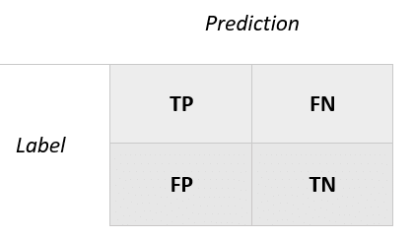
INTRODUCTION
⇒ Heart Attack Risk Prediction
⇒ Machine Learning problem : Classification Problem
⇒ Our objective :
Predict the heart attack risk (True or False)
Increase Recall score (reduce the False Negative)
2ary: Increase Precision score (reduce the False Positive)
⇒ Potential impact : detect patients at risk as soon as possible

Slide 4
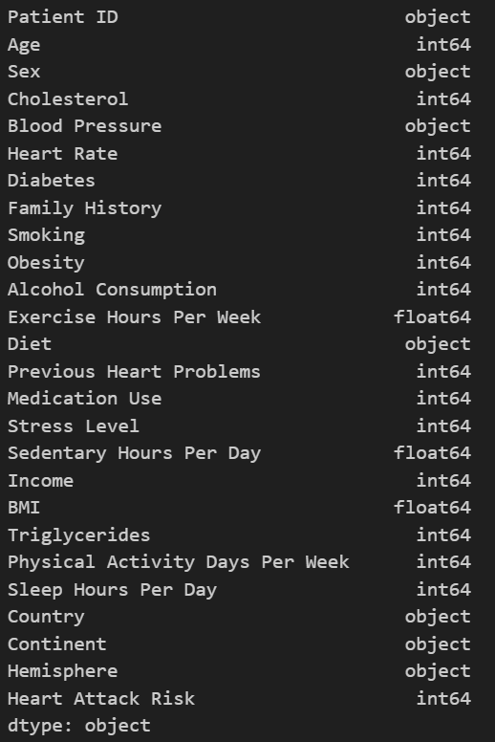
DATA SELECTION & PREPARATION
Description of the dataset
⇒ Link to our dataset
(from Kaggle) : Heart Attack Prediction
⇒ Characteristics : 8763 records, 26 fields
⇒ Data cleaning & pre-processing:
- data clean with no null value nor duplicate
- no outliers

Slide 5
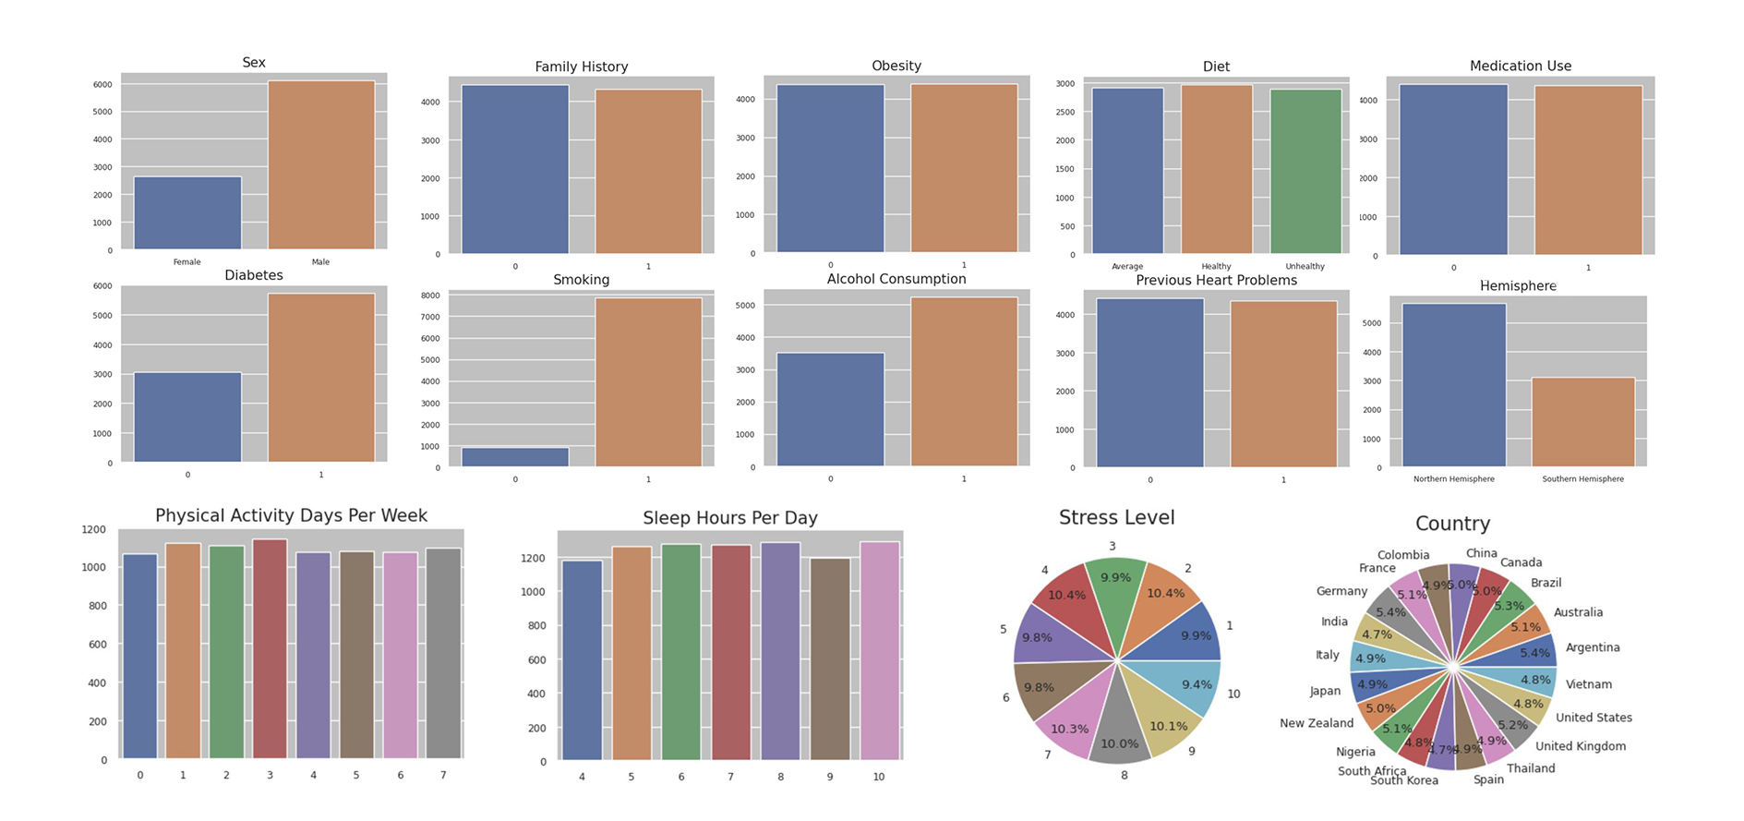
EDA
Plots of categorical columns

Slide 6
FEATURE ENGINEERING & SELECTION
Process of feature engineering :
Feature selection :
- Encoding columns:
“blood pressure”,
”diet”,
”Sex”
- Drop of the columns:
“patientId”,
”Continent”,
”Country”,
”hemisphere”
Correlation of features:
- Heatmap
- T-test
Normal distribution→ False
- Mann Whitney U test
Result→ no significant relation
- tree_importance
- Features :
age,
cholesterol,
heart_rate,
BMI,
sedentary_hours_per_day,
triglycerides,
exercise_hours_per_week

Slide 7
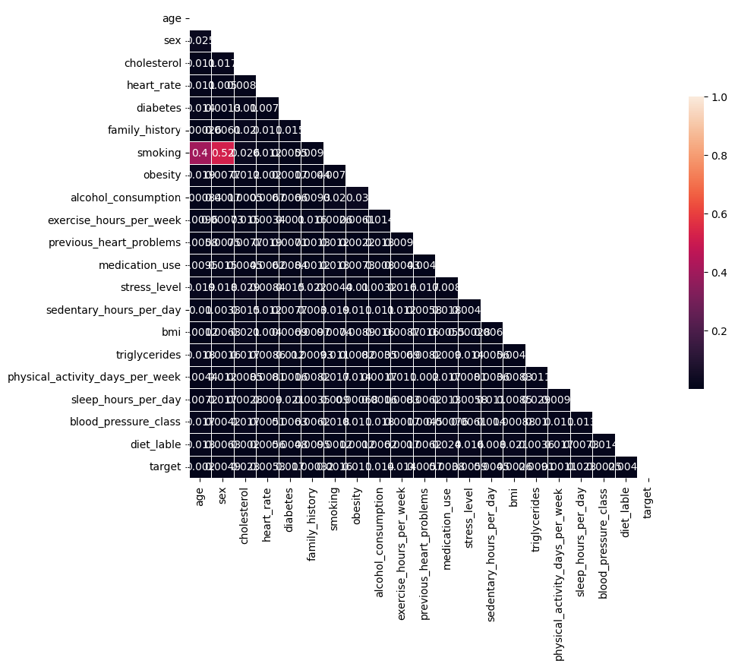
Correlation matrix

Slide 8
MODELS TESTED
KNN scaled/ unscaled
Decision Tree
Bagging/Pasting
MODEL 2
MODEL 4
MODEL 6
MODEL 5 & 6
MODEL 1
MODEL 3
MODEL 5
Logistic Regression
Random
Forest
Gradient Boosting
XXX

Slide 9

MODEL BUILDING & EVALUATION
Process of feature engineering :
⇒ Types of models used :
Model 1 : KNN unscaled / KNN scaled
Model 2 : LogisticRegression,
Model 3 : Bagging and pasting,
Model 4 : RandomForest,
Model 5 : DecisionTree,
Model 6 : Gradient Boosting
Model 7 : Adaptive Boosting
⇒ Balancing dataset : Undersized & Smote
After Smote : 4510 per class

Slide 10
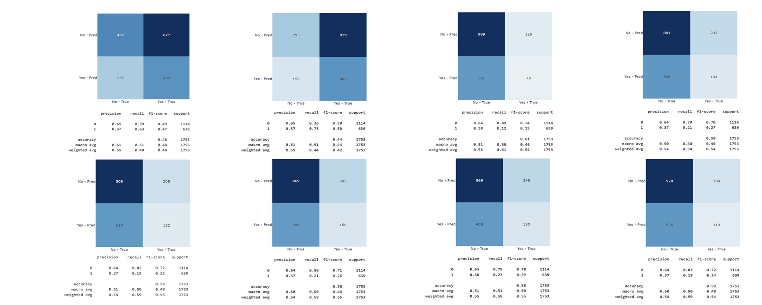
MODEL BUILDING & EVALUATION
Evaluation : metrics / validation techniques
KNN
Recall 0.63
LR
Decision
Tree
GB
RF
BAG
With
pasting
BAG
Without pasting
ADA

Slide 11
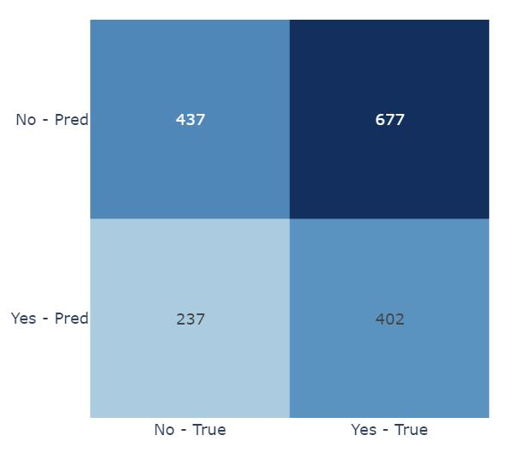
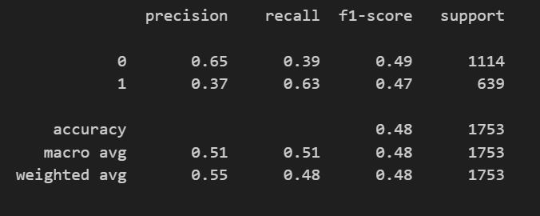
MODEL BUILDING & EVALUATION
Evaluation : metrics / validation techniques
KNN (n_neighbors=30)
LR
Decision
Tree
GB
RF
BAG
With
pasting
ADA

Slide 12
HYPERPARAMETER TUNING & MODEL OPTIMIZATION
Techniques employed :
Manual for KNN
Grid Search :
⇒ on Logistic Regression
Hyperparameter: “penalty”, ”C”
Insights on the improvement of our model :
⇒ we tried different random states, different max_depths, n_estimators

Slide 13
CHALLENGES & LEARNINGS
Key-learnings :
⇒ not biasing the data (see fig)
⇒ look at all the indicators
⇒ do a more systematical approach
⇒ be more organized
⇒ no magic model :)
Challenges :
Insufficient & imbalanced data
Choice of target : Heart attack Risk

Slide 14
FUTURE WORK & IMPROVEMENTS
Areas for future research :
⇒ acquire more data
⇒ reliability of the dataset

Slide 15
THE WISDOM OF THE CROWD
-ARISTOTLE - Politics
“"It is possible that the many, though not individually good men, yet when they come together may be better, not individually but collectively, than those who are so [...]”

Slide 16
THANKS
Do you have any questions? :)

