Slide 1




LINUX SYSTEM & PROCESS MONITORINGTOOL

Slide 2


INTRODUCTION
Linux is a widely used operating system designed to manage system resources, applications, and multiple processes efficiently. Effective monitoring of these resources is essential for maintaining system performance and identifying potential issues.
The Linux System & Process Monitoring Tool is a C++-based application developed to monitor system resources and running processes in a Linux environment through a command-line interface.
The project provides information related to system performance and process activity, enabling users to observe resource utilization and monitor important system conditions efficiently.

Slide 3


PROBLEM STATEMENT
System monitoring is essential for maintaining the performance, stability, and reliability of a Linux-based environment. However, monitoring different system resources and running processes often requires the use of multiple commands and utilities.
This project addresses this requirement by developing a unified command-line tool that provides system resource information, process details, and basic monitoring capabilities through a single application.

Slide 4



OBJECTIVES
System Resource Monitoring:
Monitor CPU, memory, and disk utilization.
Process Monitoring:
Display running processes and their corresponding process IDs (PIDs).
Process Watchdog:
Monitor selected processes and identify changes or failures.
Event Monitoring:
Monitor relevant system and device events.
Logging & Reporting:
Record important monitoring information for analysis and reference.

Slide 5


TECHNOLOGIES USED
C++ — Core programming language used to develop the monitoring application. Linux — Operating system and execution environment for the project.
/proc Filesystem — Used to obtain system and process information. Command-Line Interface (CLI) — Provides interaction with the monitoring tool. Git & GitHub — Used for version control and project repository management.

Slide 6
PROJECT MODULES
System Resource Monitor — Monitors CPU, memory, and disk utilization.
Process Monitor — Displays running processes, PIDs, and process-related information.
Process Watchdog — Monitors selected processes and detects process status
changes.
Event Monitor — Tracks relevant system and device events.
Logging Module — Records important monitoring information for later analysis.

Slide 7
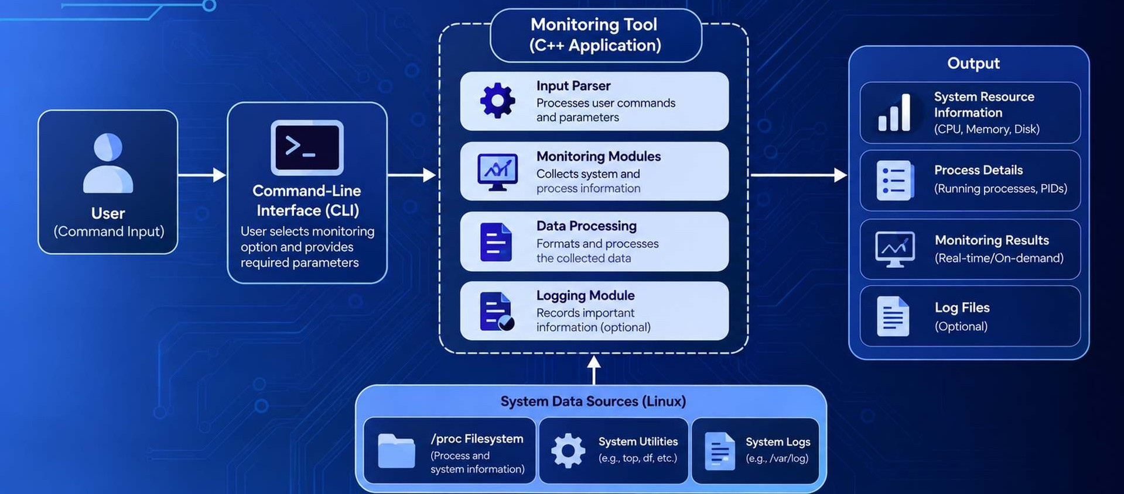
EM ARCHITECTURE

Slide 8


WORKING / WORKFLOW
I ”
Command-Line Interface (CLI)
User Input
Select monitoring optio s
Provic!e reouired parameters
(if any)
Data Collection
Reads data from
/proc filesystem
Uses system ut'lities (G.p., toD, df, etc.)
Collec ts process, system, and event information
Data Processing & Monitoring
Results & Logging
P ocessc ihc colecied data
Displays the monitoring
results in the tern i Tal
S th es In per LaiIt ttJformation ill log flies ( pt,gt\g|]
Calcdilates and formats the reset Its
Monitors CPU memory,
Idendrites the requi red mod uie
Repeat for continuous monitoring (if selected)

Slide 9
OUTPUT / RESULTS
e ø e
smitaØsmita-Linux: -/tinux-monitor
$ . / process wat chdog
U
e
=== Process Watchdog ---
Enter PI0 to monitor . i'
e |  |  |  | 1234 | 2. 1 | 1. 3 | bash
sP*Ueo '28e*” | ’*56 3‘ | ( '50 | GB / 8. 00 GB) | 2345 | 0. S | 2. 7 | 1i refor
How i tormy process 3d o', every 2 seconds . . .
[I 6: 12 : 08 ] Process 3456 is runn in g . . .
[J6 : 12 : T0] Process 3456 is runnEng . . .
Disk Usage
: 62. 1 8 (124.18 GB / 200. 0 GB)
34 56
4567
5678
snt
1. 8
0. 0
3.2
ziJu x :
0. 9
0. 4
T . J
code sshd
pyth on3
$
[t6 : 12 : t2] Process 3456 has stopped ! Alert logged to logs/process .log
System Resource Monitoring
Process Monitoring
Process Watchdog
smitagsmita-Linux: -/linux-monitor
smitagsmita-Linux: -/tinux-monitor
$ . /device noVitor
=== Device Ponztor (Press Ctrl+C to stop) ---
$ . /driver test
=== LTnux Driver Test ---
[16 : 20 : 15 j add
[ 16 - 20 : 22 ] change
/devices/pci0000: 00/: 0000 00 : 14. 0/usb1/ 1-1 (usb)
/devices/virtuaI/input/znput5 (input)
/devices/pcz0000 : 00/0000: 00 : 14. 0/usb1/1 -2 (usb)
/devzces/pci0000 : 00/0000 : 00 : 14. 0/usb1/1 -2 ( u sb)
En ter message to send to driver : -.c t ’ c' : °'
les sage sent to driver .
Reading response from driver . . .
Dr iver response : C++ apps ica t to n connec t ed to
16 - 21 : 03 add
Lin u x dr i ver
Art a Sa la - L Tnu x '
Device Monitoring
Kernel Driver Test

Slide 10
CONCLUSION & FUTURE SCOPE
CONCLUSION
Developed a C++-based Linux System & Process Monitoring Tool.
Provides centralized monitoring of CPU, memory, disk, and running processes.
Uses Linux system interfaces and utilities to co lect and process system information. Provides monitoring results through a simple command-line interface.
FUTURE SCOPE
Add a graphical user interface (GUI) for easier interaction. Introduce real-time graphical performance charts.
Add automated alerts for high resource utilization.
Extend monitoring and logging capabilities for remote systems.

