Slide 1
DAA Assignment-4
Smitesh Hadape : IIT2019090
Varun Bhardwaj : IIT2019091
Tanish Patel : IIT2019092

Slide 2
Question
Find the missing element in an array that represents elements of an arithmetic progression in order using divide and conquer approach.

Slide 3
Abstract
In this report, the design and analysis of an algorithm that finds the missing element in an array that represents elements of an arithmetic progression in order using divide and conquer approach.

Slide 4
Keywords
Divide and Conquer Approach
Arithmetic Progression
Array

Slide 5
Introduction
Since the elements of an array represent an arithmetic progression, the array is already sorted either in increasing or decreasing order.

Slide 6
Algorithm Design
We use divide and conquer approach where we divide the given problem into smaller sub-problems and appropriately combine their solutions to get the solution to the main problem.

Slide 7
Algorithm Design
Approach:
The idea is to keep on checking the difference between the middle element and its adjacent elements unless the difference is not equal to the desired common difference.

Slide 8
Pseudo Code
Declare global variable ans=INT MIN
Function missingTerm(Argument a[], Argument l, Argument h, Argument d){
If l is greater than or equal to h
return;
initialize m = (l + h) / 2
initialize current=a[0]+m*d
If a[m]-a[m − 1] is not equal to d and m is greater than 0
ans=a[m − 1]+d
Else if a[m+1]-a[m] is not equal to d and m+1 is less than h
ans=a[m]+d
Else if a[m] is equal to current
missingTerm(a, m+1, h, d)
Else
missingTerm(a. l, m-1, d)
return ;
end

Slide 9
Pseudo Code
Main function()
Initialize integer array arr[]
Initialize n as size of array
Input the elements of the array
If n is less than 3, print ”invalid input”
Else {
Initialize d
If a[2]-a[1] is equal to a[1]-a[0]
d=a[1]-a[0]
Else if a[3]-a[2] is equal to a[2]- a[1]
d=a[2]-a[1]
Else d=a[1]-a[0]
missingTerm(a, 0, n, d)
If ans is greater than INT MIN print ans If ans is greater than INT MIN print No term is missing 2

Slide 10
Algorithm Analysis
Assume the length of the array before any function calls is n.After the kth function call, length of array becomes n/2k . Since the length of the array becomes 1 after k function calls(worst case) => n = 2^k
Hence k = log2 (n) Hence, the time complexity for the above approach is log2 (n).
Best Case Analysis
The best case arises when the element at the middle position is not at the appropriate position in the AP. In this case, there are no function calls involved and hence the time complexity would be O(1).
Average Case Analysis
Average case arises when that element is present somewhere in between.
Worst Case Analysis
Worst case arises when the element is present in the end of each half.

Slide 11
Time And Space Complexities
Time Complexity :
Space Complexity :
No extra space is required so, space complexity will be constant.
Space Complexity: O(1)
Best Case | Average Case | Worst Case
O(1) | ~O(logn) | O(logn)

Slide 12
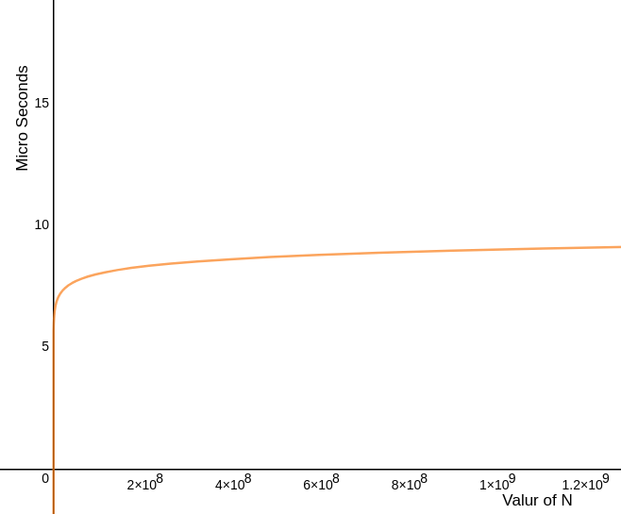
Profiling/Posteriori Analysis - Time Complexity
By the experimental analysis, we found that on increasing the value of N, the graph is logarithmic. Thus the overall time increases with an increase in number of elements.

Slide 13
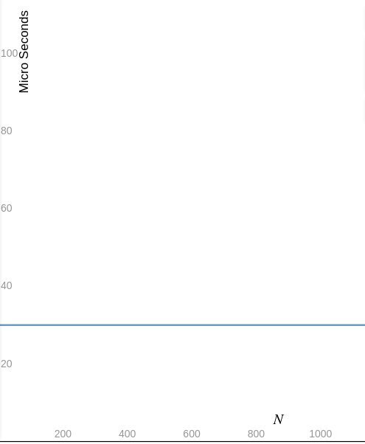
Profiling/Posteriori Analysis - Space Complexity
For the algorithm space complexity is independent of the value of N and just comprise of the constant data.

Slide 14
Conclusion and References
We can conclude that the above algorithm has the least time and space complexity to find the missing element in an array that represents elements of an arithmetic progression in order.
References:
Introduction to Algorithms by Cormen, Charles, Rivest and Stein.
Introduction to STL using C++ by Robert H.

