Slide 1
Slide 1
Presentation on
Music Store Data Analysis
An Analysis of Sales Data from a Music Store
By –
Smitesh Dutta

Slide 2
About the Project
The objective of this project is to analyze the sales data of a music store using SQL queries.
The data is sourced from the Music Store Database, which includes information about customers, sales, products, and employees.
The main objectives were to identify the top-selling products, analyze customer behavior, and determine the most profitable regions.
The analysis has uncovered some valuable insights about the music store's performance and gaind a deeper understanding of its customers.

Slide 3
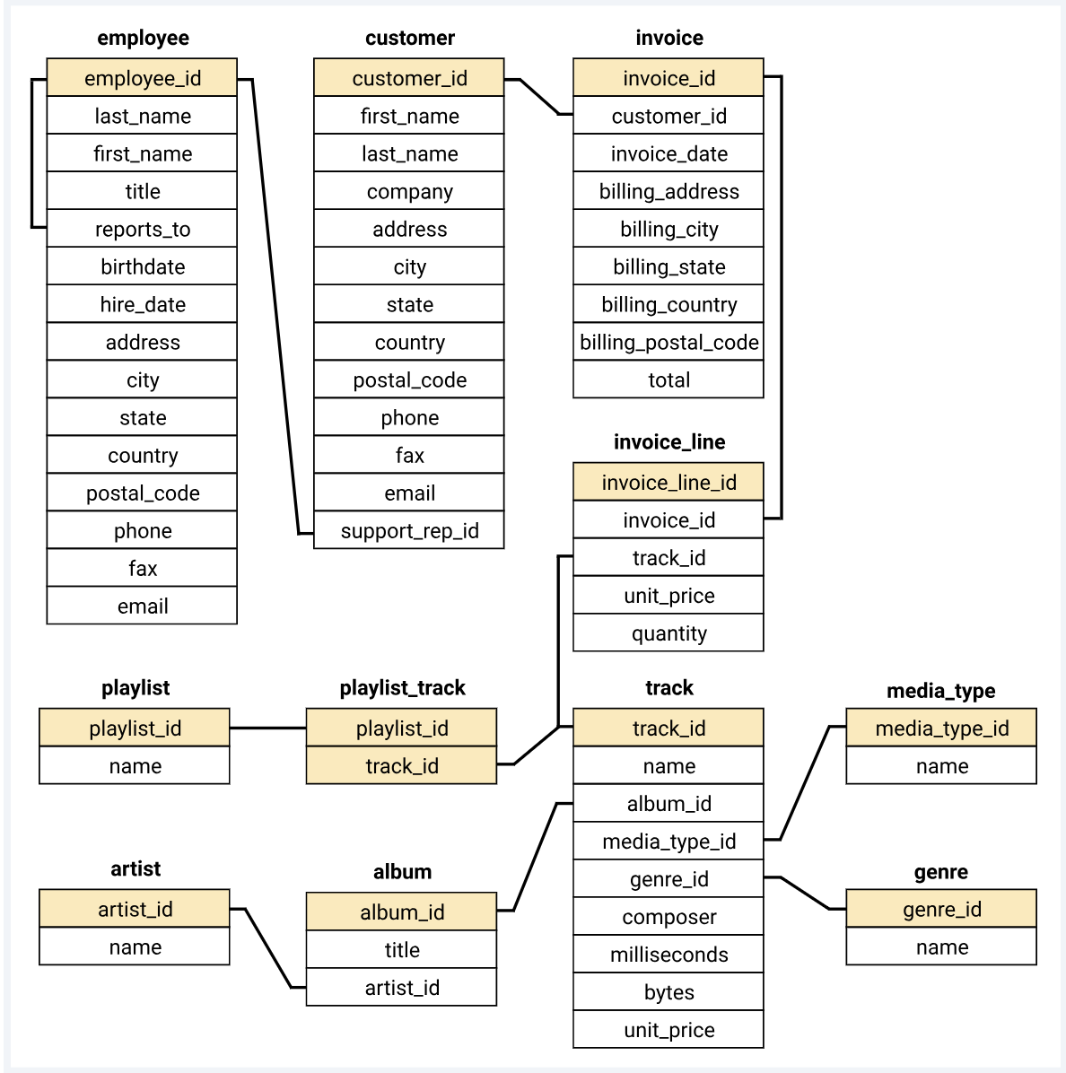
Understanding the Structure and Contents of the Database
The Music Store Database is a relational database designed to track sales data for a music store.
The database includes several tables that are linked together to provide a comprehensive view of the store's operations.
The Customers table stores data about the store's customers, such as their name and address.
The Employees table contains information about the store's staff, such as their job title and hire date.
The Products table includes details about the store's inventory, such as product name, artist, and price.
The Sales table is used to track information about each transaction, including the customer, employee, and product involved.
Overall, these tables work together to provide a comprehensive view of the store's operations and sales data.

Slide 4
The provided data can be analyzed based on the following parameters:
Analysis of the Music Store Database using SQL queries should provide several key insights and metrics that can inform business decisions and strategies.
These insights must include identifying the store's most active markets, most profitable cities, most valuable customers, and top-selling genres.
Analyze customer preferences for songs to identify the most popular music genres by country so that the store can optimize its inventory and marketing strategies.
Insights into customer spending habits and preferences that can inform targeted marketing and promotional campaigns, as well as customer engagement strategies.
Overall, these insights should provide valuable information for optimizing business operations and developing successful marketing and customer engagement strategies.

Slide 5
Slide 2
Insights and Metrics from Music Store Data Analysis (Phase I)
The senior most employee of the company is Jane Peacock, who is a Sales Support Agent.
The countries with the most invoices are the United States, Canada, and Brazil.
The top three values of total invoices are $23.76, $19.84 and $18.36.
The city with the highest sum of invoice totals is Prague, with a total of $273.24 in sales.
The best customer is ‘Frantiaiek Wichterlovai', who spent a total of $212.04 on music.
In this phase analysis focused on understanding the customer and sales data, including the senior most employee, top spending customers, and highest performing cities and countries.
2

Slide 6
Insights and Metrics from Music Store Data Analysis (Phase II)
There are a total of 2187 customers who listen to Rock music.
The top 10 Rock bands by track count are AC/DC, Aerosmith, Guns N' Roses, Jimi Hendrix, Led Zeppelin, Metallica, Pearl Jam, Queen, Red Hot Chili Peppers, and The Rolling Stones.
There are a total of 492 tracks with a song length longer than the average song length.
This phase of the analysis focused on exploring the music and artist data, including identifying the top Rock bands and longest tracks in the dataset.

Slide 7
Insights and Metrics from Music Store Data Analysis (Phase III)
The total amount spent by each customer on artists varies widely, from $0.99 to $27.72.
The most popular genre for each country varies, with Rock being the most popular genre in the United States, Brazil, and Canada, while Latin is the most popular genre in Mexico.
The top spending customers for each country also vary widely, with some countries having multiple customers who spent the most on music.
Phase III of the music store data analysis focused on examining the relationship between customer spending and artist data, as well as exploring the most popular genres by country.

Slide 8
Insights and Metrics from Music Store Data Analysis (Phase III)
The total amount spent by each customer on artists varies widely, from $0.99 to $27.72.
The most popular genre for each country varies, with Rock being the most popular genre in the United States, Brazil, and Canada, while Latin is the most popular genre in Mexico.
The top spending customers for each country also vary widely, with some countries having multiple customers who spent the most on music.
Phase III of the music store data analysis focused on examining the relationship between customer spending and artist data, as well as exploring the most popular genres by country.

Slide 9
Overall observation for improving sales and business performance
Promote top-selling genres (Rock, Alternative & Punk, and Metal).
Improve customer engagement and retention through loyalty programs and personalized recommendations.
Expand into countries with high sales potential (such as the USA, Canada, and Brazil).
Collaborate with popular artists and bands to attract more customers to the store.
By focusing on these areas, the company can increase its sales and improve its overall business performance.

Slide 10
Slide 11
THANK YOU

