Slide 1
Slide 1
Presentation on
SALES DASHBOARD
By –
Smitesh Dutta

Slide 2
About the dashboard
The objective of this project is to design a comprehensive dashboard that provides visual representations of the sales performance of a global toy manufacturing company across different parameters.
The dashboard will enable the company to gain valuable insights into their sales factors and make informed decisions to improve their overall sales performance.

Slide 3
About The Dataset
The dataset at hand comprises 2844 observations and 24 variables.
The data encompassing a three-year span of the company's sales data.
Within this timeframe, the company manufactured seven distinct products that were marketed and sold in 19 different countries.

Slide 4
The provided data can be analyzed based on the following parameters:
Aggregate sales across various territories.
Monthly sales performance.
Top-selling products.
Sales distribution across different countries.
Distribution of deal size across various territories.
Current status of orders.

Slide 5
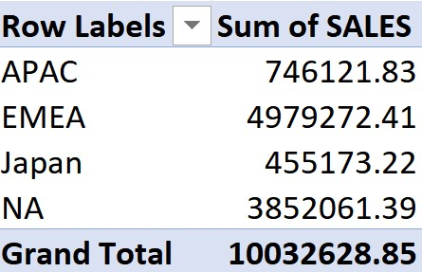
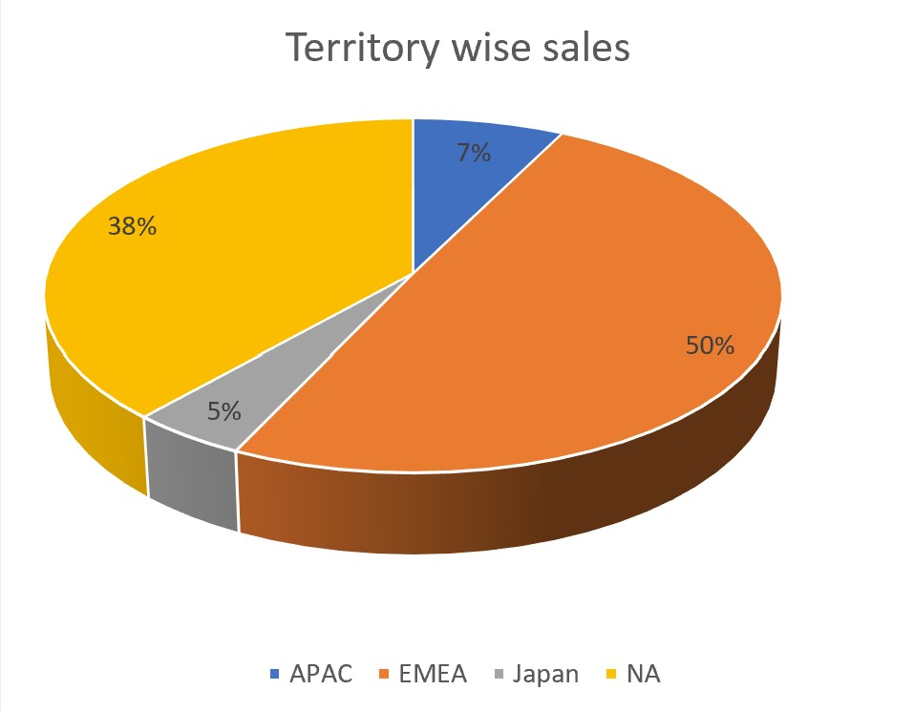
Slide 2
Territory wise sales
The dataset includes four distinct territories, namely APAC (Asia Pacific), EMEA (Europe, Middle East, and Africa), Japan, and NA (North America).
An analysis of the data reveals that EMEA accounts for 50% of the total sales, followed by NA with 38% of the sales.
2

Slide 6
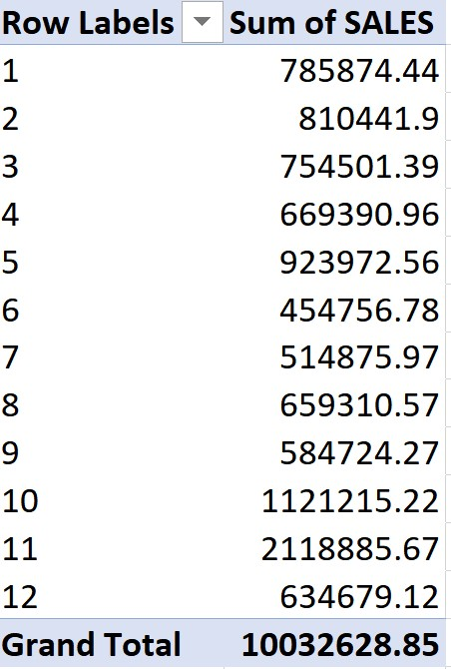
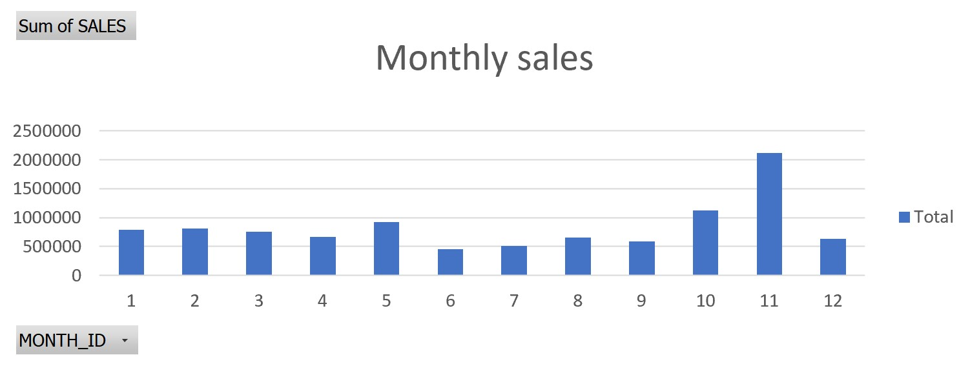
Monthly sales performance
The presented data displays the monthly sales performance of the company.
A clear trend emerges, indicating that sales follow a linear pattern during the initial months of the year.
Towards the end of the third quarter, there is a significant uptick in sales, peaking in the middle of the quarter, before tapering off and returning to a linear pattern.
This sales performance is consistent over the three-year period analyzed.

Slide 7
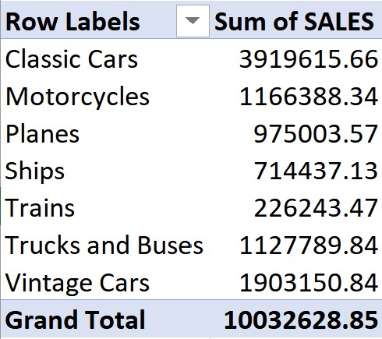
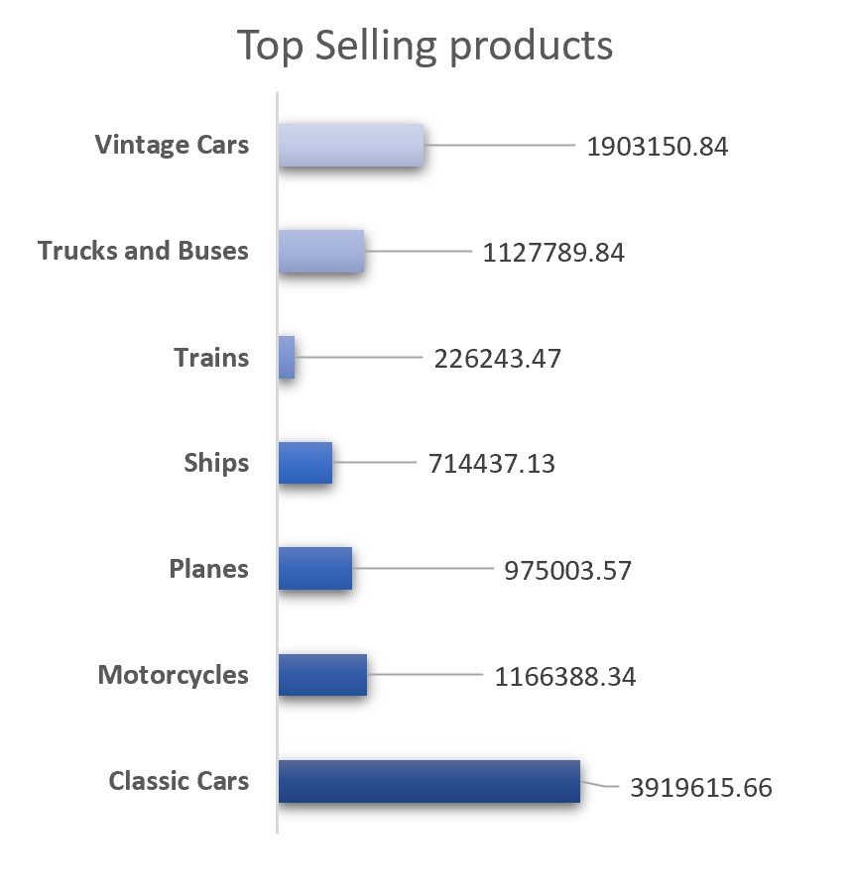
Top selling products
The company offers a range of seven distinct products, including Classic Cars, Motorcycles, Planes, Ships, Trains, Trucks and Buses as well as Vintage Cars.
Upon analyzing the data, it becomes apparent that Classic Cars are the highest selling product, with sales totaling 1,484,785.29.
This is followed by Vintage Cars, which generated sales of 650,987.76.
The remaining products performed relatively similarly in terms of sales figures.

Slide 8
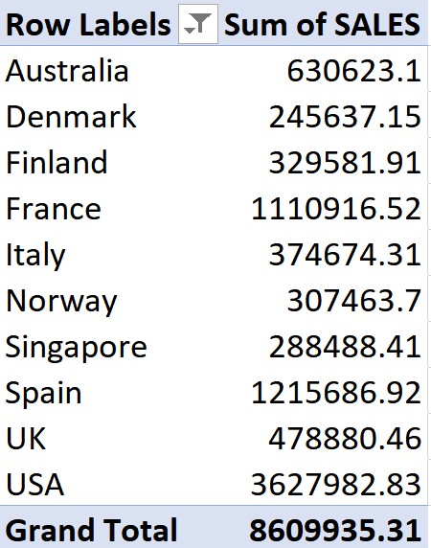
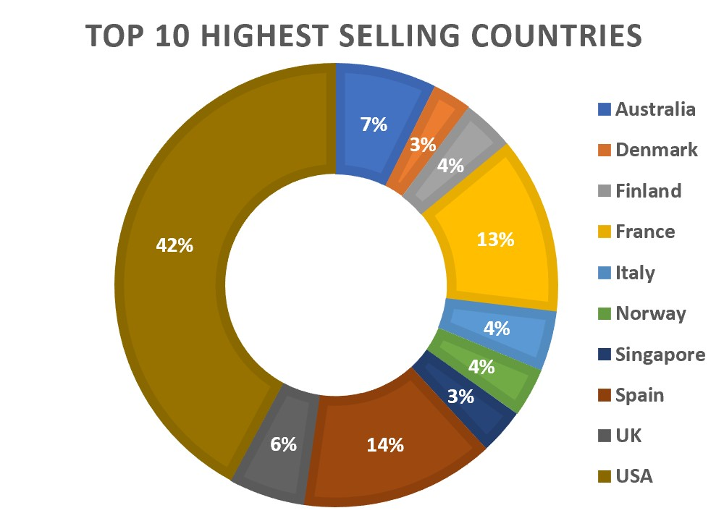
Country wise sales distribution
Based on the data, the top 10 countries in terms of sales performance are revealed as follows: Australia, Denmark, Finland, France, Italy, Norway, Singapore, Spain, UK, and USA.
The analysis indicates that the USA is at the top of the list, accounting for more than 42% of total sales, followed by Spain with 14%.
The remaining countries on the list also demonstrated varying levels of sales performance.

Slide 9
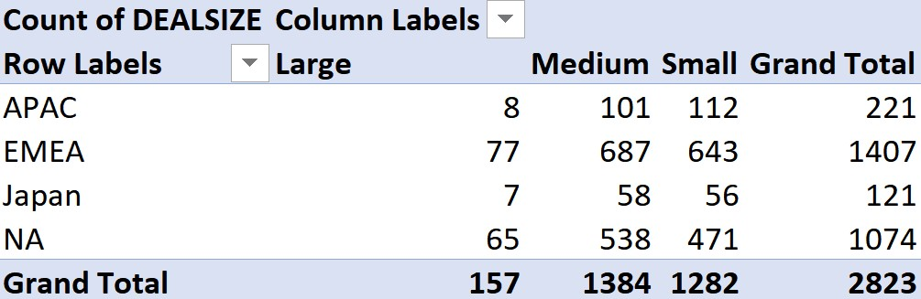
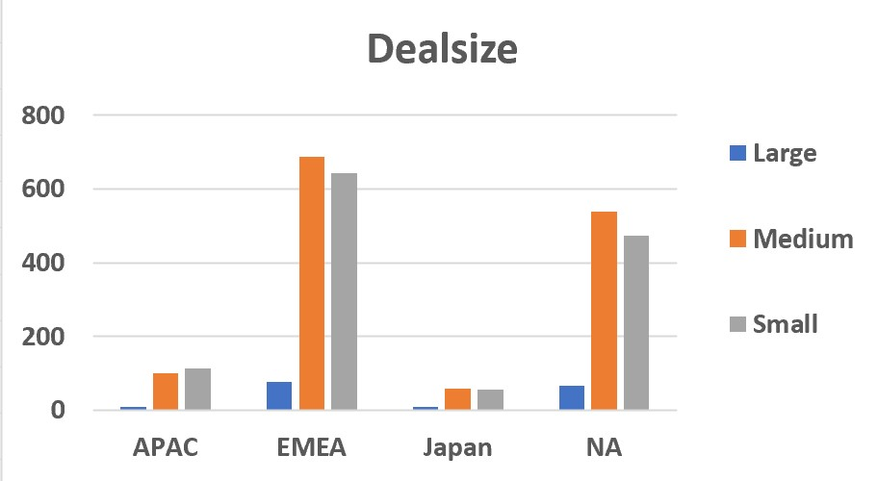
Territorial distribution of deal size
The dataset includes four territories, namely APAC (Asia Pacific), EMEA (Europe, Middle East, and Africa), Japan, and NA (North America).
Upon analyzing the data, it becomes evident that the majority of territories in the dataset have a preference for medium and small-sized deals.
Additionally, it is noteworthy that the EMEA and NA territories have the highest number of deals in this size range.

Slide 10
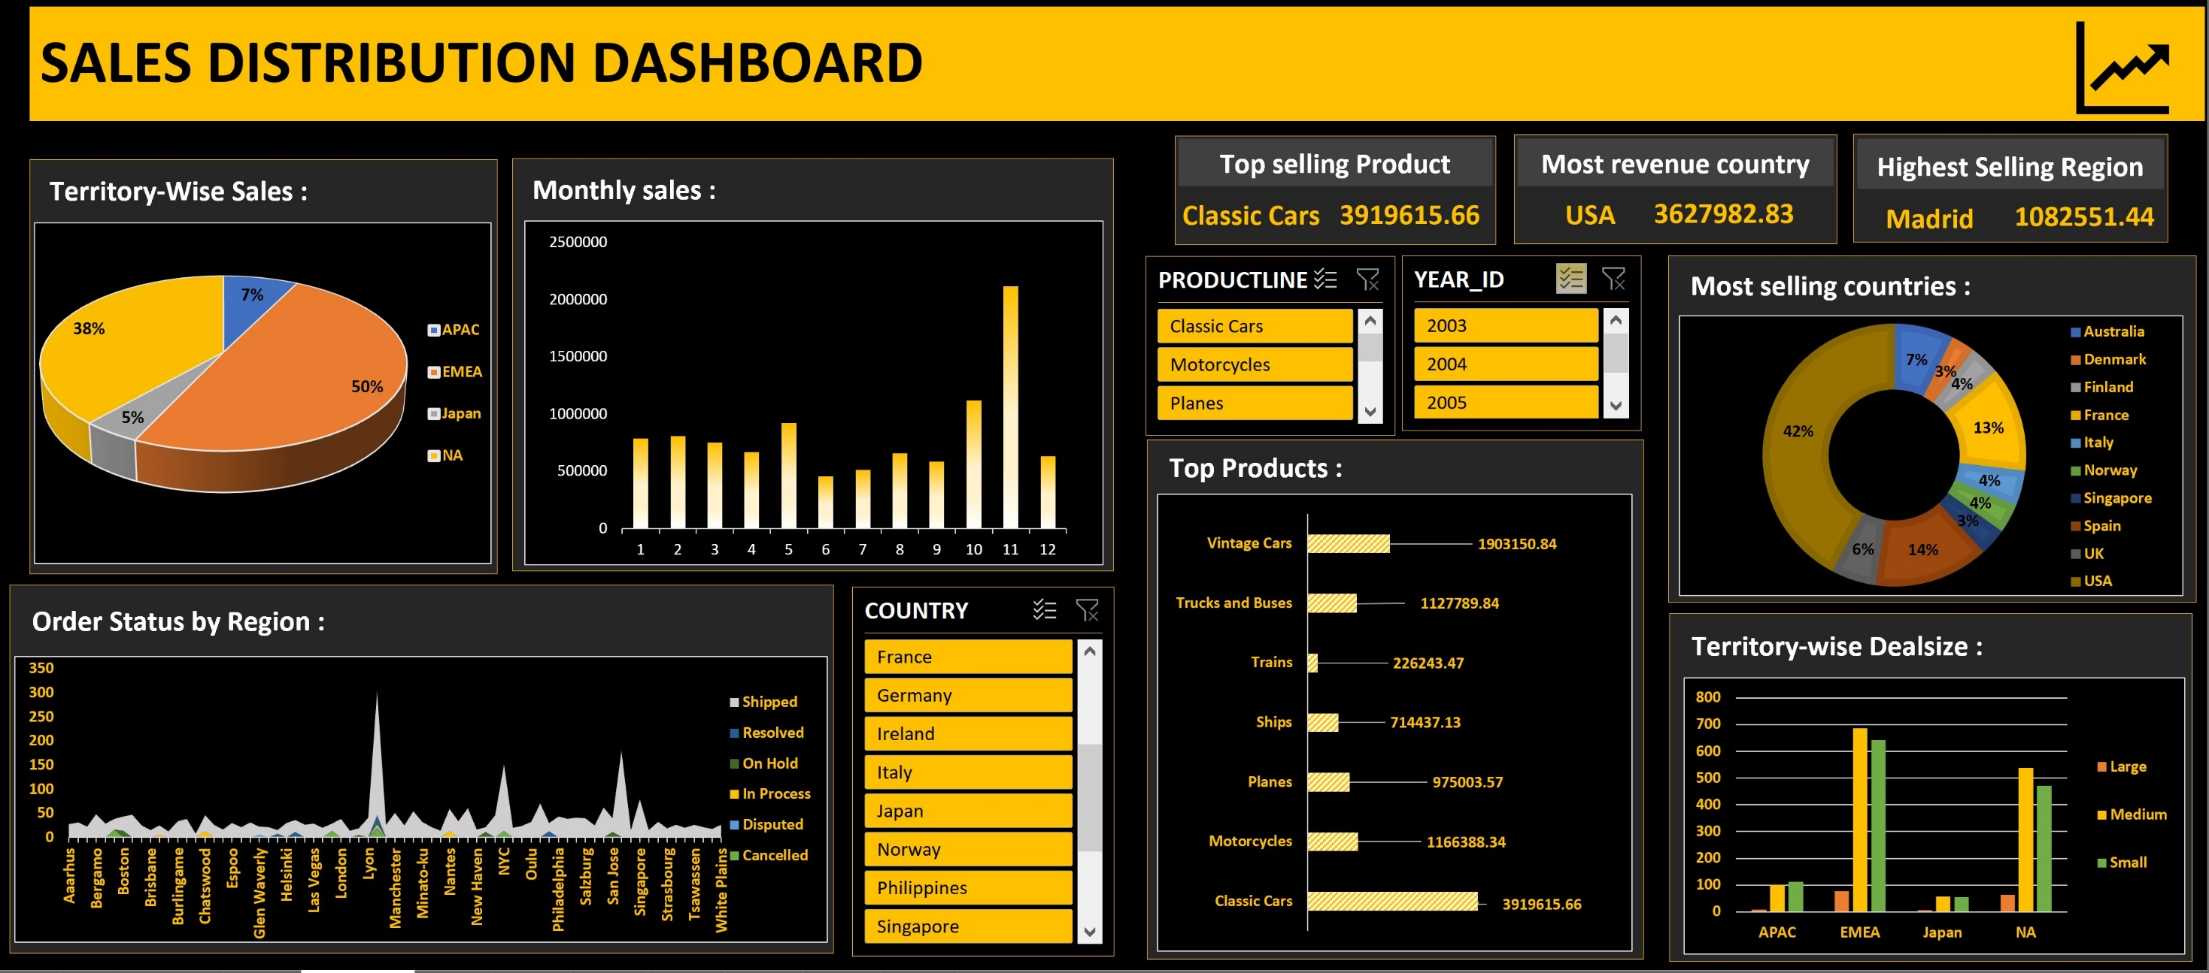
Dashboard

Slide 11
Slide 11
THANK YOU

