Slide 1
Elementary Algorithmic

Slide 2

Outline
  Analysis of Algorithm
  The efficient algorithm
  Average, Best and Worst case analysis
  Asymptotic Notations
  Analyzing control statement
  Loop invariant and the correctness of the algorithm
  Sorting Algorithms and analysis: Bubble sort, Selection sort, Insertion sort, Shell sort and Heap sort
  Sorting in linear time : Bucket sort, Radix sort and Counting sort
  Amortized analysis
Looping

Slide 3


Introduction
What is Analysis of an Algorithm?
Analyzing an algorithm means calculating/predicting the resources that the algorithm requires.
Analysis provides theoretical estimation for the required resources of an algorithm to solve a specific computational problem.
Two most important resources are computing time (time complexity) and storage space (space complexity).
Why Analysis is required?
By analyzing some of the candidate algorithms for a problem, the most efficient one can be easily identified.

Slide 4
Efficiency of Algorithm
The efficiency of an algorithm is a measure of the amount of resources consumed in solving a problem of size 𝑛.
An algorithm must be analyzed to determine its resource usage.
Two major computational resources are execution time and memory space.
Memory Space requirement can not be compared directly, so the important resource is computational time required by an algorithm.
To measure the efficiency of an algorithm requires to measure its execution time using any of the following approaches:
  Empirical Approach: To run it and measure how much processor time is needed.
  Theoretical Approach: Mathematically computing how much time is needed as a function of input size.

Slide 5

How Analysis is Done?
Empirical (posteriori) approach
Theoretical (priori) approach
  Programming different competing techniques & running them on various inputs using computer.
  Implementation of different techniques may be difficult.
The same hardware and software environments must be used for comparing two algorithms.
Results may not be indicative of the running time on other inputs not included in the experiment.
  Determining mathematically the resources needed by each algorithm.
Uses the algorithm instead of an implementation.
The speed of an algorithm can be determined independent of the hardware/software environment.
Characterizes running time as a function of the input size $n,$ considers all possible values.

Slide 6
Time Complexity
Time complexity of an algorithm quantifies the amount of time taken by an algorithm to run as a function of the length of the input.
Running time of an algorithm depends upon,
  Input Size
  Nature of Input
Generally time grows with the size of input, for example, sorting 100 numbers will take less time than sorting of 10,000 numbers.
So, running time of an algorithm is usually measured as a function of input size.
Instead of measuring actual time required in executing each statement in the code, we consider how many times each statement is executed.
So, in theoretical computation of time complexity, running time is measured in terms of number of steps/primitive operations performed.

Slide 7
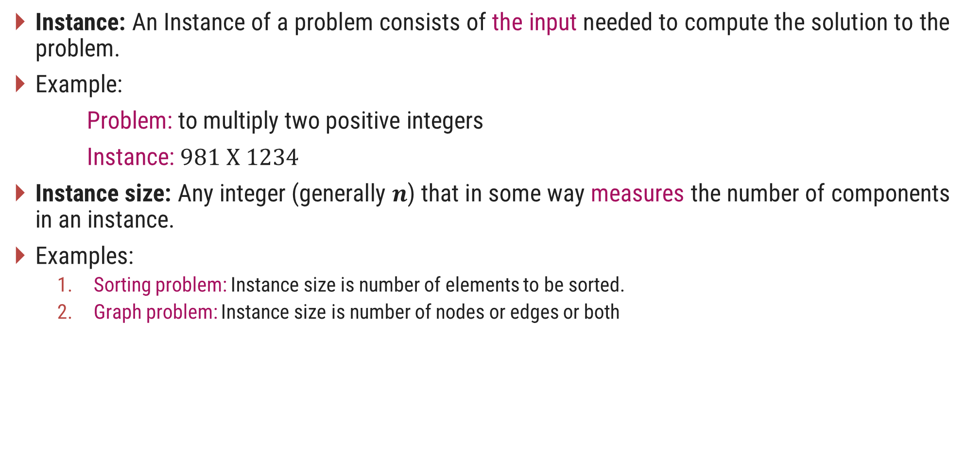
Problem & Instance
Instance: An Instance of a problem consists of the input needed to compute the solution to the problem.
Example:
Problem: to multiply two positive integers
Instance: $981 X 1234$
Instance size: Any integer (generally 𝒏) that in some way measures the number of components in an instance.
Examples:
  Sorting problem: Instance size is number of elements to be sorted.
  Graph problem: Instance size is number of nodes or edges or both

Slide 8

Linear Search
Suppose, you are given a jar containing some business cards.
You are asked to determine whether the name “Bill Gates" is in the jar.
To do this, you decide to simply go through all the cards one by one.
How long this takes?
Can be determined by how many cards are in the jar, i.e., Size of Input.
Linear search is a method for finding a particular value from the given list.
The algorithm checks each element, one at a time and in sequence, until the desired element is found.
Linear search is the simplest search algorithm.
It is a special case of brute-force search.

Slide 9



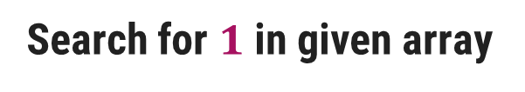






Linear Search – Example
Search for $1$ in given array
$$2$$ | $$9$$ | $$3$$ | $$1$$ | $$8$$
Comparing value of i^{th} index with the given element one by one, until we get the required element or end of the array
Step 1: i=1
Step 3: i=3
$$2$$ | $$9$$ | $$3$$ | $$1$$ | $$8$$
$$2$$ | $$9$$ | $$3$$ | $$1$$ | $$8$$
i
i
$$2≠1$$
$$3≠1$$
Step 2: i=2
Step 4: i=4
$$2$$ | $$9$$ | $$3$$ | $$1$$ | $$8$$
$$2$$ | $$9$$ | $$3$$ | $$1$$ | $$8$$
$$1$$
i
i
$$9≠1$$
Element found at i^{th} index, i=4

Slide 10
Linear Search - Algorithm
# Input : Array A, element x
# Output : First index of element x in A or -1 if not found
Algorithm: Linear_Search
for i = 1 to last index of A
if A[i] equals element x
return i
return -1

Slide 11




Linear Search - Analysis
The required element in the given array can be found at,
  E.g. 2: It is at the first position
  Best Case: minimum comparison is required
  E.g. 3 or 1: Anywhere after the first position
  Average Case: average number of comparison is required
  E.g. 7: Last position or element does not found at all
  Worst Case: maximum comparison is required
Worst Case
Search for $2$
$$3$$
$$7$$
$$2$$ | $$9$$ | $$3$$ | $$1$$ | $$8$$ | $$7$$
Best Case
Average Case

Slide 12




Linear Search - Analysis
The required element in the given array can be found at,
Case 1: element 2 which is at the first position so minimum comparison is required
Case 2: element 3 anywhere after the first position so, an average number of comparison is required
Case 3: element 7 at last position or element does not found at all, maximum comparison is required
Best Case
Average Case
Worst Case
Worst Case
Search for $2$
$$3$$
$$7$$
$$2$$ | $$9$$ | $$3$$ | $$1$$ | $$8$$ | $$7$$
Best Case
Average Case

Slide 13
Analysis of Algorithm
Best Case | Average Case | Worst Case
Resource usage is minimum | Resource usage is average | Resource usage is maximum
Algorithm’s behavior under optimal condition | Algorithm’s behavior under random condition | Algorithm’s behavior under the worst condition
Minimum number of steps or operations | Average number of steps or operations | Maximum number of steps or operations
Lower bound on running time | Average bound on running time | Upper bound on running time
Generally do not occur in real | Average and worst-case performances are the most used in algorithm analysis.

Slide 14
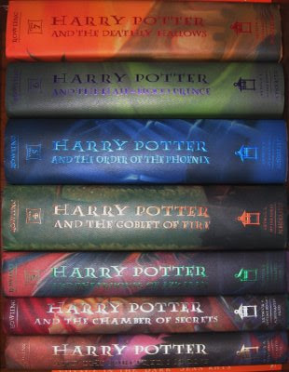
Book Finder Example
Suppose, you are writing a program to find a book from the shelf.
For any required book, it will start checking books one by one from the bottom.
If you wanted Harry Potter 3, it would only take 3 actions (or tries) because it’s the third book in the sequence.
If Harry Potter 7 — it’s the last book so it would have to check all 7 books.
What if there are total 10 books? How about 10,00,000 books? It would take 1 million tries.

Slide 15




Number Sorting - Example
Suppose you are sorting numbers in Ascending / Increasing order.
The initial arrangement of given numbers can be in any of the following three orders.
  Numbers are already in required order, i.e., Ascending order
  No change is required – Best Case
  Numbers are randomly arranged initially.
  Some numbers will change their position – Average Case
  Numbers are initially arranged in Descending or Decreasing order.
  All numbers will change their position – Worst Case
$$5$$ | $$9$$ | $$12$$ | $$23$$ | $$32$$ | $$41$$
$$9$$ | $$5$$ | $$12$$ | $$32$$ | $$23$$ | $$41$$
$$5$$ | $$9$$ | $$12$$ | $$23$$ | $$32$$ | $$41$$
$$41$$ | $$32$$ | $$23$$ | $$12$$ | $$9$$ | $$5$$

Slide 16




Number Sorting - Example
Suppose you are sorting numbers in Ascending / Increasing order.
The initial arrangement of given numbers can be in any of the following three orders.
Case 1: Numbers are already in required order, i.e., Ascending order
No change is required
Case 2: Numbers are randomly arranged initially. Some numbers will change their position
Case 3: Numbers are initially arranged in Descending order so, all numbers will change their position
Best Case
Average Case
Worst Case
$$5$$ | $$9$$ | $$12$$ | $$23$$ | $$32$$ | $$41$$
$$9$$ | $$5$$ | $$12$$ | $$32$$ | $$23$$ | $$41$$
$$5$$ | $$9$$ | $$12$$ | $$23$$ | $$32$$ | $$41$$
$$41$$ | $$32$$ | $$23$$ | $$12$$ | $$9$$ | $$5$$

Slide 17
Best, Average, & Worst Case
Problem | Best Case | Average Case | Worst Case
Linear Search | Element at the first position | Element in any of the middle positions | Element at last position or not present
Book Finder | The first book | Any book in-between | The last book
Sorting | Already sorted | Randomly arranged | Sorted in reverse order

Slide 18
What is a Good Algorithm?
Efficient
  Running time
  Space used
Efficiency as a function of input size
  The number of bits in an input number
  Number of data elements(Numbers and Points)

Slide 19
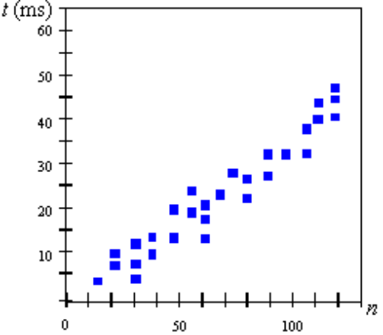
Measuring the Running Time
How should we measure the running time of an algorithm?
Experimental Study
  Write a program that implements the algorithm
  Run the program with data sets of varying size and composition.
  Use a method like System.currentTimeMillis() to get an accurate measure of the actual running time

Slide 20
Limitations of Experimental Studies
It is necessary to implement and test the algorithm in order to determine its running time.
Experiments can be done only on a limited set of inputs, and may not be indicative of the running time on other inputs not included in the experiment.
In order to compare two algorithms, the same hardware and software environments should be used.

Slide 21
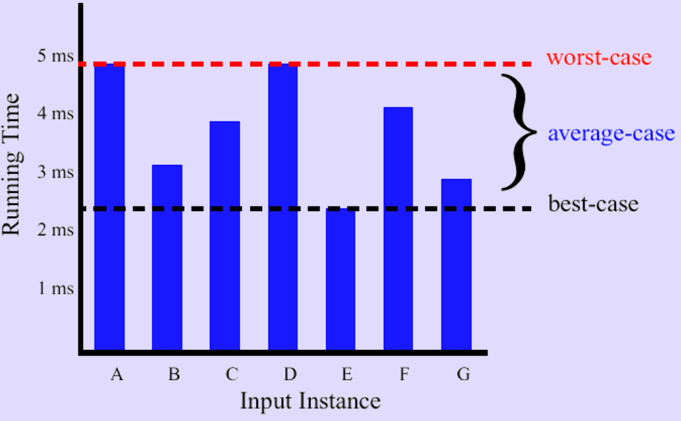
Best/Worst/Average Case
For a specific size of input n, investigate running times for different input instances:

Slide 22
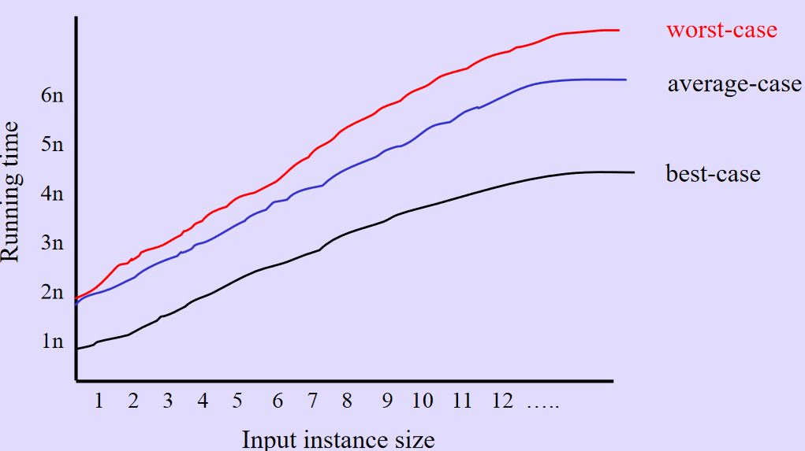
Best/Worst/Average Case
For inputs of all sizes:

Slide 23
Asymptotic Notations

Slide 24
Given two algorithms A1 and A2 for a problem, how do we decide
which one runs faster?
What we need is a platform independent way of comparing algorithms.
Solution: Count the worst-case number of basic operations b(n) for inputs of size n and then analyse how this function b(n) behaves as n grows. This is known as worst-case analysis.
Observations regarding worst-case analysis:
  Usually, the running time grows with the input size n.
  Consider two algorithm A1 and A2 for the same problem. A1 has a worst-case running time (100n + 1) and A2 has a worst-case running time (2n² + 3n + 1). Which one is better?
    A2 runs faster for small inputs (e.g., n = 1, 2)
    A1 runs faster for all large inputs (for all n ≥ 49)
  We would like to make a statement independent of the input size.
  Solution: Asymptotic analysis
    We consider the running time for large inputs.
    A1 is considered better than A2 since A1 will beat A2 eventually

Slide 25
continue..
Solution: Do an asymptotic worst-case analysis.
Observations regarding asymptotic worst-case analysis:
It is difficult to count the number of operations at an extremely fine level and keep track of these constants.
Asymptotic analysis means that we are interested only in the rate of growth of the running time function w.r.t. the input size. For example, note that the rates of growth of functions (n² + 5n + 1) and (n² + 2n + 5) is determined by the n² (quadratic) term. The lower order terms are insignificant. So, we may as well drop them.
The nature of growth rate of functions 2n² and 5n² are the same. Both are quadratic functions. It makes sense to drop these constants too when one is interested in the nature of the growth functions.
These constants typically depends upon system you are using, such as hardware, compiler etc.
We need a notation to capture the above ideas.

Slide 26
Introduction
The theoretical (priori) approach of analyzing an algorithm to measure the efficiency does not depend on the implementation of the algorithm.
In this approach, the running time of an algorithm is describes as Asymptotic Notations.
Computing the running time of algorithm’s operations in mathematical units of computation and defining the mathematical formula of its run-time performance is referred to as Asymptotic Analysis.
An algorithm may not have the same performance for different types of inputs. With the increase in the input size, the performance will change.
Asymptotic analysis accomplishes the study of change in performance of the algorithm with the change in the order of the input size.
Using Asymptotic analysis, we can very well define the best case, average case, and worst case scenario of an algorithm.

Slide 27
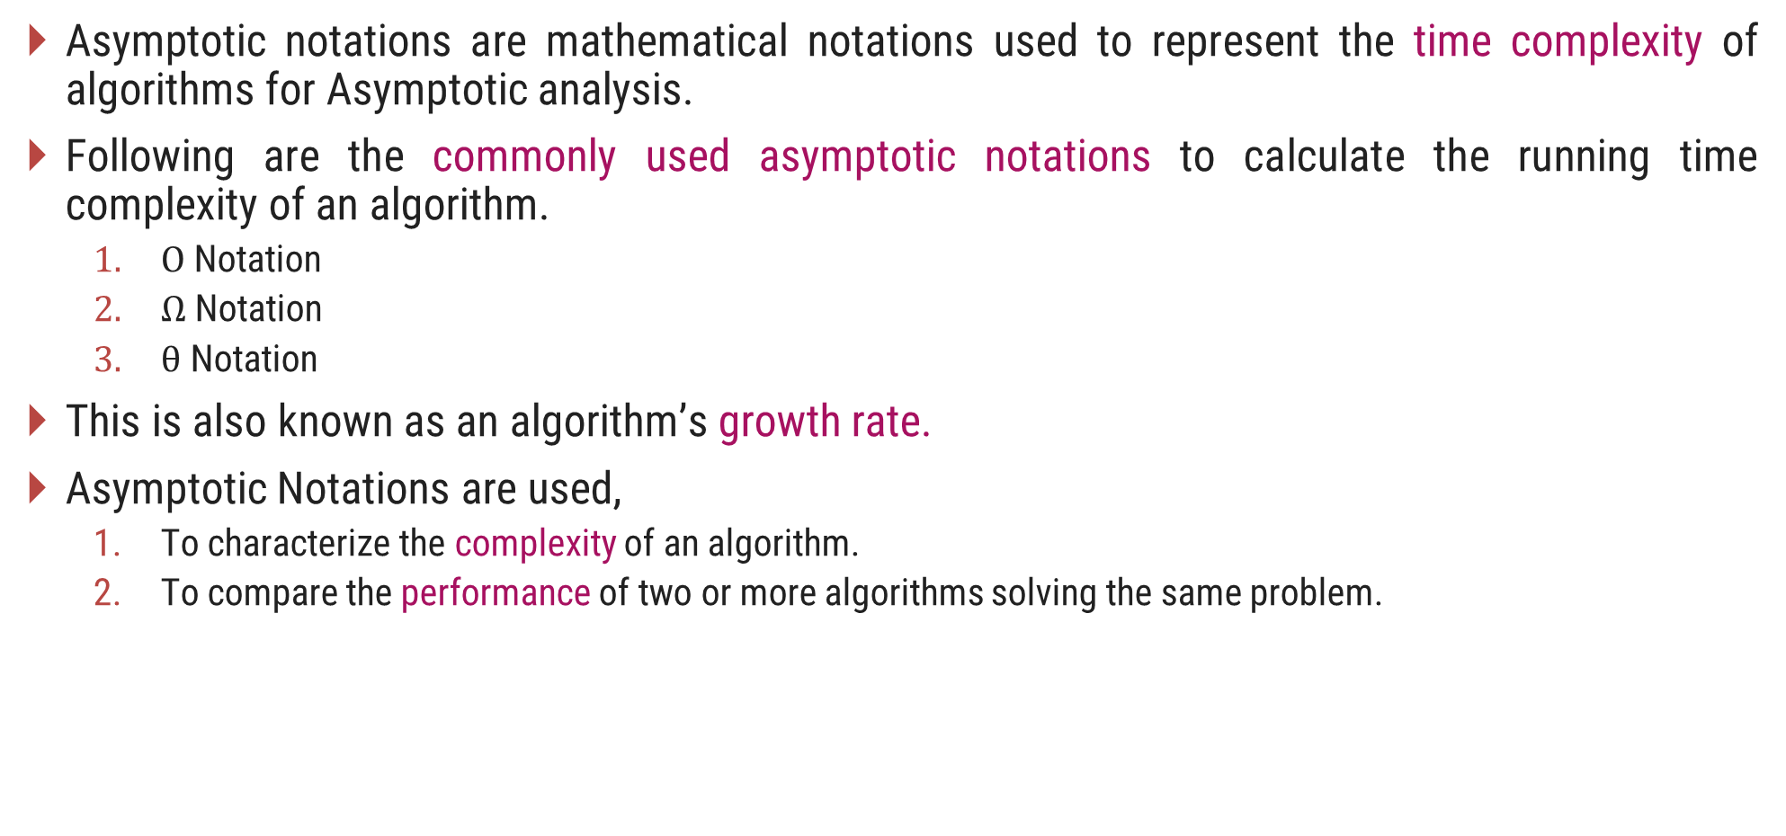
Asymptotic Notations
Asymptotic notations are mathematical notations used to represent the time complexity of algorithms for Asymptotic analysis.
Following are the commonly used asymptotic notations to calculate the running time complexity of an algorithm.
  $Ο$ Notation
  $Ω$ Notation
  $θ$ Notation
This is also known as an algorithm’s growth rate.
Asymptotic Notations are used,
  To characterize the complexity of an algorithm.
  To compare the performance of two or more algorithms solving the same problem.

Slide 28

$O$-Notation (Big $O$ notation) (Upper Bound)
The notation $Ο(n)$ is the formal way to express the upper bound of an algorithm's running time.
It measures the worst case time complexity or the longest amount of time an algorithm can possibly take to complete.
For a given function $g(n)$, we denote by $Ο(g(n))$the set of functions,
$Ο(g(n))$= {$f(n)$ : there exist positive constants $c$ and $n0$ such that $0≤f(n)≤cg(n)$for all $n0≤n$}

Slide 29
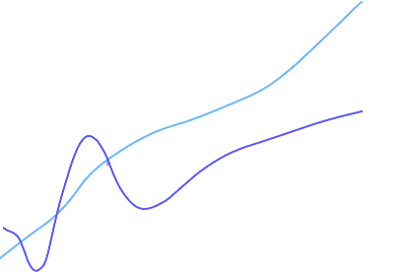

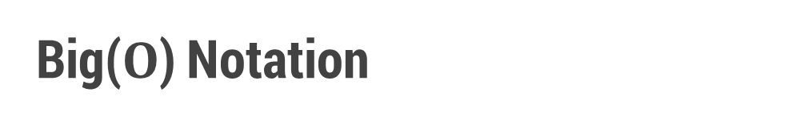

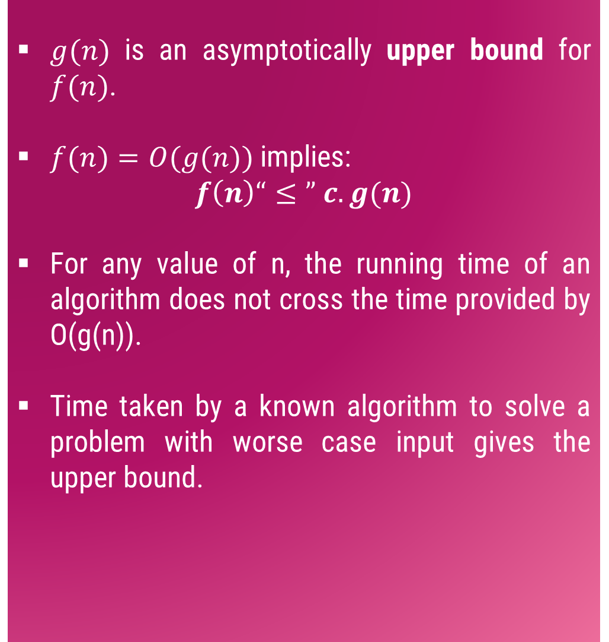



Big($O$) Notation
$g(n)$ is an asymptotically upper bound for $f(n)$.
$f(n)=O(g(n))$implies:
$$f\left(n\right)“≤” c.g(n)$$
For any value of n, the running time of an algorithm does not cross the time provided by O(g(n)).
Time taken by a known algorithm to solve a problem with worse case input gives the upper bound.
$$c.g(n)$$
$$f(n)$$
$$n$$
$$n_{0}$$
$$f(n)=O(g(n))$$

Slide 30
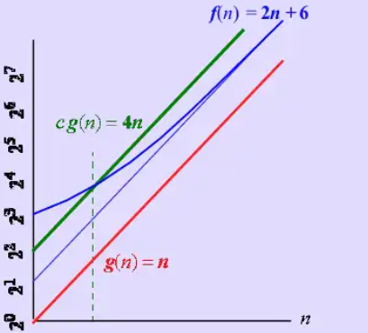
Example
For a function f(n) and g(n) there are positive constants c and n₀ such that :
f(n) ≤ c.g(n) for n ≥ n₀
Conclusion: 2n+6 is O(n)

Slide 31
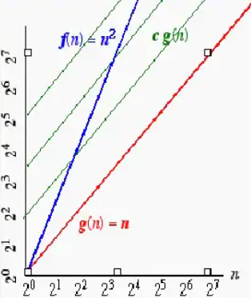
Example
On the other hand n² is not O(n) because
there is no c and n₀ such that:
n² ≤ cn for n ≥ n₀
The graph shows that no matter how large
a c is chosen there is an n big enough
that n² > cn.

Slide 32
Simple rule
Drop lower order term and constant factor
  50 n log n is O(n log n)
  7n -3 is O(n)
  8n² log n + 5n² + n is O(n² log n )
  Use O-notations to express number of primitive operations executed as function of input size.
  Comparing asymptotic running time:
    an algorithm that runs O(n) times is better than one that runs in O(n²) times
    similarly, O(logn) is better than O(n)
    Hierarchy of function: log n < n < n² < n³ < 2^{n}

Slide 33
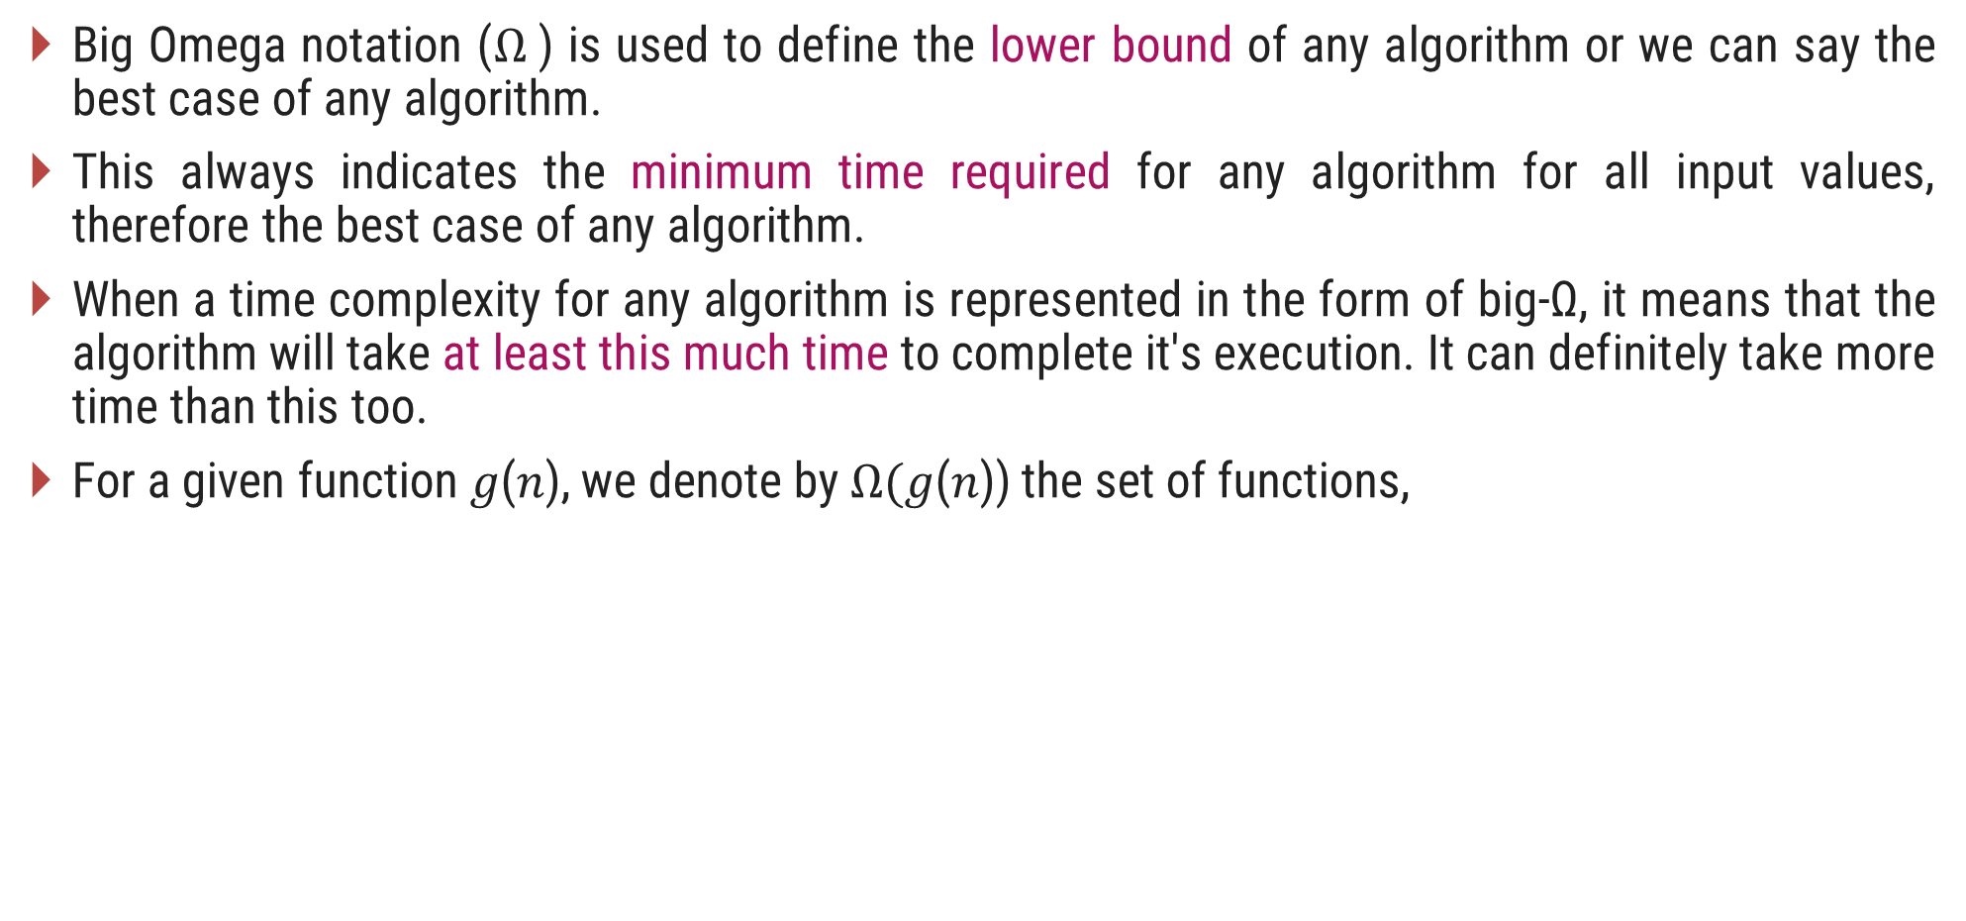
$Ω$-Notation (Omega notation) (Lower Bound)
Big Omega notation ($Ω$) is used to define the lower bound of any algorithm or we can say the best case of any algorithm.
This always indicates the minimum time required for any algorithm for all input values, therefore the best case of any algorithm.
When a time complexity for any algorithm is represented in the form of big-Ω, it means that the algorithm will take at least this much time to complete it's execution. It can definitely take more time than this too.
For a given function 𝑔(𝑛), we denote by $Ω($𝑔(𝑛)) the set of functions,
$Ω(g(n))=\{f(n):$there exist positive constants $c$ and $n_{0}$ such that $0≤cg\left(n\right)≤f\left(n\right)$for all $n_{0}≤n\}$

Slide 34
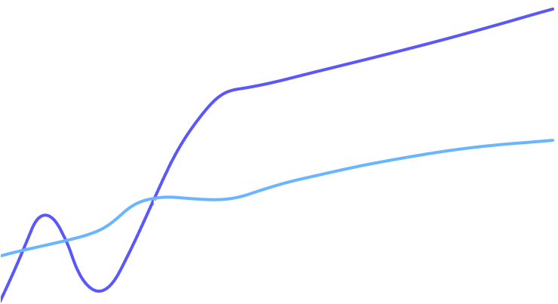

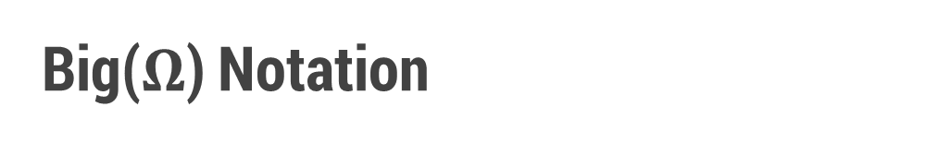
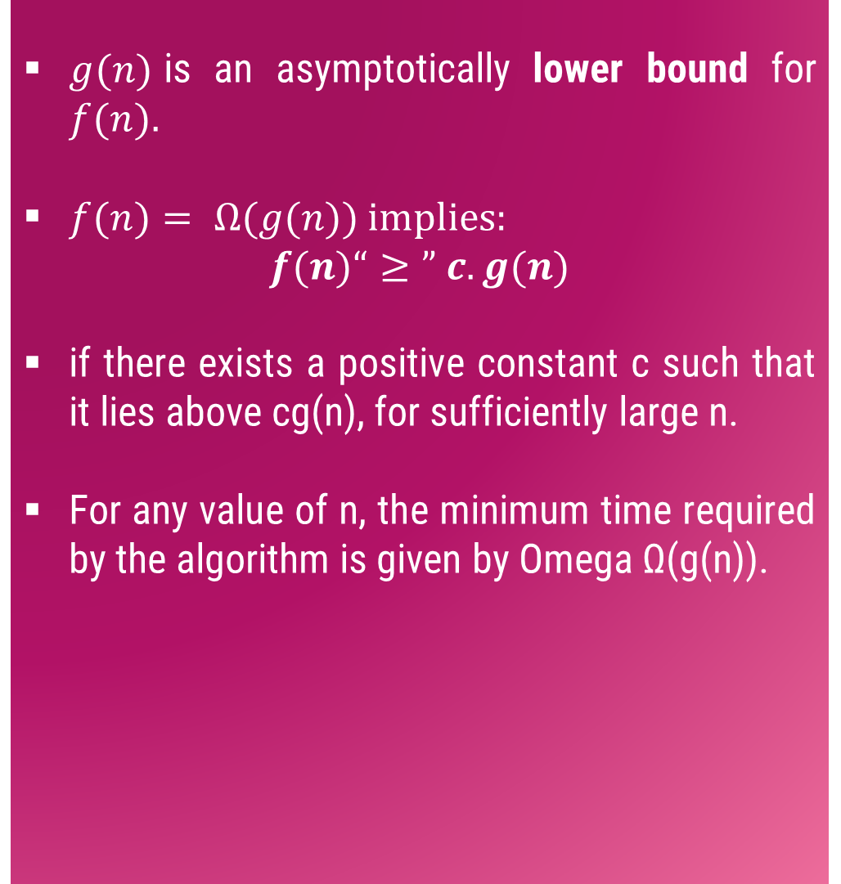


Big($Ω$) Notation
$g(n)$is an asymptotically lower bound for $f(n).$
$f(n)= Ω(g(n))$implies:
$$f(n)“≥” c.g(n)$$
if there exists a positive constant c such that it lies above cg(n), for sufficiently large n.
For any value of n, the minimum time required by the algorithm is given by Omega Ω(g(n)).
$$f(n)$$
$$c.g(n)$$
$$n$$
$$n_{0}$$
$$f(n)=Ω(g(n))$$

Slide 35
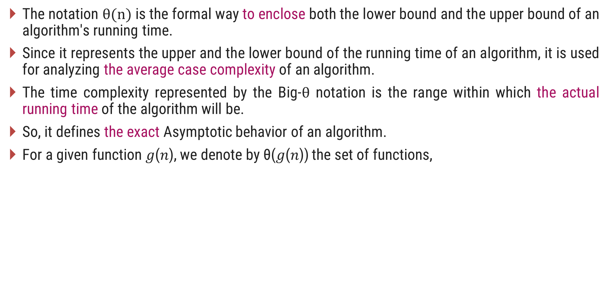
$θ$-Notation (Theta notation) (Same order)
The notation $θ(n)$is the formal way to enclose both the lower bound and the upper bound of an algorithm's running time.
Since it represents the upper and the lower bound of the running time of an algorithm, it is used for analyzing the average case complexity of an algorithm.
The time complexity represented by the Big-$θ$ notation is the range within which the actual running time of the algorithm will be.
So, it defines the exact Asymptotic behavior of an algorithm.
For a given function 𝑔(𝑛), we denote by θ(𝑔(𝑛)) the set of functions,
$θ(g(n))\text{ = \{}f(n)\text{ : }$there exist positive constants $c_{1}\text{, }c_{2} \text{and} n0 \text{such} \text{that} 0≤c_{1}g\left(n\right)≤f\left(n\right)≤c_{2}g\left(n\right) \text{for} \text{all} n0≤n\text{\}}$

Slide 36
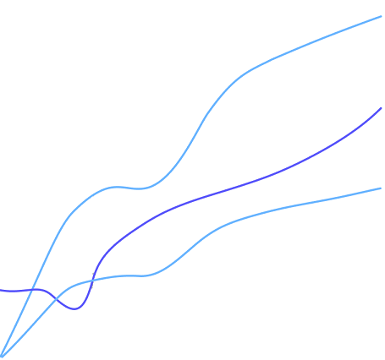

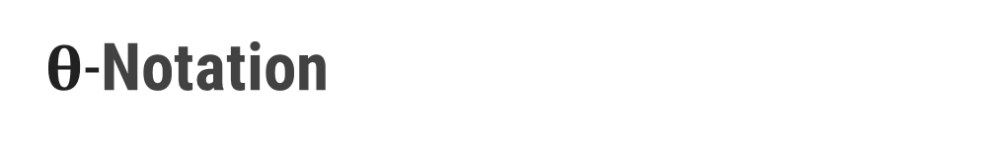
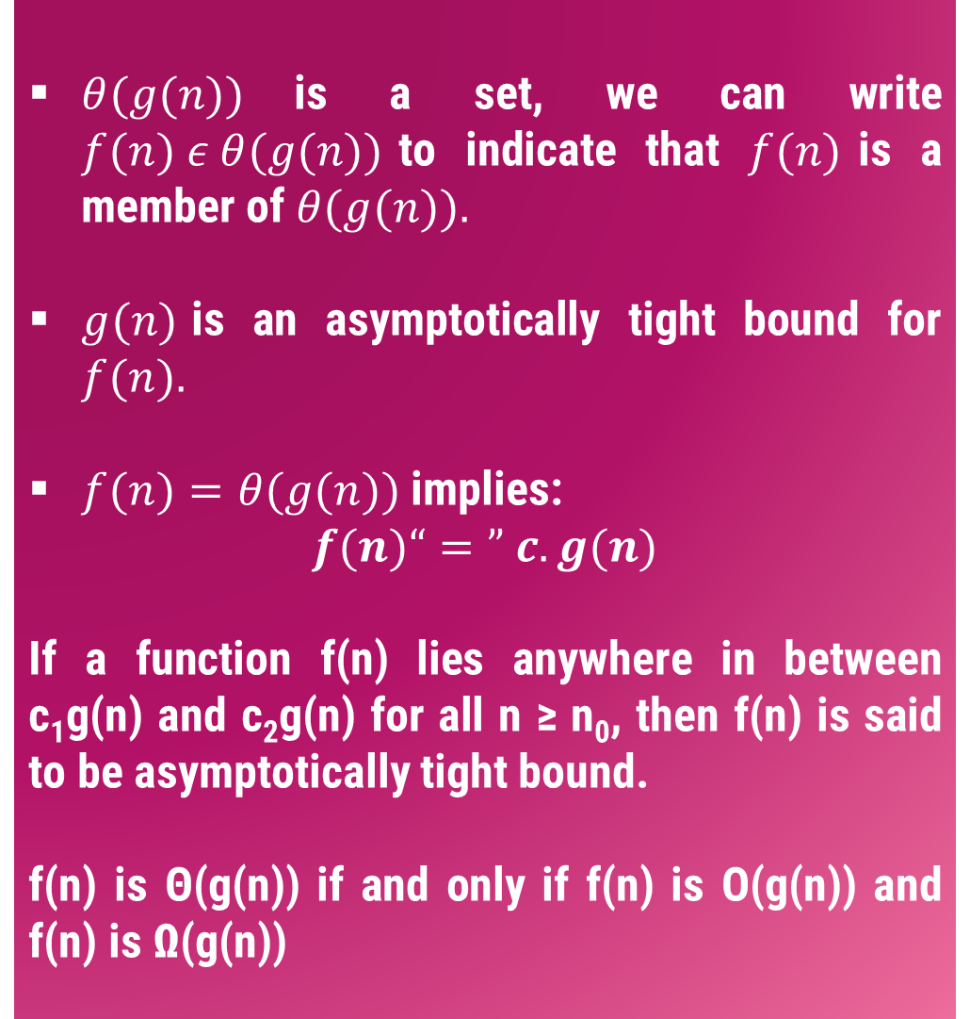





$θ$-Notation
$θ(g(n))$is a set, we can write $f(n) ε θ(g(n))$to indicate that $f(n)$is a member of $θ(g(n)).$
$g(n)$is an asymptotically tight bound for $f(n).$
$f(n)=θ(g(n))$implies:
$$f(n)“=” c.g(n)$$
If a function f(n) lies anywhere in between c₁g(n) and c₂g(n) for all n ≥ n₀, then f(n) is said to be asymptotically tight bound.
f(n) is Θ(g(n)) if and only if f(n) is Ο(g(n)) and f(n) is Ω(g(n))
$$c_{2}.g(n)$$
$$f(n)$$
$$c_{1}.g(n)$$
$$n$$
$$n_{0}$$
$$f(n)=θ(g(n))$$

Slide 37
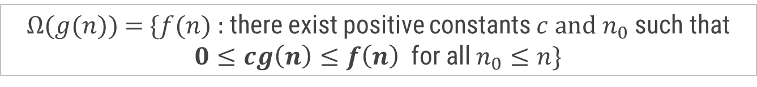

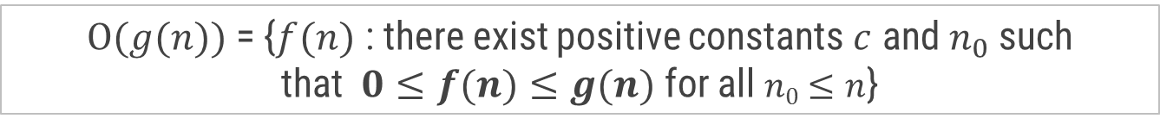


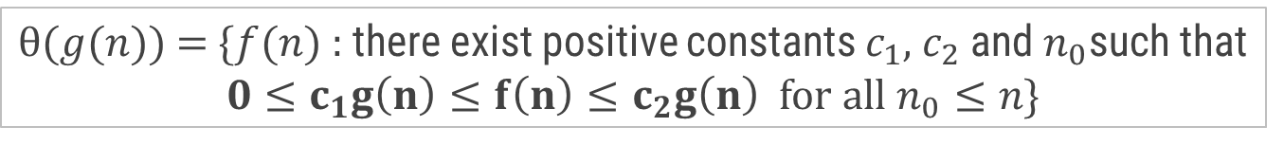
Asymptotic Notations
O-Notation (Big O notation) (Upper Bound)
Ω-Notation (Omega notation) (Lower Bound)
θ-Notation (Theta notation) (Same order)
$Ο(g(n))$= {$f(n)$ : there exist positive constants $c$ and${ n}_{0}$ such that$0≤f(n)≤g(n)$for all$n0≤n$}
$$f(n)=O(g(n))$$
$\text{Ω}(g(n))$= {$f(n)$ : there exist positive constants $c$ and $n_{0}$ such that $0≤cg\left(n\right)≤f\left(n\right)$ for all $n_{0}≤n$}
$$f\left(n\right)=\text{Ω}(g(n))$$
$θ(g(n))$ = {$f(n)$ : there exist positive constants $c_{1}$, $c_{2}$ and${ n}_{0}$such that $0≤c_{1}g\left(n\right)≤f\left(n\right)≤c_{2}g\left(n\right)$ for all $n_{0}≤n$}
$$f(n)=θ(g(n))$$

Slide 38

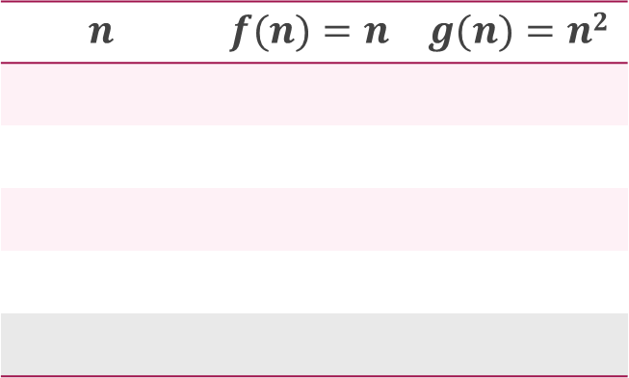


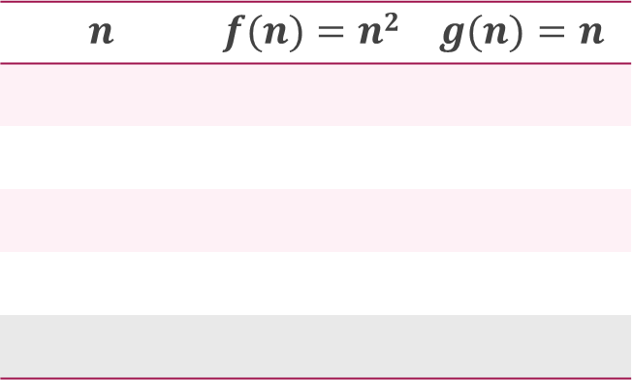

Asymptotic Notations – Examples
Example 1:
  $f(n)=n^{2}$ and $g\left(n\right)=n$
Example 2:
  $f\left(n\right)=n$ and $g\left(n\right)=n^{2}$
Algo. 1 running time
Algo. 2 running time
Algo. 1 running time
Algo. 2 running time
$$f\left(n\right)≥g\left(n\right)⟹f\left(n\right)=\text{Ω}(g(n))$$
$$f\left(n\right)≤g\left(n\right)⟹f\left(n\right)=\text{O}(g(n))$$
$$n$$ | $$f(n)=n2$$ | $$g(n)=n$$
$$n$$ | $$f(n)=n$$ | $$g(n)=n2$$
1
1
1
1
1
1
2
4
2
2
2
4
3
9
3
3
3
9
4
16
4
4
4
16
5
25
5
5
5
25

Slide 39



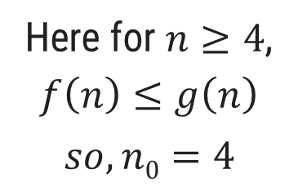
Asymptotic Notations – Examples
Example 3: $f\left(n\right)=n^{2}$ and $g\left(n\right)= 2^{n}$
$$f\left(n\right)≤g\left(n\right)⟹f\left(n\right)=\text{O}(g(n))$$
$$n$$ | $$f(n)=n2$$ | $$g(n)=2n$$
1 |  |  | $$f(n) < g(n)$$
2 |  |  | $$f(n) = g(n)$$
3 |  |  | $$f(n) > g(n)$$
4 |  |  | $$f(n) = g(n)$$
5 |  |  | $$f(n) < g(n)$$
6 |  |  | $$f(n) < g(n)$$
7 |  |  | $$f(n) < g(n)$$
1
2
4
4
9
8
16
16
Here for $n≥4$, $f\left(n\right)≤g\left(n\right)$
$$so, n0=4$$
25
32
36
64
49
128

Slide 40

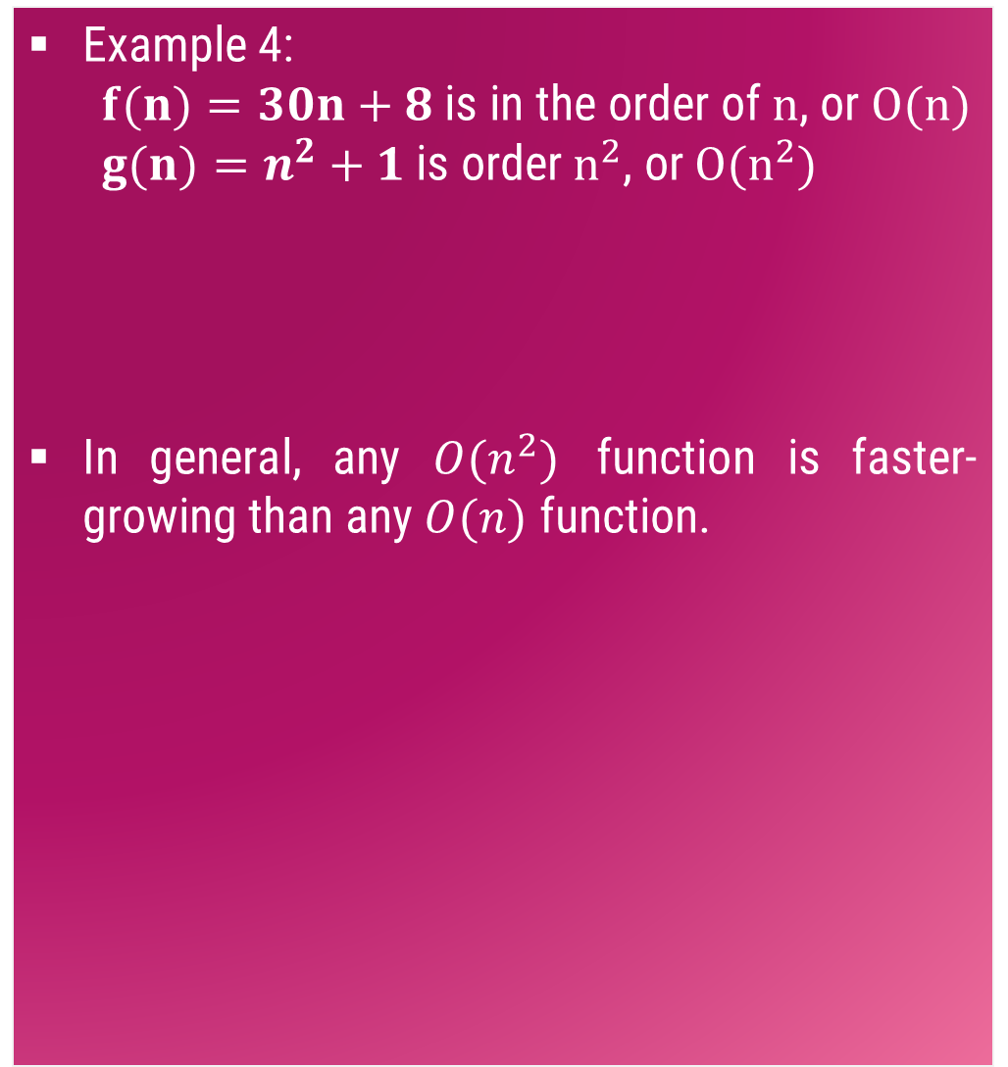

Asymptotic Notations – Examples
Example 4:
  $f(n)=30n+8$is in the order of $n$, or $O(n)$
  $g(n)=n^{2}+1$is order $n^{2}$, or $O(n^{2})$
In general, any $O(n^{2})$ function is faster-growing than any $O(n)$ function.
    $$f(n) = O(g(n))$$
g (n)=n²+1
f(n)=30n+8
Value of function →
Base value $n_{0}$
Increasing n →

Slide 41
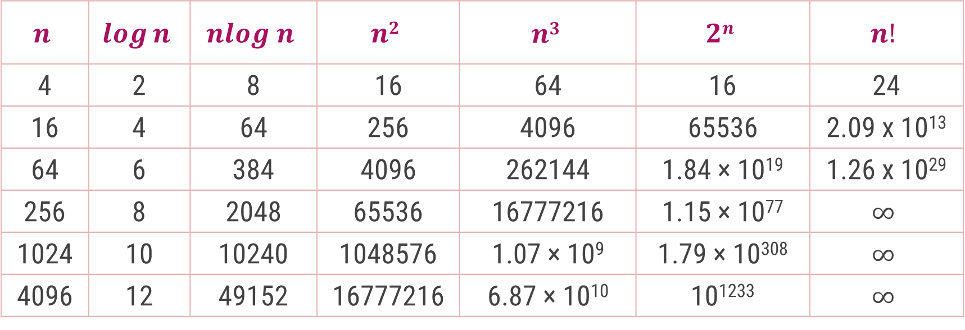
Common Orders of Magnitude
$$n$$ | $$\log{n}$$ | $$nlog n$$ | $$n2$$ | $$n3$$ | $$2n$$ | $$n!$$
4 | 2 | 8 | 16 | 64 | 16 | 24
16 | 4 | 64 | 256 | 4096 | 65536 | 2.09 x 10¹³
64 | 6 | 384 | 4096 | 262144 | 1.84 × 10¹⁹ | 1.26 x 10²⁹
256 | 8 | 2048 | 65536 | 16777216 | 1.15 × 10⁷⁷ | $$∞$$
1024 | 10 | 10240 | 1048576 | 1.07 × 10⁹ | 1.79 × 10³⁰⁸ | $$∞$$
4096 | 12 | 49152 | 16777216 | 6.87 × 10¹⁰ | 10¹²³³ | $$∞$$

Slide 42
Comparison
O(c) < O(log logn) < O(logn) < O(n^{1/2}) < O(n) < O(nlogn) < O(n²) < O(n³) < O(n^{k}) < O(2^{n}) < O(n^{n}) < O(2^{2^n})

Slide 43

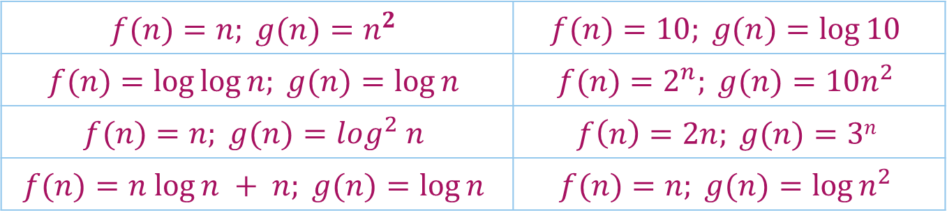
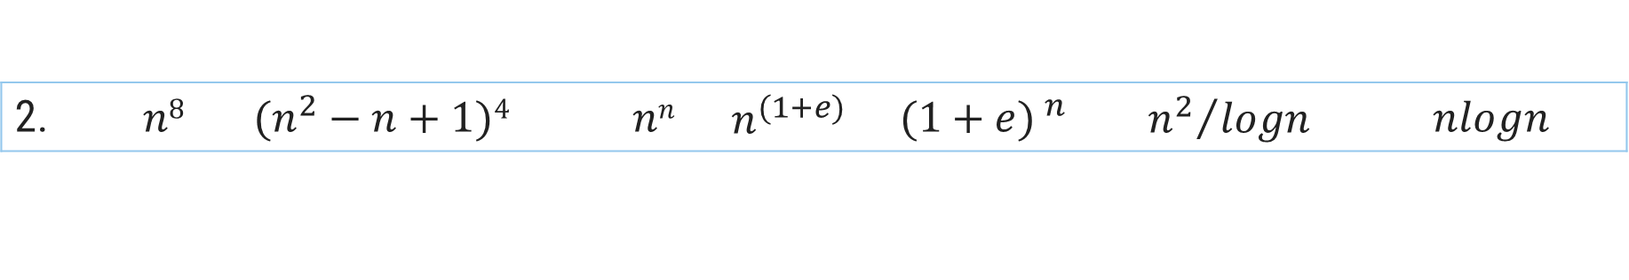
Growth of Function
Arrange the given notations in the increasing order of their values.
For each of the following pairs of functions, either $f(n)$ is $O(g(n))$, $f(n)$ is $Ω(g(n))$, or $f(n) =θ(g(n))$. Determine which relationship is correct.
1. | $$n$$ | $$nlogn$$ | $$2n$$ | $$logn$$ | $$\sqrt{n}$$ | $$en$$ | $$n2+logn$$ | $$n2$$ | $$loglogn$$ | $$n3$$ | $$(logn)2$$ | $$n!$$
2. | $$n8$$ | $$(n^{2}−n+1)4{}^{}$$ | $$nn$$ | $$n^{(1+e)}$$ | $${(1+e) }^{n}$$ | $${n^{2}}/{logn}$$ | $$nlogn$$
$$f(n)=n; g(n)=n^{2}$$ | $$f(n)=10; g(n)=log⁡10$$
$$f(n)=log⁡log⁡n; g(n)=log⁡n$$ | $$f(n)=2^{n}; g(n)=10n^{2}$$
$$f(n)=n; g(n)=\log^{2} n$$ | $$f\left(n\right)=2n; g(n)=3n$$
$$f(n)=n log⁡n + n; g(n)=log⁡n$$ | $$f(n)=n; g(n)=log⁡n^{2}$$

Slide 44
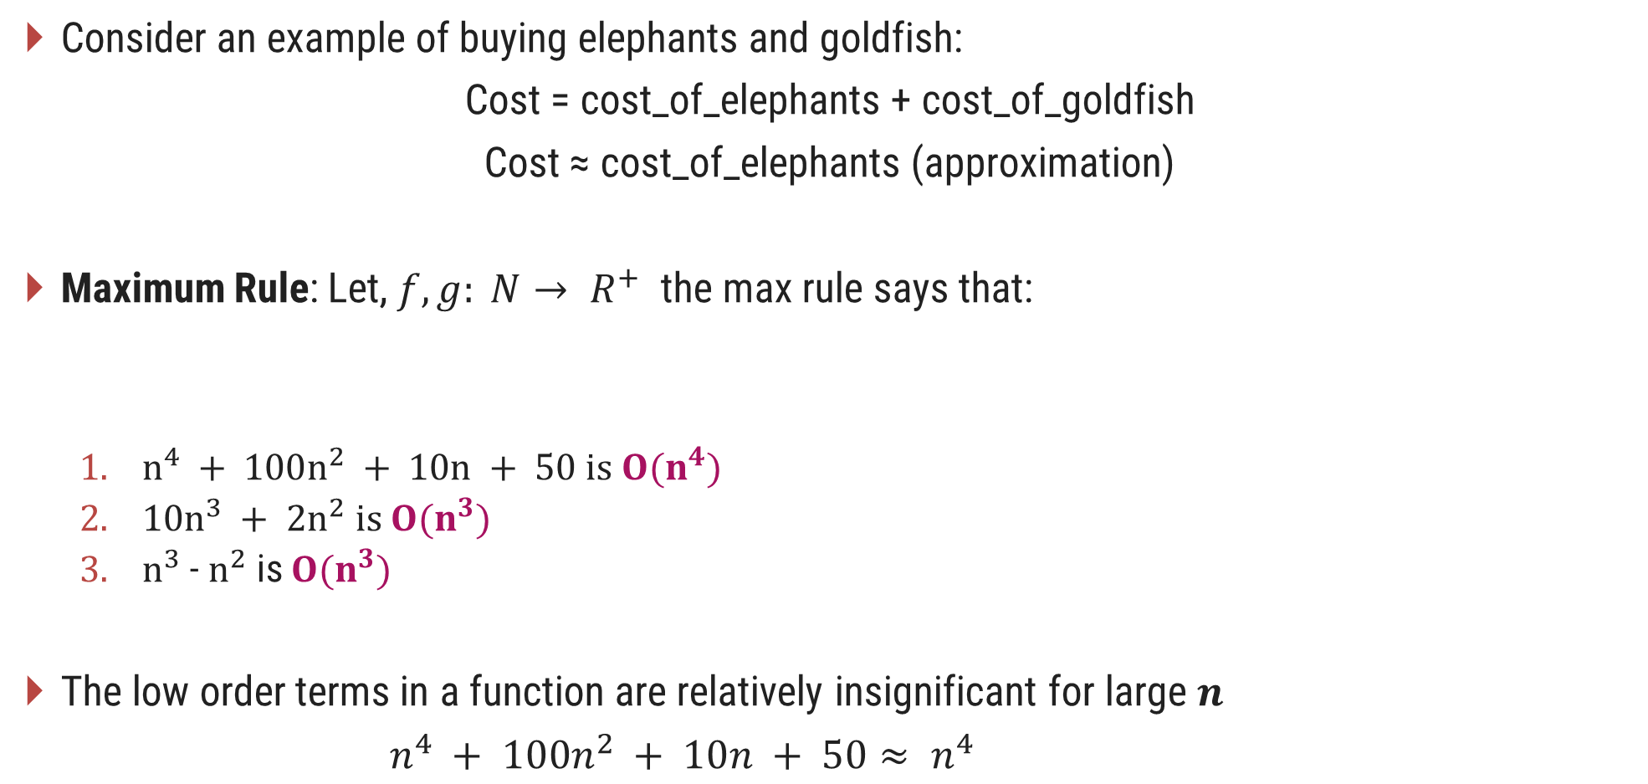
Asymptotic Notations in Equations
Consider an example of buying elephants and goldfish:
Cost = cost_of_elephants + cost_of_goldfish
Cost ≈ cost_of_elephants (approximation)
Maximum Rule: Let, $f, g: N→ R^{+}$ the max rule says that:
  $n^{4} + 100n^{2} + 10n + 50 is O(n^{4})$
  $10n^{3} + 2n^{2} is O(n^{3})$
  $n^{3}$ - $n^{2}$ is $O(n^{3})$
The low order terms in a function are relatively insignificant for large 𝒏
$n^{4} + 100n^{2} + 10n + 50≈ n^{4}$
Negligible
𝑂( 𝑓(𝑛)+𝑔(𝑛))=𝑂(max⁡(𝑓(𝑛),𝑔(𝑛)))

Slide 45
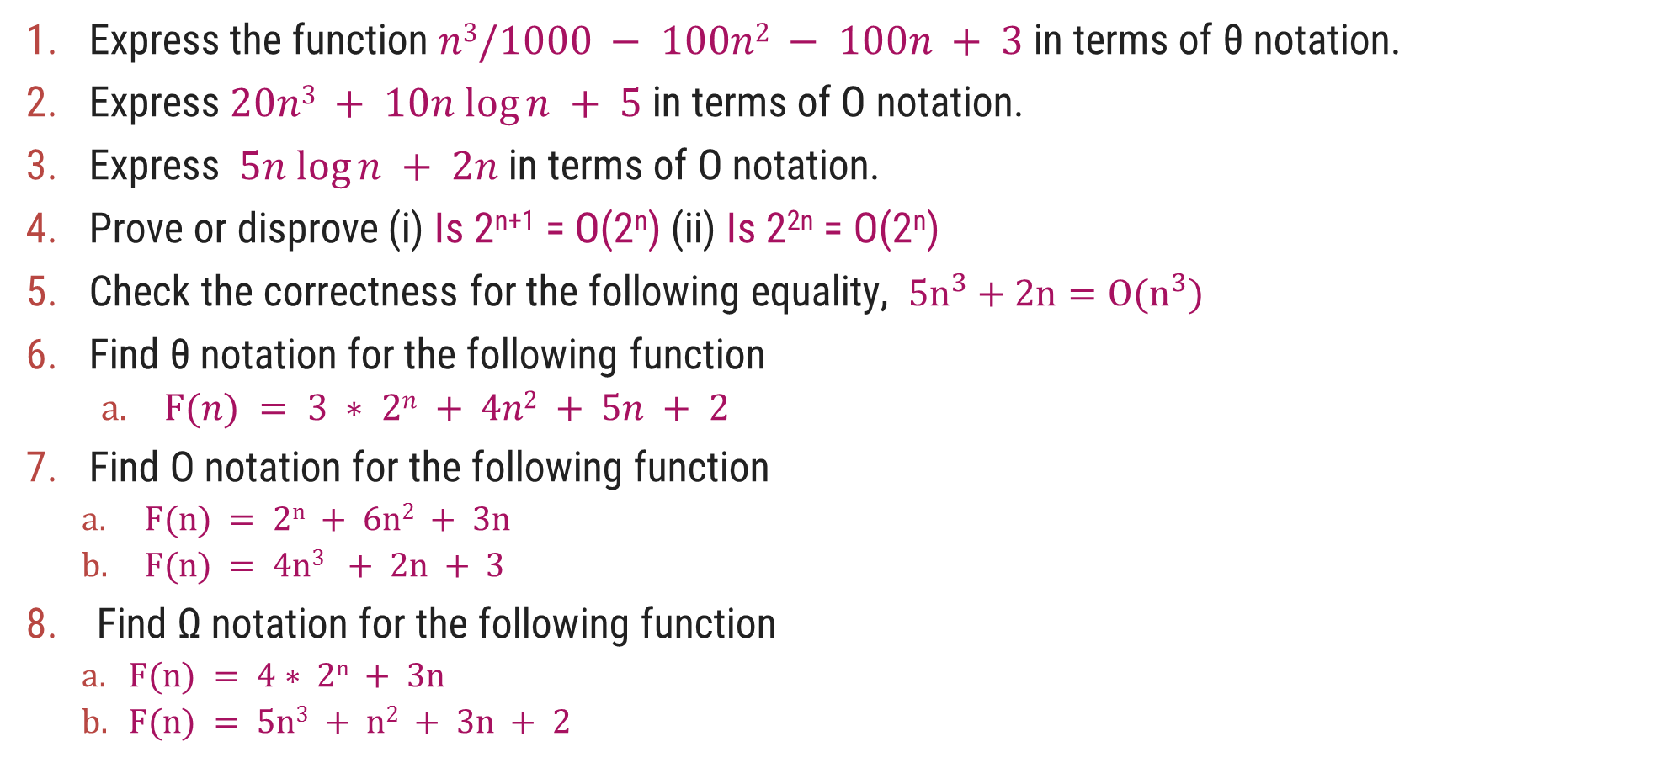
Exercises
Express the function $n3/1000 − 100n2 − 100n + 3$in terms of θ notation.
Express $20n3 + 10n log⁡n + 5$in terms of O notation.
Express $5n log⁡n + 2n$in terms of O notation.
Prove or disprove (i) Is 2^{n+1} = O(2^{n}) (ii) Is 2^{2n} = O(2^{n})
Check the correctness for the following equality, $5n^{3}+2n=O(n^{3})$
Find θ notation for the following function
  $F(n) = 3 ∗ 2n + 4n2 + 5n + 2$
Find O notation for the following function
  $F(n) = 2n + 6n2 + 3n$
  $F(n) = 4n3 + 2n + 3$
Find Ω notation for the following function
    $F(n) = 4∗ 2n + 3n$
    $F(n) = 5n3 + n2 + 3n + 2$

Slide 46
Methods of proving Asymptotic Notations
1) Proof by definition : In this method, we apply the formal definition of the asymptotic notation, and find out the values of constants c > 0 and n₀ > 0, such that the required notation is proved.
2) Proof by Limit Rules : In this method, we apply certain rules of limit, and then prove the required notation.

Slide 47
Proof by definition
Prove the following statements :
n² + n = O(n²)
  According to the formal definition, let f(n) = n² + n and g(n) = n²
  Find the values of constants c > 0 and n₀ > 0, such that 0 ≤ f(n) ≤ c g(n), for all n ≥ n₀ (condition for Big-O notation)2
n³ + 4n² = Ω(n²)
  According to the formal definition, let f(n) = n³ + 4n² and g(n) = n²
  Find the values of constants c > 0 and n₀ > 0, such that 0 ≤ c g(n) ≤ f(n), for all n ≥ n₀ (condition for Big-Ω notation)
n² + n = Θ(n²)
  According to the formal definition, let f(n) = n² + n and g(n) = n²
  Find the values of constants c1 > 0, c2 > 0, and n0 > 0, such that 0 ≤ c1 g(n) ≤ f(n) ≤ c2 g(n), for all n ≥ n₀ (condition for Θ notation)
≈ O(n³)
≈ Ω(n)

Slide 48
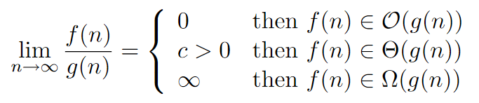
Proof by Limit Rules
If f(n) and g(n) are asymptotically increasing functions, then the following rules hold true:
Prove that : √n grows asymptotically faster than log n.
Proof: Let us consider f(n) = √n and g(n) = log n
We compute and then based on the result, the specific
“Limit Rule” proves the desired result.
f(n)=n³ and g(n)=2n³+n

Slide 49
Little-Oh and Little-Omega
f(n)=o(g(n)) => For every c, there should exist n₀ , s.t. f(n) ≤ c g(n) for n ≥ n₀
f(n)=ω(g(n)) => For every c, there should exist n₀ , s.t. f(n) ≥ c g(n) for n ≥ n₀
Analogy with real numbers
f(n) = O(g(n)) ≅ f ≤ g
f(n) = Ω(g(n)) ≅ f ≥ g
f(n) = Θ(g(n)) ≅ f = g
f(n) = o(g(n)) ≅ f < g
f(n) = ω(g(n)) ≅ f > g

Slide 50
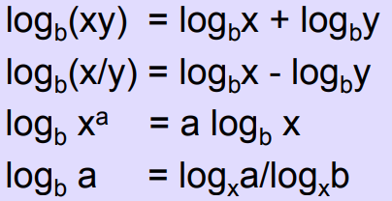



Math You Need to Review
Properties of logarithms:
Properties of exponentials:
Geometric progression:
Arithmetic progression:

Slide 51
Examples
Example: Find upper bound of running time of constant function f(n) = 6993.
To find the upper bound of f(n), we have to find c and n0 such that 0 ≤ f (n) ≤ c.g(n) for all n ≥ n₀
0 ≤ f (n) ≤ c × g (n)
0 ≤ 6993 ≤ c × g (n)
0 ≤ 6993 ≤ 6993 x 1
So, c = 6993 and g(n) = 1
Any value of c which is greater than 6993, satisfies the above inequalities, so all such values of c are possible.
0 ≤ 6993 ≤ 8000 x 1 → true
0 ≤ 6993 ≤ 10500 x 1 → true
Function f(n) is constant, so it does not depend on problem size n. So n0= 1
f(n) = O(g(n)) = O(1) for c = 6993, n₀ = 1
f(n) = O(g(n)) = O(1) for c = 8000, n₀ = 1 and so on.

Slide 52
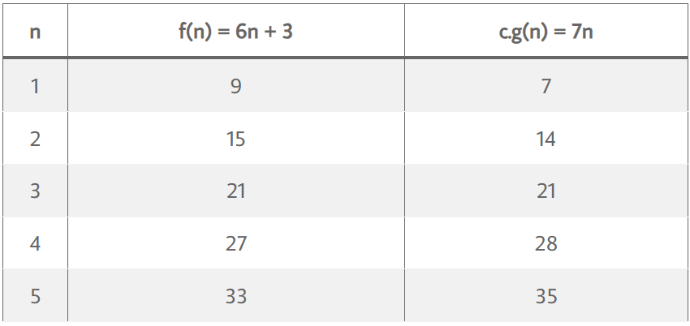
Find upper bound of running time of a linear function f(n) = 6n + 3.
To find upper bound of f(n), we have to find c and n0 such that 0 ≤ f (n) ≤ c × g (n) for all n ≥ n0
0 ≤ f (n) ≤ c × g (n)
0 ≤ 6n + 3 ≤ c × g (n)
0 ≤ 6n + 3 ≤ 6n + 3n, for all n ≥ 1 (There can be such infinite possibilities)
0 ≤ 6n + 3 ≤ 9n
So, c = 9 and g (n) = n, n₀ = 1
Tabular Approach
0 ≤ 6n + 3 ≤ c × g (n)
0 ≤ 6n + 3 ≤ 7 n
Now, manually find out the proper n₀, such that f (n) ≤ c.g (n)
From Table, for n ≥ 3, f (n) ≤ c × g (n) holds true. So, c = 7, g(n) = n and n₀ = 3, There can be such multiple pair of (c, n₀)
f(n) = O(g(n)) = O(n) for c = 9, n₀ = 1
f(n) = O(g(n)) = O(n) for c = 7, n₀ = 3

Slide 53
Example: Find lower bound of running time of quadratic function f(n) = 3n² + 2n + 4.
To find lower bound of f(n), we have to find c and n0 such that 0 ≤ c.g(n) ≤ f(n) for all n ³ n0
0 ≤ c × g(n) ≤ f(n)
0 ≤ c × g(n) ≤ 3n² + 2n + 4
0 ≤ 3n² ≤ 3n² + 2n + 4, → true, for all n ≥ 1
0 ≤ n² ≤ 3n² + 2n + 4, → true, for all n ≥ 1
Above both inequalities are true and there exists such infinite inequalities.
So, f(n) = Ω (g(n)) = Ω (n2) for c = 3, n0 = 1
f(n) = Ω (g(n)) = Ω (n2) for c = 1, n0 = 1

Slide 54
Find tight bound of running time of a cubic function f(n) = 2n³ + 4n + 5.
To find tight bound of f(n), we have to find c₁, c₂ and n₀ such that, 0 ≤ c₁ × g(n) ≤ f(n) ≤ c₂ × g(n) for all n ≥ n₀
0 ≤ c₁ × g(n) ≤ 2n³ + 4n + 5 ≤ c₂ × g(n)
0 ≤ 2n³ ≤ 2n³ + 4n + 5 ≤ 11n³, for all n ≥ 1
Above inequality is true and there exists such infinite inequalities. So,
f(n) = Θ(g(n)) = Θ(n³) for c₁ = 2, c₂ = 11, n₀ = 1

Slide 55
General Problems
Example: Show that : (i) 3n + 2 = Θ(n) (ii) 6*2^{n} + n² = Θ(2^{n})
(i) 3n + 2 = Θ(n)
  To prove above statement, we have to find c₁, c₂ and n₀ such that, 0 ≤ c₁× g(n) ≤ f(n) ≤ c₂ g(n) for all n ≥ n₀
  0 ≤ c₁× g(n) ≤ 3n + 2 ≤ c₂ × g(n)
  0 ≤ 2n ≤ 3n + 2 ≤ 5n, for all n ≥ 1
  So, f(n) = Θ(g(n)) = Θ(n) for c₁ = 2, c₂ = 5 n₀ = 1
(ii) 6*2^{n} + n² = Θ(2^{n})
  To prove above statement, we have to find c₁, c₂ and n₀ such that, 0 ≤ c₁× g(n) ≤ f(n) ≤ c₂ g(n) for all n ≥ n₀
  0 ≤ c₁× g(n) ≤ 6*2^{n} + n² ≤ c₂ × g(n)
  0 ≤ 6.2^{n} ≤ 6*2^{n} + n² ≤ 7*2^{n}, for all n ≥ 1
  So, f(n) = Θ(g(n)) = Θ(2^{n}) for c₁ = 6, c₂ = 7 n₀ = 1

Slide 56
Thank You!

