Slide 1
Analyzing Control Statements

Slide 2
For Loop
# Input : int A[n], array of n integers
# Output : Sum of all numbers in array A
Algorithm: int Sum(int A[], int n)
{
  int s=0;
  for (int i=0; i<n; i++)
      s = s + A[i];
  return s;
}
n+1
1
n
Total time taken = n+1+n+2 = 2n+3
Time Complexity f(n) = 2n+3

Slide 3









Running Time of Algorithm
The time complexity of the algorithm is : $f\left(n\right)= 2 ∙n +3$
Estimated running time for different values of 𝑛 :
As 𝑛 grows, the number of steps grow in linear proportion to 𝑛 for the given algorithm Sum.
The dominating term in the function of time complexity is $n$: As $n$ gets large, the $+3$ becomes insignificant.
The time is linear in proportion to $n$.
$$n=10$$
$23$ steps
$$n=100$$
$203$ steps
$$n=1000$$
$2,003$ steps
$$n=10000$$
$20,003$ steps

Slide 4
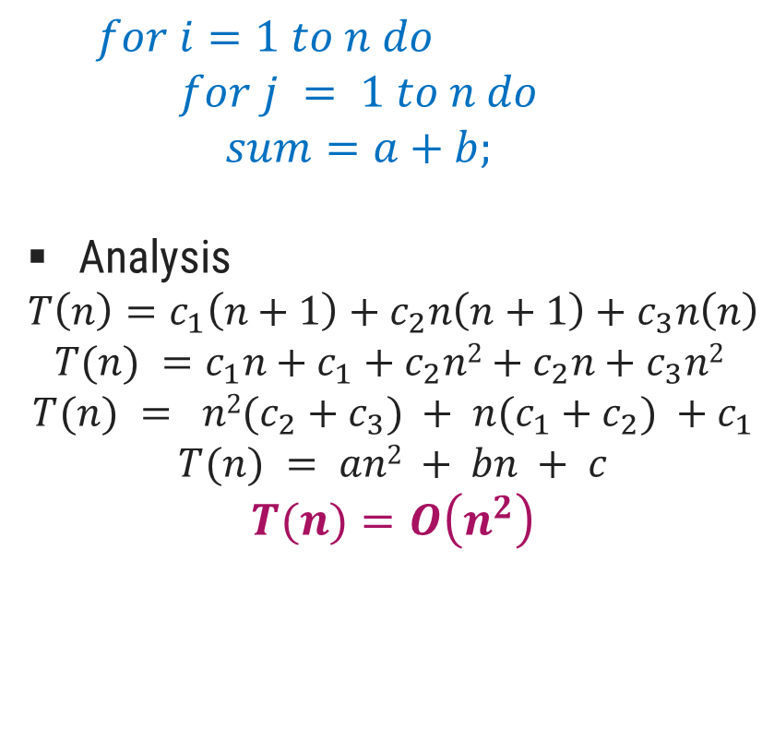

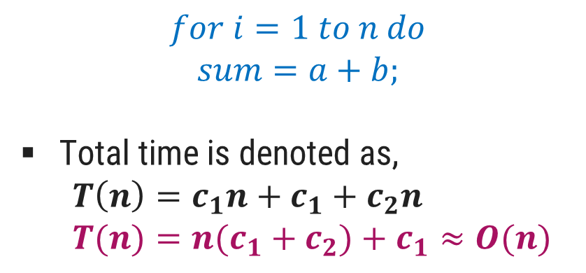

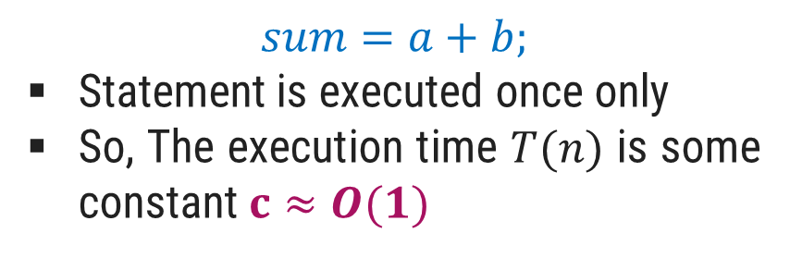






Analyzing Control Statements
Example 1:
Example 3:
$$sum=a+b;$$
Statement is executed once only
So, The execution time $T(n)$ is some constant $c≈O(1)$
$$c_{1} \left(n+1\right)$$
$$c$$
  $$for i=1 to n do$$
  $$for j = 1 to n do$$
  $$sum=a+b;$$
Analysis
  $$T\left(n\right)=c_{1}\left(n+1\right)+c_{2}n\left(n+1\right)+c_{3}n\left(n\right)$$
  $$T(n) =c_{1}n+c_{1}+c_{2}n2+c_{2}n+c_{3}n2$$
  $$T(n) = n2(c_{2}+c_{3}) + n(c_{1}+c_{2}) +c_{1}$$
  $$T(n) = an2 + bn + c$$
  $$T(n)=O\left(n^{2}\right)$$
$$c_{2} n \left(n+1\right)$$
$$c_{3}∗n∗n$$
Example 2:
$$c_{1}$$
$$for i=1 to n do$$
$$sum=a+b;$$
Total time is denoted as,
  $$T\left(n\right)=c_{1}n+c_{1}+c_{2}n$$
  $$T(n)=n(c_{1}+c_{2})+c_{1}≈O(n)$$
$$∗\left(n+1\right)$$
$$c_{2}$$
$$∗\left(n\right)$$

Slide 5

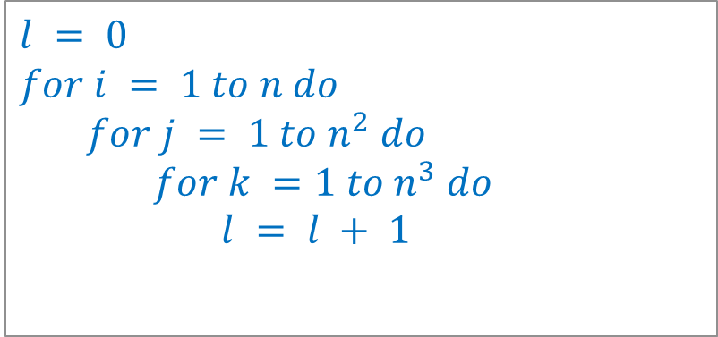

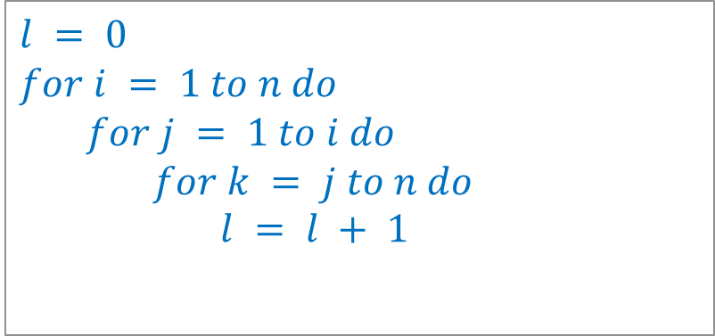

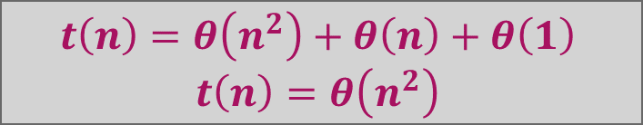



Analyzing Control Statements
Example 4:
Example 6:
$$l = 0$$
$$for i = 1 to n do$$
  $$for j = 1 to i do$$
      $$for k = j to n do$$
        $$l = l + 1$$
$$for j = 1 to n do$$
  $$for k = 1 to j do$$
    $$sum = sum + j∗k$$
$$for l =1 to n do$$
      $$sum=sum− l + 1$$
  printf(“sum is now %d”,$sum$)
$$θ\left(n^{2}\right)$$
$$θ\left(n\right)$$
$$t\left(n\right)=θ\left(n^{3}\right)$$
$$θ\left(1\right)$$
Example 5:
$$l = 0$$
$$for i = 1 to n do$$
  $$for j = 1 to n^{2} do$$
      $$for k =1 to n^{3} do$$
        $$l = l + 1$$
$$t\left(n\right)=θ\left(n^{2}\right)+θ\left(n\right)+θ\left(1\right)$$
$$t\left(n\right)=θ\left(n^{2}\right)$$
$$t\left(n\right)=θ\left(n^{6}\right)$$

Slide 6
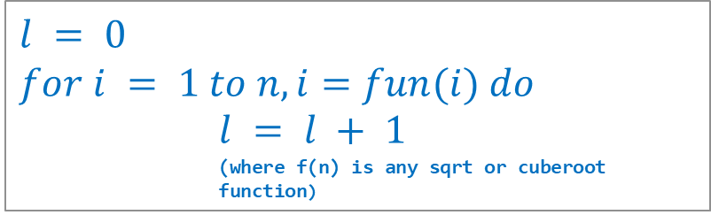
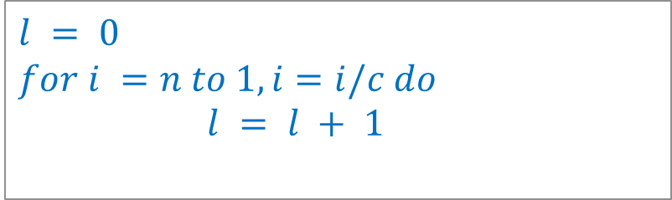

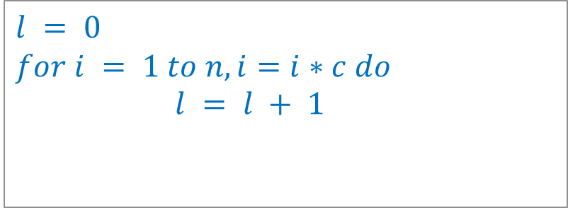
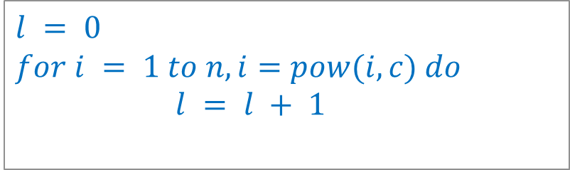



Analyzing Control Statements
Example 7:
Example 9:
$$l = 0$$
$$for i = 1 to n, i=i∗c do$$
        $$l = l + 1$$
$$l = 0$$
$$for i = 1 to n, i=pow(i,c) do$$
        $$l = l + 1$$
$$t\left(n\right)=θ(logn)$$
$$t\left(n\right)=θ\left(loglogn\right)$$
Example 8:
Example 10:
$$l = 0$$
$$for i =n to 1, i=i/c do$$
        $$l = l + 1$$
$$l = 0$$
$$for i = 1 to n, i=fun(i) do$$
        $$l = l + 1$$
        (where f(n) is any sqrt or cuberoot function)
$$t\left(n\right)=θ\left(logn\right)$$
$$t\left(n\right)=θ\left(loglogn\right)$$

Slide 7
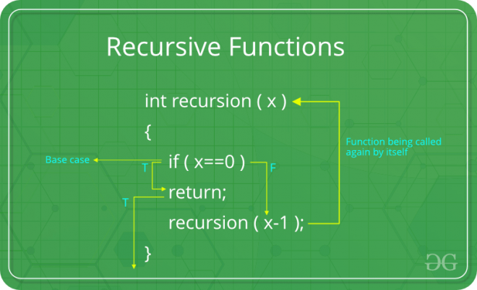
Recursion

Slide 8
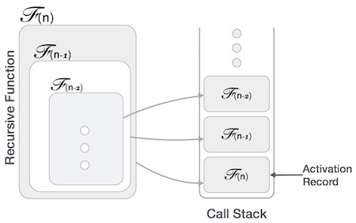
Example:
int fun(int x)
{
if(x < 1)
return;
fun(x - 1);
printf("%d ",x);
}

Slide 9
Example:
int fun(int n)
{
if (n < = 1) // base case
return 1;
else
return n + fun(n-1);
}
int fun(int n)
{
// wrong base case (it may cause stack overflow).
if (n == 100)
return 1;
else
return n + fun(n-1);
}

Slide 10
Algorithm to find factorial using recursion
Factorial of n
Factorial of any number n is denoted as n! and is equal to
n! = 1 x 2 x 3 x ... x (n – 2) x (n – 1) x n
Factorial of 3:
3! = 1 x 2 x 3
= 6
int factorial(int n)
{
int fact = 1, i;
for (i = 2; i <= n; i++)
fact = fact * i;
return fact;
}

Slide 11
Algorithm: FACTORIAL
Step 1: Start
Step 2: Read number n
Step 3: Call factorial(n)
Step 4: Print factorial f
Step 5: Stop
factorial(n)
Step 1: If n==1 then return 1
Step 2: Else
f=n*factorial(n-1)
Step 3: return f

Slide 12
FACTORIAL
int fun(int n)
{
if (n < = 1) // base case
return 1;
else
return n * fun(n-1);
}

Slide 13
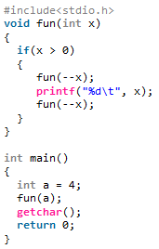
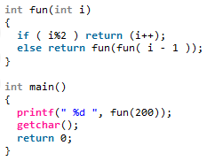
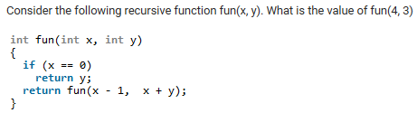
Examples:
Output: 199
Output: 0 1 2 0 3 0 1
Output: 13

Slide 14
Sorting Algorithms
Bubble Sort, Selection Sort, Insertion Sort

Slide 15
Introduction
Sorting is any process of arranging items systematically or arranging items in a sequence ordered by some criterion.
Applications of Sorting
  Phone Bill: the calls made are date wise sorted.
  Bank statement or Credit card Bill: transactions made are date wise sorted.
  Filling forms online: “select country” drop down box will have the name of countries sorted in Alphabetical order.
  Online shopping: the items can be sorted price wise, date wise or relevance wise.
  Files or folders on your desktop are sorted date wise.

Slide 16
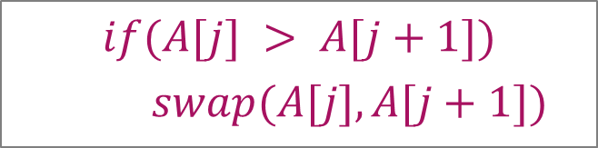
Bubble Sort – Example
Sort the following array in Ascending order
45 | 34 | 56 | 23 | 12
Pass 1 :
45
34
swap
34
34
34
34
45
45
45
45
56
56
56
23
swap
23
23
23
23
56
56
12
swap
12
12
12
12
56
$$if(A[j] > A[j+1])$$
    $$swap(A[j],A[j+1])$$

Slide 17
Bubble Sort – Example
Pass 2 :
Pass 3 :
Pass 4 :
34
34
34
34
23
23
23
swap
12
swap
34
45
45
12
23
23
23
34
12
swap
swap
23
12
23
23
34
45
45
12
swap
12
34
12
12
12
45
45
45
45
56
56
56
56
56
56
$$if(A[j] > A[j+1])$$
    $$swap(A[j],A[j+1])$$

Slide 18


Bubble Sort - Algorithm
# Input: Array A
# Output: Sorted array A
Algorithm: Bubble_Sort(A)
for i ← 1 to n-1 do
for j ← 1 to n-i do
if A[j] > A[j+1] then
swap(A[j], A[j+1])
$$θ\left(n\right)$$
temp ← A[j]
A[j] ← A[j+1]
A[j+1] ← temp
$$θ\left(n^{2}\right)$$

Slide 19
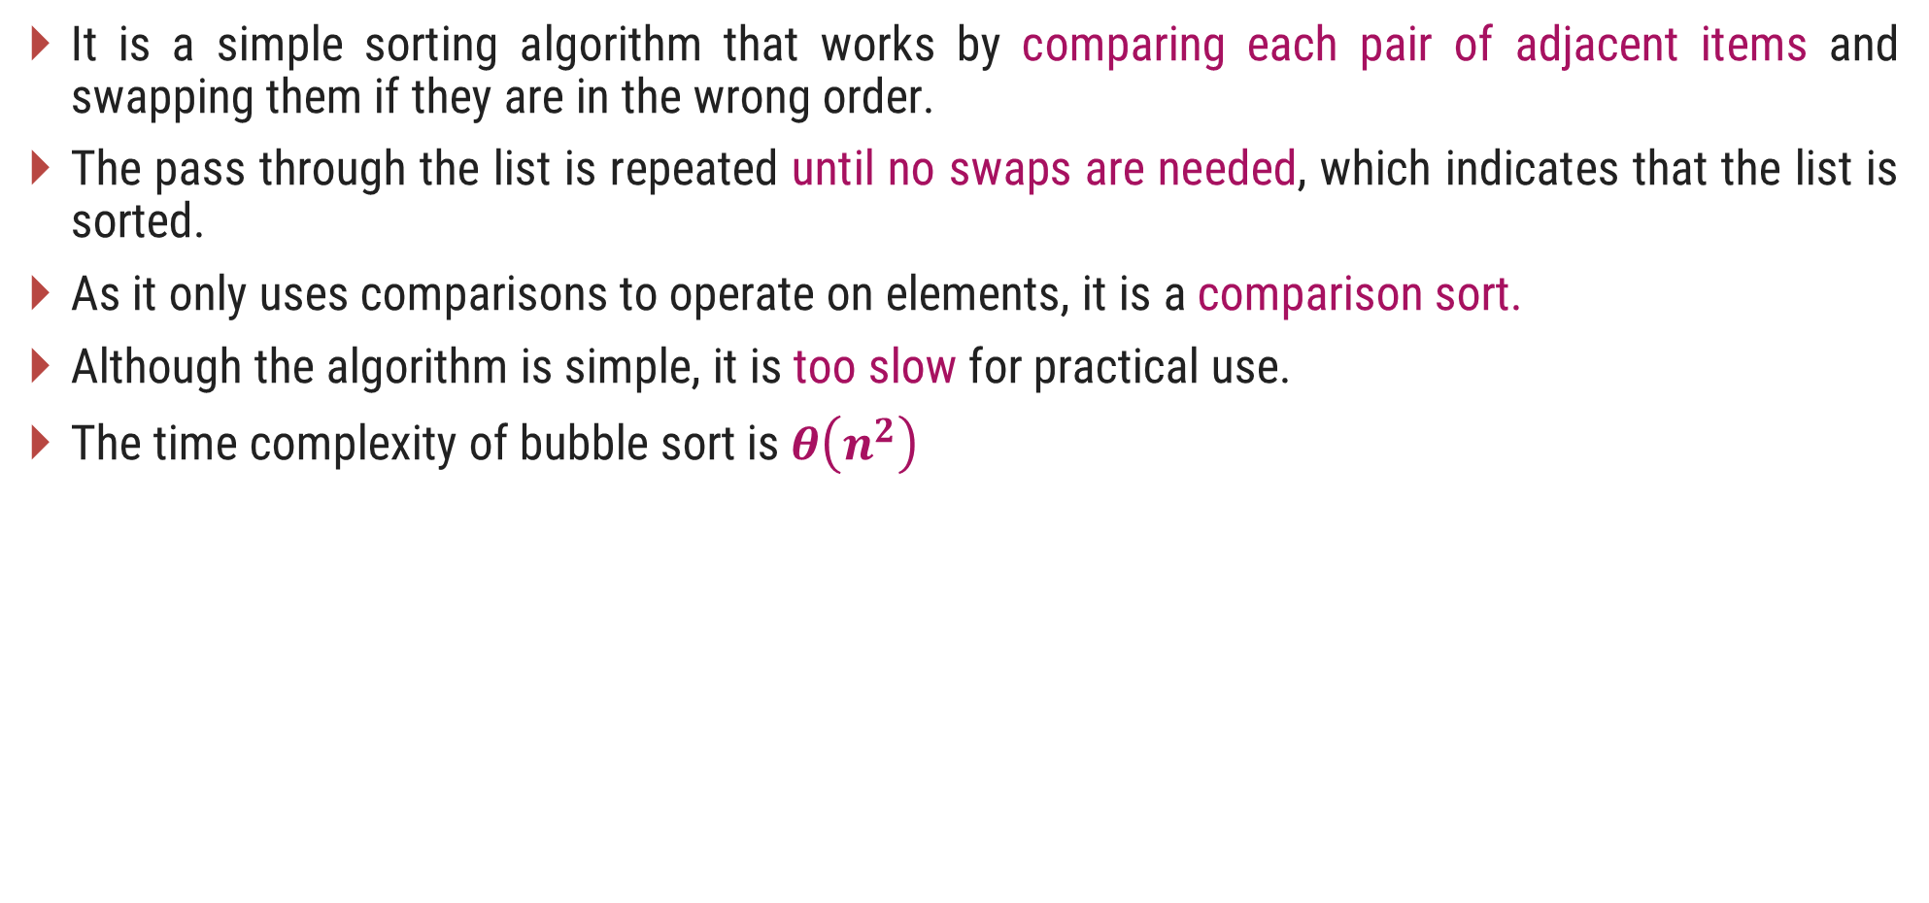
Bubble Sort
It is a simple sorting algorithm that works by comparing each pair of adjacent items and swapping them if they are in the wrong order.
The pass through the list is repeated until no swaps are needed, which indicates that the list is sorted.
As it only uses comparisons to operate on elements, it is a comparison sort.
Although the algorithm is simple, it is too slow for practical use.
The time complexity of bubble sort is $θ\left(n^{2}\right)$

Slide 20
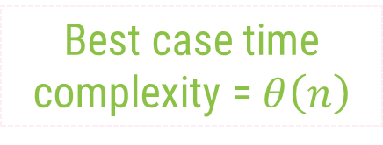
Bubble Sort Algorithm – Best Case Analysis
# Input: Array A
# Output: Sorted array A
Algorithm: Bubble_Sort(A)
int flag=1;
for i ← 1 to n-1 do
for j ← 1 to n-i do
if A[j] > A[j+1] then
flag = 0;
swap(A[j],A[j+1])
if(flag == 1)
  cout<<"already sorted"<<endl
  break;
Pass 1 :
i = 1
12
j = 1
23
j = 2
34
j = 3
Condition never becomes true
45
j = 4
59
Best case time complexity = $θ\left(n\right)$

Slide 21
Selection Sort – Example 1
Sort the following elements in Ascending order
5 | 1 | 12 | -5 | 16 | 2 | 12 | 14
Step 1 :
Unsorted Array
5 | 1 | 12 | -5 | 16 | 2 | 12 | 14
1 | 2 | 3 | 4 | 5 | 6 | 7 | 8
Step 2 :
Minj denotes the current index and Minx is the value stored at current index.
So, Minj = 1, Minx = 5
Assume that currently Minx is the smallest value.
Now find the smallest value from the remaining entire Unsorted array.
Unsorted Array (elements 2 to 8)
5
-5
1
12
-5
5
16
2
12
14
1
2
3
4
5
6
7
8
Swap
Index = 4, value = -5

Slide 22
Selection Sort – Example 1
Step 3 :
Unsorted Array (elements 3 to 8)
Now Minj = 2, Minx = 1
Find min value from remaining unsorted array
-5
1
1
12
5
16
2
12
14
1
2
3
4
5
6
7
8
Index = 2, value = 1
No Swapping as min value is already at right place
Step 4 :
Unsorted Array
(elements 4 to 8)
Minj = 3, Minx = 12
Find min value from remaining unsorted array
-5
1
12
2
5
16
2
12
12
14
Index = 6, value = 2
1
2
3
4
5
6
7
8
Swap

Slide 23
Selection Sort – Example 1
Step 5 :
Unsorted Array
(elements 5 to 8)
Now Minj = 4, Minx = 5
Find min value from remaining unsorted array
-5
1
2
5
5
16
12
12
14
1
2
3
4
5
6
7
8
Index = 4, value = 5
No Swapping as min value is already at right place
Step 6 :
Minj = 5, Minx = 16
Find min value from remaining unsorted array
Unsorted Array
(elements 6 to 8)
Index = 6, value = 12
-5
1
2
5
16
12
12
16
12
14
1
2
3
4
5
6
7
8
Swap

Slide 24
Selection Sort – Example 1
Step 7 :
Unsorted Array
(elements 7 to 8)
Now Minj = 6, Minx = 16
Find min value from remaining unsorted array
-5
1
2
5
12
16
12
12
16
14
1
2
3
4
5
6
7
8
Index = 7, value = 12
Swap
Step 8 :
Unsorted Array
(element 8)
Minj = 7, Minx = 16
Find min value from remaining unsorted array
-5
1
2
5
12
12
16
14
14
16
Index = 8, value = 14
1
2
3
4
5
6
7
8
Swap
The entire array is sorted now.

Slide 25
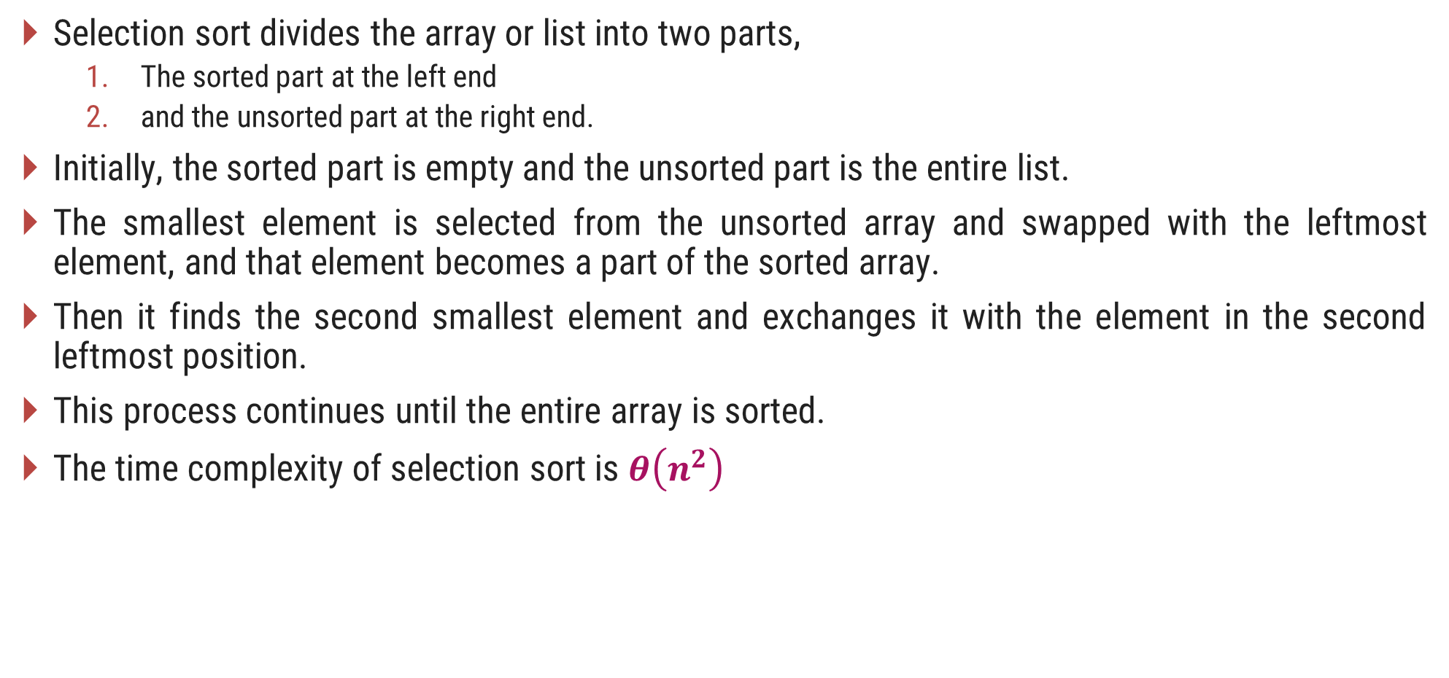
Selection Sort
Selection sort divides the array or list into two parts,
  The sorted part at the left end
  and the unsorted part at the right end.
Initially, the sorted part is empty and the unsorted part is the entire list.
The smallest element is selected from the unsorted array and swapped with the leftmost element, and that element becomes a part of the sorted array.
Then it finds the second smallest element and exchanges it with the element in the second leftmost position.
This process continues until the entire array is sorted.
The time complexity of selection sort is $θ\left(n^{2}\right)$

Slide 26


Selection Sort - Algorithm
# Input: Array A
# Output: Sorted array A
Algorithm: Selection_Sort(A)
for i ← 1 to n-1 do
    minj ← i;
    minx ← A[i];
    for j ← i + 1 to n do
        if A[j] < minx then
            minj ← j;
            minx ← A[j];
    A[minj] ← A[i];
    A[i] ← minx;
$$θ\left(n\right)$$
$$θ\left(n^{2}\right)$$

Slide 27
Selection Sort – Example 2
Algorithm: Selection_Sort(A)
for i ← 1 to n-1 do
  minj ← i; minx ← A[i];
  for j ← i + 1 to n do
    if A[j] < minx then
      minj ← j ; minx ← A[j];
  A[minj] ← A[i];
  A[i] ← minx;
Pass 1 :
i = 1
2
minj ← 1
34
34
No Change
minx ← 45
j = 2
3
A[j] = 34
56
Sort in Ascending order
45 | 34 | 56 | 23 | 12
45
1 | 2 | 3 | 4 | 5

Slide 28
Selection Sort – Example 2
Algorithm: Selection_Sort(A)
for i ← 1 to n-1 do
  minj ← i; minx ← A[i];
  for j ← i + 1 to n do
    if A[j] < minx then
      minj ← j ; minx ← A[j];
  A[minj] ← A[i];
  A[i] ← minx;
Pass 1 :
i = 1
4
minj ← 2
5
minx ← 34
12
23
j = 2
3
4
5
A[j] = 23
12
Sort in Ascending order
Unsorted Array
45 | 34 | 56 | 23 | 12
45
45 | 34 | 56 | 23 | 12
12
45
1 | 2 | 3 | 4 | 5
1 | 2 | 3 | 4 | 5
Swap
34
56
34
45
45 | 34 | 56 | 23 | 45
12
23
56

Slide 29
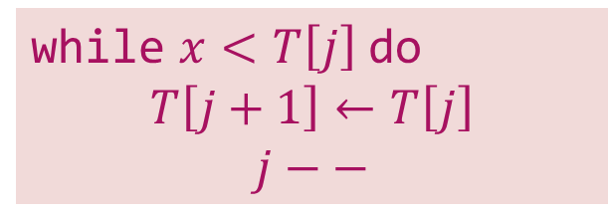



Insertion Sort – Example
Sort the following elements in Ascending order
5 | 1 | 12 | -5 | 16 | 2 | 12 | 14
Step 1 :
Unsorted Array
5 | 1 | 12 | -5 | 16 | 2 | 12 | 14
1 | 2 | 3 | 4 | 5 | 6 | 7 | 8
Step 2 :
$$j$$
$$i=2, x=1$$
$$j=i –1 and j>0$$
1
5
1
12
-5
16
2
12
14
while $x<T\left[j\right]$ do
$$T\left[j+1\right]←T\left[j\right]$$
$$j−−$$
1
2
3
4
5
6
7
8
Shift down

Slide 30

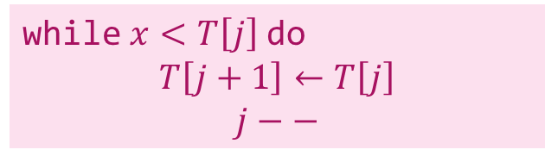


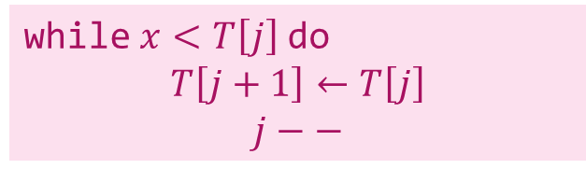




Insertion Sort – Example
Step 3 :
$$j$$
$$i=3, x=12$$
$$j=i –1 and j>0$$
1
5
12
-5
16
2
12
14
while $x<T\left[j\right]$ do
$$T\left[j+1\right]←T\left[j\right]$$
$$j−−$$
1
2
3
4
5
6
7
8
No Shift will take place
Step 4 :
$$i=4, x=−5$$
$$j=i –1 and j>0$$
$$j$$
while $x<T\left[j\right]$ do
$$T\left[j+1\right]←T\left[j\right]$$
$$j−−$$
$$j$$
-5
1
5
12
-5
16
2
12
14
1
2
3
4
5
6
7
8
Shift down
Shift down
Shift down

Slide 31




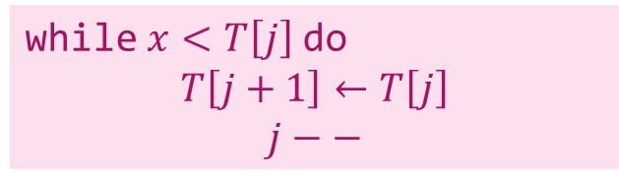


Insertion Sort – Example
Step 5 :
$$j$$
$$i=5, x=16$$
$$j=i –1 and j>0$$
-5
1
5
12
16
2
12
14
while $x<T\left[j\right]$ do
$$T\left[j+1\right]←T\left[j\right]$$
$$j−−$$
1
2
3
4
5
6
7
8
No Shift will take place
Step 6 :
$$i=6, x=2$$
$$j=i –1 and j>0$$
$$j$$
$$j$$
while $x<T\left[j\right]$ do
$$T\left[j+1\right]←T\left[j\right]$$
$$j−−$$
-5
1
2
5
12
16
2
12
14
1
2
3
4
5
6
7
8
Shift down
Shift down
Shift down

Slide 32
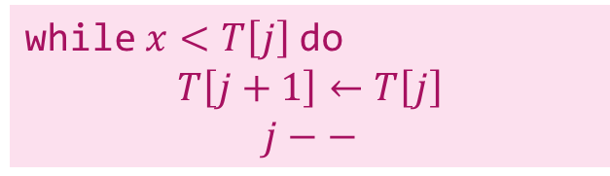






Insertion Sort – Example
Step 7 :
$$j$$
$$i=7, x=12$$
$$j=i –1 and j>0$$
-5
1
2
5
12
12
16
12
14
while $x<T\left[j\right]$ do
$$T\left[j+1\right]←T\left[j\right]$$
$$j−−$$
1
2
3
4
5
6
7
8
Shift down
Step 8 :
$$i=8, x=14$$
$$j=i –1 and j>0$$
$$j$$
while $x<T\left[j\right]$ do
$$T\left[j+1\right]←T\left[j\right]$$
$$j−−$$
-5
1
2
5
12
12
14
16
14
1
2
3
4
5
6
7
8
Shift down
The entire array is sorted now.

Slide 33


Insertion Sort - Algorithm
# Input: Array T
# Output: Sorted array T
Algorithm: Insertion_Sort(T[1,…,n])
for i ← 2 to n do
    x ← T[i];
    j ← i – 1;
    while x < T[j] and j > 0 do
        T[j+1] ← T[j];
        j ← j – 1;
    T[j+1] ← x;
$$θ\left(n\right)$$
$$θ\left(n^{2}\right)$$

Slide 34

Insertion Sort Algorithm – Best Case Analysis
# Input: Array T
# Output: Sorted array T
Algorithm: Insertion_Sort(T[1,…,n])
for i ← 2 to n do
    x ← T[i];
    j ← i – 1;
    while x < T[j] and j > 0 do
        T[j+1] ← T[j];
        j ← j – 1;
    T[j+1] ← x;
Pass 1 :
12
23
i=2
x=23
T[j]=12
34
i=3
x=34
T[j]=23
$$θ\left(n\right)$$
45
i=4
x=45
T[j]=34
59
i=5
x=59
T[j]=45
The best case time complexity of Insertion sort is $θ\left(n\right)$
The average and worst case time complexity of Insertion sort is $θ\left(n^{2}\right)$

Slide 35
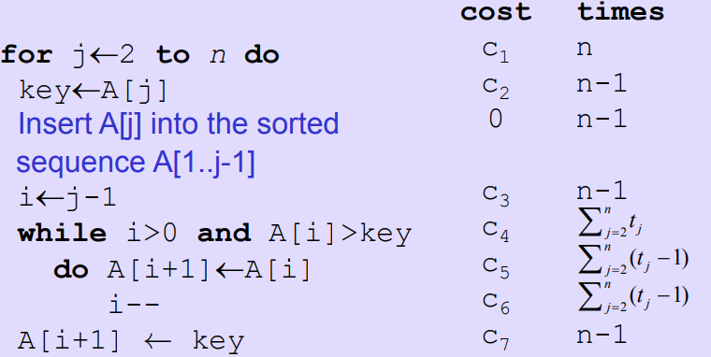
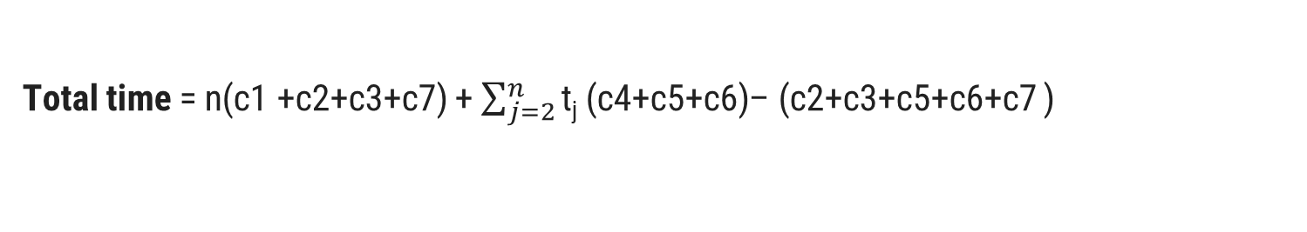
Analysis of Insertion Sort(alternate)
Best case: elements already sorted;
tj=1, running time = f(n)
Worst case: elements are sorted in inverse
order; tj=j, running time = f(n ²)
Average case: tj=j/2, running time = f(n 2)
Total time = n(c1 +c2+c3+c7) + $\sum_{j=2}^{n}{\text{t}\text{j}\text{ (}\text{c}\text{4+}\text{c}\text{5+}\text{c}\text{6)}}$– (c2+c3+c5+c6+c7 )

Slide 36
Comparison counting
34
45
56
23
12

Slide 37
Thank You!

